Slide 1



Beyond Points:
Three Alternative Grading Strategies to Improve Learning
Mark Cooper & Sacha Johnson
QM Connect 2023 | November #, 2023
Notes:
[Mark]

Slide 2

Introduction & Overview
Notes:
[Mark]

Slide 3


Today’s Presenters
Mark Cooper, MBA
Sacha Johnson, Ph.D.
Notes:
[Mark]

Slide 4
Learning Objectives
Distinguish between three different alternative grading strategies.
Recall situations where alternative grading strategies would be beneficial in your course.
Identify ways to implement alternative grading strategies while meeting QM Specific Review Standards 3.2 and 3.3.
Notes:
[Mark]

Slide 5
Alternative Grading Strategies
Learning Obj. #1: Distinguish between three different alternative grading strategies.
Notes:
[Mark]

Slide 6
What are Alternative Grading Strategies?
Forgoes a conventional points-based approach to grading and favors holistic and continuous forms of assessment and feedback (Feldman, 2019).
Can help to reduce grade-related stress and promote student learning - students not penalized for making mistakes (Schinske & Tanner, 2017).
Encourage students to think critically about their own learning and educational goals (Palmer & Streifer, 2020).
Notes:
[Mark]
Studies have shown that traditional grading systems often play on students’ fear of punishment, lessens their intrinsic motivation and performance, and increases their desire to outcompete peers (Schinske & Tanner, 2017)

Slide 7
Alternative Grading Strategy Types
Specifications grading: Students are given a rubric for each assignment and are graded on how well they meet the specified criteria.
Contract grading: Students negotiate a contract with the instructor at the beginning of the course, outlining their specific learning goals and how they will be assessed.
Ungrading: Students receive feedback on their work, but no letter grades.
Notes:
[Mark]

Slide 8




Specifications grading
Students are given a rubric for each assignment and are graded on how well they meet the specified criteria.
Mastery of
Rubrics
Feedback on Work
Reduce Stress
Learning Outcomes
Meet Specified Criteria
Revise/Resubmit
Promote Learning
Mastery by Shape’Br from Noun Project (CC BY 3.0)
Report by Bastian Konigr from Noun Project (CC BY 3.0)
Feedback by Vectorstall from Noun Project (CC BY 3.0)
Meditation by Chanut is Industries from Noun Project (CC BY 3.0)
Promote Learning
Notes:
[Mark]
Focuses on student mastery of learning outcomes.
Students are given a rubric for each assignment and are graded on how well they meet the specified criteria.
Assignments completed multiple times: students receiving feedback on work, have opportunities to revise/resubmit specifications are met.
Can help to reduce grade-related stress and promote student learning - students not penalized for making mistakes.

Slide 9




Contract grading
Students negotiate a contract with the instructor at the beginning of the course, outlining their specific learning goals and how they will be assessed.
Students/Instructor
Specific Learning Goals
Choose Variety
Promote Motivation
Negotiate
How They’re Assessed
Negotiate Due Dates & Grade Criteria
Choose Learning Goals
Negotiate by Creative Stall from Noun Project (CC BY 3.0)
Goal by Komkrit Noenpoenpisut from Noun Project (CC BY 3.0)
Motivation by SITI NURHAYATI from Noun Project (CC BY 3.0)
Variety by WEBTECHOPS LLP from Noun Project (CC BY 3.0)
Notes:
[Mark]
Allows students to negotiate a contract with the instructor at the beginning of the course.
The contract outlines the student's specific learning goals and how they will be assessed.
Students can choose from a variety of assignments and activities, and they can also negotiate the due dates and grading criteria for their work.
Can help to promote student motivation and engagement, as students are able to choose their own learning goals and have a say in how they are assessed.

Slide 10
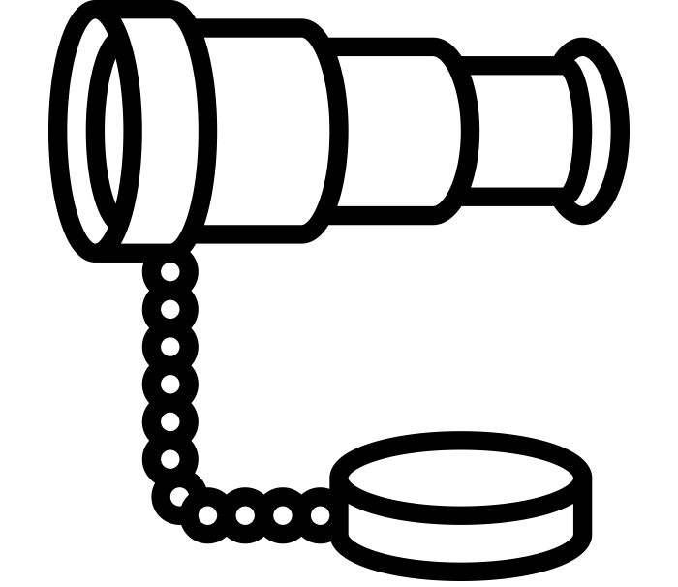



Ungrading
Students receive feedback on their work, but no letter grades.
Focus on Feedback
Revise & Resubmit
Reduce Stress
Equity & Inclusion
Not Assigned Grades
Based on Feedback
Promote Learning
Removes Pressure of Competition
spyglass by Eucalyp from Noun Project (CC BY 3.0)
revise by Rena Shin from Noun Project (CC BY 3.0)
calm by Soni Sokell from Noun Project (CC BY 3.0)
multicultural by afian roc from Noun Project (CC BY 3.0)
Notes:
[Mark]
Focuses on providing feedback to students on their work, rather than assigning grades.
Students are given opportunities to revise and resubmit their work based on the feedback they receive.
Can help to reduce grade-related stress and promote student learning, as students are not penalized for making mistakes.
Can also help to promote equity and inclusion in the classroom, as it removes the pressure of competition and allows students to focus on their own learning.

Slide 11
Benefits & Challenges
Learning Obj. #2: Recall situations where alternative grading strategies would be beneficial or challenging in your course.
Notes:
[Mark]

Slide 12




Benefits of Alternative Grading
Positive/Supportive
Positive/Supportive
Motivation/Engagement
Teacher by ToZIcon from Noun Project (CC BY 3.0)
grades by Creative Mahira from Noun Project (CC BY 3.0)
Participation by MUHAMAD KHOTIBUL UMAM from Noun Project (CC BY 3.0)
Learning/Achievement
Reduce Inequities
achievement by Flatart from Noun Project (CC BY 3.0)
multicultural by afian roc from Noun Project (CC BY 3.0)
Notes:
[Mark]
Positive and supportive learning Environment
Reduced grade-related stress and anxiety
Improved student motivation and engagement
Increased student learning and achievement
Reduced inequities among students from different backgrounds (Feldman, 2019)

Slide 13

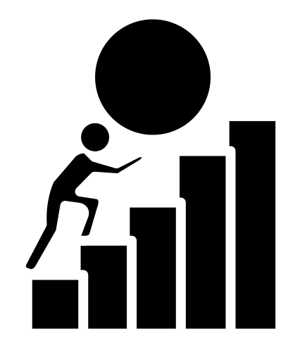
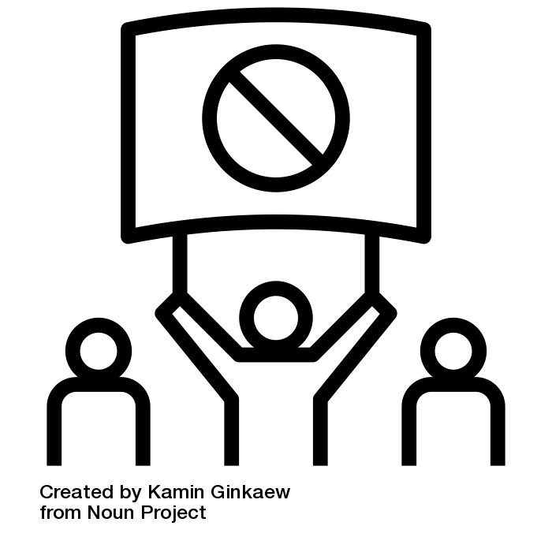


Challenges of Alternative Grading
Faculty time
Faculty effort
Student resistance
Stopwatch by Koson Rattanaphan from Noun Project (CC BY 3.0)
effort by Akbar from Noun Project (CC BY 3.0)
Resistance by Kamin Ginkaew from Noun Project (CC BY 3.0)
Implementation
Technical challenges
implementation by ramacae from Noun Project (CC BY 3.0)
Technology by Turkkub from Noun Project (CC BY 3.0)
Notes:
[no modifications made to icons]
[Sacha]
increased time and effort
student adjustment and resistance
implementation / scalability
technical challenges
using scales with rubrics
our LMS does not allow us to remove points from a rubric, have to create an “overall” criterion that’s weighted more heavily if you want to say, “if any one of these criteria are not met, the overall rating is not met”
Image credits
Stopwatch by Koson Rattanaphan from <a href="https://thenounproject.com/browse/icons/term/stopwatch/" target="_blank" title="Stopwatch Icons">Noun Project</a> (CC BY 3.0)
effort by Akbar from <a href="https://thenounproject.com/browse/icons/term/effort/" target="_blank" title="effort Icons">Noun Project</a> (CC BY 3.0)
Resistance by Kamin Ginkaew from <a href="https://thenounproject.com/browse/icons/term/resistance/" target="_blank" title="Resistance Icons">Noun Project</a> (CC BY 3.0)
implementation by ramacae from <a href="https://thenounproject.com/browse/icons/term/implementation/" target="_blank" title="implementation Icons">Noun Project</a> (CC BY 3.0)
Technology by Turkkub from <a href="https://thenounproject.com/browse/icons/term/technology/" target="_blank" title="Technology Icons">Noun Project</a> (CC BY 3.0)

Slide 14
QM & Alternative Grading
Learning Obj. #3: Identify ways to implement alternative grading strategies while meeting QM Specific Review Standards 3.2 and 3.3.
Notes:
[Sacha]

Slide 15
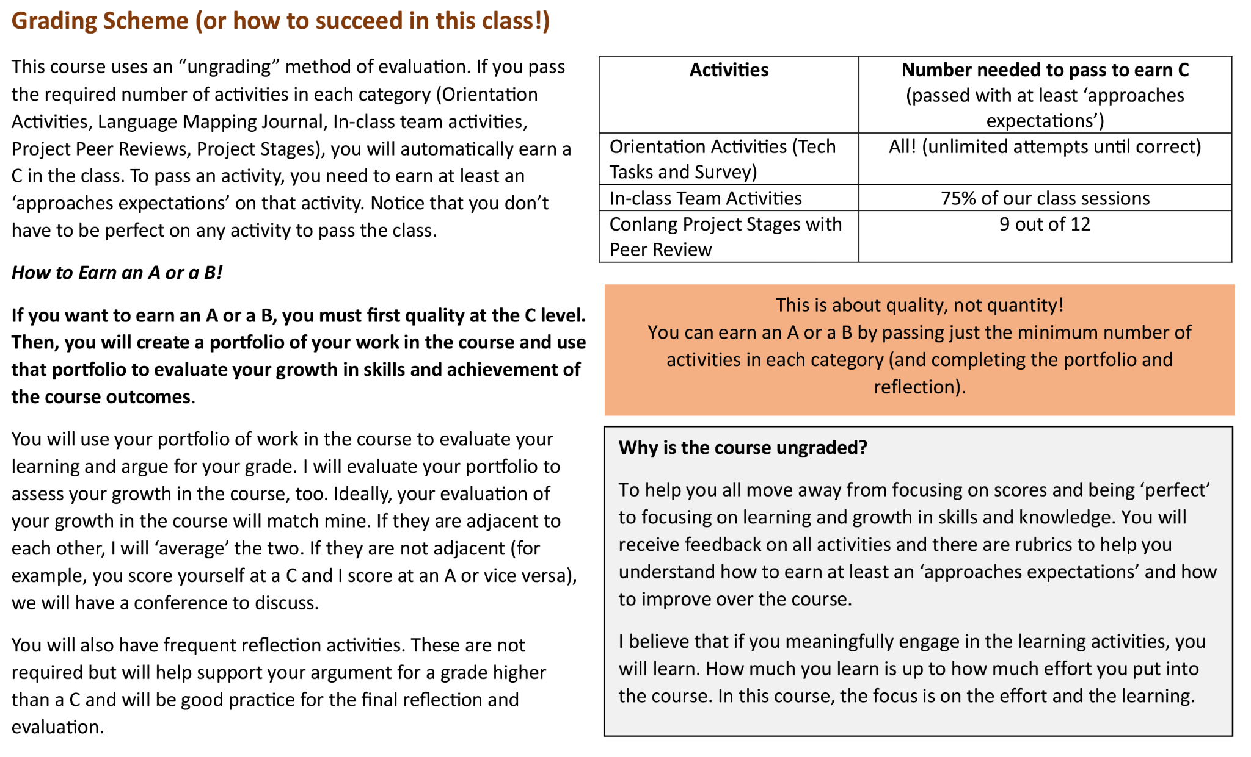
Alternative Grading Strategies & SRS 3.2
Specific Review Standard 3.2: The course grading policy is stated clearly, available at the beginning of the course, and consistent throughout the course site.
Notes:
[Sacha]

Slide 16
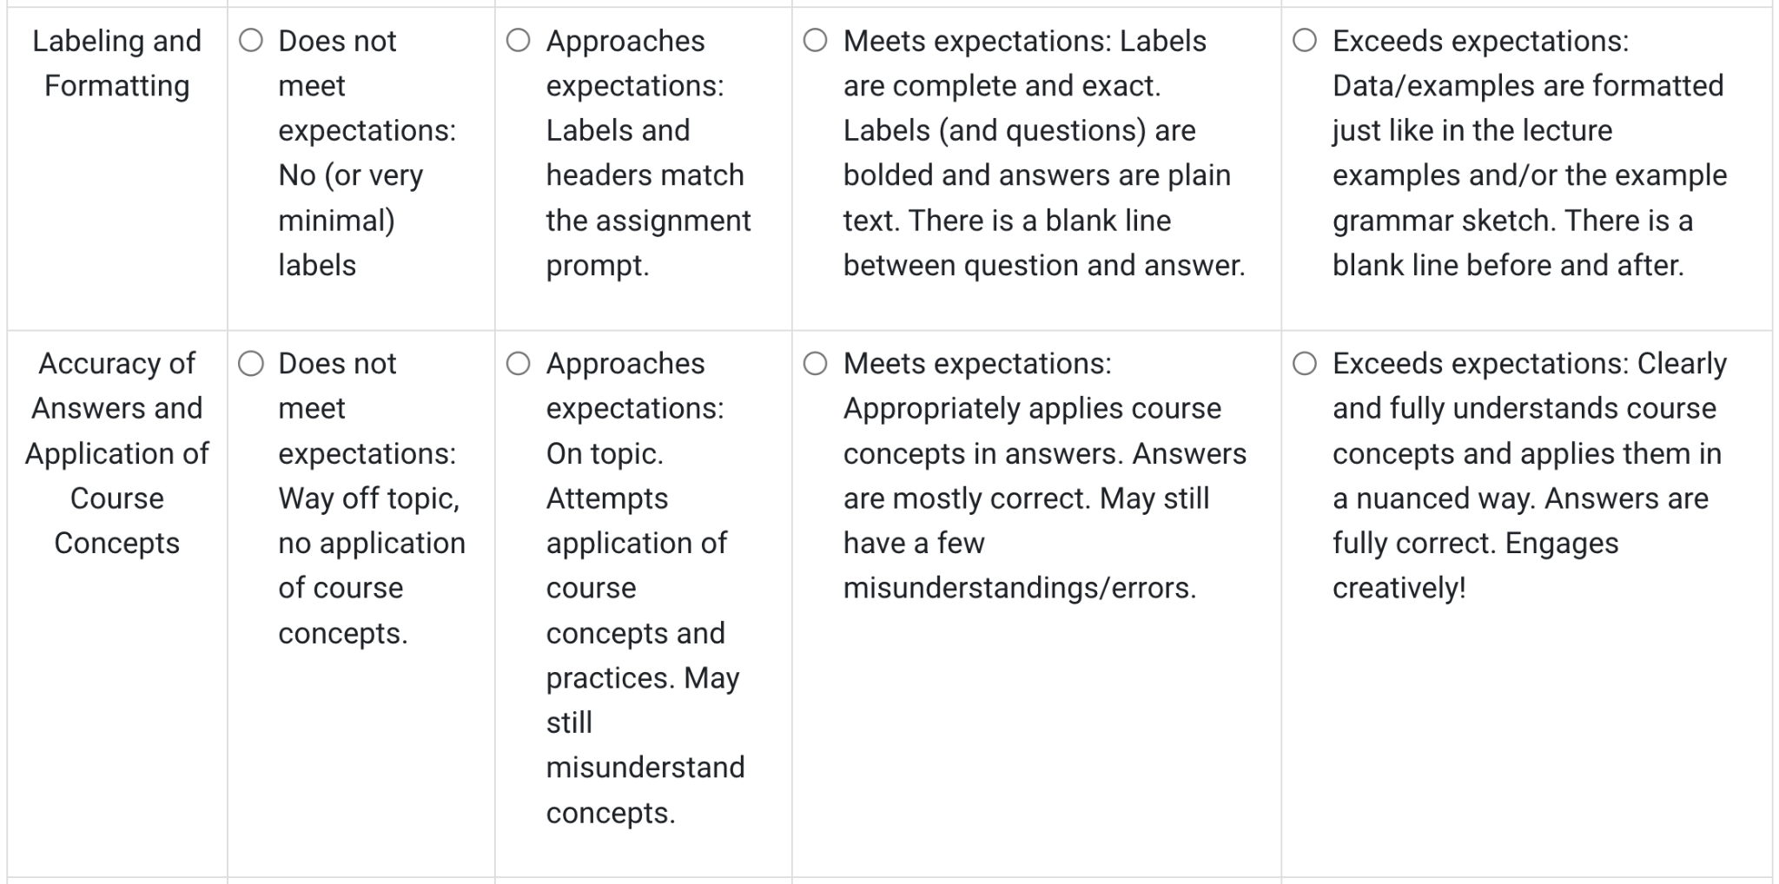
Alternative Grading Strategies & SRS 3.3
Specific Review Standard 3.3: Specific and descriptive criteria are provided for the evaluation of learners’ work, and their connection to the course grading policy is clearly explained.
Notes:
[Sacha]

Slide 17
ISU Perspectives
Notes:
[Sacha]

Slide 18
ISU Faculty Perspectives
“At first, [students] are generally apprehensive because they are used to grades and feel 'unmoored' without the touchstone.”
“[Students] also have trouble seeing the value in moving from extrinsic rewards to intrinsic rewards and motivation.”
“[The LMS] does not support ungrading well. The assumptions underlying the set up of the gradebook, rubrics, and scales are all based on points or weighted percentages grading.”
Notes:
[Sacha]
See QM Connect 2023 Presentation Outline [Faculty and Student Feedback section]

Slide 19
ISU Student Perspectives
“I didn't think I would like it, but once I stopped worrying about the A and focused on learning, I realized it was 'easier' for me. I could just try to learn. As long as I grew, I was doing okay.”
“This was one of the most meaningful classes I've taken at ISU. I now routinely cite without thinking about it and really think about what I am reading.”
“The grading system did not feel super fitting. Getting either a 0 or a 100 is a little bit of a problem in my opinion.”
Notes:
[Sacha]

Slide 20
Summary
Help reduce grade-related stress and promote student learning.
Help offset inequities among students and foster greater dialogues on challenging traditional grading systems.
There are both challenges and benefits to implementing alternative grading strategies.
Encourage addressing SRS 3.2 and 3.3 when using alternative grading strategies in your own course(s).
Notes:
[Sacha]

Slide 21

Questions and Discussion
Notes:
[Sacha]

Slide 22
References
Grading for Equity: What It Is, Why It Matters, and How It Can Transform Schools and Classrooms" by Joe Feldman (2019)
Palmer, M., & Streifer, A. (2020) Alternative Grading: Practices Support Both Equity and Learning. https://cte.virginia.edu/blog/2020/12/04/alternative-grading-practices-support-both-equity-and-learning
Schinske, J., & Tanner, K. (2014). Teaching More by Grading Less (or Differently). CBE life sciences education, 13(2), 159–166. https://doi.org/10.1187/cbe.cbe-14-03-0054
Notes:
[Sacha]

