Slide 1
The Learning Brain -
Implications for the Future of QM
At Some Point, You Have to Eat The Broccoli
Notes:
Homeostasis: The basic self-regulating feedback loops that keep us repeating the same habits over and over. The predictable forces that keep us from changing ourselves. Let’s take the example of learning how to give better feedback. What could be a more useful skill? But actually doing so, actually following through with the idea, is not at all easy. You have to overcome your natural impulse to criticize. You have to get over your natural ego. You have to be very careful to watch your words, trying to decipher what will be heard when you deliver feedback. All of these are hard things to do, all of them unnatural. All will require some re-doubling to accomplish.
Thus, most people won’t actually do it. This an Iron Rule of life: Biological systems tend towards what is comfortable.

Slide 2

Does
need to address
learning strategies
in a more
straightforward
way?

Slide 3
Standard 4.2: (3 Points)
4.2 Both the purpose of instructional materials and how the materials are to be used for learning activities are clearly explained.
Standard 5.1: (3 Points)
5.1 The learning activities promote the achievement of the stated learning objectives or competencies.
Standard 5.2: (3 Points)
5.2 Learning activities provide opportunities for interaction that support active learning.

Slide 4
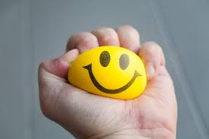

Slide 5

What learning strategies
would you use to improve your
outcome?
5 minutes

Slide 6
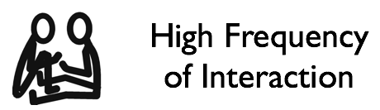
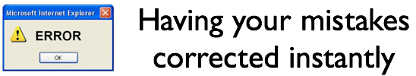
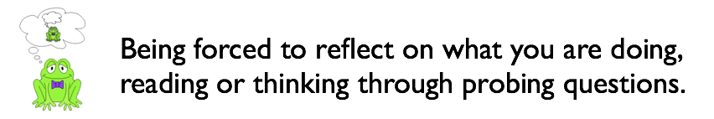

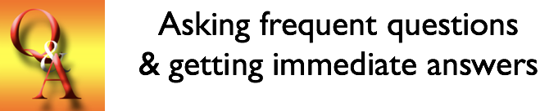
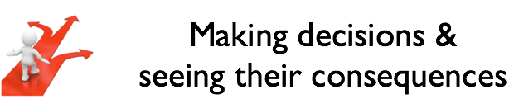

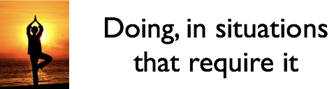
Motivation

Slide 7
Bloom | Chickering & Gamson
high frequency of interaction | encourages contact between students and faculty
asking frequent questions & getting immediate answers | develops reciprocity and cooperation among students
practice & repetition | encourages active learning
having your mistakes corrected instantly | prompt feedback
doing, in situations that require it | emphasizes time on task
motivation | communicates high expectations
marshaling your thoughts in formal form | respects diverse talents and ways of learning
making decisions & seeing their consequences
being forced to reflect on what you are doing, reading or thinking through probing questions

Slide 8
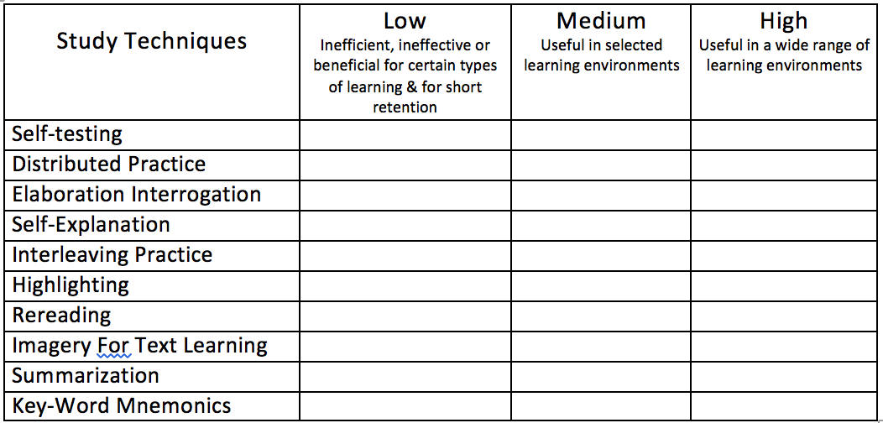

Slide 9
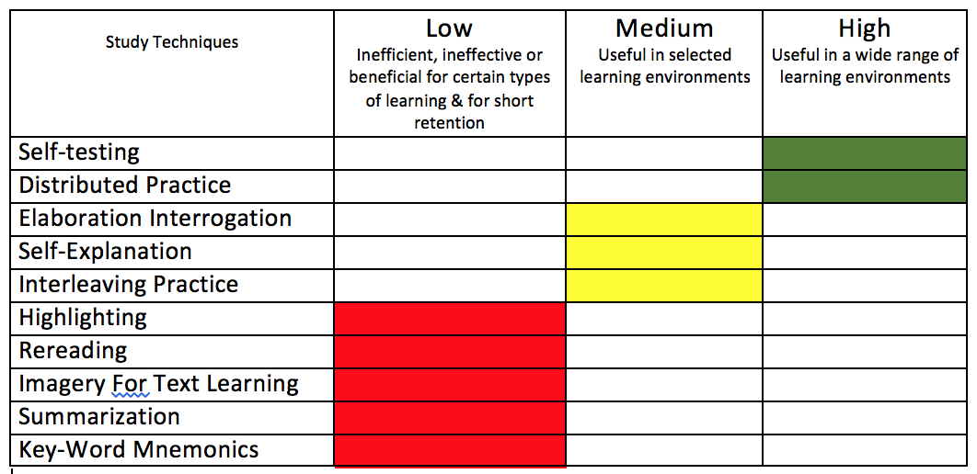
https://www.scientificamerican.com/article/what-works-what-doesn-t/

Slide 10
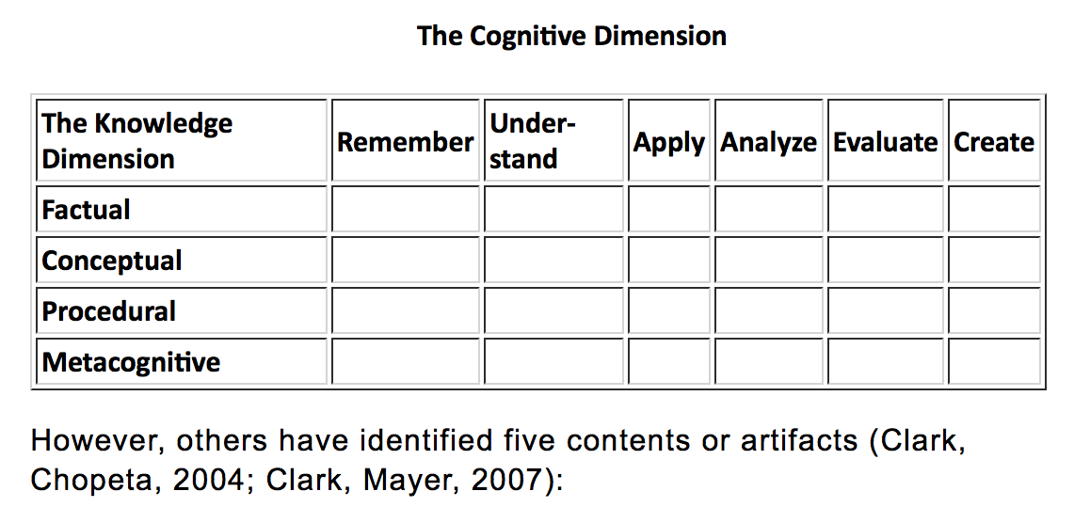
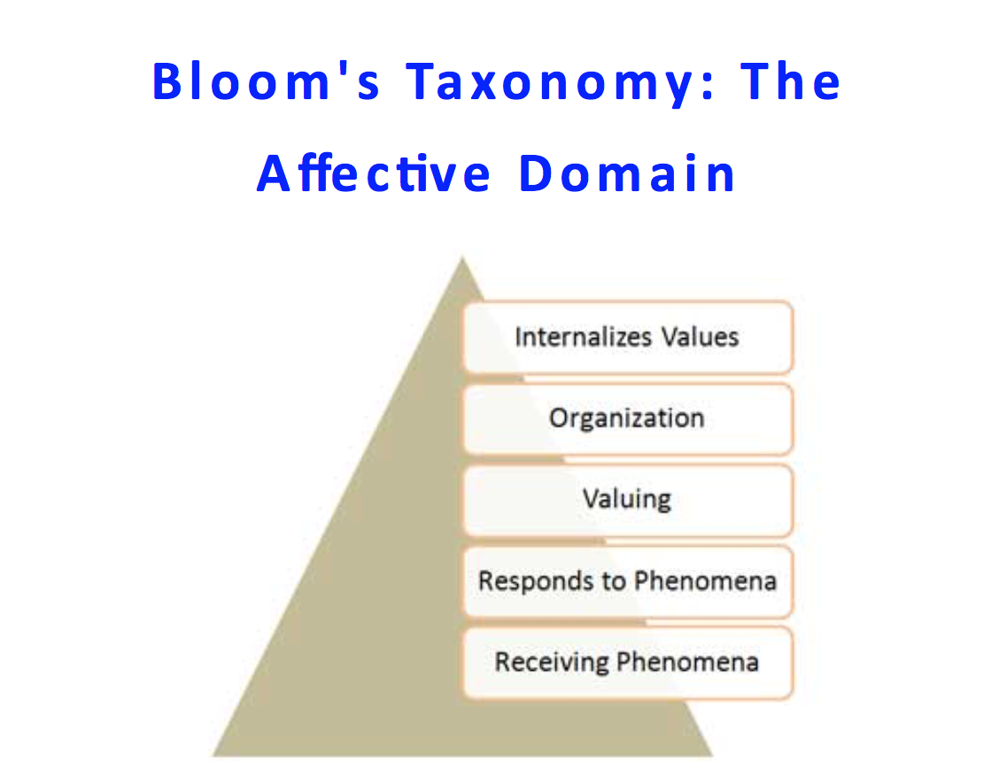
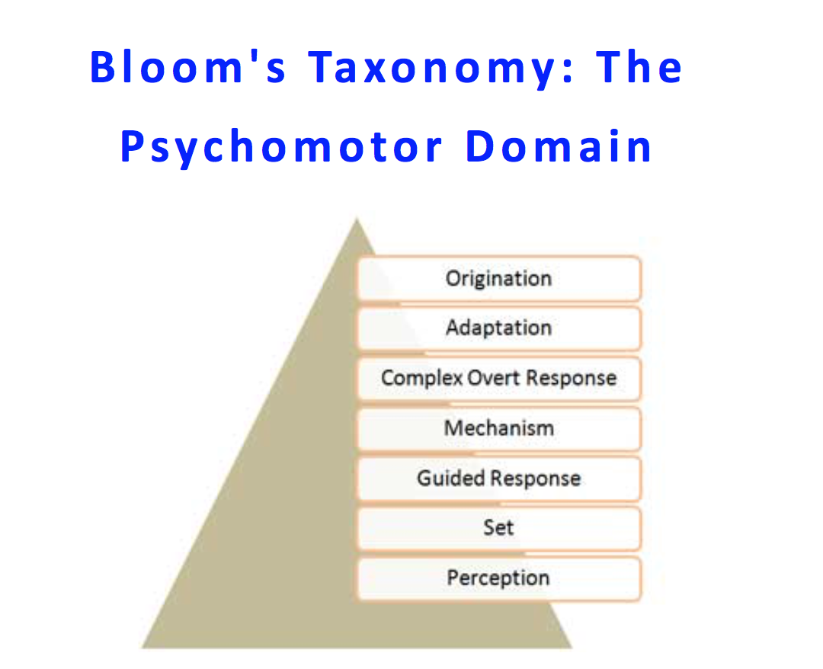
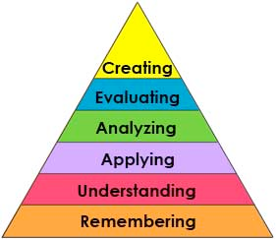

Slide 11
Learning Outcome
Learning Strategy | 1 | 2 | 3 | 4 | 5
Motivation
High Frequency of Interaction
Mistakes Corrected Instantly
Frequent Q&A
Making Decisions & Seeing Consequences
Doing It
Reflect
Marshalling Thoughts In Formal Form
Practice & Repetition
Shallow Deep

Slide 12
What would a general standard
look like?
What would a specific standard
look like?
5 minutes

Slide 13
Does
need to address
learning strategies
in a more
straightforward
way?

