Slide 1
Reborn Digital But Not Born Accessible: Challenges of Digital Accessibility
The 6th Annual QM Conference on Quality Assurance in Online Learning
Baltimore
September 30, 2014
Evangeline (Litsa) Varonis
Design and Development Services, The University of Akron
varonis@uakron.edu
Jillian Jevack
Quality Matters
Jillian.jevack@qualitymatters.org
Michael Johanyak
Department of Associate Studies, The University of Akron
mfjohan@uakron.edu

Slide 2
Learning Objectives
Distinguish between “born digital” and “born accessible” courses.
Discuss the significance of the point values of the Quality Matters accessibility standards.
Summarize legislation related to accessibility.
Describe examples of universal design in online and blended courses.
Distinguish among idealist, realist, and practicalist perspectives on accessibility in online and blended courses.
Discuss implications of accessible design for blended courses.
Discuss institutional and legal pressures that pose challenges to instructors who seek to make all content accessible.

Slide 3
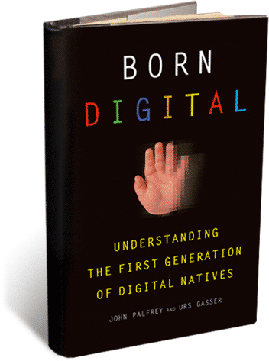
Born Digital
Today’s traditional higher ed students are digital natives (Prensky, 2001).
They were “born digital” (Gasser & Palfrey, 2008).
Most courses were not born digital, but can be converted.
Other courses are born digital from the start.

Slide 4
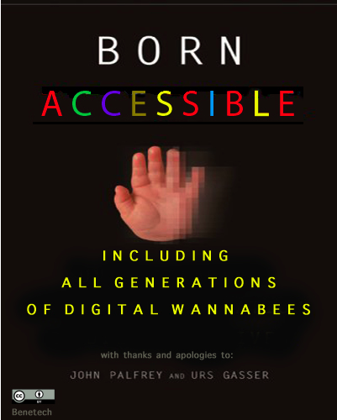
Born Accessible
Larry Goldberg & Madeleine Rothberg
2013 Educause webinar
Born Digital – and Accessible

Slide 5
Goldberg & Rothberg 2013
Rothberg.
  Present is not “paper.”
  Digitization of Online Learning: digital media; textbooks; electronic publishing.
  Old models of retrofitting: no longer work; very expensive.
Goldberg
  Hardware is available that facilitates accessibility…but…
  …a better approach is to build accessibility in from the beginning.
When consumers demand accessibility it will become more widely available.

Slide 6
Many Online Courses
Were Reborn Digital
But Not Born Accessible

Slide 7
QM 5th Edition Higher Education Rubric
Standard 8: Accessibility and Usability
  Course navigation facilitates ease of use. (3 pts)
  Information is provided about the accessibility of all technologies required in the course. (3 pts)
  The course contains alternative means of access to course materials in formats that meet the needs of diverse learners. (2 pts)
  The course design facilitates readability. (2 pts)
  Course multimedia facilitate ease of use. (2 pts)
© 2014 MarylandOnline, Inc. All rights reserved.
Notes:
Standard 8.1. Intent to ensure that LMS, tools, and media are accessible.
Standard 8.1. If the course is offered in an accessible learning management system (LMS), a statement by the LMS provider certifying accessibility should be readily available as a link or attached to the Instructor Worksheet.
Standard 8.1. The instructor provides documentation stating the degree of accessibility of any content, tools, and software used in the course. If any component of the course is inaccessible, instructions are provided on how to obtain accommodation.
Standard 8.2. Intended to ensure accessibility for hearing- or vision-impaired student, either within or outside of the course.
Standard 8.2. Ex: audio lecture with a text transcript.; Ex: video clip, image, or animation with captioning or available with text transcript.
Standard 8.2. Statement accompanies media explaining how to seek accommodations or content in alternative formats.
Standard 8.3. Design elements include colors, fonts, spacing, graphics, formatting, and color coding.
Standard 8.3 Formatting and color coding used to communicate key points, group like items, emphasize relevant relationships. Contrast between text and background; awareness of color issues; additional means also used (e.g. bold or italics).
Standard 8.4 Text format allows use of a screen reader. Navigation can be streamlined by inserting “skip to content” links to allow users to skip repeated elements.
Standard 8.4. Links should be self-describing and meaningful. Icons used as links should have html tags or accompanying text link.
Standard 8.4. HTML documents and tagged pdf files are largely accessible. If using Word, use styles to mark headings.
Standard 8.4. Tables used for data have appropriate headers.

Slide 8
QM Higher Education Standard 8.3
  “The course contains alternative means of access to course materials in formats that meet the needs of diverse learners.” (2 pts)
The equivalent standard is a 3-point standard in the K-12 rubric.
Should this be a 3-point standard in the higher ed rubric?

Slide 9
Three Perspectives on Digital Accessibility
Idealist (Litsa): Everything that needs to be done to achieve an ideal standard of perfection or excellence.
Realist (Jillian): Anything that can be done based on what is real at the moment.
Practicalist (Mike): Anything practical that can be done.

Slide 10
1. The Idealist Perspective:
Everything that must be done to achieve an ideal standard of perfection or excellence
8.3 should be a 3-point standard

Slide 11
Access is desirable, achievable, and reasonable
Accessibility fosters independence.
  Online learning can create barriers to access.
We have the potential to not only overcome those barriers, but to facilitate everyone’s learning through enhanced delivery options.
  Teaching and learning outcomes remain the same.
  In most cases, simple accommodations can make all classes and content accessible.

Slide 12

What does the law say?-
The Americans with Disabilities Act of 1990 (ADA): http://www.ada.gov/pubs/adastatute08.htm.
The Rehabilitation Act of 1973 Section 504.
The Rehabilitation Act of 1973 Section 508 (1998).
The Twenty-First Century Communications and Video Accessibility Act of 2010 (CVAA).

Slide 13
What is a disability?
According to the Americans with Disabilities Act of 1990 (since amended), Sec. 12102, the term "disability" means, with respect to an individual
a physical or mental impairment that substantially limits one or more major life activities of such individual;
a record of such an impairment; or
being regarded as having such an impairment.
For more information on the definition of disabilities: http://www.ada.gov/pubs/adastatute08.htm#12102.
Here and on subsequent slides, emphasis is ours.

Slide 14
The Americans with Disabilities Act of 1990 (ADA)
Includes ADA Amendments Act of 2008 (ADAAA).
“Physical or mental disabilities in no way diminish a person’s right to fully participate in all aspects of society, yet many people with physical or mental disabilities have been precluded from doing so because of discrimination.”
Discrimination includes “outright intentional exclusion, the discriminatory effects of architectural, transportation, and communication barriers, overprotective rules and policies, failure to make modifications to existing facilities and practices, exclusionary qualification standards and criteria, segregation, and relegation to lesser services, programs, activities, benefits, jobs, or other opportunities.”
(Chapter 126, Sec. 12101: http://www.ada.gov/pubs/adastatute08.htm)

Slide 15
ADA Title II – Public Inst.
Subchapter II – Public Services (Title II) Part A, Sec. 12132: “no qualified individual with a disability shall, by reason of such disability, be excluded from participation in or be denied the benefits of services, programs, or activities of a public entity, or be subjected to discrimination by any such entity.”
(Private institutions are covered by Title III).
Any public or private institution that receives federal funds must uphold the ADA with respect to its services.
BOTTOM LINE: people with disabilities must have “an equal opportunity to benefit.”

Slide 16
The Rehabilitation Act of 1973: Section 504
“No otherwise qualified individual with a disability in the United States, shall, solely by reason of her or his disability, be excluded from participation in, be denied the benefits of, or be subjected to discrimination under any program or activity receiving Federal financial assistance.”
For more information on Section 504: www.dol.gov/oasam/regs/statutes/sec504.htm
BOTTOM LINE: educational programs must be accessible.

Slide 17
The Rehabilitation Act of 1973: Section 508, amended 1998
Section 508 applies to individuals working for or seeking information from the federal government.
In 1998, Section 508 was amended to include access to “electronic and information technology” unless such access would cause an “undue burden.”
In that event, the information must be made available by “an alternative means of access.” For more information on the amendment:
http://www.justice.gov/crt/508/archive/deptofed.html
BOTTOM LINE: online materials must be accessible unless this causes an “undue burden.”

Slide 18
ADA Rehab Act Section 508: 16 standards
A text equivalent for every non-text element shall be provided (e.g., via "alt", "longdesc”, or in element content).
Equivalent alternatives for any multimedia presentation shall be synchronized with the presentation.
Web pages shall be designed so that all information conveyed with color is also available without color, for example from context or markup.
Documents shall be organized so they are readable without requiring an associated style sheet.
Redundant text links shall be provided for each active region of a server-side image map.
Client-side image maps shall be provided instead of server-side image maps except where the regions cannot be defined with an available geometric shape.
Row and column headers shall be identified for data tables.
Markup shall be used to associate data cells and header cells for data tables that have two or more logical levels of row or column headers.
Frames shall be titled with text that facilitates frame identification and navigation.
Pages shall be designed to avoid causing the screen to flicker with a frequency greater than 2 Hz and lower than 55 Hz.
A text-only page, with equivalent information or functionality, shall be provided to make a web site comply with the provisions of this part, when compliance cannot be accomplished in any other way. The content of the text-only page shall be updated whenever the primary page changes.
When pages utilize scripting languages to display content, or to create interface elements, the information provided by the script shall be identified with functional text that can be read by assistive technology.
When a web page requires that an applet, plug-in or other application be present on the client system to interpret page content, the page must provide a link to a plug-in or applet that complies with §1194.21(a) through (l).
When electronic forms are designed to be completed on-line, the form shall allow people using assistive technology to access the information, field elements, and functionality required for completion and submission of the form, including all directions and cues.
A method shall be provided that permits users to skip repetitive navigation links.
When a timed response is required, the user shall be alerted and given sufficient time to indicate more time is required.

Slide 19
What is an “undue burden”?
1997: letter from the Office of Civil Rights to CSU Los Angeles
“When a public institution selects software programs and/or hardware equipment that are not adaptable for access by persons with disabilities, the subsequent substantial expense of providing access is not generally regarded as an undue burden when such cost could have been significantly reduced by considering the issue of accessibility at the time of the initial selection.”
Coombs, 2012, pp 14-15.
BOTTOM LINE: get it right the first time.

Slide 20
The 21st Century Communications and Video Accessibility Act of 2010
Updates federal communications law to increase the access of persons with disabilities to modern communications.
Ensures that accessibility laws enacted in the 1980s and 1990s are brought up to date with 21st century technologies, including new digital, broadband, and mobile innovations.
Title I: advanced communications services (e.g., VoIP; electronic messaging; video conferencing)
Title II: video programming (e.g., restores and expands video description rules of 2000).
http://www.fcc.gov/guides/21st-century-communications-and-video-accessibility-act-2010
BOTTOM LINE: emerging communications technologies must be accessible.

Slide 21
Web Accessibility
According to the World Wide Web Consortium (W3C), Web accessibility entails that “people with disabilities can perceive, understand, navigate, and interact with the Web, and that they can contribute to the Web.” More information from W3C on Web accessibility.
Best practices for achieving Web accessibility are also best practices in good Web design.

Slide 22
W3C Web Content Accessibility Guidelines (WCAG) 2.0: 12 guidelines
1. Perceivable
  1.1 Provide text alternatives for any non-text content so that it can be changed into other forms people need, such as large print, braille, speech, symbols or simpler language.
  1.2 Provide alternatives for time-based media.
  1.3 Create content that can be presented in different ways (for example simpler layout) without losing information or structure.
  1.4 Make it easier for users to see and hear content including separating foreground from background.
2. Operable
  2.1 Make all functionality available from a keyboard.
  2.2 Provide users enough time to read and use content.
  2.3 Do not design content in a way that is known to cause seizures.
  2.4 Provide ways to help users navigate, find content, and determine where they are.
3. Understandable
  3.1 Make text content readable and understandable.
  3.2 Make Web pages appear and operate in predictable ways.
  3.3 Help users avoid and correct mistakes.
4. Robust
  4.1 Maximize compatibility with current and future user agents, including assistive technologies.

Slide 23
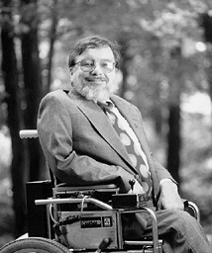
Universal Design
  Ron Mace developed polio as a child and had to be carried into inaccessible buildings at North Carolina State University, where he earned a degree in architecture. He contributed to the first U.S. building code to incorporate principles of accessibility. (Silver & Wilson, 2007).
National Museum of American History
  Universal design is “The design of products and environments to be usable by all people, to the greatest extent possible, without the need for adaptation or specialized design” (Center for Universal Design, 1997).

Slide 24
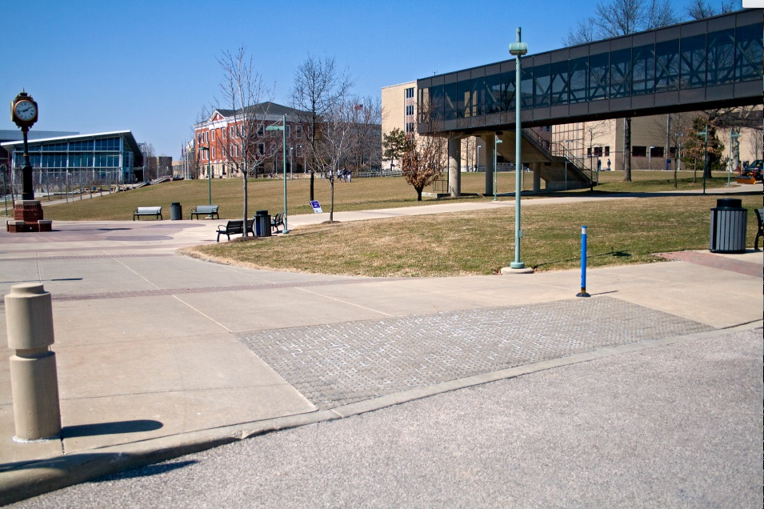
Carryover Benefits:
Curbcuts
  Curb cuts and ramps mandated by building regulations benefit persons in wheelchairs as well as persons pushing strollers, on crutches, on roller skates, and on bikes.

Slide 25
Electronic Curbcuts
  “Electronic Curbcuts” also have universal design benefits.
  It is best to design for universal access rather than retrofitting when the need arises.
  Truly accessible course content can improve educational outcomes for all students since it addresses those with different learning styles and different needs.

Slide 26
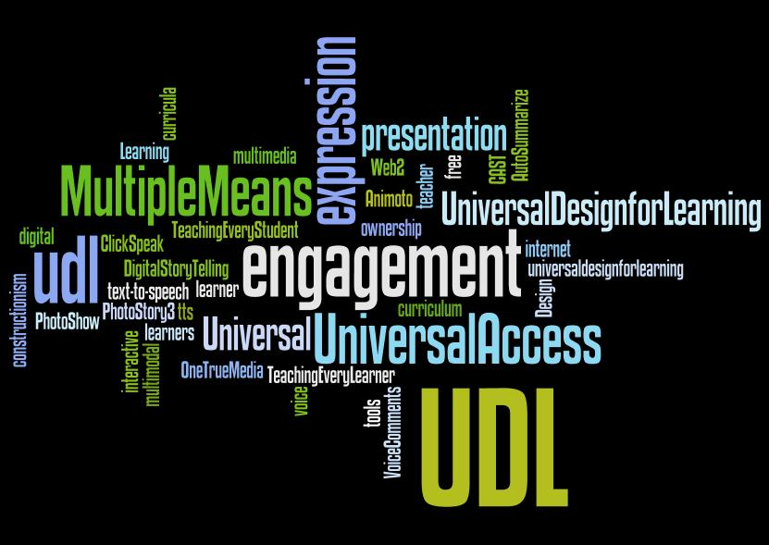
Universal Design for Learning
Movement developed at the non-profit Center for Applied Special Technology (CAST).
“A flexible approach to curriculum design that offers all learners full and equal opportunities to learn.”
Provide multiple means of Representation
  Vision, hearing, touch
  User can make adjustments
Provide multiple means of Action and Expression
  E.g., keyboard alternatives for mouse actions
Provide multiple means of engagement
  Opportunities for personal control

Slide 27
The Universal Design Orchard
Low Hanging Fruit | High Hanging Fruit
Alt-text to an image Creating audio/video from a script; including the script Multiple ways of emphasizing text (not just color) Providing a text description of a short video. Making multimedia optional Self-describing links Using built-in heading levels High contrast between font and background Creating accessible Web pages using built-in LMS editor | Closed captioning Audio description Creating accessible Web pages using external software

Slide 28
Universal Design for Visual Impairments
Good organization
Hyperlinks
Images that are captioned or described
Good contrast and resizable fonts
Audio narration
Audio description
Audio narration can also benefit non-native speakers, those with an auditory learning style, and those with senior eyes.

Slide 29
Universal Design for Hearing Impairments
Auditory content provided as text
Commercial content that is already captioned!
Lecture capture that includes closed captioning or transcription
Speech-to-text software to help with captioning.
Captioning and transcripts also assist non-native speakers, those who speak different dialects, those with a reading/writing learning style, and those with senior ears.

Slide 30
Universal Design for Motor Impairments
Streamline the movement necessary to navigate pages.
Minimize the need for scrollbars.
Identify all titles, headings, and links so that navigation is not mouse-dependent.
This also assists those with arm casts or those with senior bones.

Slide 31
Universal Design for Cognitive Disabilities
Make sure navigation is consistent.
Break up long blocks of texts with headings and paragraphs.
Provide adequate descriptions of visual elements.
Avoid distracting elements, e.g., blinking and buzzing text or images. These can also trigger seizures.
Making content available in multiple formats helps those with a dominant learning style who achieve success by accessing information in specific ways.

Slide 32
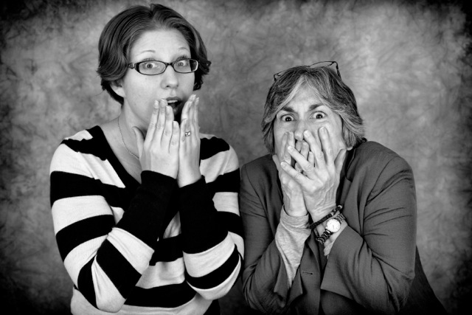
Potential, fear, cost…
“Online learning has the potential to provide a learning space that is fully accessible to the formerly print disabled without compromising its quality.”
“Administrators fear that the process will be unduly expensive. And faculty fear that providing for these students will mean that they have to become information technology experts.”
Image of Jevack and Varonis by Jamie Newhall
“Creating online content that is accessible to students with disabilities is much easier—and probably far less expensive—than people fear.”
--Norman Coombs. 2012. Making Online Teaching Accessible, pp ix-x

Slide 33

…and self-reliance
“I believe that creating accessible online learning experiences for students with disabilities can do even more than give them a quality education—it can empower them to becomes stronger, more self-reliant people.”
--Norman Coombs. 2012. Making Online Teaching Accessible, p. xiii.
Artwork © Roger Xavier, http://www.rogerxavier.com Used with permission

Slide 34
Summary of the Idealist Perspective
All online courses should be totally accessible.
Standard 8.3 should be a 3-point standard in the Quality Matters Higher Ed rubric.

Slide 35
2. The Realist Perspective:
Anything that can be done based on what is real at the moment

Slide 36
A Composite Scenario
Fictional, but these scenes are based on true stories.
Cast
  Narrator: Jillian
  Professor: Tim
  Dual role of Dean and Director of Office of Accessibility: Litsa

Slide 37
Scene 1: Dean’s Office
The Dean is seated behind a table. The Professor comes up to the table and sits down across from her.
Dean: Hi there, Professor. Thanks for coming in.
Professor: Sure thing, Dean. What’s this all about?
Dean: Well, Professor, I’d like you to teach an online section of your course. Students have been asking for an online version of this course, and you seem like you’re pretty good with computers, so we thought you’d be the perfect fit!
Professor: Hmm, ok. I think I could do that. I am pretty good with computers. But is there any kind of training I can take that will help me learn how to design an online course?
Dean: Oh, yes! We have an excellent resource that we subscribe to here; it’s called QM.
Professor: All right then; sign me up!

Slide 38
Scene Change Narration
Narrator: In QM training, the Professor decides to record weekly video lectures as part of his online course design. He also learns about Universal Design for Learning in relationship to General Standard 8. He knows that he once taught a face to face course in which a student with a hearing impairment was enrolled, and the Office of Accessibility provided a real time transcriber for his lectures. So, the Professor makes an appointment with the Office of Accessibility to see about getting his video lectures closed captioned.
The Professor comes up to The Office of Accessibility table and sits down across from the Director of the office.

Slide 39
Scene 2: The Office of Accessibility
Director: Hi, Professor. Thanks for coming in. What can we do for you?
Professor: Well, I’m teaching an online course this semester, and I’ve learned about the benefits of Universal Design for Learning. I’m planning to record weekly video lectures, and I’d like to have them close captioned.
Director: Good for you! Universal Design for Learning is so important. We have a captioning service that you can send them out to; let me get you the information on how to contact them and what it will cost.
Professor: Um…cost? Is this something I would have to pay for?
Director: Well, our records show that we don’t have any students registered with us and requesting accommodations for your course. Unfortunately, we don’t have the budget to cover requests that, as beneficial as they might be, are not required by law. Perhaps your department would be able to cover the cost?
Professor: Oh, ok. I guess I could talk to my Dean.

Slide 40
Scene Change Narration
Narrator: The Professor makes an appointment to see his Dean and ask her if she would be able to fund the captioning of the videos.
The Professor returns to the Dean’s office.

Slide 41
Scene 3: The Dean’s Office
Dean: Hi, Professor. Thanks for coming in. What can I do for you?
Professor: Well, you know that online course I’m teaching? I’m planning to record weekly video lectures, and I’d really like to have them closed captioned because we learned all about the benefits of Universal Design for Learning in that QM training I took.
The Dean nods head vigorously in agreement.
Dean: Absolutely, absolutely. Take them over to the Office of Accessibility; they’ll do it for you. Now if you don’t mind, I’ve got a committee meeting to get to…
Professor: Actually, it’s not quite that simple. The Office of Accessibility doesn’t have the budget to do it unless there is a student who legally requires it. But it’s best practice in the field of online design…
Dean sits back down.

Slide 42
Scene 3: The Dean’s Office (cont.)
Dean Litsa: But we wouldn’t be expected to pay for a real time transcriber in a face to face classroom just because it would be good for everyone in the class, regardless of whether or not they had a disability, to have a copy of what was said in class. Why are online courses held to a higher standard?
Professor Professor: Well, they’re not, technically. Universal Design for Learning applies to face to face courses, too. It just seems like it’s a bigger deal for online courses. But I really do think it would be beneficial to have these captions. Haven’t you ever been in a noisy place and been able to keep up with whatever was on the TV because the captions were turned on? Imagine how beneficial that could be to our students!
Dean Litsa: I know, I know, believe me, I totally get it. But we just had to lay off three people in our department, and we’re being asked to make additional cuts. I’m sorry, but we just can’t do it unless we have to.

Slide 43
Final Narration
Narrator: The Professor is disappointed, but he still believes it would be beneficial if his video lectures were captioned. He learns that the system his institution uses has the ability for him to enter captions himself, so he begins to do so for the first few videos in his course. However, it takes time, and time is something in short supply now that he’s covering an extra class due to those layoffs, working on that article he needs to submit for tenure, and chairing the committee to reduce the number of committees. Professor is realistically unable to continue captioning the remainder of the videos.

Slide 44
The Realistic Scenario
The Professor tries to follow the best practice of Universal Design for Learning, but…
  …Universal Design for Learning is not the law,
  …he is not trained on how to put UDL into practice, and
  …resources are not available to him.
Legally, in any type of course, if there is a student with a disability who is registered with the Office of Accessibility and who requests and is approved for accommodations:
  accommodations will be provided
  the cost (if any) will be paid for by the Office of Accessibility through budget provided to it by the University.
But in courses where this is not the case, faculty may be on their own.

Slide 45
Automatic Captioning May Not Be Perfect!
YouTube has released a beta captioning service which holds promise but also demonstrates the need for human intervention because of many errors.
  University of Akron TV commercial
  Select “CC” and then “English: automatic captions.”
MAGpie (Media Access Generator) is another option. Download MAGpie at the website of the National Center for Accessible Media.

Slide 46
Professional Captioning May Not Be Perfect, Either!
UA submits video files and/or transcripts to a professional captioning service that produces closed captions.
The transcriptions are generally good but must be reviewed for accuracy and “gaps.”
As Transcribed | What She Really Said
or you can sort of weigh | or you can survey
by the style | body style
and it’s really that metaphor for | it really does not matter for
Sorted contribution | Thirty contribution
????????? stuff | Learning style

Slide 47
Summary of the Realist Perspective
Given present realities, we cannot expect higher education online courses to be totally accessible.
8.3 should not become a 3-point standard in the Quality Matters Higher Education rubric until institutional policies align with best practices.

Slide 48
3. The Practicalist Perspective:
Everything practical that can be done

Slide 49
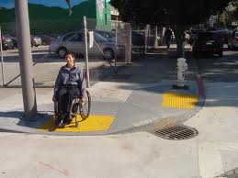
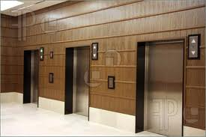

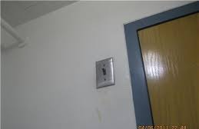
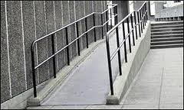
Born Accessible: Fixed Structures
Curb Ramps
Elevators
Door Opener Buttons
Light Switch Placement
Sidewalk Ramps

Slide 50
Born Accessible: Dynamic Structures?
eTextbooks
Training
Web Sites
MOOCs
Web Courses
Extensive Reach
Extensive Reach
Extensive Reach
Extensive Reach
Limited Reach

Slide 51
Born Accessible: Dynamic Structures?
eTextbooks
Training
Web Sites
MOOCs
Web Courses
Born Accessible
Born Accessible
Born Accessible
Born Accessible
Accessible*

Slide 52
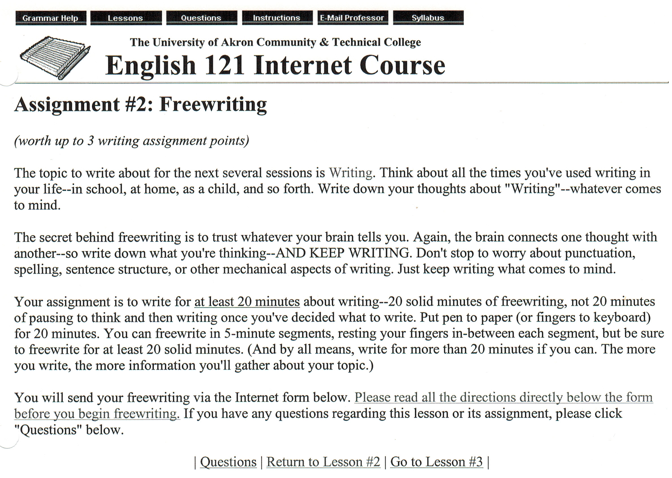
Born Accessible: Dynamic Web Courses?
Cut and paste with background first
AccommodationRequests = 0
1998 to 2000: English 121
No Learning Management System

Slide 53
Born Accessible: Dynamic Web Courses?
Background sent to back
Accommodation
Requests = 0
1998 to 2000: English 121
No Learning Management System

Slide 54
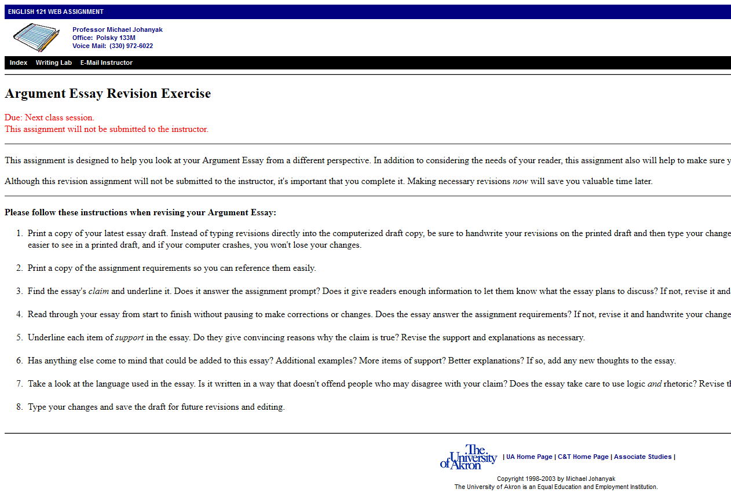
Born Accessible: Dynamic Web Courses?
Accommodation
Requests = 0
2001 to 2003: English 121
No Use of Early LMS

Slide 55
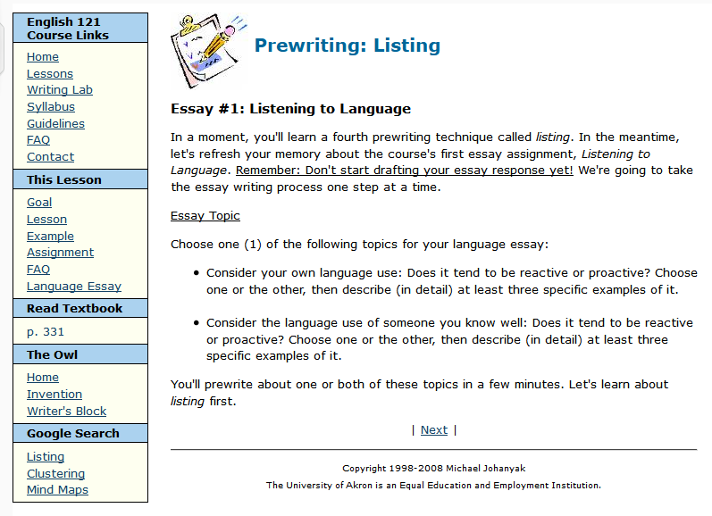
Born Accessible: Dynamic Web Courses?
2004 to 2008: English 121
Limited Use of LMS
Accommodation
Requests = 0

Slide 56
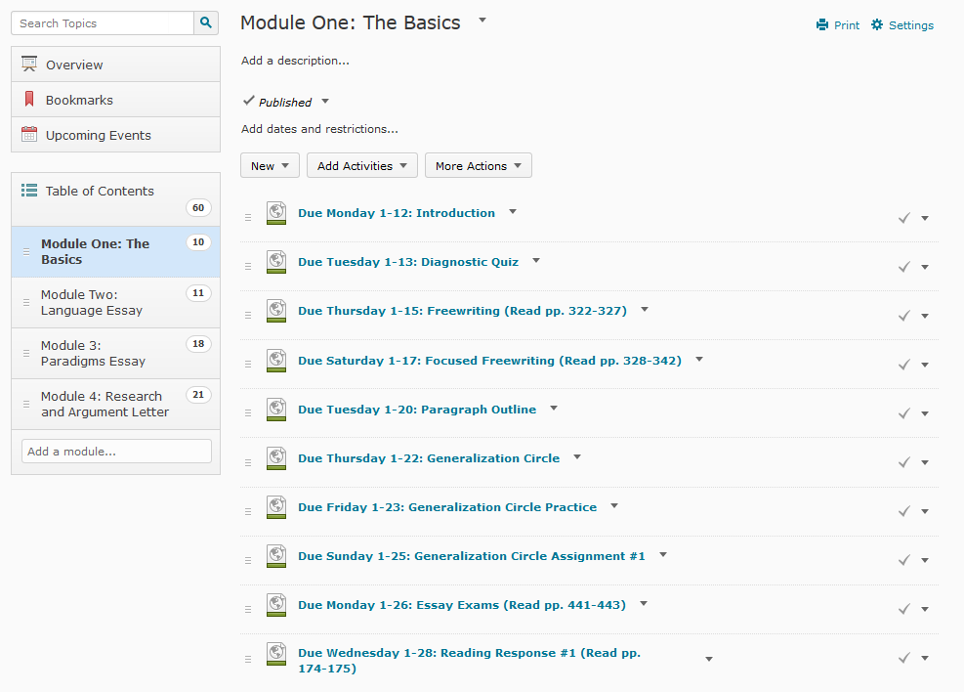
Born Accessible: Dynamic Web Courses?
2009 to 2012: English 121
Universal Design Accessibility
Learning Management System
Accommodation Requests = 0

Slide 57
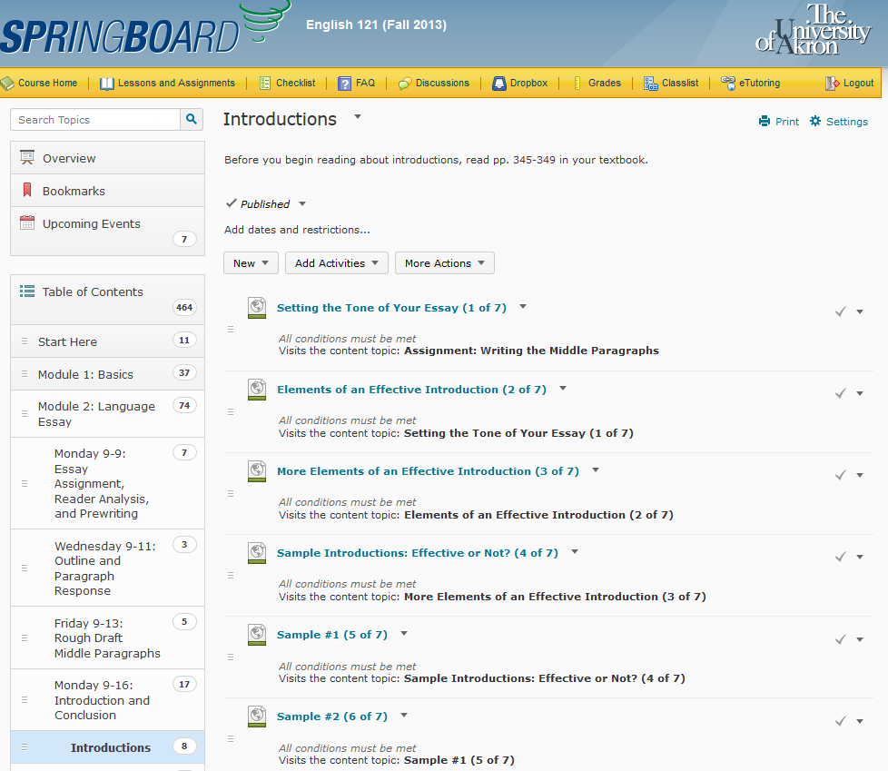
Born Accessible: Dynamic Web Courses?
2013 to present: English 121
Universal Design Accessibility
Learning Management System
Accommodation
Requests = 0

Slide 58

# of Requested Accommodations for the Past 15 Years and 5 Revisions . . .

Slide 59
Courses and Accommodation Requests
Major Content/Delivery Changes and/or Updates Approximately Every 2 to 3 Years
Web Course | Years Offered | Accommodation Requests*
English 121 (Composition) | 1998 to present | 0
Writing for Advertising | 2004 to present | 0
Writing for the World Wide Web | 2001 to present | 0
Writing and Editing | 2009 to present | 0
Technical Report Writing | 2012 to present | 0
Writing and Research | Spring 2014 | 0
*Namely, those related to online course design. This does not include such requests as time extensions, distraction-reduced spaces, and use of a tape recorder in class.

Slide 60
Fall 2014: Request for Course Accommodations
Office of Accessibility requested classroom accommodations for a freshman student who self-disclosed dyslexia:
  Use of textbooks in an alternative format.
  Time extensions for completing tests and in-class work equal to 100% additional time.
  Use of a computer for essay tests and in-class writing assignments, with spell check.
  Use of adaptive technology: voice recognition software.
  Use of adaptive technology to assist in written expression and organization.
  Use of laptop in class with access to electrical outlet.
  Use of tape recorder in the classroom.

Slide 61
Fall 2014: Request for Course Accommodations
Actual Needed Accommodation: Screen reader for online course content.
Problems:
  Screen reader never mentioned in Office of Accessibility accommodations.
  LMS wouldn’t allow screen reader to work within an individual LMS frame unless course pages were downloaded first.
  Course release conditions wouldn’t allow all pages to be downloaded without first accessing each page separately.
Solutions:
  Instructor adds a new release condition that allows student to bypass regular release conditions in the course—accessibility as needed.
  LMS develops work-around so screen reader can work within an LMS frame.

Slide 62

Consequences of Requiring
Born Accessible Web Courses
Web course creators might avoid technologies that require double the time investment
  Videos
  Narrated PowerPoint
  Radio/TV Spots
Accessibility might drive pedagogical decisions
Web course creators might waste time creating accessible content that is never used or needed.

Slide 63
Practicalist
Approach
  Everything practical that can be done.
  Accessibility built-in to LMS
  Low-hanging fruit
    PDF copies of scripted videos and PowerPoint
    Font styles for different colors
    Written descriptions of short videos
    Image descriptions, etc.
    Universal design
  Accessibility as needed

Slide 64
Problems with 8.3 as 3-Point Standard
Faculty and IT personnel can’t predict every possible accessibility consequence related to course design (e.g., release conditions affecting screen readers that require extra steps to work when content is in an LMS frame).
A list of clearly-defined criteria indicating exactly what is meant by “alternative means of access to course materials in formats that meet the needs of diverse learners” would need to be developed and updated frequently.
Keeping an updated list of clearly-defined criteria would be impractical if not impossible given the fast pace of changes in software and technology.

Slide 65
Summary of the Practicalist Perspective
From a practical point of view, we should not expect higher ed online courses to be totally accessible.
8.3 in the QM Higher Ed rubric should not become a 3-point standard until technology makes it reasonable.

Slide 66
Some Closing Thoughts

Slide 67
QM Higher Education Standard 8.3
  “The course contains alternative means of access to course materials in formats that meet the needs of diverse learners.” (2 pts)
Should this be a three-point standard?
  The idealist: yes
  The realist: not until institutional policies align with best practices
  The practicalist: not right now, but yes when technology makes it reasonable

Slide 68
Converging Perspectives

Slide 69
Legal Challenges
What will the Miami University of Ohio case tell us?
Simultaneous access to all course information
Information access: available vs. preferred formats
Impact on online and blended course design:
  Stifled creativity and innovation…and
  …Increased costs and effort…or
  Better course design?

Slide 70
Questions?

