Slide 1

It Takes a Village:
Building a Successful Statewide QM Implementation Through Collaboration
Dr. Jonnie “Jill” Phipps The University of Akron

Slide 2
Background – p.1
The Ohio Board of Regents (OBR) funded the Ohio Learning Network (OLN) to promote access to Distance Education for all Ohioans
In 2006 Brenda Boyd first presented information on the QM Rubric at the OLN annual conference
In 2007 Brenda Boyd challenged OLN to start a QM state-wide system
Six institutions met with OLN to explore the creation of a pilot program on the QM review process. It was established in 2008.

Slide 3
Background – p.2
OLN in turn promoted the Statewide QM initiative and by 2011 there were over 60 institutions that had joined the Ohio QM consortium.
  Paid the State-wide QM Membership Fee ($5,500)
  Sponsored Professional Development Training (APPQMR)
    Paid for workbooks
    Created Check list for hosts
    Established facilitators travel with reimbursement
    Developed the 15/15 enrollment policy
  Annual Meeting for Institutional Representatives
OLN was disbanded in Fall of 2011.

Slide 4
How could we maintain the consortium and the related benefits?
It appeared too difficult and time consuming for any one institution to take on the responsibilities.
Four institutions stepped forward to take a leadership role.

Slide 5

Executive Committee was formed
Sharing the Responsibilities
Columbus State Community College
  Finances
Cuyahoga Community College
  Professional Development
The University of Akron
  The Bartering System
Bowling Green State University
  Administrative Tasks

Slide 6
Mission Statement
The mission of the Ohio Quality Matters Consortium is to enhance the experience of students and faculty engaged in online and blended learning in its member institutions.

Slide 7
Goals for Consortium Members
Maintain a cohesive community of institutions committed to quality in online and blended teaching and learning.
Raise awareness of the quality of Ohio’s online and blended learning.
Be an ambassador of Quality Matters standards in online and blended learning.
Provide an affordable and sustainable course review system for Ohio QM Institutions.
Provide professional development in quality practices and implementation processes.

Slide 8
Goals for Executive Committee
To ethically and responsibly manage Consortium operations.
To model best practices for shared leadership in state-wide systems.

Slide 9
Executive Committee Strategies
Increase and maintain financial stability
Increase number of trainers
Update and maintain Ohio QM website
Develop and implement bartering system

Slide 10
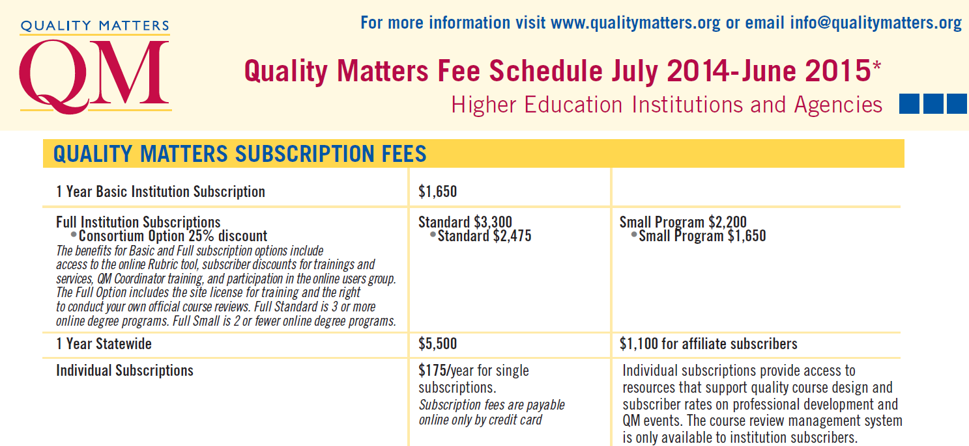
What are the financial options?

Slide 11
Executive Committee Strategies
Need for Financial Sustainability
Columbus State Community College (CSCC) volunteered to manage the finances.
  CSCC has three members on the Executive Committee
    Dr. Tom Erney
    Ann Palazzo
    Suzanne Patzer
Designated monies were transferred from OLN to CSCC

Slide 12
Executive Committee Strategies
Need for Financial Sustainability
Institutions Pay:
  $1,100 Dues for National QM Membership
    Forwarded directly to National QM
  $500 Dues for Ohio Consortium Membership
    Currently have sixty members
      60 X $500 = $30,000
Consortium Pays:
    $5,500 per year for State-wide Dues
    Facilitator training
    Annual Member Meeting

Slide 13
Executive Committee Strategies
Financial Procedures
Institutions receive an invoice from Columbus State Community College for $1,600
  $500 Ohio QM Consortium Fee
  $1,100 National QM Fee
CSCC forwards National Fees to QM
CSCC pays the $5,500 Consortium Dues on behalf of Ohio members
Ohio QM Website reflects members in good standing

Slide 14
Executive Committee Strategies
Benefits of Ohio QM Membership
Reduced individual institutional dues
    (from $3,300 to $1,100)
Access to free APPQMR F2F training
Discounted rates for Online Certification Courses
Participation in the Review Bartering System
    Cost for non-bartered reviews $1,000/$1,400
Quarterly State-wide webinars for Quality Matters Coordinators
The Ohio QM Consortium Annual Member Meeting
Master Reviewer Recertification costs included
  40 at $50 each = $2,000
Finance F2F APPQMR facilitator certification

Slide 15
Executive Committee Strategies
Professional Development
Cuyahoga Community College (Tri-C) was already involved in managing some of the professional development / certification records.
  Tri-C has two members on the Executive Committee
    Sasha Thackaberry
    Melanie Thompson

Slide 16
Executive Committee Strategies
Increase Number of Trainers
There were only 5 traveling APPQMR trainers in Ohio in 2011.
State divided into five regions (required long distances for many sessions).
  NE, NW, Central, SE, and SW
“Scholarships” to pay training fees in return for a commitment of conducting 4 workshops within two years.
  First one added seven more trainers statewide
    (at $500 each = $3,500)
  Second one added five more trainers statewide
    (at $500 each = $2,500)

Slide 17
Executive Committee Strategies
Tri-C Manages Requests for Training
A request for an APPQMR is sent to Tri-C
Tri-C Communicates with F2F facilitators
  secures a volunteer
Assign facilitator and communicate with organization
Gather available dates from facilitators
Distribute the dates to all QMCs
Match requests with facilitators

Slide 18



Executive Committee Strategies
Tri-C & UA Update Ohio QM Website & Social Media
QM Ohio Website http://qmohio.org/
  List of current members with QMCs
  Calendar of training events
  FAQ page
  Announcements
  Blog
Social Media
  Twitter
  Facebook
  Linkedin

Slide 19
Executive Committee Strategy
Create a Bartering System
The University of Akron volunteered to create a database to record bartering information.
  UA has three members on the Executive Committee
    Dr. John Savery
    Wendy Lampner
    Dr. Jill Phipps

Slide 20
Quality Matters Course Reviews
Some institutions were informally bartering with one another.
  Presented some difficulties
  Try it yourselves!
The Bartering Game

Slide 21
Bartering Game
Role | Pts. | Represented by
Chair: must be a Master Reviewer | 2 | Chocolate Candy Bars: Milky Way, Snickers, 3Musketeers, Butterfinger, and Twix
External Reviewer | 1 | Butterscotch & Cinnamon
Subject Matter Expert (SME) | 1 | Math = Spearmint/Green Striped Education = Peppermint/Red Striped English = Whoppers Nursing = Tootsie Rolls Business = Twizzlers Engineering = Smarties Law = Root Beer Barrels Communications = Caramel Modern Languages = Starburst Philosophy = Jolly Rancher Biology = Strawberry

Slide 22
Executive Committee Strategies
Implement a State-wide Bartering System
Provide an affordable/sustainable course review system for Ohio QM Institutions.
Maintain a cohesive community of institutions committed to quality in online and blended teaching and learning.
Raise awareness of the quality of Ohio’s online and blended learning.
Be an ambassador of Quality Matters standards in online and blended learning.
Utilize resources throughout the state.

Slide 23
Strategy: Fit Bartering into the Model of Subscriber Managed Course Reviews
Subscriber-Managed Course Reviews
    Official QM course reviews.
    Managed by a QM Coordinator (QMC).
    Adhere to the QM Course Review Standards and use the QM online tools.
New certification introduces two-tier pricing
    No cost if the QMC has successfully completed the Course Review Manager Certification (CRMC). Cost of training is $300.
    $100 per course if the QMC has not completed the CRMC.

Slide 24
Course Review Bartering System
Debits and Credits
The University of Akron maintains a database of bartered courses within the Consortium, including credits earned and credits spent.
8 credits come with membership each year.
  Credits are “spent” on reviewers outside the institution.
  A review costs a maximum of 4 credits.
Credits can be “earned” by supplying reviewers.

Slide 25
Course Review Bartering System
Payroll!
Each review requires three reviewers
  A Team Chair costs 2 credits.
  A SME costs 1 credit
  An External Reviewer costs 1 credit
Institutions can “bank” credit earned by their own reviewers.
  Some institutions compensate their reviewers.
Some Organizations “pay” only for an external reviewer and fill the other roles in-house.

Slide 26
Course Review Bartering System
The Balance Sheet
QMCs have access to the Ohio QM Report:
    https://learn.uakron.edu/qualitymatters/view/

Slide 27
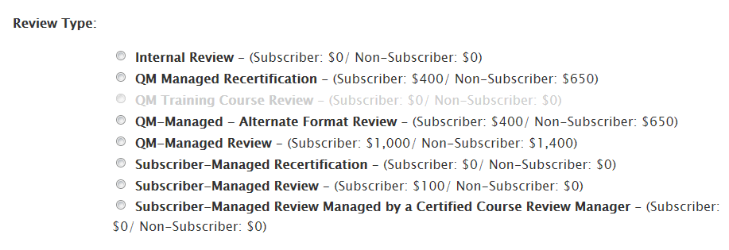
Walking through the Steps—p. 1
Apply to QM for a course review as always
Select the appropriate Subscriber-Managed as the Review Type

Slide 28
Walking through the Steps—p. 2
*Contact potential reviewer to see if they are interested in bartering
    Do they meet your institution’s qualifications?
    CC the QMC
Continue the process as you would for any review
*Record the completed bartered review on the bartering website https://learn.uakron.edu/qualitymatters/view/
*QMCs can access the database to check on the current balance for their institution.
* Step unique to bartering system

Slide 29
Plan to move forward…
For example at the University of Akron:
Determine short-term goals (3 months)
  Two additional peer reviewers
  One additional master reviewer
  First bartered review completed
Set mid-term goals (1 year)
  Five additional peer reviewers
  Two additional master reviewers
  Five courses QM Certified
Set long-term goals (5 year)

Slide 30
Questions and Comments

