Slide 1
Uncovering Your Inner
Learning Objectives
Quality Matters Mid-Atlantic Conference
Drexel University
Evangeline (Litsa) Varonis
The University of Akron
varonis@uakron.edu

Slide 2
Overview
This session will
Distinguish course descriptions, course goals, course objectives, and module objectives.
Present several theoretical frameworks associated with learning objectives, including:
  Cognitive
  Affective
  Psychomotor
  Interpersonal
Provide examples of strong and weak learning objectives for discussion.
Offer authentic scenarios of courses with hidden learning objectives.
Encourage participants to work in small groups to find and articulate the hidden objectives.

Slide 3
Frames of Reference
Courses and Students and Modules, Oh My!

Slide 4
Constantly Confused Concepts
Course description (and goals)
  “tells you something about the content and procedures of a course” (Mager 1984, p. 11).
Learning objectives: (what’s supposed to happen)
  Course objectives: (also referred to as competencies and/or course outcomes)
    Describe “a desired outcome of a course” (Mager 1984, p. 11).
    Focus on broad skills or attitudes students are expected to achieve.
    These skills can be listed on a resume (e.g., Create PowerPoint presentations).
  Module objectives
    the individual steps required to achieve the broader course objectives (e.g., Insert Images into a PowerPoint presentation).
Learning outcomes: (what happened)

Slide 5
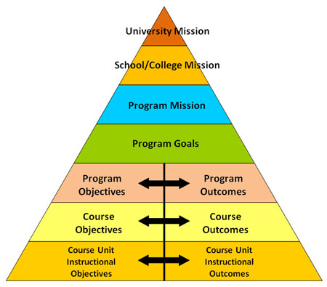
Missions & Goals & Objectives & Outcomes
http://assessment.uconn.edu/primer/goals1.html

Slide 6
What is a course goal?
It is written from the point of view of the institution.
It is consistent with the mission of the university, department, and program.
It relates the intent of the department, course, or instructor.
It is written in general terms.

Slide 7
What is a learning objective?
Definition: Mager, 1984, p. 3
  “An objective is a description of performance you want learners to be able to exhibit before you consider them competent.”
  “An objective describes an intended result of instruction, rather than the process of instruction itself.”
Learning objectives should be measurable and specific.
  Imagine a checklist of skills for the course. The student should be able to check off those skills as they are acquired and have a good idea of what is still left to work on.

Slide 8
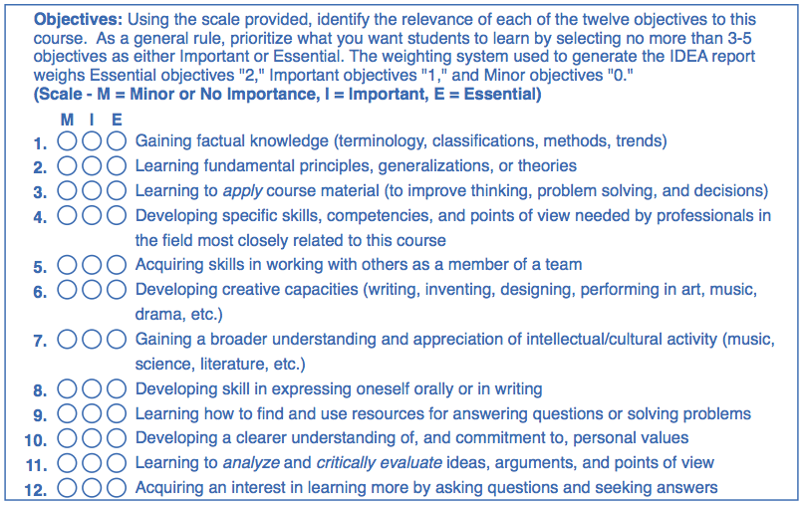
IDEA Center Form: Objectives
http://www.theideacenter.org

Slide 9
What is a learning outcome?
The terms “student learning objective” and “student learning outcome” are used interchangeably.
A possible distinction:
Student Learning Objective | Student Learning Outcome
Design | Delivery
A check box next to an item on a checklist | A check in the check box next to an item in the checklist

Slide 10
Goal or learning objective?
Discusses and illustrates principles and techniques of computer programming. (Mager p. 11)
Goal
Learning Objective
Notes:
As the frame of reference is the course, this might be considered part of a course description but not a learning objective. Students taking this course would not be expected to “discuss” computer programming; they would be expected to program. However, a conference participant who teaches computer programming indicated that programming students would be expected to go beyond what he termed “spaghetti code” and demonstrate the ability to discuss and explain how the code was developed. Therefore, depending on the course it is possible that this statement could be a learning objective.

Slide 11
Goal or learning objective?
In at least two computer languages, be able to write and test a program to calculate arithmetic means. (Mager p. 11)
Goal
Learning Objective
Notes:
In fact, this is a well-written learning objective.

Slide 12
Find the learning objectives! Psych Course
Course Perspective: Course Description identified as “Course Objectives” (excerpted as written; used by permission) | Student Perspective: Learning Objectives (Try beginning with “You will be able to:”
This course will familiarize you with the field of psychology, including its various sub-fields, and the opportunities associated with a degree in psychology.
Notes:
Note that while the Syllabus identifies the text as being “Course Objectives,” in fact the text is more accurately part of a course description.

Slide 13
Psychology Course: one solution
Course Perspective: Course Description identified as “Course Objectives” (excerpted as written; used by permission) | Student Perspective: Learning Objective
This course will familiarize you with the field of psychology, including its various sub-fields, and the opportunities associated with a degree in psychology. | You will be able to: Describe the subject matter and sub-fields of psychology. Identify opportunities associated with a degree in psychology.

Slide 14
Find the learning objectives! Sociology course
Course Perspective: Course Description identified as “Course Objectives” (excerpted as written; used by permission) | Student Perspective: Learning Objective (Try beginning with “You will be able to:”
Introduction to the discipline of sociology. Its major purposes are: to introduce you to the basic concepts, theoretical perspectives, and methods of sociology; 2) to enhance your understanding of how and why individuals and groups behave as they do; and 3) to encourage you to apply the sociological perspective to comprehend and analyze events, problems, and situations in the world and in your own everyday lives.
Notes:
Note that while the Syllabus identifies the text as being “Course Objectives,” in fact the text is more accurately part of a course description.

Slide 15
Sociology course: one solution
Course Perspective: Course Description identified as “Course Objectives” (excerpted as written; used by permission) | Student Perspective: Learning Objective (Try beginning with “You will be able to:”
Introduction to the discipline of sociology. Its major purposes are: to introduce you to the basic concepts, theoretical perspectives, and methods of sociology; 2) to enhance your understanding of how and why individuals and groups behave as they do; and 3) to encourage you to apply the sociological perspective to comprehend and analyze events, problems, and situations in the world and in your own everyday lives. | Identify the basic concepts… Explain why individuals and groups behave as they do; Apply the sociological perspective to events, problems, and situations in the world; and Apply the sociological perspective to your own everyday life.

Slide 16
Find the learning objectives! Photography Course
Identified as “Course Objectives” (excerpted as written; used by permission) | Which are actually Learning Objectives?
Course objectives: To develop proficiency at making prints of consistent quality on fiber-based paper; to provide an introduction to the work of historical and contemporary photographers; to provide a critical vocabulary for photography; and to begin the development of a personal vision for artists working in photography.
Notes:
Note that while the Syllabus identifies the text as being “Course Objectives,” in fact the text is more accurately part of a course description.

Slide 17
Find the learning objectives! Photography Course
Course Goals | Learning Objectives
To provide an introduction to the work of historical and contemporary photographers To provide a critical vocabulary for photography | To develop proficiency at making prints of consistent quality on fiber-based paper To begin the development of a personal vision for artists working in photography.
Notes:
Note that while the Syllabus identifies the text as being “Course Objectives,” in fact the text is more accurately part of a course description.

Slide 18
Four domains of learning objectives
Cognitive, Psychomotor, Affective, Interpersonal
Notes:
Bloom (1956) introduced the concept of cognitive, psychomotor, and affective objectives. His work has been expanded by others.

Slide 19
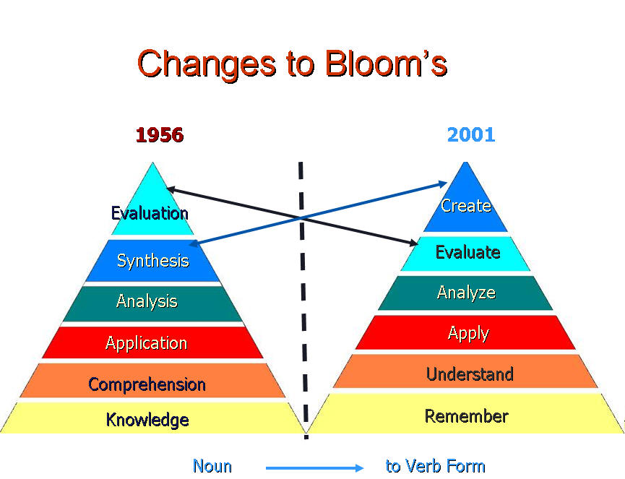
Cognitive Domain
(Bloom, 1956; Anderson & Krathwohl, 2001)
Image courtesy of Leslie Owen Wilson http://www4.uwsp.edu/education/lwilson/curric/newtaxonomy.htm
Notes:
In Anderson and Krathwohl’s 2001 formulation, nouns were changed to verbs and the top two categories changed places, with “synthesis” being replaced by “create.” This switch is nicely conveyed by the “twin peaks” (my term) image created by Leslie Owen Wilson. The pyramid reinforces the notion of the cognitive domain, and the other domains as well, as the simple levels (e.g., knowledge/remember) provide the basis for the more complex. More detailed information on the Cognitive Domain is available in the conference handout.

Slide 20
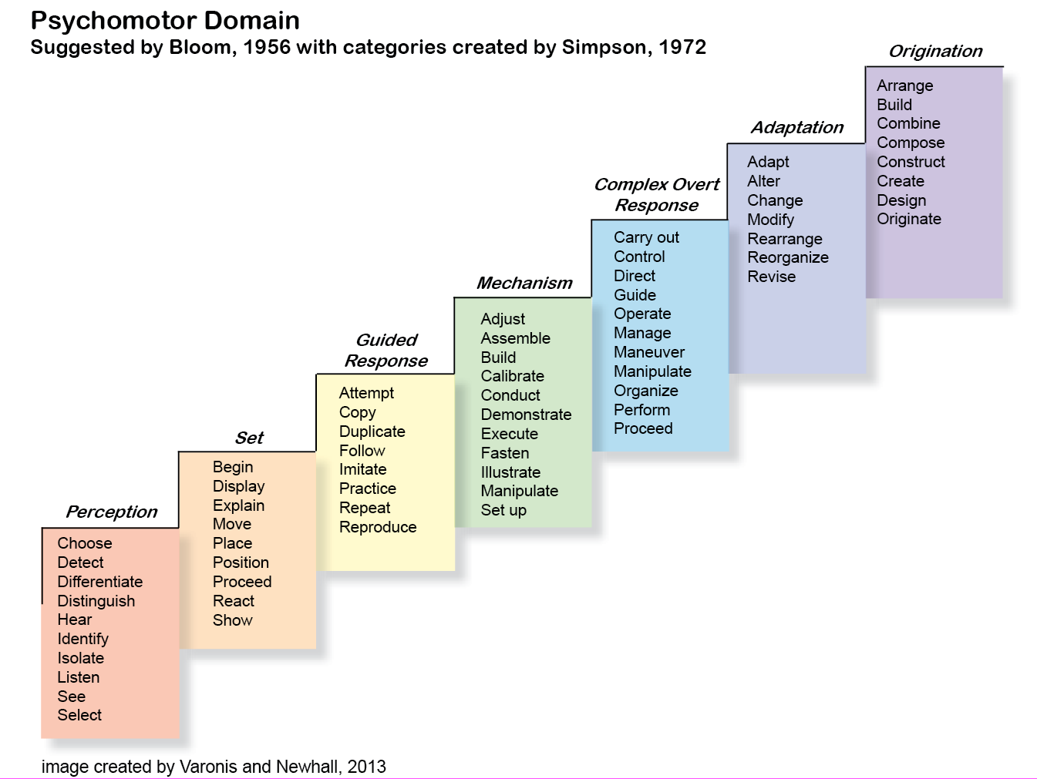
Psychomotor Domain
(Bloom, 1956; Simpson, 1972)
Notes:
The “staircase” depicted in this graphic reinforces the notion of the psychomotor domain, as the participant physically ascends from the simplest level, perception, to the highest level, origination. More detailed information on the Psychomotor Domain is available in the conference handout.

Slide 21
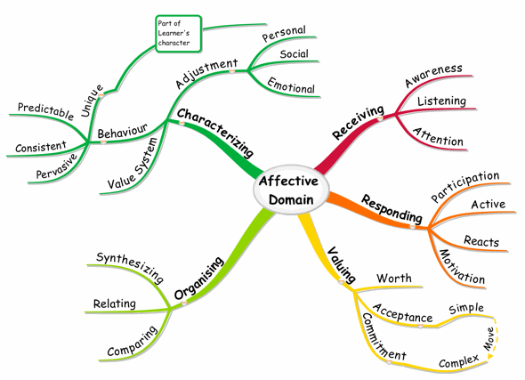
Affective Domain
(Bloom, 1956; Krathwohl, Bloom, & Masia 1964)
Image courtesy of Faizel Mohidin. Lowest level is receiving; move clockwise to characterizing. http://www.mindmaptutor.com/2010/04/blooms-taxonomy-mind-map-of-the-affective-domain/
Notes:
The color and movement in this image reinforce the notion of the affective domain, which is associated with attitudes, beliefs, values, and emotions. More detailed information on the Affective Domain is available in the conference handout.

Slide 22
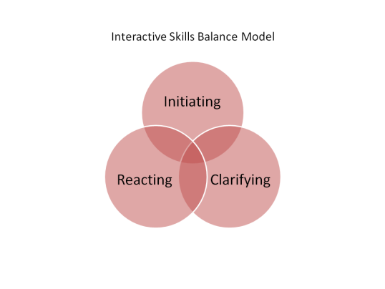
Interpersonal Domain
(Rackham & Morgan, 1977)
A fourth category, not depicted here, is “Process,” related to a participant pulling in or shutting out other participants.
Image courtesy of Nick Anderson. http://thecrispianadvantage.com/tag/control/
Notes:
The overlapping circles in this image reinforce the notion of the interpersonal domain, which is associated with interactions among people. The interpersonal domain was first described by Rackham and Morgan, 1977, as a way to assess the interpersonal skills of managers. Those who were most successful were able to balance initiating and reacting behaviors as well as clarifying and “bringing in” the ideas and opinions of others. Several behaviors, e.g., the reactive behavior of defending/attacking or the process behavior of shutting out, would not be appropriate learning objectives and are therefore grayed out on the chart in the handout and on the next slide. More detailed information on the Interpersonal Domain is available in the conference handout.

Slide 23
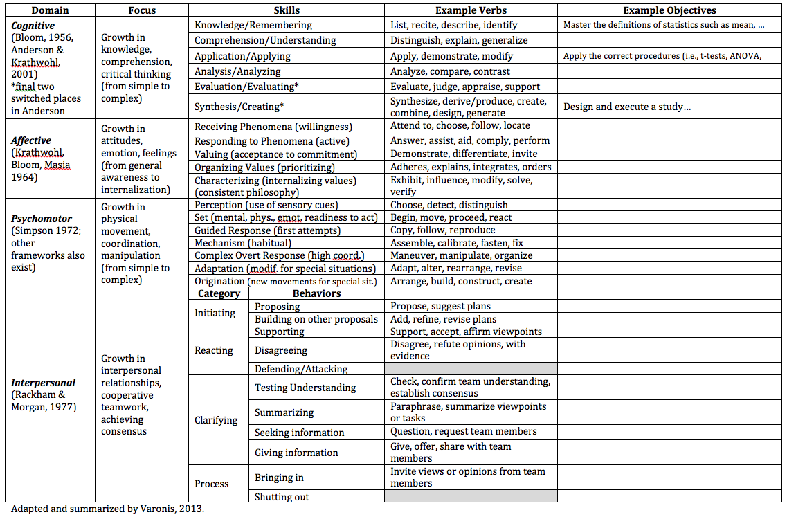
Types of Learning Objectives by Domain
Notes:
This chart is my attempt to summarize the four domains associated with learning objectives and the skills that each domain focuses on. For the first three, cognitive, affective, and psychomotor, the skills are listed in the order of simple to complex.

Slide 24
IDEA Form Objective: Gaining factual knowledge (terminology, classification, methods, trends)
Cognitive
Psychomotor
Affective
Interpersonal
Notes:
This would probably be considered an objective in the “cognitive” domain.

Slide 25
IDEA Form Objective: Acquiring skills in working with others as a member of a team
Cognitive
Psychomotor
Affective
Interpersonal
Notes:
This would probably be considered an objective in the “interpersonal” domain.

Slide 26
IDEA Form Objective: Gaining a broader understanding and appreciation of intellectual/cultural activity (music, science, literature, etc.)
Cognitive
Psychomotor
Affective
Interpersonal
Notes:
This would probably be considered an objective in the “affective” domain but it probably also involves the cognitive domain.

Slide 27
IDEA does not include psychomotor objectives. Can you write one for your own course?

Slide 28
The Characteristics of Learning Objectives
Performance, Conditions, Criteria…and Audience

Slide 29
What does a learning objective focus on?
“Given any objective in a subject matter with which you are familiar, in all instances be able to identify (label) correctly the PERFORMANCE, the CONDITIONS, and the CRITERION of acceptable performance when any or all those characteristics are present.” Mager, 1984, p. 3.
Note that learning objectives do not necessarily contain all three attributes!
Heinich et al incorporated these into the ABCD model:
  Audience (who will perform; added by Heinich et al)
  Behaviors (Performance; written as a measurable verb)
  Conditions (under which performance will occur)
  Degree of Mastery (Criteria of acceptable performance, e.g., speed, accuracy, quality)

Slide 30
Performance (Behaviors): must be present in the learning objective
Performance references what the learner should be able to do or perform as a result of the course. It is measurable!
Internal states can be demonstrated by “visible or audible human behavior” (Mager, p. 24).
The focus is what the learner will be able to do
  NOT the learner’s internal state
  NOT how the course is conducted.
If the performance is “covert,” add an indicator behavior.
  Covert: “recall”
  Overt: “describe”

Slide 31
Verbs! (Mager, p. 20)
(note the differences between the two columns)
To know
To understand
To really understand
To appreciate
To fully appreciate
To grasp the significance of
To enjoy
To believe
To have faith in
To internalize
To write
To recite
To identify
To sort
To solve
To construct
To build
To compare
To contrast
To smile
Notes:
The column on the left contains verbs that refer to internal states that could not be objectively measured and assessed. The column on the right contains verbs that refer to observable acts that could be measured and assessed.

Slide 32
Which are not effective learning objectives? (To be able to…)
Write a news article
Develop an understanding of basic grant writing concepts
Sew a seam
Stain slides
Know the characteristics of historical theater
Notes:
#2 is not an effective learning objective: the verb “develop” could be appropriate, but “an understanding” would be difficult to measure unless it were demonstrated in a tangible way.
#5 is not an effective learning objective: the verb “know” describes an internal state. “Describe” or “Present” are good alternatives.

Slide 33
Which are not effective learning objectives?
Develop a knowledge of food service equipment
Add a column of numbers
Solve linear equations in one unknown.
Memorize the list of American Presidents in chronological order.
Notes:
#1 is not an effective learning objective: the verb “develop” could be appropriate, but “a knowledge” would be difficult to measure unless it were demonstrated in a tangible way.
#4 is not an effective learning objective: the verb “memorize” describes an internal state. “Recite” or “List” are good alternatives.

Slide 34
Conditions: not required
The relevant conditions when students demonstrate mastery or an acceptable skill level
Example: Given a list of thirty-five chemical elements, be able to recall (write) the valences of at least thirty.
  Condition: Given a list of thirty-five chemical elements
  Performance: Be able to recall (write) the valences of at least thirty
Example: Be able to solve simple linear equations in one unknown.
  What is the condition?
Example taken from Mager, 1984.
Notes:
The condition would be “one unknown.”

Slide 35

Criteria (Degree of Mastery): not required, but a basis of assessment
A criterion is “the standard by which performance is evaluated.” Mager, p. 71
Rubrics are a great way to operationalize the criteria you are using to evaluate performance!
American Idol and Dancing with the Stars
  Your perception of performance is probably based on internalized criteria.
  The judges are good at articulating those criteria.
http://www.justjaredjr.com/2014/03/31/meryl-davis-maksim-chmerkovskiy-almost-kiss-during-foxtrot-on-dwts-watch-now/
Notes:
When American Idol judges—and TV viewers—respond to performers, they have a number of criteria in mind. These might include criteria such as pitch, tone, volume, range, song selection, stage presence, dress, hair, and movement. Note that not all these criteria are weighted equally!

Slide 36
Criteria: Speed, Accuracy, Quality
(examples adapted from Mager, 1984)
Weigh materials accurately to the nearest gram.
Write a research paper that meets standards of publication in the field.
Run the hundred-yard dash on a dry track within fourteen seconds.
Clear all the jelly and earn 100000 points.
Identify the criterion associated with each objective.
Notes:
Accuracy
Quality
Speed
Quality, with the key word being “all.” Some levels in this game, Candy Crush, also involve speed.

Slide 37
An Additional Characteristic: Audience not required
Heinich, Molenda, Russell & Smaldino (1996) elaborated on Mager’s model by adding “Audience” as a fourth characteristic.
“Slash” courses may need to consider two audiences: undergraduate and graduate students.
What is the “audience” specified in the following objective: “Given a bar, line, or circle graph, the seventh-grade mathematics student will be able to verbally present all the statistical or numerical information shown on the graph with 100 percent accuracy.” (Smaldino & Russell 2005 p. 57)
Notes:
Clearly, the audience in this example is “the seventh-grade mathematics student.”

Slide 38
Putting It All Together
Audience, Behavior, Condition, Degree of mastery
Given a bar, line, or circle graph,
…the seventh-grade mathematics student…
…will be able to verbally present all the statistical or numerical information shown on the graph…
…with 100 percent accuracy.
(adapted from Smaldino & Russell 2005 p. 57)
Notes:
Condition
Audience
Behavior
Degree of Mastery (Criterion)

Slide 39
Learning objectives that need your help!
Can these be assessed?
Demonstrate a thorough comprehension of…
Have a favorable attitude toward reading.
Develop a positive attitude toward…
Given twenty minutes of instruction and a lab exercise, be able to develop an understanding of the difference between igneous, metamorphic, and sedimentary rocks. Criterion: 80 percent correct.
The student will learn the basic sanitary standards in the food industry, according to local and state codes.
Notes:
“Demonstrate” is OK but “comprehension” is not tangible.
There would need to be a way to assess “attitude.”
There would need to be a way to assess “attitude.”
“Develop” is OK but “understanding” is not tangible.
There would need to be a way to assess “learn.”

Slide 40
Uncover the inner learning objectives

Slide 41
Inner Learning Objectives
As a Quality Matters reviewer, I have frequently encountered courses where some of the learning objectives remained "inner," very much a part of the instructor's underlying goals for the course but never articulated to students.
Recommending that they be formulated, or even drafting some as examples, then becomes part of the review feedback.

Slide 42
My Feedback on QM Reviews:
Biology Course
“Given the thought-provoking questions included in chapter discussions, please consider adding a course level learning objective like ‘Relate course concepts to contemporary medical and ethical debates and articulate your own position.’”
What domain/s does this proposed objective relate to?
  Cognitive
  Psychomotor
  Affective
  Interpersonal
Notes:
This objective could encompass any domain but psychomotor.

Slide 43
My Feedback on QM Reviews:
English as a Second Language
“There appears to be at least one additional course level learning objective that is not listed, however: a suggestion might be ‘Create digital learning objects that could be used in an authentic ESL environment.’”
What domain/s does this proposed objective relate to?
  Cognitive
  Psychomotor
  Affective
  Interpersonal
Notes:
This one could include cognitive and psychomotor domains since the creation of a learning object is a physical act.

Slide 44
My Feedback on QM Reviews:
Education
“Based on the final blog assignment, which appears to be a capstone assignment for the class, please consider also adding objectives like ‘Explore communication and collaboration strategies that enhance the online learning experience’ and ‘Reflect on your growth in utilizing learning technologies to become a more successful learner’ or something like that.”
What domain/s does this proposed objective relate to?
  Cognitive
  Psychomotor
  Affective
  Interpersonal
Notes:
These suggested learning objectives relate to all the domains in various ways. The exploration of communication and collaboration strategies could include both psychomotor and interpersonal domains as well as cognitive and affective. The second suggested objective is probably largely cognitive and affective.

Slide 45
My Feedback on QM Reviews:
Instructional Design
“Since the group problem-solving process is such a critical part of this course, I would recommend adding an objective or objectives that directly relate this.”
What domain does this proposed objective relate to?
  Cognitive
  Psychomotor
  Affective
  Interpersonal
Notes:
This suggestion for an added objective is probably focused on the interpersonal domain, but could also include the affective.

Slide 46
SPCH 1113 Course Worksheet
29. Identify any particular aspects of this course you would like specific feedback on from the Review Team. (If none, please enter "N/A.")
I crave help in making the Problem Solving Group Speeches less painful for the students. They constantly complain about having to do group work in an online class, but I know how vitally important group work is in the business world today and they need to learn that skill.
Notes:
The instructor’s request is centered on the interpersonal domain, but could also include the affective.

Slide 47
Module Objectives for a Nursing Course
Collaborate with team members on a group presentation
Present content to an audience of peers
Notes:
These objectives were written to describe group presentations made during the final week of the course.

Slide 48
Instructional Technology Course
Info shared in intro and assessments suggests “inner” module objectives that are not articulated
Module intro: During this first module, you will be reading about the National Educational Technology Standards (NETS) for Teachers, Students, and Administrators. It is a very important unit to help you understand what standards should be addressed when integrating technologies into educational settings. The NETS-T focus on the skills you need as a teacher; the NETS-T are the basic skill sets needed. The NETS-TF are more advanced standards and these are the focused on your ability to not only integrate technology in your own classroom or work setting, but set standards for facilitators of technology. Mastering the NETS-TF means you are proficient at helping others understand how technology can be used to support learning. It is important foundational knowledge for this program that you understand how the International Technology Standards fit into our work and what standards you are accountable to as leaders in technology integration and facilitation.
Assignment: Introduce yourself on VoiceThread.
Assignment: Sign up and start a Wiki.
Assignment: Post to discussion “your thoughts about how understanding and applying the standards will change the way you think about technology. Share at least 2 technologies you currently use that you think impact student learning in your class or workplace. How do these impact learning?”
Notes:
This is the course that motivated this presentation on inner learning objectives. The course contained strong course level objectives but lacked module level objectives, which had to be provided before a Quality Matters review could proceed. Included on this slide are excerpts from the introduction to module 1 as well as module 1 assignments that hint at what those module level objectives could be.

Slide 49
No module objectives = review suspended
E-mail to Instructional Technology faculty member
Hi, [FirstName]. [another reviewer] and I are involved in the review of your Intro to Tech course and just had a discussion of the course and module objectives. We agree that while the course objectives are clearly articulated, the module objectives appear to be distributed among the introduction to each module and the assignments for the module. For example, if you consider Module 1 of the course, there are objectives that can be gleaned from the Module One Overview, and others that can be gleaned from the discussion assignment, external resources that students are asked to consider, and the Wiki Journal assignment. If articulated more explicitly, Module One Learning Objectives might look something like this:
Notes:
This is the actual e-mail sent to the course instructor recommended that module objectives be added. I made some suggestions for just module 1, as an example, which the instructor then modified and placed in the course.

Slide 50
Module 1 Objectives as suggested in e-mail to instructor: instructor additions are in italics; instructor deletions are indicated by strikethroughs)
Identify ISTE NETS standards.
Distinguish among NETS-S, NETS-T, NETS-TF and NETS-A and the environments in which they are used.
Reflect on how applying the ISTE standards impacts the use of technology for teaching and learning.
Discuss the benefits of integrating technology for learning in the classroom or work setting.
Identify ITS standards used in technology integration and facilitation.
Reflect on your own technology strengths and challenges.
Discuss setting standards for Technology Facilitators.
Notes:
Here is the final version of the instructor’s module 1 objectives. Instructor additions are in italics, while instructor deletions are indicated with strikethroughs. The fact that I came so close to what the instructor intended, based on what the instructor had already included in the course, is a good indication that she knew exactly what her module objectives were, even though they were “inner” and not articulated at the time the review of the course began.

Slide 51
Summary
Terms like “description,” “goals,” “objectives” (or “competencies”) and “outcomes” are sometimes used interchangeably, but distinctions can be made.
Learning objectives are written from the perspective of the student!
At least four domains of learning objectives have been identified by researchers: cognitive, affective, psychomotor, and interpersonal.
Within each domain, learning objectives can be further categorized by four characteristics: audience, behaviors (performance), conditions, and degree of mastery.
Frequently, there is a gap between learning objectives that instructors have internalized for their courses and those that they explicitly express.
Asking instructors to reflect on their inner learning objectives will help them articulate those objectives to students.

Slide 52
References
Anderson, L. & Krathwohl, D. A. (2001). Taxonomy for learning, teaching and assessing: A revision of Bloom's raxonomy of educational objectives New York: Longman.
Bloom, Benjamin S. Taxonomy of educational objectives (1956). Boston MA: Allyn and Bacon; copyright (c) 1984 by Pearson Education.
Heinich, R., Molenda, M., Russell, J.D., & Smaldino, S. (1996). Instructional media and technologies for learning. Englewood Cliffs, NJ: Merrill.
Holden, J. T. (2012). A quick reference guide to developing cognitive learning objectives. Federal Government Distance Learning Association. http://ebookbrowse.com/a-quick-reference-guide-to-developing-cognitive-learning-objectives-fgdla-pdf-d57426271
Krathwohl, D.R., Bloom, B.S., and Masia, B.B. (1964). Taxonomy of educational objectives: Handbook II: Affective domain. New York: David McKay Co.
Mager, R. (1984). Preparing instructional objectives (2nd ed.) Belmont, CA: David S. Lake Publishers
Rackham, N. & Morgan, T. (1977). Behaviour analysis in training. London: McGraw-Hill.
Simpson E. J. (1972). The classification of educational objectives in the psychomotor domain. Washington, DC: Gryphon House.
Smaldino, S. & Russell, J.D. (2005). Instructional Technology and Media for Learning (8th edition). Upper Saddle River NJ: Pearson Prentice Hall.

Slide 53
Acknowledgements
Many thanks to Jill Phipps and to the faculty members who generously allowed me to quote from their courses, to Jamie Newhall who collaborated with me on the development of the graphic for the psychomotor domain, to Leslie Owen Wilson, Faizel Mohidin, and Nick Anderson for allowing me to use their graphics, and to Deb Adair for permitting the quotation from the SPCH 1113 course worksheet.
All errors and infelicities are my own.

