Slide 1


Developing a Template for Use Across Departments in Temple University's College of Public Health
Lorraine Ford, Assistant Director of Information Technology; Anne Frankel, PhD, MPH Online Program Coordinator; Laurie Friedman, MPA, MSW, LCSW, MSW Online Coordinator; Jamie Mansell, PhD, LAT, ATC, Director of Athletic Training Education; Ellen Papacostas, Instructional Technologist

Slide 2

Goals for Today
Attendees will be able to describe one approach to utilizing the QM standards to guide development of online program courses;
Attendees will be able to discuss Temple University College of Public Health's approach to integrating the QM framework within existing course structures;
Attendees will identify at least 4 areas in which Temple’s College of Public Health integrated QM standards into existing course peer review structures;
Attendees will be able to identify at least 5 ways that adhering to QM standards engages key stakeholders in the development of online programs, including students, College administrators, faculty, and accrediting bodies.

Slide 3

Let’s Jump Right In . . .
. . . With an overview

Slide 5
Background
Online teaching and learning can be challenging for both instructor and students;
One of these challenges is the time and energy spent orienting students to the format of a course;
Offering a structure for standardization provides consistency across courses, saving time for both faculty and students;

Slide 6
Background
Representatives from 3 departments in CPH worked with IT to develop a Blackboard template
The team was made up of representatives from Information Technology, Social Work, Kinesiology, Social and Behavioral Sciences, and the CPH Dean’s office, all of whom have experience with online teaching;
Team used the online teaching “Quality Matters” rubric as the foundation

Slide 7
Why a Template?
Align with online teaching best practices (Quality MattersTM)
Offer students a standardized experience
Increase accessibility of Temple resources for online students
Assist in gaining access to offer program across state lines
Assists with compliance with legal, ethical and accessibility issues regarding online courses

Slide 8
  “As students move through the program, they seek a degree of familiarity and continuity in the same way that students enjoy the sense of knowing their way around campus”
  (King & Alperstein, 2015, p.65)

Slide 9

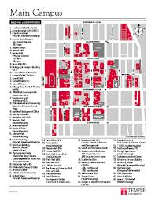
So that this….

Slide 10
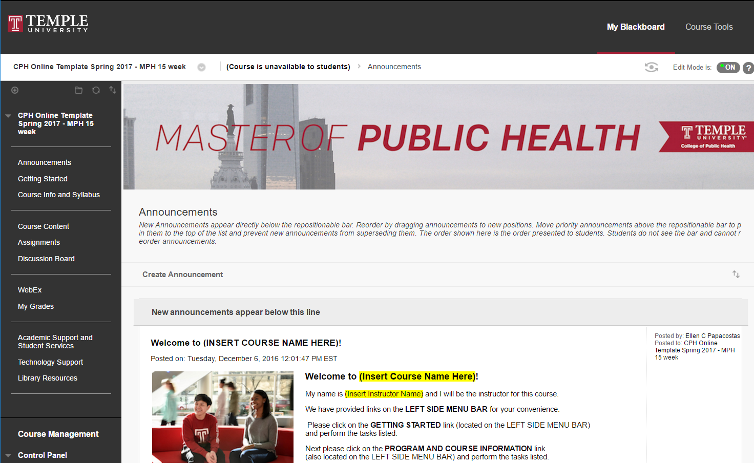
Becomes this…

Slide 11
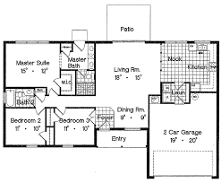


Our Approach

Slide 12
Development Timeline
May 2016: Attended day training with Temple’s General Education by QM: Applying the QM Rubric
June 2016: Ongoing meetings with CPH IT Team to create template
July/August 2016: Template pilot tested within one course
Fall 2016: Piloted with 6 faculty members across CPH departments; two team members participated in QM Peer Reviewer Course
Late Fall 2016: “Peer reviewed” our template and integrated feedback from faculty on final template
Spring 2017: Rolled out template to CPH faculty and revised based on feedback

Slide 13
Questions about the rationale/process for developing a template?

Slide 14
Integrating the Template into Existing Course Structures
Particular attention was paid to creating standardization while allowing for individual instructor autonomy within the online classroom, as well as deliberately including spaces for instructor presence;
Utilized CPH syllabus template with university and college policies;
Leveraged existing University and College resources
  Student services and technology support sections

Slide 15
Peer Review Process
Roll out of monthly discussions centered on pedagogy and technology;
  Introducing the new CPH Template;
  Alignment throughout the course;
  Diverse learning opportunities;
  Student support in the online environment
Buy in from Associate Dean of Academic Affairs
  Online course through Center for Advancement of Teaching
  Use of Template by summer 2017
Creation of teaching resource guides
  Program specific

Slide 17
Engaging Key Stakeholders
Students
  Recruitment
  Orientation
College Administrators
  Reduces need for specific QM training;
  Improves brick and mortar programs
Faculty
  More time spent on course content
Accrediting Bodies
  Ensures quality programs

Slide 18
Questions?
Thank you for sharing your time with us today!

