Slide 1


Pushing Boundaries: Are You Flexible enough to Personalize
Karen Vignare, PhD
September 25, 2017
Notes:
Title Slide

Slide 2

Personalized Learning
Personalized learning seeks to accelerate the student learning process by tailoring the instructional environment to address the needs and skills of individual learners. There are many approaches to the personalization of learning, and information technology is a powerful enabler for postsecondary institutions committed to delivering student-centered instructional models and improving retention and graduation rates…
http://www.aplu.org/projects-and-initiatives/personalized-learning-consortium/about-the-consortium/index.html
Notes:
Content with Caption

Slide 3
Personalized Learning as a Student Success Initiative
Student
Success
Personalized Learning
Financial Aid
Co-Curricular Activities
Degree Planning and Tracking Tools
Academic Advising and Coaching
Learning Analytics
Personalized Learning in postsecondary education is best understood as a set of practices that emphasize effective design, use effective technologies to improve learner engagement and empower academic personnel with the information and tools needed to intervene where needed.
It must be mission driven.
Examples:
  Student-centered advising (IPASS)
  Instructional content delivery through digital and adaptive learning
  Coaching and tutoring assistance powered by student data
  Competency-based education
  Online Learning

Slide 4
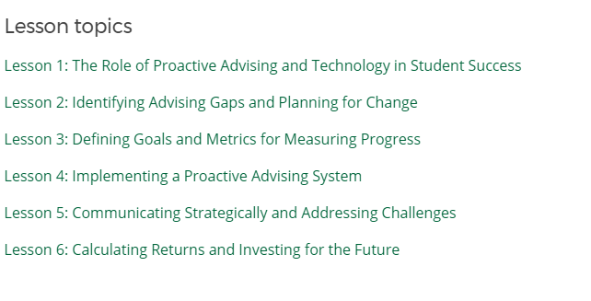
  Strategic Management of Advising Reform & Technology (SMART)
Adaptive Courseware
Project One:
Creation of English Composition Courseware
Project Two:
Eight universities agreeing to scale adaptive courseware to 15% of their total general education credits.

Slide 5
What is Adaptive Learning?
“As an approach to creating a personalized learning experience for students, adaptive learning takes a sophisticated, data-driven, and in some cases, non-linear approach to instruction and remediation, adjusting to a learner’s interactions and demonstrated performance level and subsequently anticipating what types of content and resources learners’ need at a specific point in time to make progress.”
Source: Tyton Partners, "Learning to Adapt: Understanding the Adaptive Learning Supplier Landscape," April 2013.
Notes:
So what is adaptive learning? I very much like this definition from Tyton Partners’ 2013 analysis of the adaptive learning supplier landscape.
“As an approach to creating a personalized learning experience for students, adaptive learning takes a sophisticated, data-driven, and in some cases, non-linear approach to instruction and remediation, adjusting to a learner’s interactions and demonstrated performance level and subsequently anticipating what types of content and resources learners’ need at a specific point in time to make progress.”
Faculty and other institutional stakeholders “generally want to understand ‘how’ solutions work, including a set of descriptive solution attributes that address issues such as openness of the content model, scope of course coverage, interoperability with existing institutional resources, and support services, among others.” Tyton Partners, the Online Learning Consortium and SRI have developed a framework to help administrators, instructional designers, and faculty better understand adaptive and other digital learning solutions. (Mention CWiC Framework.)
In general, postsecondary education institutions with large adult learner populations have implemented adaptive technologies more aggressively and more comprehensively than traditional universities. That said, a growing number of large and highly innovative institutions, mostly public institutions, are making significant progress toward scale, and a number of large adult-serving online education providers.” More on the APLU adaptive courseware grant program in a few minutes.

Slide 6

One Size
Fits All
“Anyone who has ever been in a classroom – where as a student or instructor –
knows that not all students procced at the same pace.” <Tyton Partners>

Slide 7
Well designed adaptive learning experiences (and products) have common attributes and approaches.
Learning Outcomes
Instructional Content
What students should know and be able to do at the end of the learning experience (lesson, unit, course)
Exposition and multimedia activities that foster active student engagement and lay foundations for future study
Activities & Assessments
Scaffolded practice that promotes learning-by-doing and assesses simultaneously (followed by summative assessment)
Notes:
Well designed adaptive learning experiences (and products) have common attributes and approaches:
Learning Outcomes: What students should know and be able to do at the end of the learning experience (lesson, unit, course)
Instructional Content: Exposition and multimedia activities that foster active student engagement and lay foundations for future study
Activities & Assessments: Scaffolded practice that promotes learning-by-doing and assesses simultaneously (followed by summative assessment)
What these experiences look like in a product can vary widely.

Slide 8
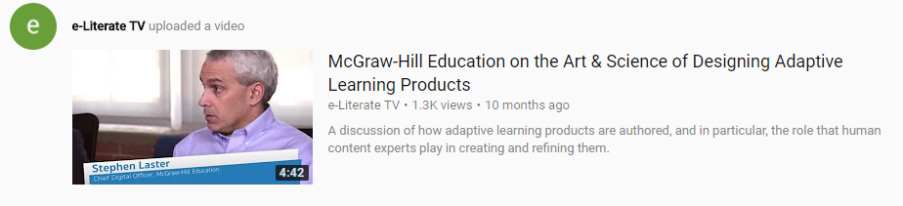
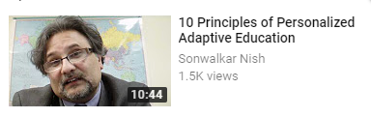
Adaptive Learning
https://www.youtube.com/watch?v=7EBYMqSlyZc
https://www.youtube.com/watch?v=zxUW_z9iA2Q

Slide 9
Adaptive learning technologies typically use one or more learning science methods to inform product design.
Cognitive Scaffolding
Visual Cues
Priming
Zone of Proximal Development
Knowledge Space Theory
Inductive Logic Programming
Active Recall
Spaced Repetition
Spatial-Temporal Reasoning
Notes:
Adaptive learning technologies typically use one or more learning science methods to inform product design. How they leverage these methods depends on may factors including a company’s market orientation and business model.

Slide 10
Subject Matter Expert
Learning Design
Adaptive Technology

Slide 11

Current online learning
Students / Learners
Course Delivery System
One size fits all

Slide 12
Personalized
Students / Learners
Tailored for each learner
Course Delivery System
Individual Recommendations
Cloud-based Adaptive Engine
Data

Slide 13
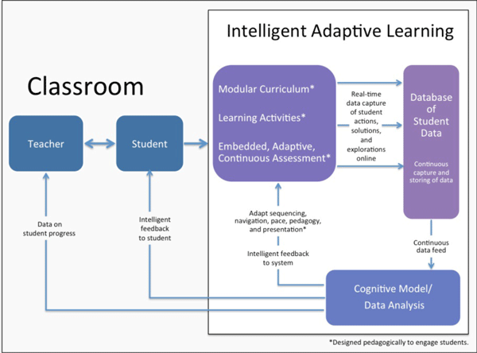
http://www.dreambox.com/white-papers/intelligent-adaptive-learning-an-essential-element-of-21st-century-teaching-and-learning

Slide 14
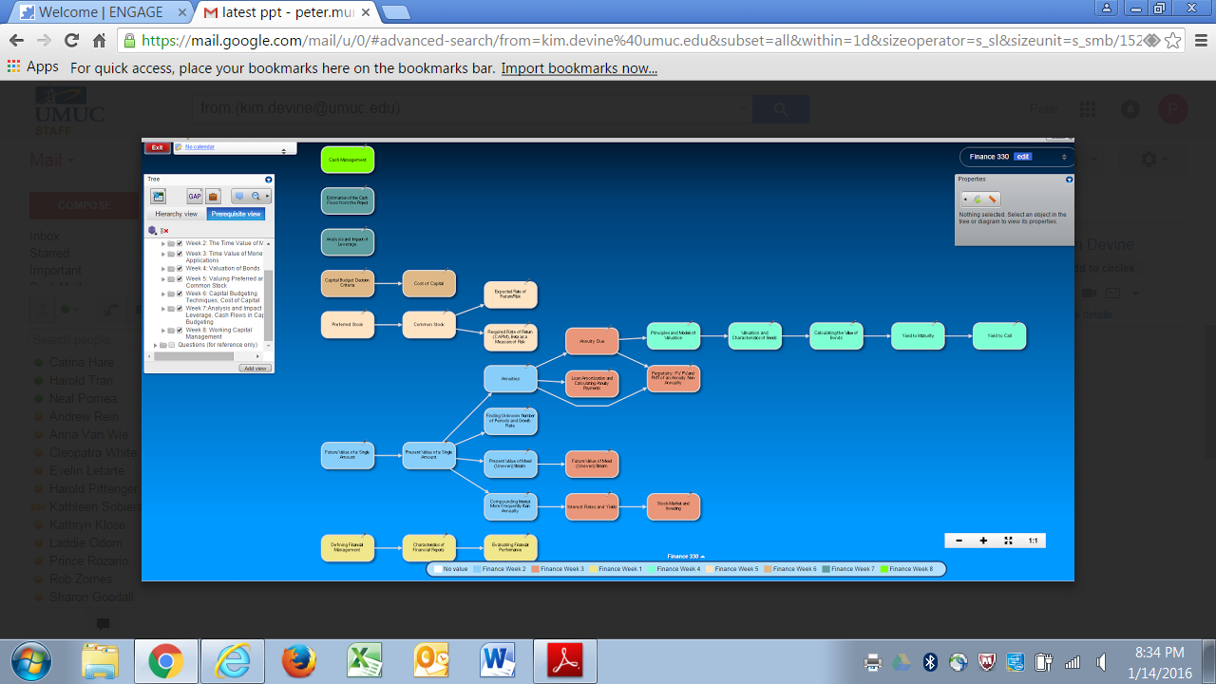

Slide 15
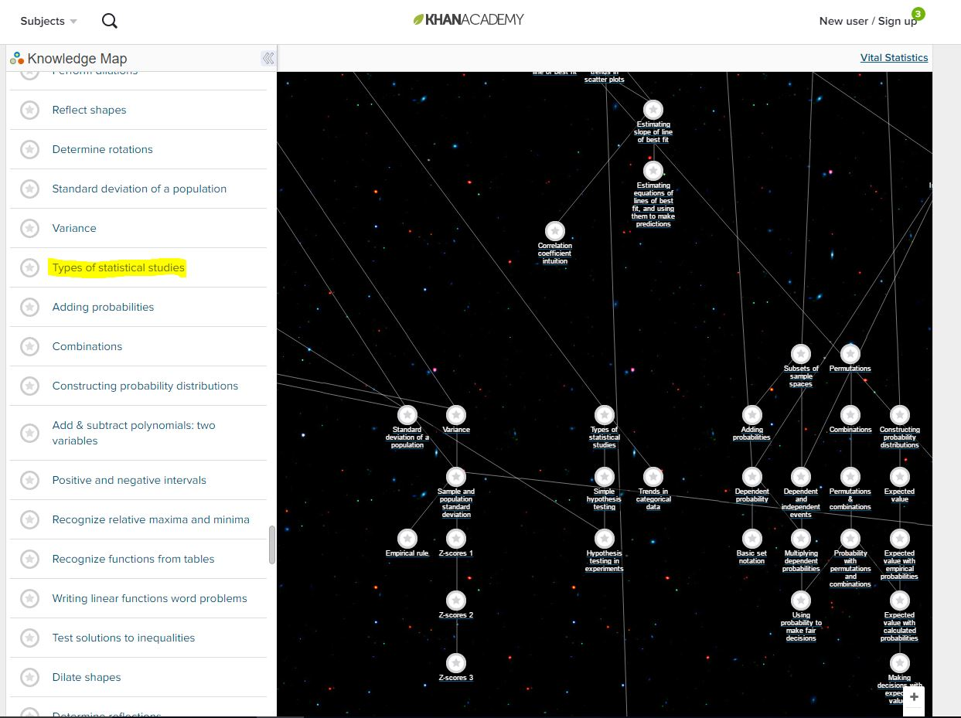
Content Map for Types of statistical studies
Source: https://www.khanacademy.org/exercisedashboard

Slide 16
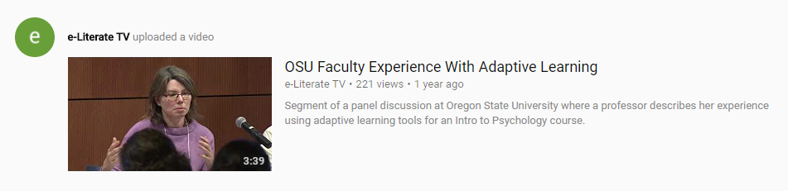
Faculty Reactions to Adaptive
https://www.youtube.com/watch?v=2VstYwLEpT0

Slide 17

APLU Accelerating the Adoption of Adaptive Courseware Grant
Cross-Institution Collaboration
Faculty Engagement Methods
  Targeting similar programs and courses
  Adopting from a list of approved adaptive courseware suppliers and products
  Sharing information within the cohort by campus-based program managers
  Common reporting requirements
Incentives (money, time, teaching support)
Training and instructional design support
Department-level adoption decisions
Peer learning communities
Senior leadership investment and recognition

Slide 18
Adaptive Courseware Suppliers & Products
Acrobatiq
Cerego (Macroeconomics, Introduction to Statistics)
Cengage Learning Mindtap (Cerego)
CogBooks
Fishtree
Fulcrum Labs
Knewton
LeAP by D2L
Learning Objects
LoudCloud
Lumen Waymaker
McGraw-Hill Education ALEKS and Smartbook
Macmillan Learning Curves
Open Learning Initiative at Carnegie Mellon University
Open Learning Initiative at Stanford University
OpenStax Tutor
Pearson MyLab and Mastering with Adaptive Practice
Realizeit
Smart Sparrow
WileyPlus with ORION (Snapwiz)
Notes:
Updated: July 2017

Slide 19
Types of Adaptive Learning
Adaptive Courseware
Adaptive Platforms
Includes most popular courses
Limited flexibility to customize
Not all dashboards are the same
Faculty Roles
Content Customization
Authoring
  Content
  Assessment
Redesign Process
Can Be More Time Intensive

Slide 20
RESULTS: Course Content
After Six Months: 22,000 enrollments

Slide 21
Comparison of Courseware Adoption from Fall 2016 to Spring 2017
  2016: 6
  2017: 12
Notes:
Almost threefold increase

Slide 22

Quality Matters Mission
Promote and improve the quality of online education and student learning nationally and internationally through:
  Development of current, research-supported, and practice-based quality standards and appropriate evaluation tools and procedures.
  Recognition of expertise in online education quality assurance and evaluation.
  Fostering a culture of continuous improvement by integrating QM standards and processes into organizational plans to improve the quality of online education.
  Providing professional development in the use of rubrics, tools and practices to improve the quality of online education.
  Peer review and certification of quality in online education.
Notes:
Content with Caption

Slide 23
Subject Matter Expert
Learning Design
Adaptive Technology

Slide 24
What are the Challenges for QM?
Innovation Pipeline
Technology knowledge
Used across modalities—Online, Blended & Face to Face
Publishing versus Process
  Content increases dramatically
  Assessments increase in variety, customization, complexity
  In-Process Course quality
Course versus Individual

Slide 25
Invention, Innovation and Implementation
Adaptive Learning Example:
Invention: 1970s
Innovation: 2012
Implementation: ? (2025)
Invention
Innovation
Implementation
Notes:
QM’s work by and large is at the implementation stage

Slide 26
Current Tools that Play a Role
Selection Framework: Courseware in Context Framework
EdTech Management & Efficacy

Slide 27
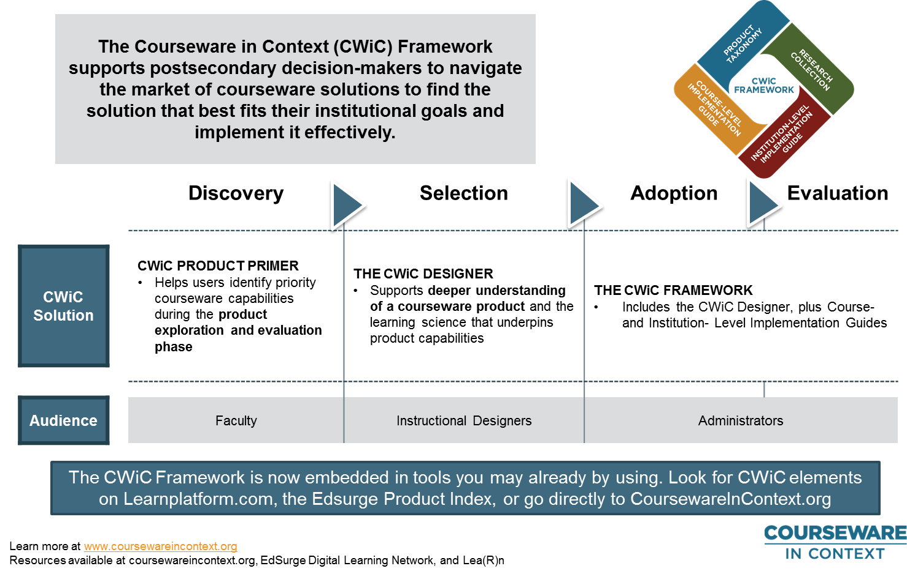
Courseware in Context Framework

Slide 28
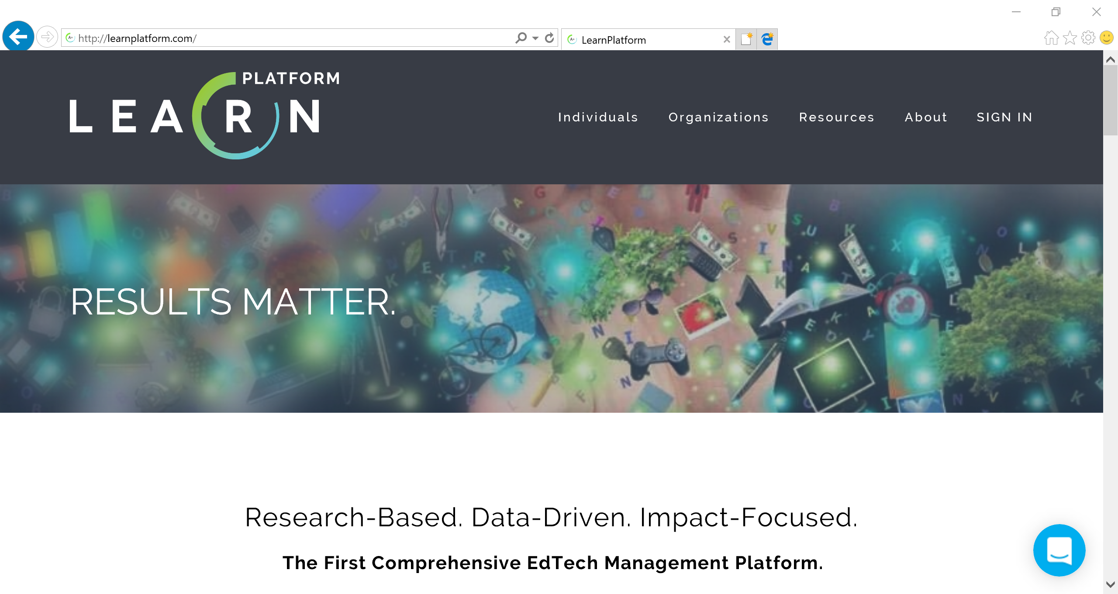
http://cwic.learnplatform.com/

Slide 29
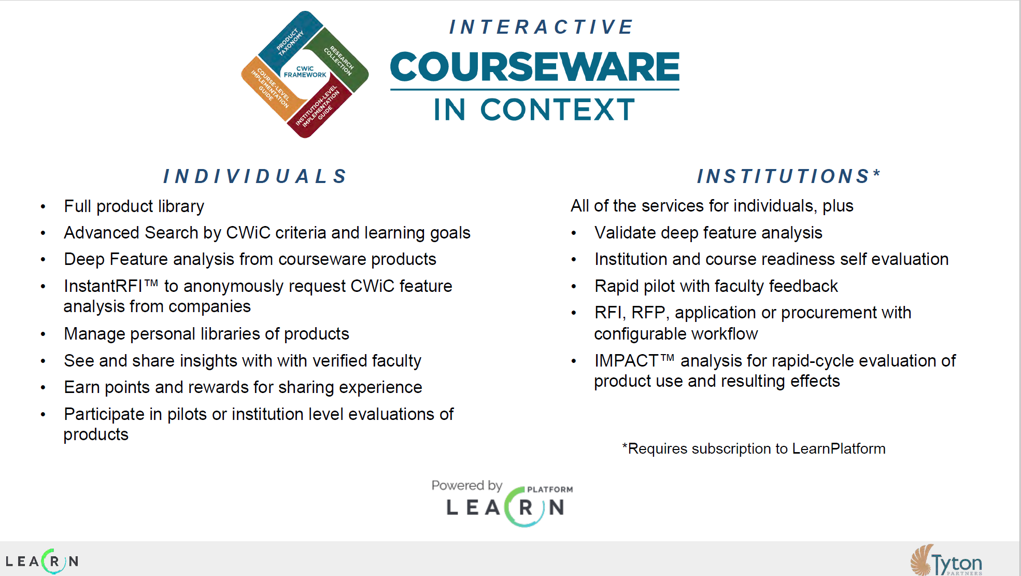

Slide 30
Digital Learning: Blended & F2F
What we know:
From the most recent NCES Distance Education report: Exclusively online, 12.5%; Some online, 13.3%
  Students choose to blend between OL and F2F within their programs—convenience, flexibility, and content
  Reduced Seat time format reports highest student outcomes
  Students taking some courses online did at least as well or better than those taking only face-to-face courses
  Students taking only online courses at community colleges were the only group retained at lower rates, and the effects were weak to moderate
09/25/2017
Notes:
Face to face enrollment is 74.2 % of all enrollment

Slide 31
Digital Learning: Blended & F2F
What we don’t know
  How big is blending or reduced seat time—no agreed upon methods for tracking but assumption that it is growing
  Are students looking for blended pedagogy or convenience in scheduling
  Quality in the Classroom
09/25/2017
Notes:
Undergrad Exclusively online: 6.2%
Undergrad some online: 9.7%

Slide 32
In-course process
Very little guidance on what to do with learning analytics
Faculty analysis and communication
Faculty redesigning in-class time around Active Learning
Notes:
Title and Content

Slide 33
Individualized Course
Tailored instruction
Integrated into advanced technology
Adaptive—content & assessments
Data rich
Human Peer Reviewed
Thorough QA through rubrics
Static certification
Notes:
Two Content

Slide 34
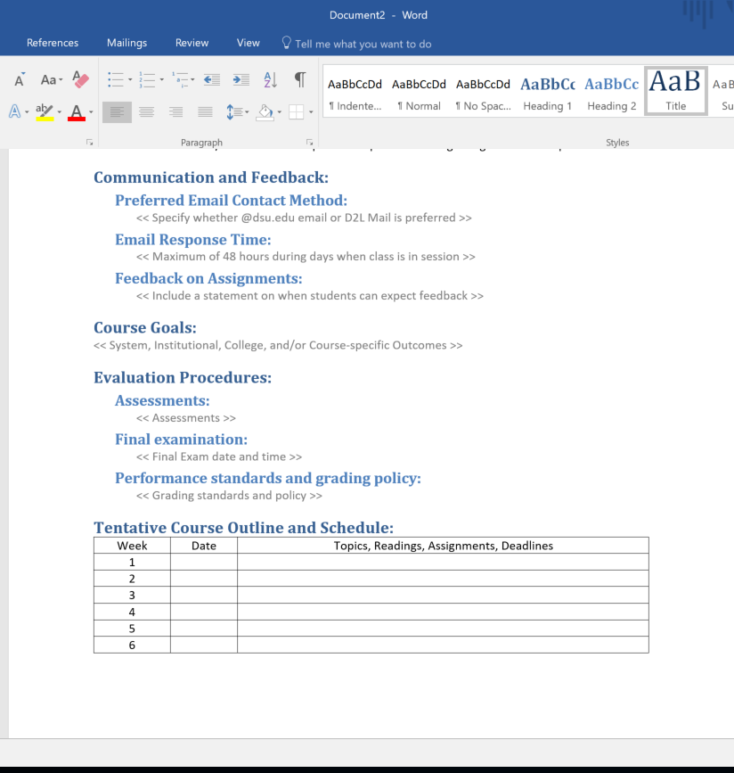
Course Organization
Outcomes, Objectives and Goals
Derived From Content, Assessments and Activities
Organized by Time
Required for ALL
Notes:
Blank

Slide 35
Summary
Quality Standards Are Needed
Changes in Demand from Online to Digital Integration
Adaptive Technologies Make Peer Review more Complex and Time-Consuming
Numerous Technology Choices
Instruction will become more personalized
Notes:
Full Width Head + Copy + Visual

Slide 36
Questions &
Thank you
www.aplu.org/plc
Kvignare@APLU.org
Notes:
Section Header

