Slide 1

“How to Meet Specific Review Standards 5.1, 6.1 and 6.2 When Teaching an Online Foreign Language Course”
International Symposium
QM Regional Conference East
April 25, 2019
Notes:
NOTE:
To change the image on this slide, select the picture and delete it. Then click the Pictures icon in the placeholder to insert your own image.

Slide 2
Soledad Garcia-King Ed.D
Director of Teaching and Learning Center, University of New Mexico Valencia Campus
Online Spanish Instructor
Formal K-12 Bilingual Teacher
Ed.D in Educational Technology
MA in Education and Spanish of the Southwest

Slide 3
Objectives
By the end of this session, attendees will be able to:
  Identify and discuss Specific Review Standards 5.1, 6.1 and 6.2 in terms of foreign language teaching
  Discuss the benefits of using multimedia tools to increase learning interaction and engagement in online foreign language classes
  Create a plan for using multimedia tools to increase communication and practice in their own disciplines

Slide 4

Student engagement in your online courses
What are your current methods?
What has worked well?
What might need improvement?
Please share your discussion with the entire session

Slide 5
QM Standards Relevant To Student Engagement
SRS 5.1
The learning activities promote the achievement of the stated learning objectives or competencies.
SRS 6.1
The tools used in the course support the learning objectives or competencies.
SRS 6.2
Course tools promote learner engagement and active learning.

Slide 6

Specific Review Standard 5.1
Consider the Four Essential Skills for learning a second language
  Listening
  Speaking
  Reading
  Writing
Consider your course learning objectives
Create interactive lessons

Slide 7

Specific Review Standard 6.1
Are the tools you use promoting the practice of the Four Essential Skills?
Are the tools helping the students meet the learning objectives?
Are the tools user friendly?

Slide 8
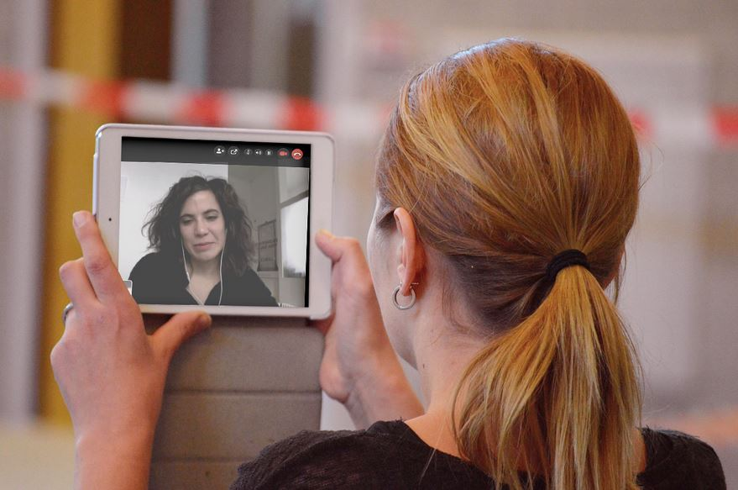
Specific Review Standard 6.2
Are students able to interact with each other to practice the language?
Are students able to interact with the instructor to get feedback?
Are there opportunities to practice the language in the real world?

Slide 9
Discussions – Reading, Writing, Student Engagement
Sample Discussion 1
Sample Discussion 2
Topic: Numbers
Purpose: Practice large number by reading and writing in a discussion forum by means of a dialogue
Topic: Descriptions
Purpose: Practice descriptions, colors and adjectives in a discussion forum by means of a dialogue
Student 1 – I have 350 Facebook friends, 250 emails and more than 1,000 pictures on my phone.
Student 2 – How may books do you have?
Student 1 – I have 98 books.
Student 1 – My name is Sarah. I am 20 years old. I have brown hair and green eyes. I am also tall. Today I am wearing blue jeans and a green shirt.
Student 2 – I am also tall but I am wearing black slacks and a white shirt.

Slide 10
Flipgrid and VoiceThread-Speaking and Listening
Tool – Flipgrid
Topic – Future Tense
Sample – Ir a + Infiitive Flipgrid
You try – Let's Connect
Tool – VoiceThread
Topic – Weather
Sample – El Tiempo VoiceThread
You Try – A Different Perspective VoiceThread

Slide 11

Goose Chase – Reading, Writing, Speaking, Listening, Student Engagement
Tool – Goose Chase Scavenger Hunt App
Topic – Language
Sample – Languages
You Try – Download the Goose Chase app (code N1Z4PQ)

Slide 12

Hello Talk – Reading, Writing, Real World Communication
Tool – Pen Pal App
Topic – Language
Download to phone and choose a pen pal

Slide 13

Discussion and Planning
What type of interaction are you hoping to encourage?
What tools will you use?
How can you overcome the challenges that may arise?

Slide 14
Resources
Duolingo-Language Practice App
Flipgrid-https://flipgrid.com/
Goosechase-https://www.goosechase.com/
Hello Talk-pen pall app, mobile download
Memrise-Language practice app, mobile download
Padlet- https://padlet.com
The English Club-https://www.englishclub.com/learn-english/language-skills.htm
VoiceThread-https://voicethread.com/

Slide 15
References
9 Ways to Increase Online Student Engagement. Retrieved from https://www.wbtsystems.com/learning-hub/blogs/9-ways-to-increase-online-student-engagement
Developing The Four Essential Skills-Listening, Speaking, Reading & Writing. Retrieved from http://www.englishmate.com/blog/developing-four-essential-skills-listening-speaking-reading-writing/
Dixson, M.D. (2010). Creating effective student engagement in online courses: What do students find engaging? Journal of the Scholarship of Teaching and Learning, 10(2),1-13. Retrieved from https://www.iupui.edu/~josotl/archive/vol_10/no_2/v10n2dixson.pdf
Lewis, B. (n.d.). Reading, Writing Speaking and Listening: The 4 basic language skills, and how to practice them.
Martyn, M. (2005). Using Interaction in Online Discussion Boards. Retrieved from https://er.educause.edu/articles/2005/1/using-interaction-in-online-discussion-boards
Milne, M. (2018). 10 Ways to Improve Your English Language Skills. Retrieved from https://www.wallstreetenglish.com/blog/10-ways-improve-english-language-skills/
Sadiku, L.M. (2015). The importance of four language skills reading, writing, listening in a lesson hour. European Journal of Language and Literature Studies, 1(1), 29-31. Retrieved from http://journals.euser.org/files/articles/ejls_jan_apr_15/Lorena_Manaj.pdf

