Slide 1

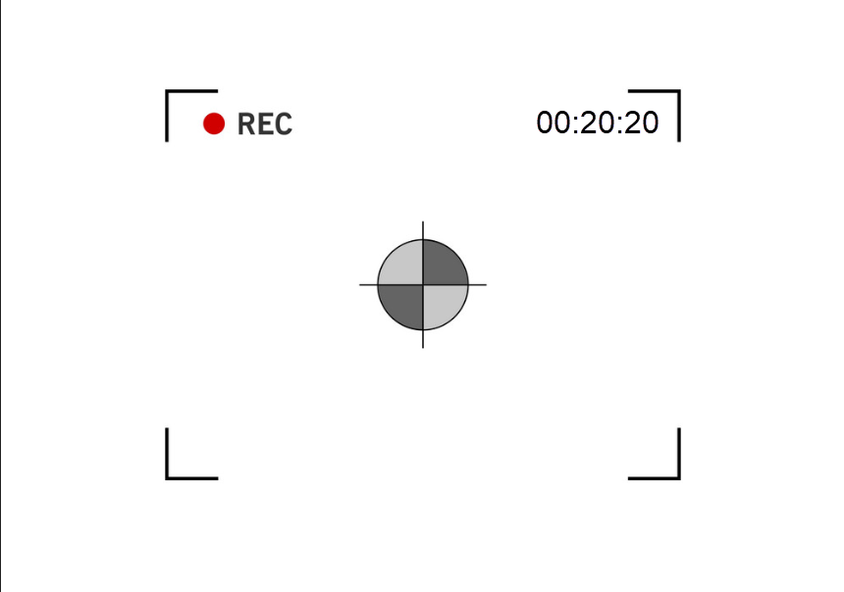
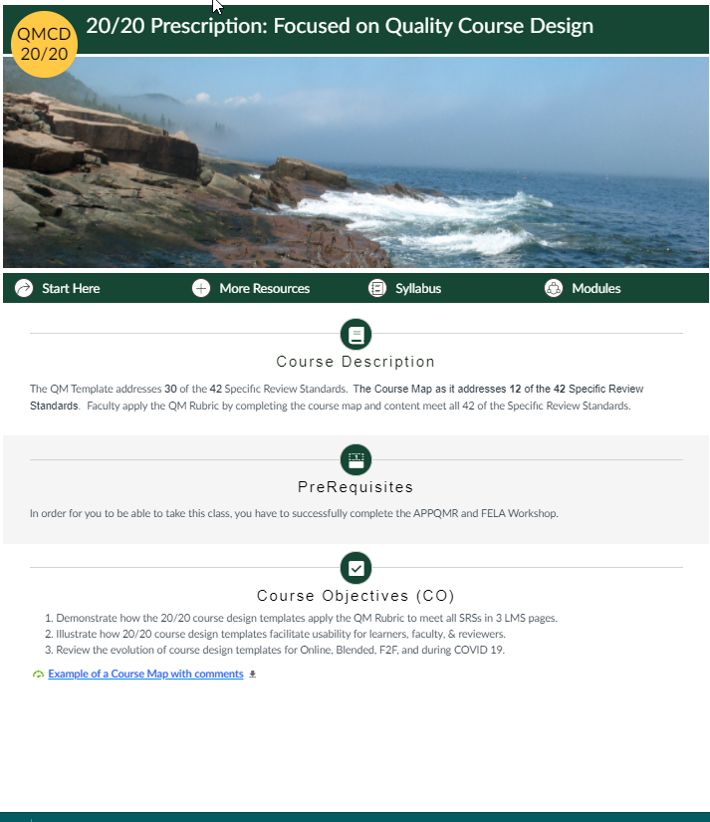
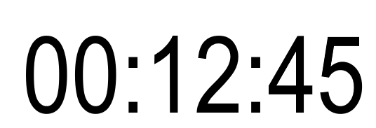

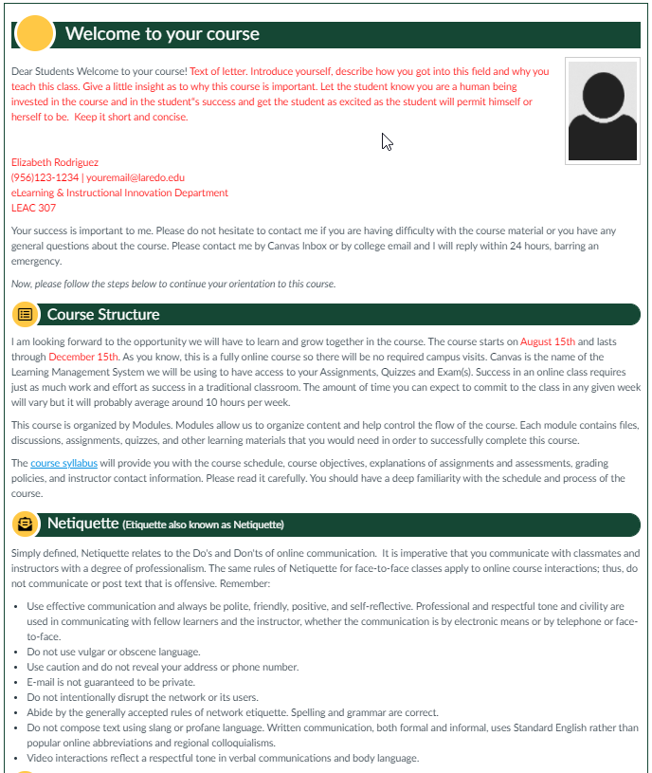
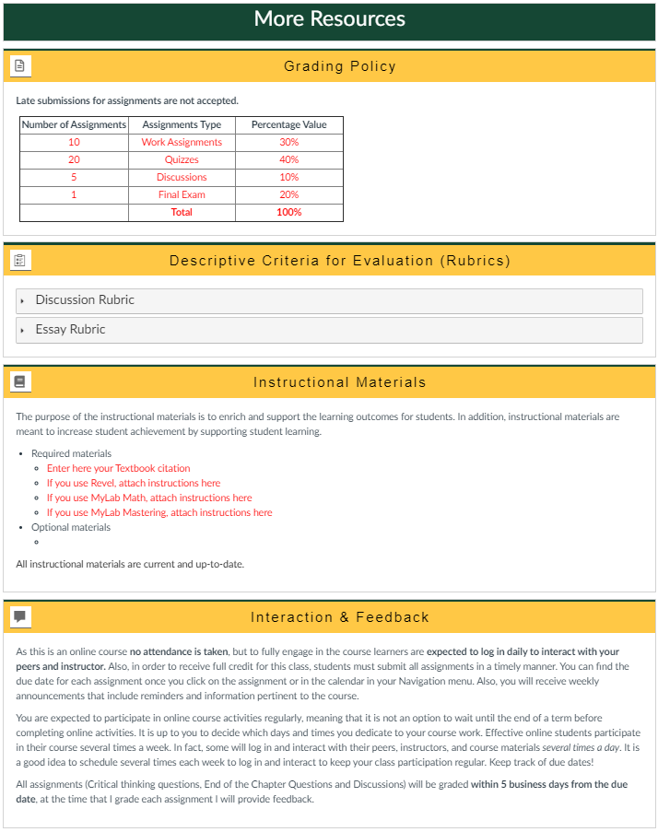
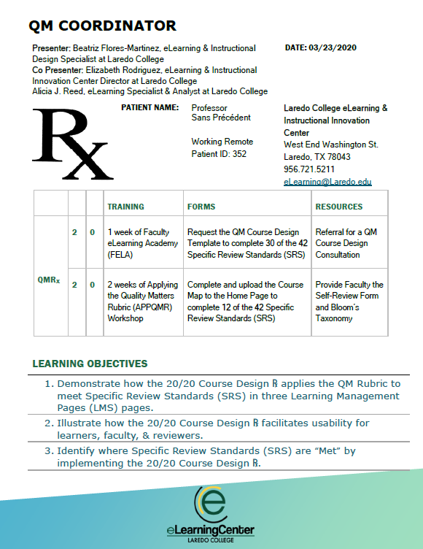

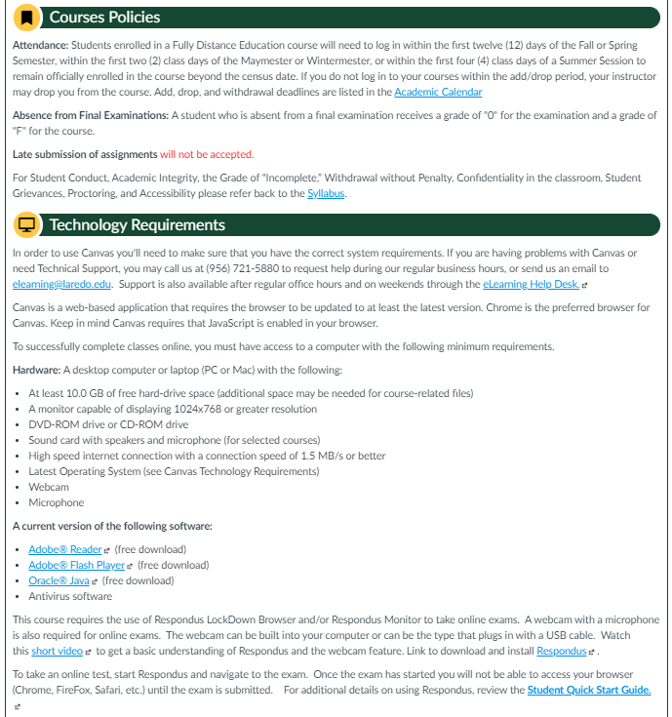
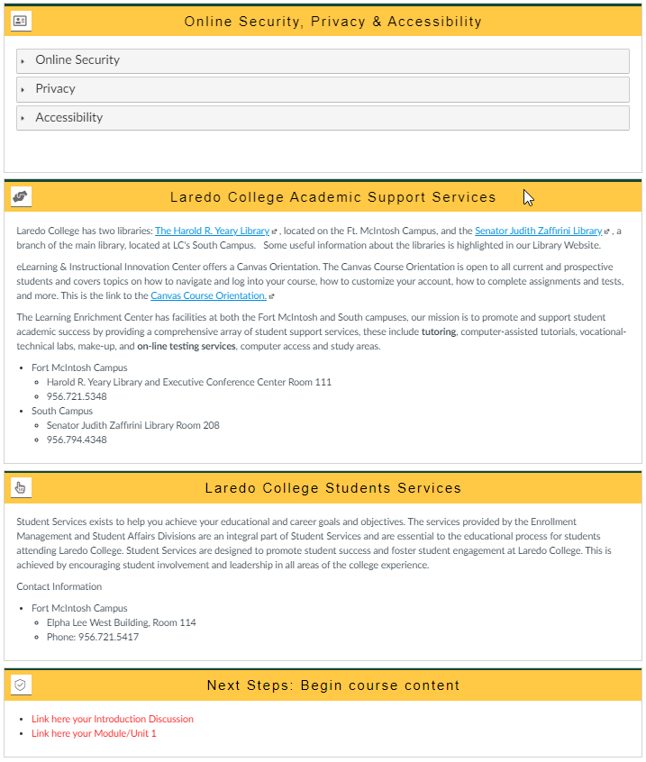
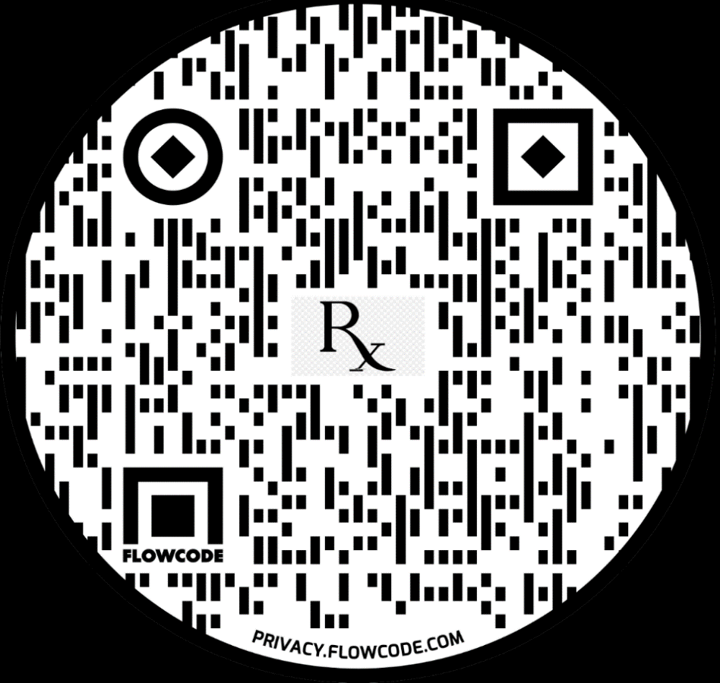
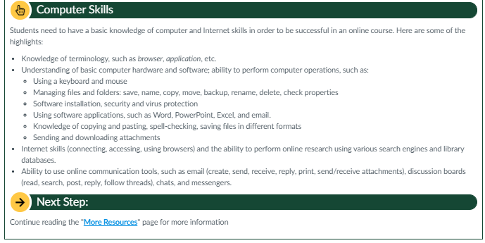
20/20 Prescription:
Focused on Quality Course Design
SRS: 1.8
SRS 3.2
SRS 1.2
SRS 1.1
SRS 3.3
SRS 1.2
SRS 4.1
SRS: 1.3
SRS 4.3
SRS 4.5
SRS 1.7
SRS 4.4
SRS 5.3
SRS 1.4
SRS 2.1
SRS 5.4
SRS 1.3
SRS 2.2
SRS 3.1
SRS 4.2
SRS 5.1
SRS 6.1
SRS 6.4
SRS 7.1
SRS 2.3
SRS 3.4
SRS 5.2
SRS 6.2
SRS 7.2
SRS 1.5
SRS 2.4
SRS 3.5
SRS 6.3
SRS 8.6
SRS 8.4
SRS 2.5
SRS 7.3
SRS 8.2
SRS 1.6
Hover/Roll Mouse over the SRS Lens to identify which SRS is “Met” in the 20/20 ℞ Course Design.
Use a magnifying glass to focus on which SRS is “Met: in the 20/20 ℞ Course Design.
SRS 7.4
Scan/Click on the QR Code to access Laredo College’s 20/20 Prescription: Focused on Quality Course Design.
SRS 8.2
QM Higher Education Rubric, Sixth Edition, 2018 MarylandOnline, Inc. Used under license. All rights reserved. Retrieved from MyQM.
SRS8.1
SRS 8.1
SRS 6.3
SRS 1.9
Notes:
Prepare Faculty to implement ℞ to overcome and adapt to COVID-19 to teach online by Fall 2020.

