Slide 1
Dr. Erick Kong
Assistant Professor
Dept. Hospitality, Recreation
& Tourism
Dr. Roger Wen
Sr. Director of the Online Campus &
MS in eLearning Program Director

Slide 2

Data and Analysis on QM Impact to students' Learning

Slide 3
Setting the Stage: Governing Policy, Support, and Services

Slide 4
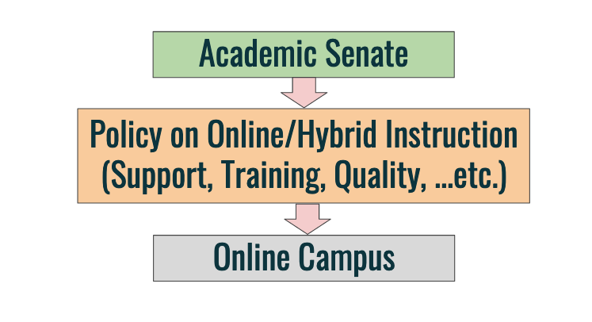
Policy

Slide 5
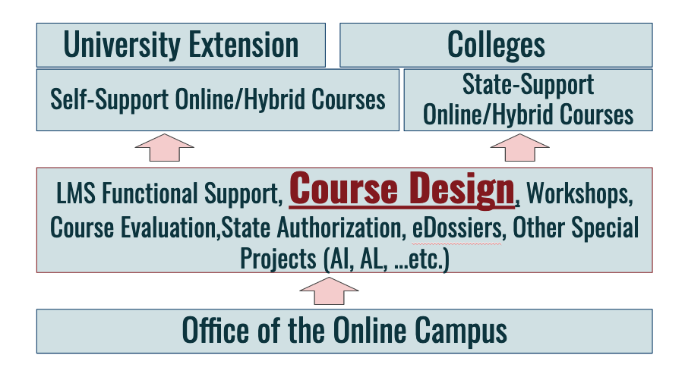
Support and Services

Slide 6
Online/Hybrid Quality Transformation Grants

Slide 7
2014 - Today
Today: 133 certified courses. More than 70% of CSU system (23 Universities) certified courses are produced by CSUEB.
Today: 600+ workshop participants (APPQMR/IYOC/PRC/MRC)

Slide 8
Curriculum Design/Re-design https://www.csueastbay.edu/online/course-design-system.html

Slide 9
Faculty participation in QA activities impacts student learning by reducing the percentage of repeatable grades in courses.

Slide 10
Data

Slide 11
Departmental Analysis
(Office of the Online Campus)

Slide 12
Year 1 Analysis
Between Fall 2014 and Spring 2016, %DWF on courses taught by faculty who participated in QA activities [9.01%] is significantly lower than courses taught by faculty without participation in QA activities [10.77%].
[F(1, 1940)=11.031, p=.001]

Slide 13
Faculty Research Associates Analysis

Slide 14
Dr. Eric Kong (2017)
“Underrepresented Minority students had a significant lower percentage (24%) of D/F/W in QM certified courses versus non-certified courses (34%)”.
“Pell Grant Eligible students have a lower percentage (34%) of D/F/W in QM certified courses versus non-certified courses (42%)”.
“Students needed Remediation have a lower percentage (12%) in QM certified courses versus non-certified courses (20%)”.

Slide 15
Dr. Shirley Yap (2018)
Percentage of grade A received in the courses taught by QM participating faculty is lower than the non QM participating faculty. Dr. Yap also reconfirmed Dr. Kong’s study on URM, Pell, and Remedial students learning as to the courses taught by QM or non-QM participating faculty.

Slide 16
Departmental Analysis
(Office of the Online Campus)

Slide 17
3-Year Analysis
Between Summer 2014 and Summer 2017, %DWF on online courses taught by faculty who participated in QA activities [9.60%] is significantly lower than courses taught by faculty without participation in QA activities [10.47%]. [F(1, 3261)=4.162, p=.041]

Slide 18
Dr. Kevin Kaatz(2019)
How has our quality assurance training (either through QM, QOLT, or OLC) helped with your courses (online, hybrid, and/or in-class) in the following areas (Preparation/Design, Teaching, and Students' Learning)? Please be as specific as possible, provide examples, and/or provide students' feedback.

Slide 19
Dr. Kevin Kaatz(2019)
Course Organization
Alignment
Accessibility
Use of Other Rubrics
Support from eLearning Specialists
Student Benefits
Not Sure
Criticisms – not related to QA
NEXT?

Slide 20
Another View at the Impact to
Students’ Learning

Slide 21
A total of 4,452 online and hybrid sections that have been offered by the CSUEB between over 3 years period. Approximately 18% of those courses with an average course size of 18 students, are taught by faculty who have involved in the Quality Assurance initiative. This affects total 14,400 student counts who are taught by those faculty members and/or Quality Design courses.

Slide 22
Q & A
Dr. Roger Wen roger.wen@csueastbay.edu

