Slide 1

Active/Applied Research on Online Learning and
Quality Assurance
February 9, 2021| Online
1:00 - 4:30 p.m. Eastern
Notes:
Hello, everyone! I'd like to welcome you to our second-ever QM Research Online Conference!
While we offer several hour-long QM Research webinars throughout the year, we are
happy to have put together this event with nine different research-related presentations
so that you can see them live and ask your questions in real time.
We'll have breaks between each time slot with the first slot starting at 1:40 p.m. Eastern,
the second slot starting at 2:40 p.m. Eastern, and the third slot starting at 3:40 p.m. Eastern.
But, before we provide some details about how the conference will work this afternoon, I want to share a bit of information about QM Research and Innovation with you, now.

Slide 2
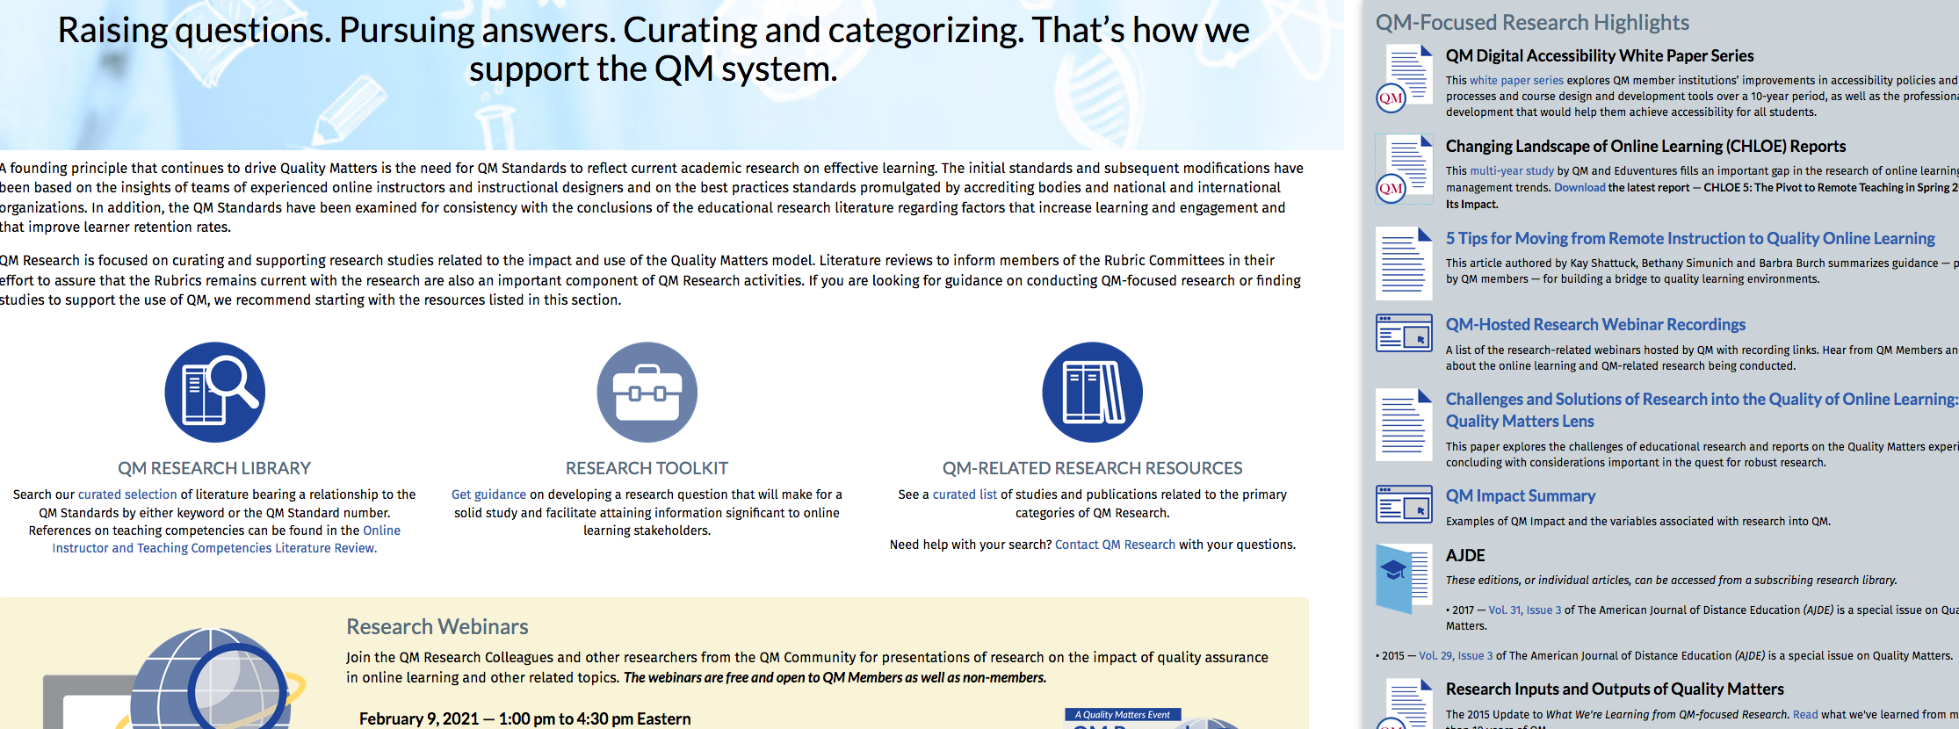
QM Research Landing page

Slide 3
The “Big Three”

Slide 4
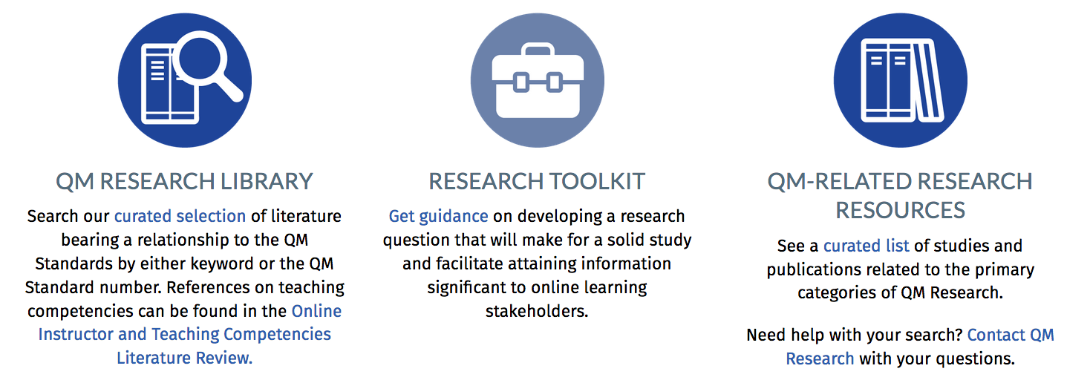
Library, Toolkit, Resources

Slide 5

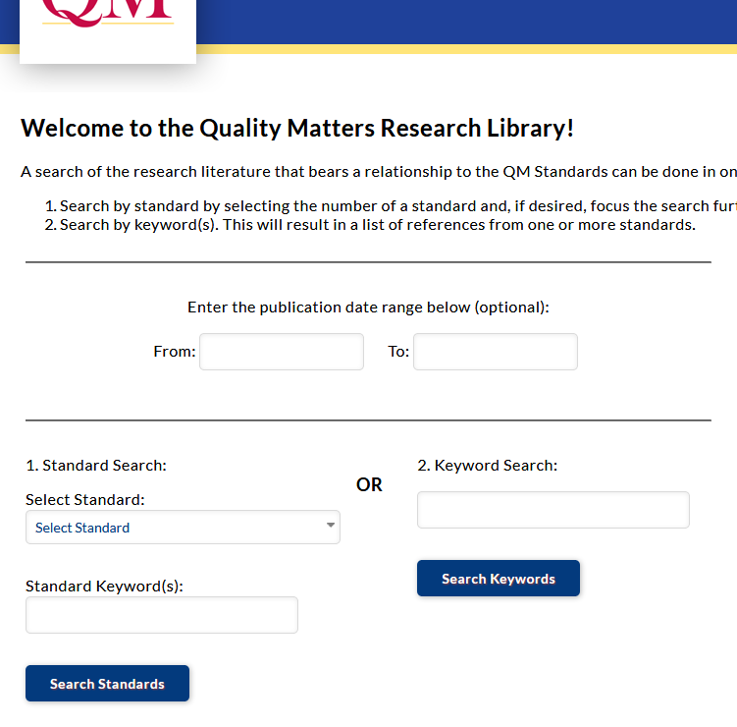
The Research Library
The research that supports the QM Rubric
Add’l related research
Search by Standard
Search by Keyword
Contribute and help it grow!

Slide 6
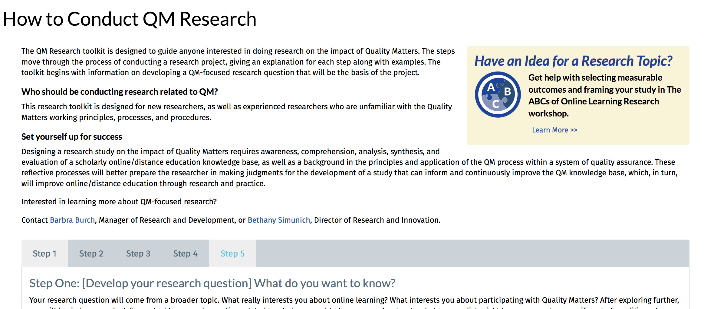
The Research Toolkit

Slide 7
The Research Toolkit

Slide 8
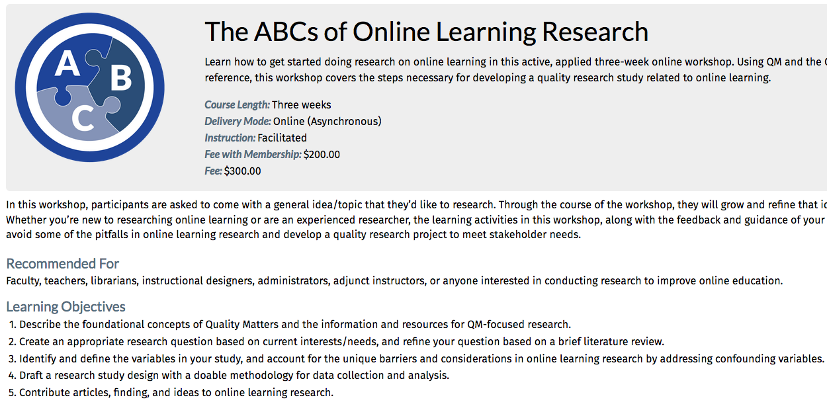
Online Research Workshop

Slide 9
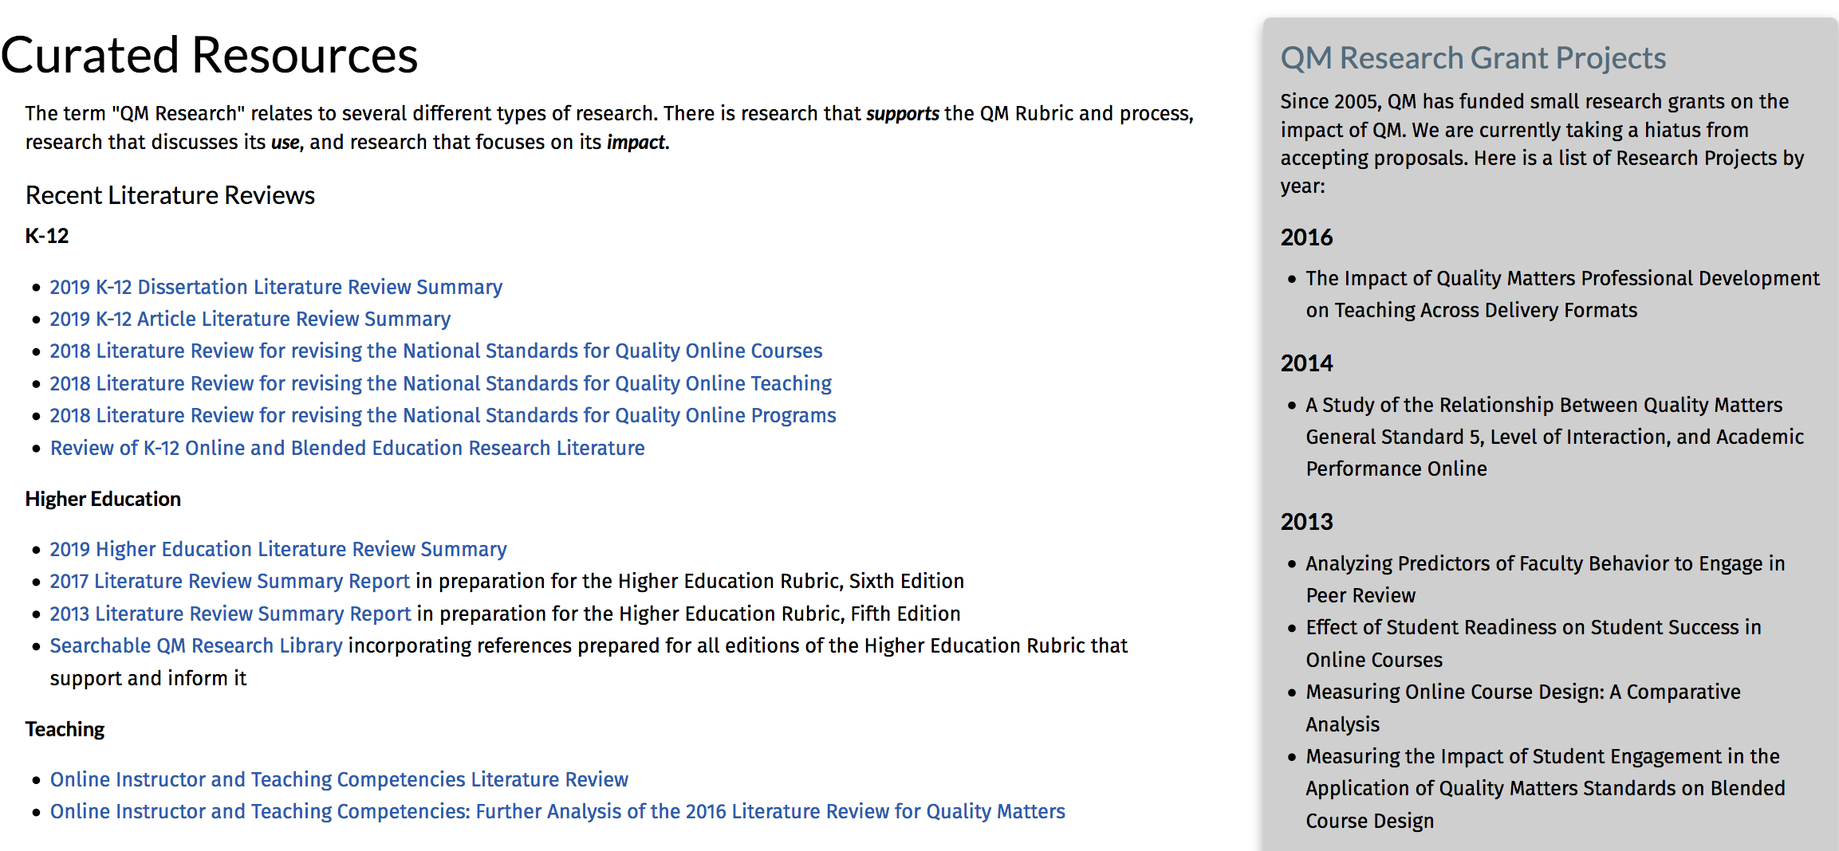
Curated QM-focused Resources

Slide 10
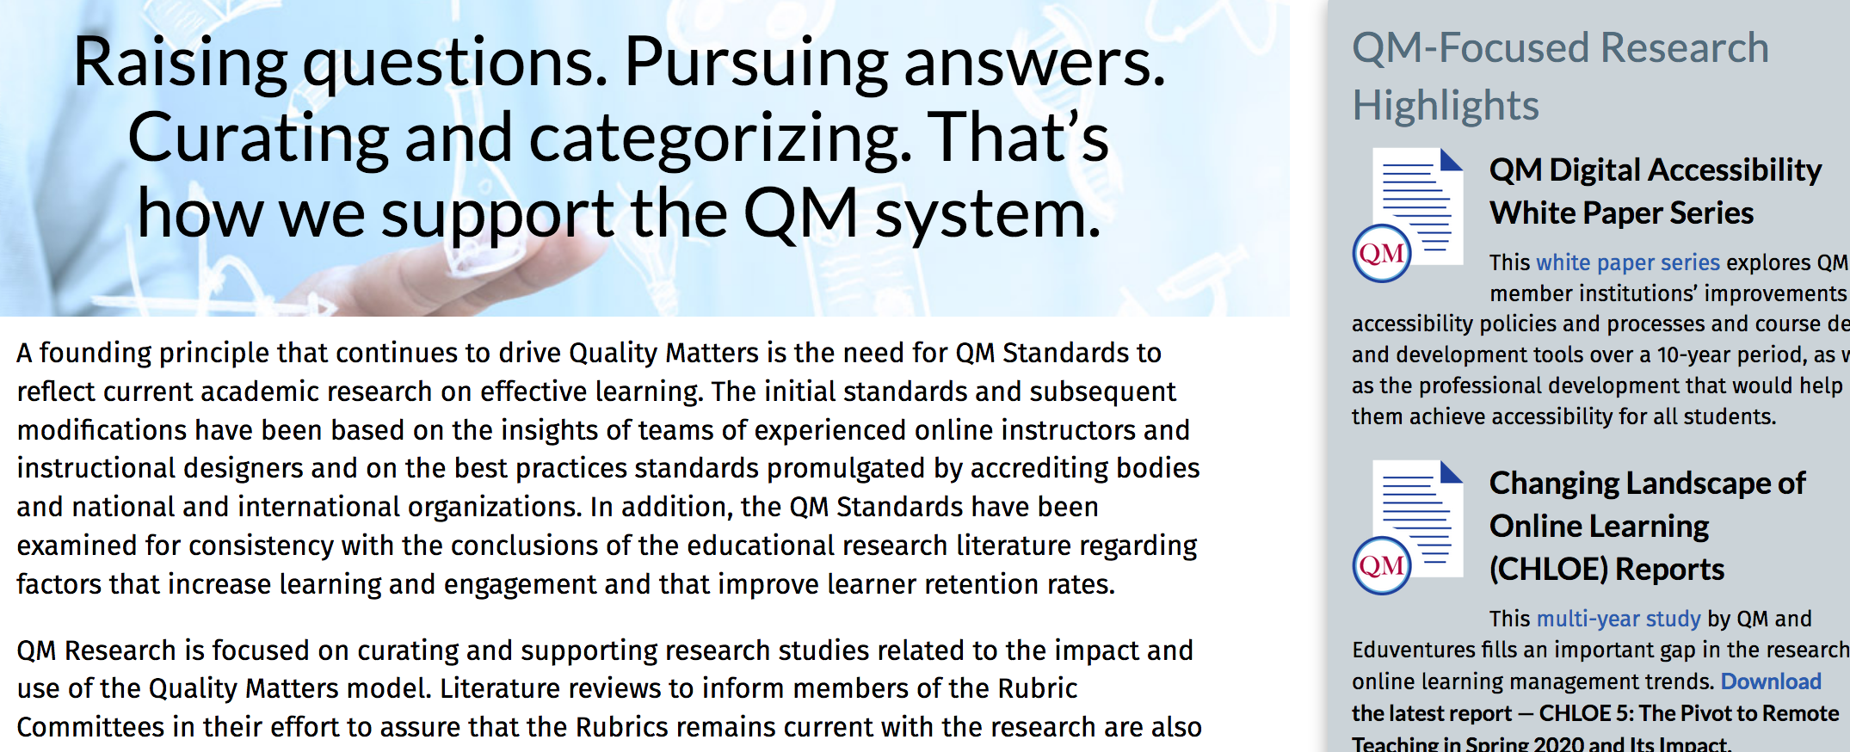
QM Research Landing page

Slide 11
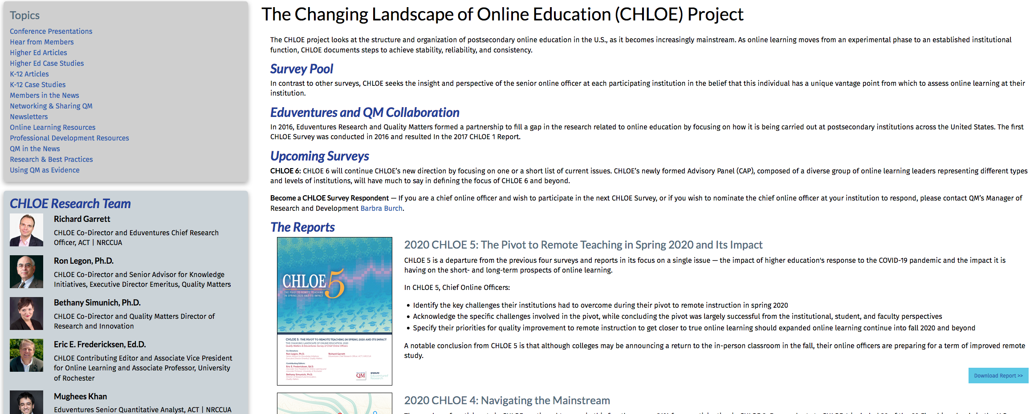
CHLOE Report

Slide 12
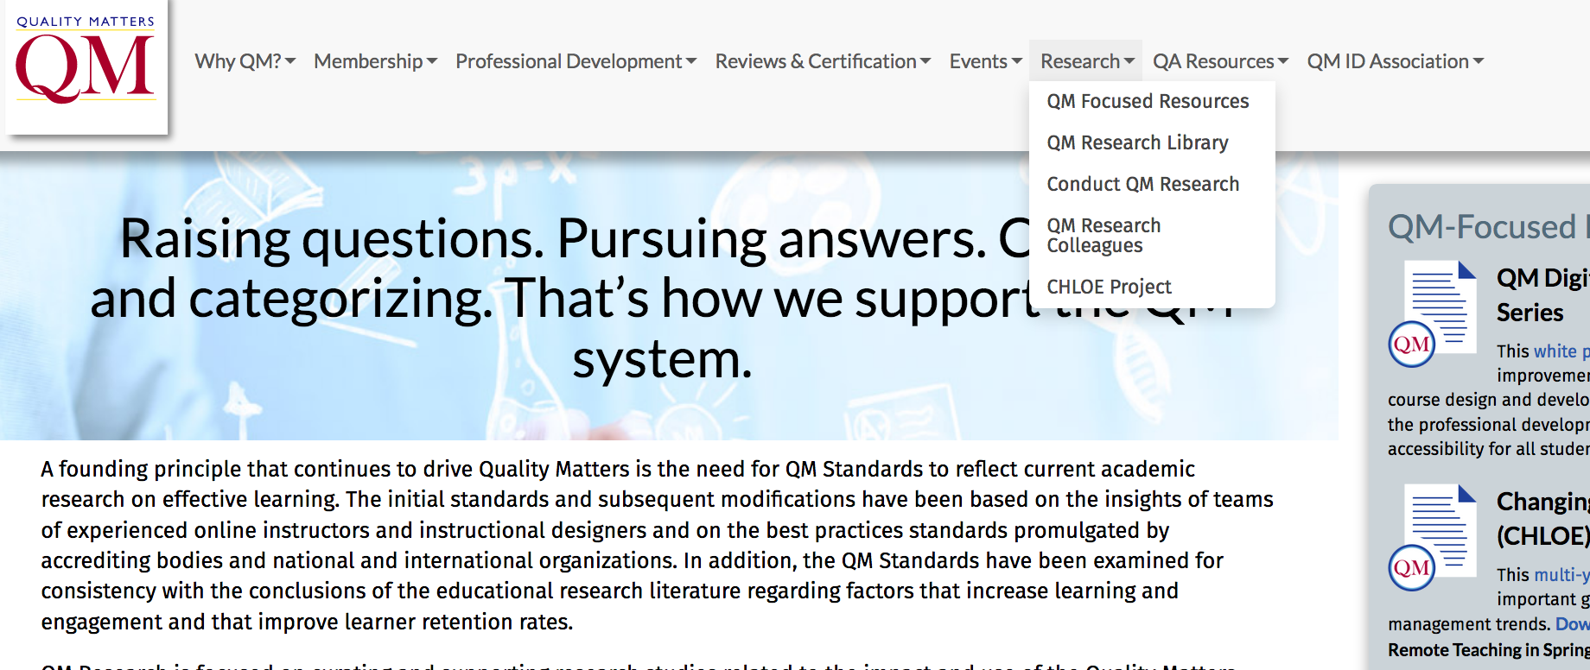
QM Research Landing page

Slide 13
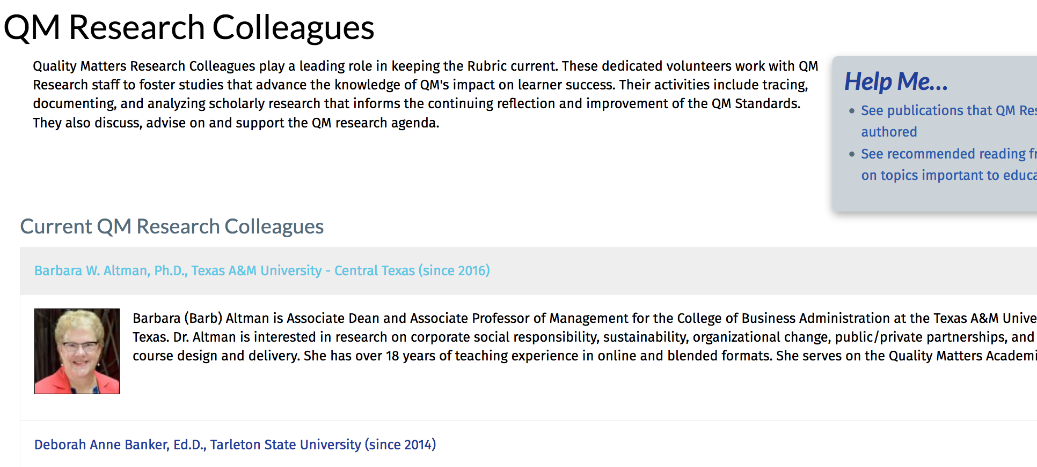
Research Colleagues

Slide 14
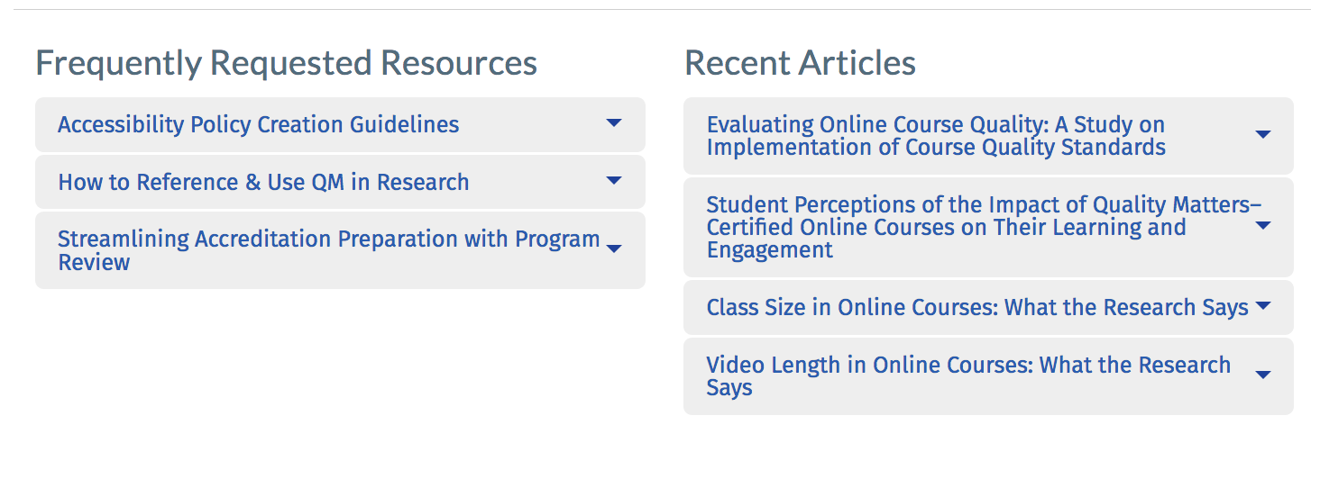
Rounding out the Research pg.

Slide 15
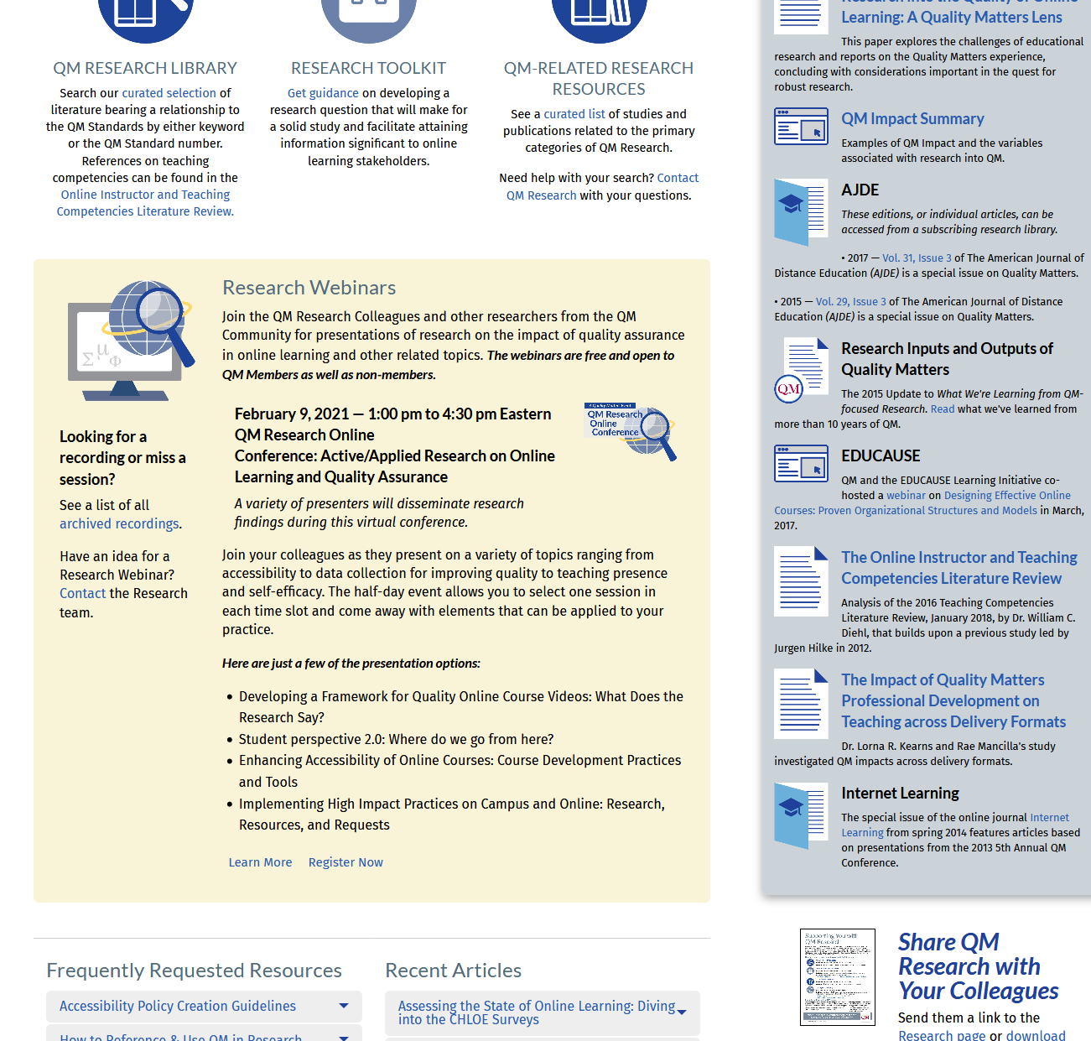
Share QM Research
Printable PDF
Notes:
Back to the Landing Page; Many of the other resources in the sidebar are articles that discuss QM's effects.
At the very bottom of the sidebar is a one-page PDF that may be helpful to you and for you to share QM Research resources with others.

Slide 16
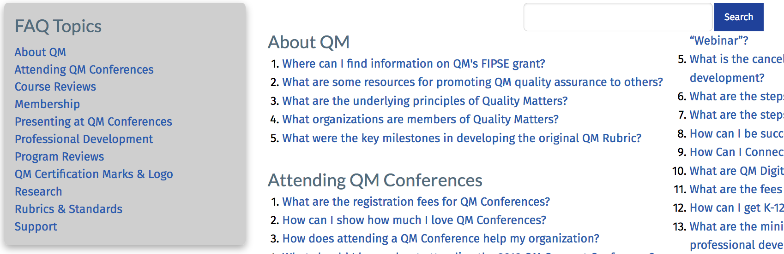
FAQs for All Your Questions

Slide 17
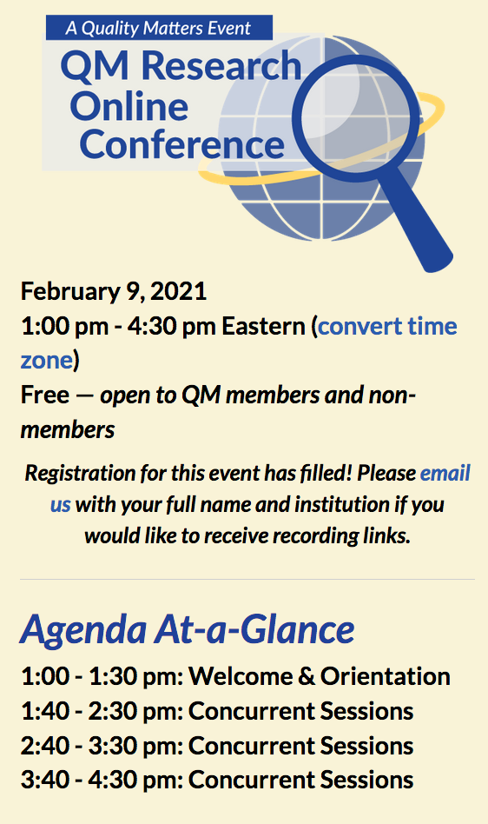
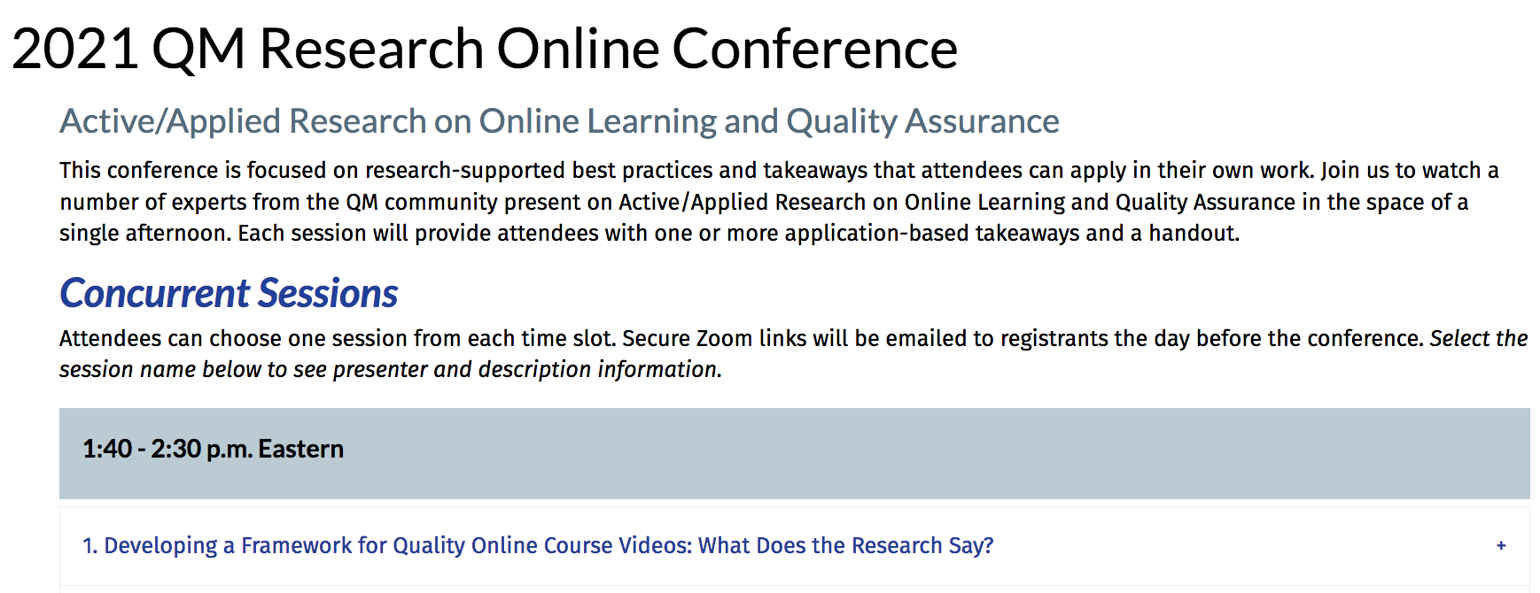
ROC Landing Page

Slide 18

Thank you for joining us today!
research@qualitymatters.org

