Slide 1
Beyond Assumptions:
Putting Research into Practice to Document Quality Learning Experiences

Slide 2
Active/Applied Research on Online Learning and
Quality Assurance
February 17, 2022| Online

Slide 3


Presenter
Dr. Andria Schwegler
Associate Professor of Psychology
Program Coordinator, MS Educational Psychology

Slide 4
Session Outcomes
1. Define quality learning experiences and situate them in the broader educational context.
2. Distinguish academic rigor from confounded variables including mode of delivery, course grades, student characteristics, and idiosyncratic experiences.
3. Apply session content to analyze learning experiences at your own institution.

Slide 5
Quality Learning
Assumptions and Confounds

Slide 6
Audience Poll
Please respond in the chat:
  What are some concerning or questionable assumptions you’ve heard regarding what makes for quality learning?

Slide 7
Mode of Delivery
Assumption: “In person learning is the gold standard.”
Research:
National Council for Online Education (2022)
Emergency Remote Instruction Is Not Quality Online Learning
US Dept of Education (2010)
Meta-Analysis and Review of Online Learning Studies
National Research Center for Distance Education and Technological Advancement (DETA)
No Significant Difference Database

Slide 8
Student Characteristics
Assumption: “Our programs are rigorous because we admit only the most qualified applicants.”
Research:
Sternberg (2014)
Intelligence includes a general factor (g)
Intelligence is heritable, which increases with age
Schnee (2008)
“Implementing rigor is complicated by the range of students’ abilities and backgrounds” (p. 72).

Slide 9
Student Characteristics
Assumption: “We optimize learning by matching instruction to each student’s learning style.”
Research:
Pashler, McDaniel, Rohrer, & Bjork (2009)
Individuals can report preferences when studying (e.g., VARK).
But, no clear evidence that preference is related to learning.
Its popularity given lack of credible evidence is “striking and disturbing.”
Mayer (2019)
Instructional methods are related to learning.

Slide 10
Idiosyncratic Experiences
Assumption: “My courses are rigorous because they are comparable to those I took.”
Research:
Schwegler (2013)
  We may believe that how we were taught is how we should teach.
Schnee (2008)
Discrepancy between faculty and student perceptions of rigor.
Judgments are based on one’s own educational experiences which are highly variable.

Slide 11
Students’ Grades
Assumption: “Students’ grades are evidence our courses are rigorous.”
Research:
Schnee (2008)
  “feel entitled to good grades in exchange for tuition” (p. 68)
Schutz, Drake, & Lessner (2013)
45.69% of faculty in their sample (N = 1556) reported assigning higher final grades than students actually earned.

Slide 12
Audience Poll
Please respond in the chat:
  After reviewing this list of assumption, did you think of other questionable or concerning assumptions about which you’d like to learn more?

Slide 13
Quality Learning Experiences
Characteristics and Context of Academic Rigor

Slide 14
Research Review
Research areas describing quality learning experiences
Teaching and Learning
High-Impact Practices
Cognitive Psychology

Slide 15
Teaching and Learning
Draeger, Hill, Hunter, & Mahler (2013)
  Higher-order thinking
  Active learning
  Appropriate expectations
  Meaningful content
Schnee (2008)
  Deep, critical, inquiry-based learning
  Sufficient scaffolding for all students
  High standards
  Integration of lived experiences with knowledge from research

Slide 16
High-Impact Practices
AAC&U
High-Impact Practices
Kuh, O’Donnell, & Reed (2013)
High expectations
Ongoing, substantive interactions with faculty and peers (time, feedback)
Structured reflection on and synthesis of learning
Real-world application

Slide 17
Cognitive Psychology
Kornell & Bjork (2008)
Perceptions of learning efficacy are not accurate.
Kornell & Bjork (2009)
Stability bias in human memory:
underestimate what we can learn from studying,
overestimate what we will remember.
Bjork & Bjork (2011)
“We can be misled by our subjective impressions” (p. 57).

Slide 18
Cognitive Psychology
Smith & Vela (2001) meta-analysis
Context affects memory of information, but the effects can be suppressed.
Donovan & Radosevich (1999) meta-analysis
Performance is better after spaced practice of information than massed practice.

Slide 19
Cognitive Psychology
Roediger & Karpicke (2006)
Testing improves memory of information.
“Testing not only measures knowledge, but also changes it…”
Bjork & Bjork (2011)
“Desirable difficulties” can improve long-term retention though they reduce perceived ease of learning and short-term recall.

Slide 20
Research Integration
Schwegler (2019a)
Teachers
Identify and create research evidence as basis for instruction
Intentionally craft and sequence learning activities and interactions
Students
Create own interpretation
Demonstrate own interpretation
Provide evidential support for their interpretation

Slide 21
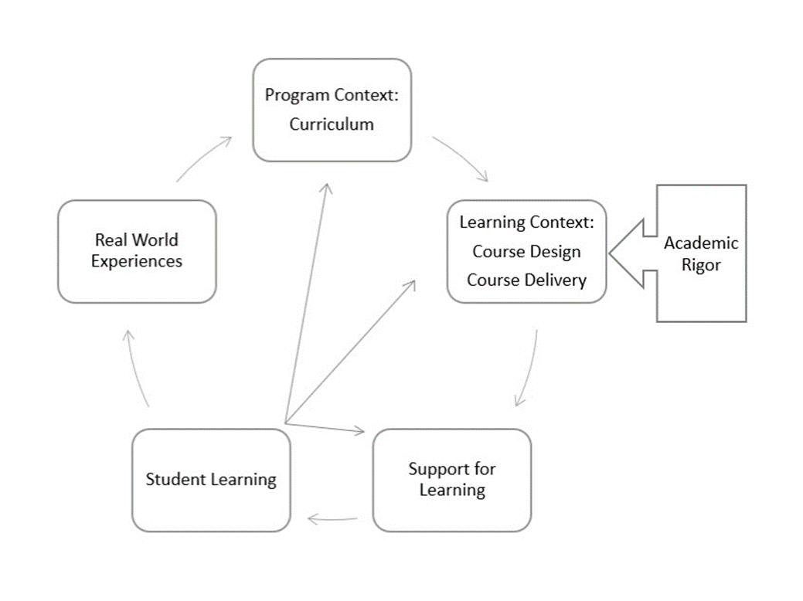
Context
Schwegler (2019b)
https://www.qualitymatters.org/qa-resources/resource-center/articles-resources/academic-rigor-white-paper-part-two

Slide 22
Applications to Your Institution

Slide 23
Teaching Evaluations
What qualities are measured on the teaching evaluations used at your institution?
Mannerisms (e.g., inflection, saying “um” - assumes lecture)?
Personality characteristics (e.g., caring, approachable)?
  Schnee (2008) care was expressed as lowering academic expectations
  Arum & Roksa (2011) approachable did not predict student learning
Characteristic of the learning context (i.e., research support)?
Are revisions needed?

Slide 24
Student Ratings of Instruction
What qualities are measured on the end-of-semester student evaluation forms used at your institution?
Idiosyncratic experiences (e.g., more rigorous than other courses)?
Teacher popularity or positive relations with students
  Rugutt, Ellet & Culross (1998) relationship quality was negatively correlated with higher-order thinking
Characteristics of the learning context (i.e., supporting interpretations with evidence)?
Are revisions needed?

Slide 25
Assessment of Student Learning
What evidence is used for assessment at your institution?
Perceived learning?
  Sitzmann, Ely, Brown, & Bauer (2010) higher correlations with affect than learning
Students’ grades or pass/fail rates?
Actual learning on contrived or genuine tasks?
  Pan & Rickard (2018) similarity of responses across contexts associated with transfer of learning
Are revisions needed?

Slide 26
Professional Development
What support is provided to help faculty improve memory for information in their courses at your institution?
Research-based teaching tips?
Presentations from learning researchers?
Instruction on implementing high-impact practices?
Are revisions needed?

Slide 27
Audience Poll
Please respond in the chat:
  Which concepts reviewed here will you apply to analyze the quality of the learning environments at your institution?

Slide 28
References
American Association of Colleges & Universities. (2022). High-impact practices. https://www.aacu.org/trending-topics/high-impact
Arum, R., & Roksa, J. (2011). Academically adrift: Limited learning on college campuses. Chicago, IL: University of Chicago Press.
Bjork, E. L., & Bjork, R. A. (2011). Making things hard on yourself, but in a good way: Creating desirable difficulties to enhance learning. In M. A. Gernsbacher, R. W. Pew, L. M. Hough, & J. R. Pomerantz (Eds.) Psychology and the real world: Essays illustrating fundamental contributions to society (pp. 56-64). New York, NY: Worth.
Donovan, J. J., & Radosevich, D. J. (1999). A meta-analytic review of the distribution of practice effect: Now you see it, now you don’t. Journal of Applied Psychology, 84(5), 795-805.
Draeger, J., del Prado Hill P., Hunter, L. R., & Mahler, R. (2013). The anatomy of academic rigor: The story of one institutional journey. Innovative Higher Education, 38, 267-279.
Kornell, N., & Bjork, R. A. (2008). Learning concepts and categories: Is spacing the “enemy of induction”? Psychological Science, 19(6), 585-592.
Kornell, N., & Bjork, R. A. (2009). A stability bias in human memory: Overestimating remembering and underestimating learning. Journal of Experimental Psychology: General, 138(4), 449-468.

Slide 29
References
Kuh, G. D., O’Donnell, K., & Reed, S. (2013). Ensuring quality and taking high-impact practices to scale. American Association of Colleges & Universities. https://secure.aacu.org/imis/ItemDetail?iProductCode=E-HIPQUAL&Category=
Mayer, R. E. (2019). Thirty years of research on online learning. Applied Cognitive Psychology, 33, 152-159. doi: 10.1002/acp.3482
Means, B., Toyama, Y., Murphy, R., Bakia, M., & Jones, K. (2010). Evaluation of evidence-based practices in online learning: A meta-analysis and review of online learning studies. U.S. Department of Education Office of Planning, Evaluation, and Policy Development. https://www2.ed.gov/rschstat/eval/tech/evidence-based-practices/finalreport.pdf
National Council for Online Education (2022, February 3). Emergency remote instruction is not quality online learning (Op-Ed in Inside Higher Ed). https://www.nationalcouncil.online/news/emergency-remote-instruction-is-not-quality-online-learning-op-ed-in-inside-higher-ed
National Research Center for Distance Education and Technology Advancement. (2019). No significant difference. https://detaresearch.org/research-support/no-significant-difference/
Pan, S. C., & Rickard, T. C. (2018). Transfer of test-enhanced learning: Meta-analytic review and synthesis. Psychological Bulletin, 144(7), 710-756. doi: 10.1037/bul0000151
Pashler, H., McDaniel, M., Rohrer, D., & Bjork, R. (2009) Learning styles: Concepts and evidence. Psychological Science in the Public Interest, 9(3), 105-119.

Slide 30
References
Roediger, H. L., & Karpicke, J. D. (2006). The power of testing memory: Basic research and implications for educational practice. Perspectives on Psychological Science, 1, 181-210. doi: 10.1111/j.1745-6916.2006.00012.x
Rugutt, J. K., Ellett, C. D., & Culross, R. R (1998, January). Discriminating student learning and efficacy levels in higher education: Contributions of classroom environment and teaching and learning effectiveness. Paper presented at the Annual Meeting of the Southwest Educational Research Association, Houston, TX.
Schnee, E. (2008). “In the real world no one drops their standards for you”: Academic rigor in a college worker education program. Equity & Excellence in Education, 41(1), 62-80. doi: 10.1080/10665680701764502
Schutz, K. R., Drake, B. M., & Lessner, J. (2013). Do community college full-time and adjunct faculties differ in their perceptions of rigor in assigning grades? American Journal of Educational Studies, 6(2), 59-77.
Schwegler, A. F. (2013). From lessons learned the hard way to lessons learned the harder way. Insight: A Journal of Scholarly Teaching, 8, 26-31.
Schwegler, A. F. (2019a). Academic rigor white paper 1: A comprehensive definition. Quality Matters. https://www.qualitymatters.org/qa-resources/resource-center/articles-resources/academic-rigor-white-paper-part-one
Schwegler, A. F. (2019b). Academic rigor white paper 2: Contextualizing academic rigor. Quality Matters. https://www.qualitymatters.org/qa-resources/resource-center/articles-resources/academic-rigor-white-paper-part-two

Slide 31
References
Sitzmann, T., Ely, K., Brown, K. G., & Bauer, K. N. (2010). Self-assessment of knowledge: A cognitive learning or affective measure? Academy of Management Learning & Education, 9(2), 169-191.
Smith, S. M., & Vela, E. (2001). Environmental context-dependent memory: A review and meta-analysis. Psychonomic Bulleting & Review, 8(2), 203-220.
Sternberg, R. J. (2014). Teaching about the nature of intelligence, 42, 176-179. http://dx.doi.org/10.1016/j.intel.2013.08.010

Slide 32
Thank you for attending!
Beyond Assumptions:
Putting Research into Practice to Document Quality Learning Experiences
schwegler@tamuct.edu

