Slide 1
NSQ x UDL:
Promoting Equity & Inclusion through Three Lenses
2023 Q-Up for K-12 Digital Quality Conference
Dr. Rebecca C. Itow
Principal, IU High School Online

Slide 2
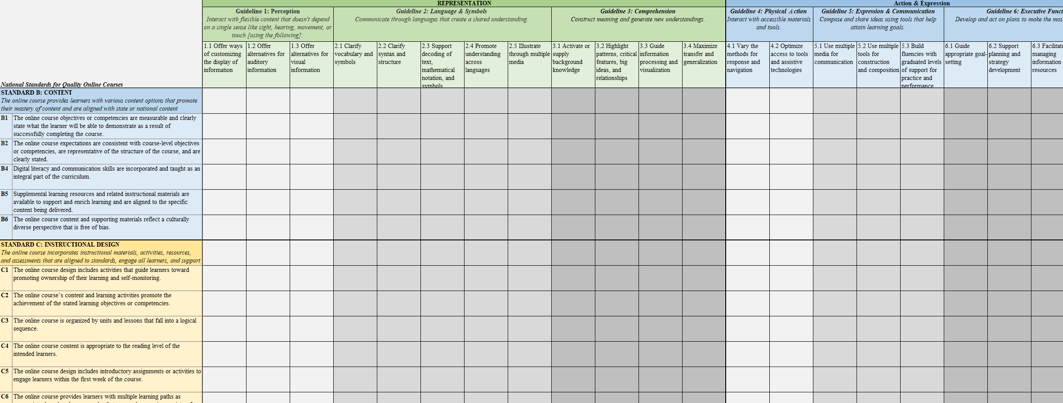
NSQ-C x UDL Worksheet

Slide 3

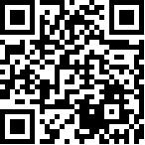

How to Use the NSQ-C x UDL Worksheet
Identify your Review Team (diverse stakeholders!)
This is a conversation!
Define goals for review
Review the course by NSQ-C
  Review, discuss, come to consensus
  Y or N (conditionally formatted cells)
  Make a note (evidence, gap)
Use results to support students on 3 levels:
  Relationship-building (tracking/monitoring progress)
  Individualizing Learning experience (innovative accommodations)
  Environmental & content-area pedagogy (teacher PD)
    Appropriate tool use
Download a copy
here!
https://go.iu.edu/4QHb

Slide 4
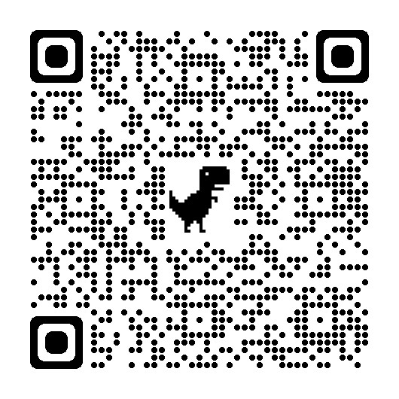


Let’s chat!
Dr. Rebecca C. Itow
rcitow@iu.edu
@RebeccaItow

