Slide 1
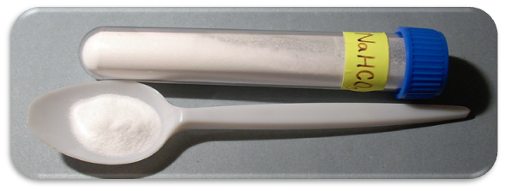
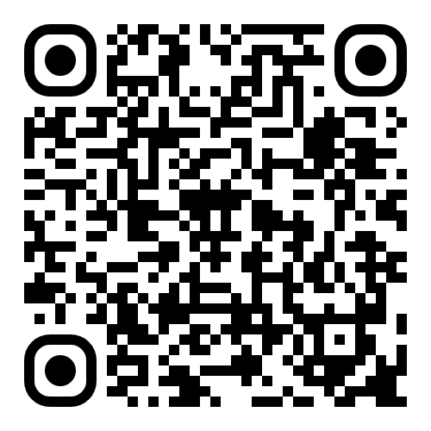

An Experiment in Equity
Developing Online Labs for Science
Rachel Walker
ACCESS Virtual Learning
Scan for presentation and resources
Notes:
Need to replace Pics
Add QR code for presentation

Slide 2
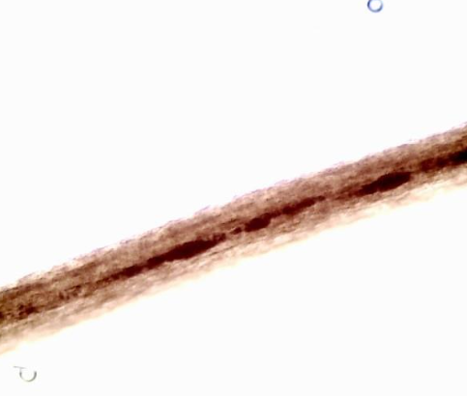
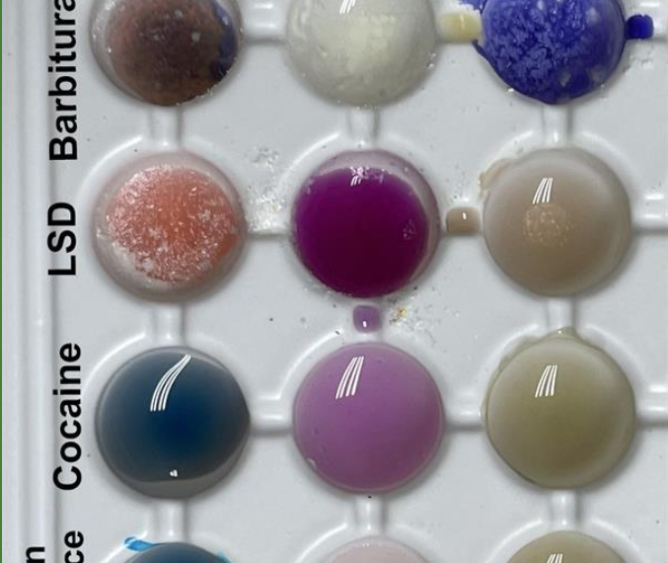
Goals
Discuss factors of equity in hands-on labs
Outline the development process for online labs, including design choices
Analyze data on the impact of online labs
Describe the unplanned benefits of developing online labs
Notes:
Provide some caveats and introduce

Slide 3
Background
What is ACCESS and why do we care about labs?

Slide 4
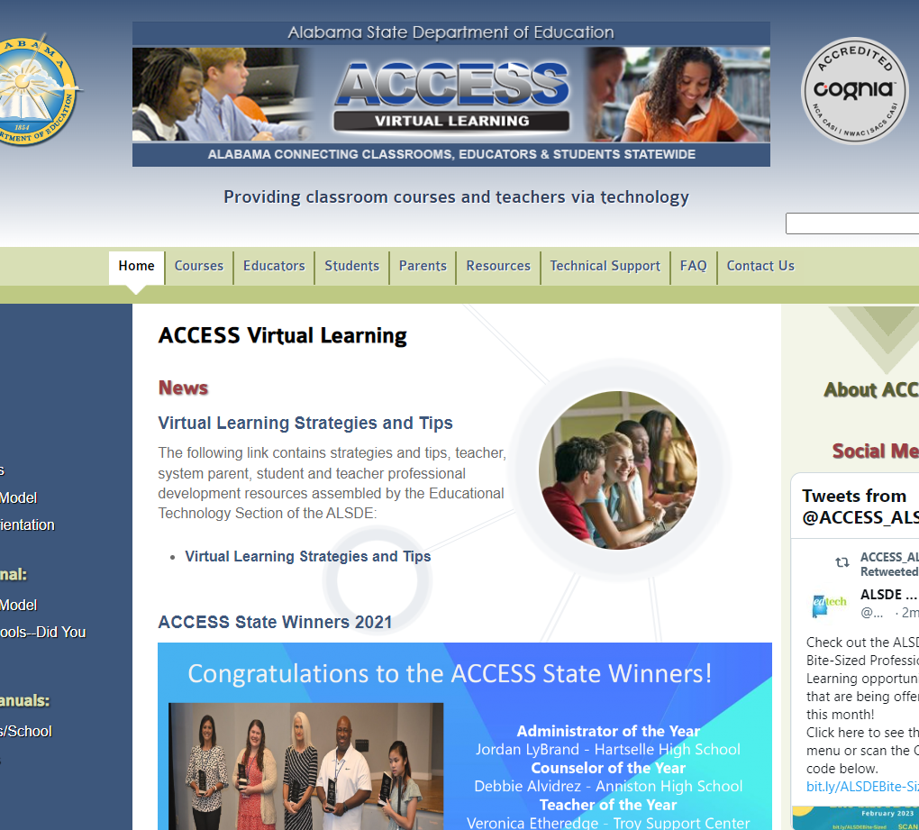
What is ACCESS?
Alabama’s free public virtual learning program
Students in grades 7th-12th
Free franchise content to all schools
https://accessdl.
state.al.us
Notes:
MJ’s slide

Slide 5

What does ACCESS define as a lab?
Data/observations collected by students
Analysis and application of findings
Characteristics of “real-life” process
Manipulation
Variability
Hands-on or simulation

Slide 6
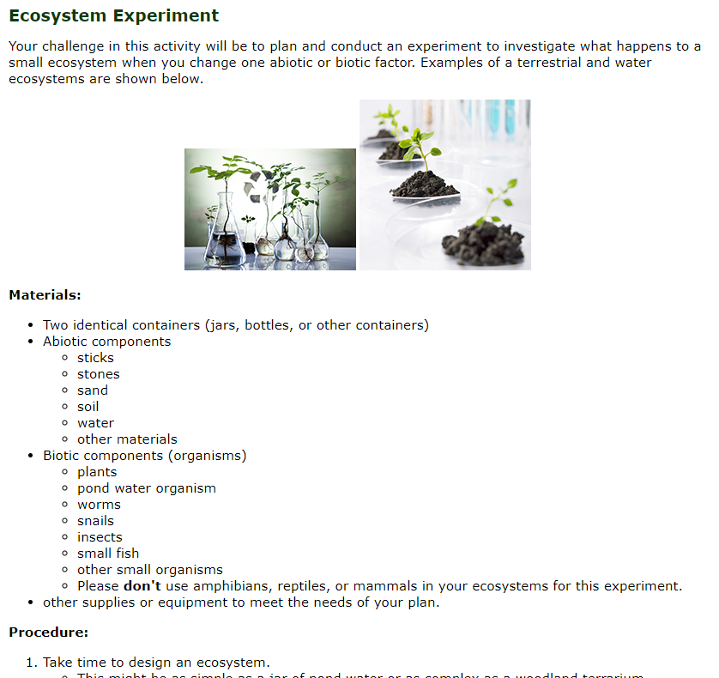
The Scenario
The principal, access facilitators, and myself were concerned about two of the labs/experiments for the environmental science course. What would be our options since our students do not have the facility or materials for two of the experiments?
With PowerPoint, you can create presentations and share your work with others, wherever they are. Type the text you want here to get started. You can also add images, art, and videos on this template. Save to OneDrive and access your presentations from your computer, tablet, or phone.

Slide 7
Spot the Problem #1
5.07 Motion lab
12 bean bags (if you cannot find bean bags, you can make your own using snack-size plastic Ziploc bags filled with dry/uncooked rice, flour, sand/dirt, or another similar substance)
Meter stick
Timer/stopwatch
Tape (masking tape or any non-clear tape is suggested)
Two people:
  A “walker” — the person who will be walking at a constant pace, dropping bean bags every 2 seconds; the student enrolled in this course should be the walker, if possible
  A “timer” — the person in charge of keeping time and telling the walker when to drop the bean bags. The timer doesn't have to be a student enrolled in this class; he or she can be a friend, sibling, parent, facilitator, or any other willing volunteer
An open, unobstructed space where the walker can move forward for a total of 24 seconds without running into anything

Slide 8
Spot the Problem #2
7.05 Energy Transformation Device
Materials will vary depending on project

Slide 9

Teacher Feedback [sic]
All the labs are challenging for the majority of students. … it does take extra time and resources to purchase lab items. … labs are very beneficial to the student and cost very little
I really enjoy the actual hands-on labs …. but it is becoming more challenging with more and more virtual students. …. despite my encouragement and contact with facilitators, many students are skipping …. lab experiments. They will do the virtual labs, but not the wet labs.
Some have no supplies to do labs, especially the blood one. I ask them to use chocolate milk or whatever liquid in order to do lab.

Slide 10
Student Feedback [sic]
Access to Materials
The labs were my least favorite I had no access to a lab to do the activities.😕most of the lab experiments needed materials i did not have access to.
Environment
the assignments …to perform a diy lab … were tiring because i do online school solely because i am traveling ... I do not have ready access to scanners, lab supplies, and drawing supplies. it forced me to put the assignments off and then i had to go back to them weeks later.
Other Responsibilities
The labs that required time at home. I never really have time to do school work outside of school with working and having to help take care of my nieces.
School Support
Labs where we needed physical materials from our facilitator sucked because we did not get them in a timely manner
Notes:
Make sure here to ask about equity issues at their schools

Slide 11
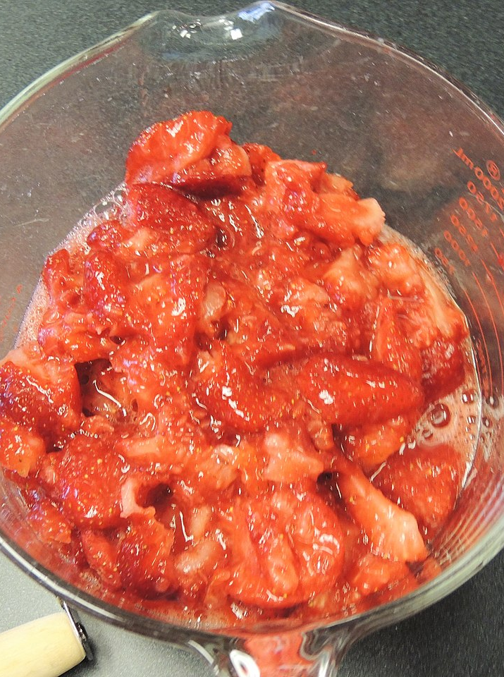
Why not lab kits?
Cost/Access to Materials
School Support
Environment
Complexity
Notes:
Talk about how we really have the same problems with these. Briefly mention experience with lab kits at QM conference a few years back with lab kit mess

Slide 12

ACCESS Dry Labs
Definitions and Characteristics

Slide 13
Types of Labs
wet lab
Traditional hand-on labs.
Students use physical equipment to carry out procedure, record observations and measurements, and analyze data.
dry lab
ACCESS-developed interactive.
Students view and may participate in procedure. They record observations and measurements and analyze data. Images and visuals are of real-life equipment.
virtual lab
Dry lab on an external site.
simulation
A coded activity, usually with abstract representations.
No real-world equipment is used. Simulations may allow higher user control and variability. A good example is PhET. Simulations are typically external resources.

Slide 14
What were our “musts” for our dry labs?
Viewable process
Student data collection
Free navigation
Report independent of asset
Rapid development
Student analysis
Notes:
Note that we took out manipulation. This is partially a limit of tech / personnel / time and part not so sure of benefit of interaction – forcing students to pour the correct container, mouse, etc. Combination of technical limitations and instructional design principles

Slide 15
Development Steps
Identify labs by standard.
1
Create a lab template.
2
Script the lab procedure.
3
Film the experiment.
4
Revise script as needed.
5
Build lab in Articulate Storyline.
6
Review lab draft and edit lab report.
7
Implement final revisions and launch.
8

Slide 16
Development Steps – Round 1
Step | Responsible Party
1. Identify labs by standard. | Subject Matter Expert and Instructional Designer
2. Create a lab template. | Instructional Designer and Assistant Director
3. Script the lab procedure. | Instructional Designers
4. Film the experiment. | Assistant Director
5. Revise script as needed | Assistant Director
6. Build lab in Articulate Storyline. | Instructional Designers
7. Review lab draft and edit lab report. | Subject Matter Expert and Assistant Director
8. Implement final revisions and launch. | Instructional Designer
Notes:
Talk through our first round of doing this, which was with forensic science. We will cover this briefly with lessons learned

Slide 17
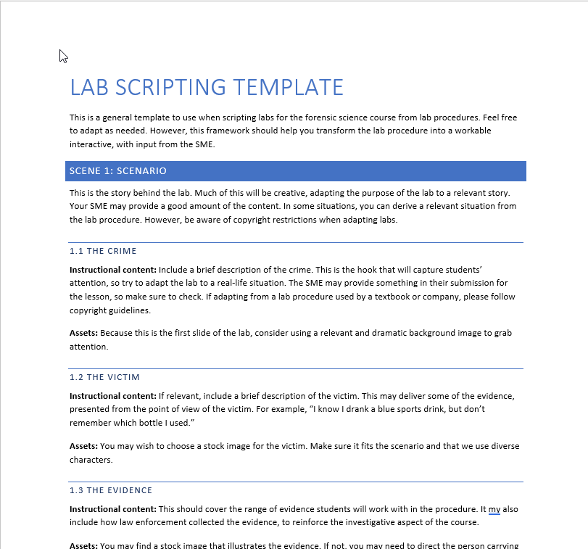
Phase 1 Template
Scenario
Background
Lab Process
Evidence
Credits
Notes:
Discuss this. Open page. Discuss why template was set up and equivalence with case studies in Forensic Science. Thought this part when well.

Slide 18
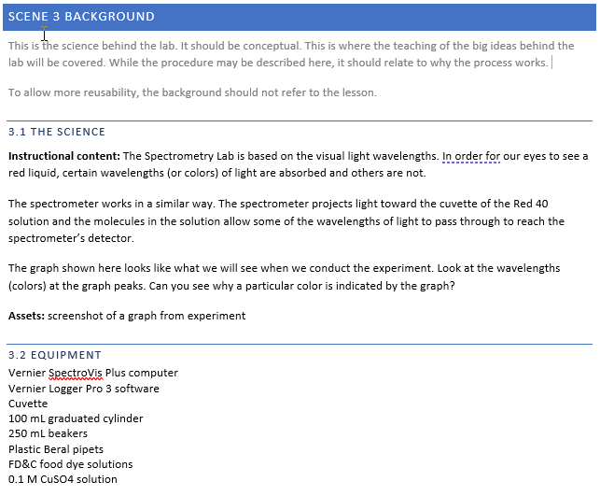
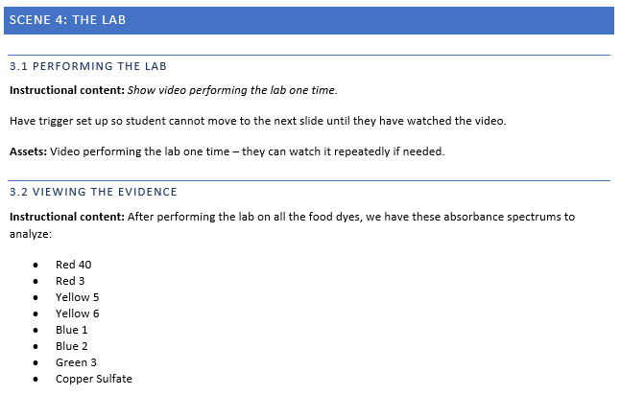
Sample Script
Notes:
Talk here about how it was difficult for IDs out of content area to track needs. Get copy of lab and copy of scripting. Students contaminating prom drink. Talk about how this lab was supposed to be of a spectrometry experiment – dyes may look the same but not reflect the same, supposed to identify contaminated drink. Show some of the misplaced background.

Slide 19
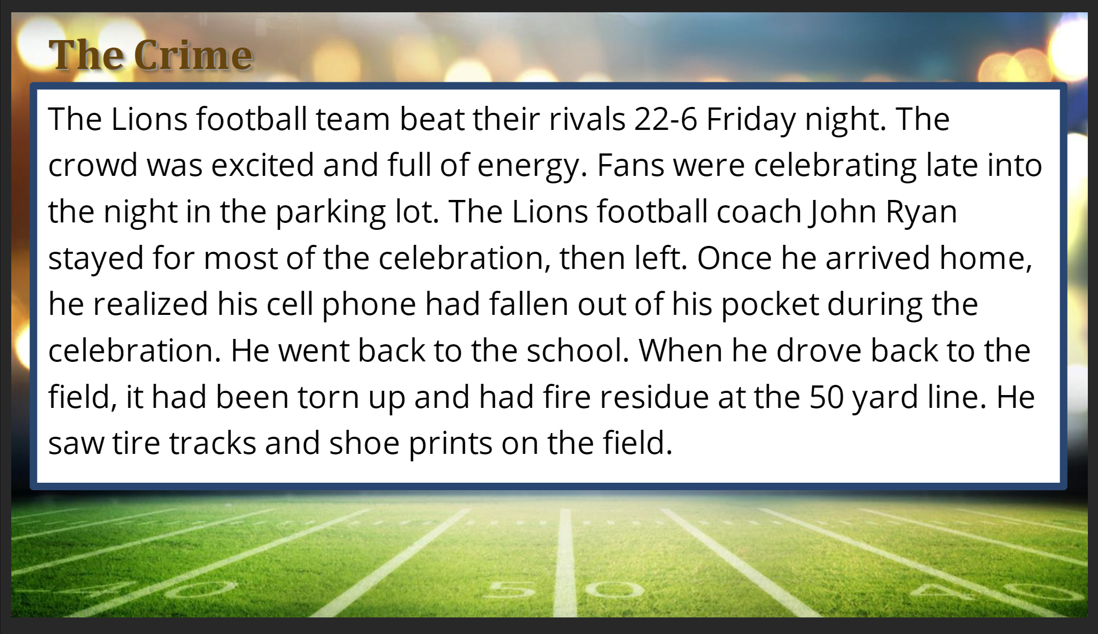
Other Issues
The Good
  Fast iteration
  Structural consistency between labs
  Growth of skills
  Naming and organization
The Bad
  Filming challenges (quality, process problems)
  Resource difficulties
  Style consistency on slides
  Scenario difficulty
Notes:
If time, show this one – mention difficulty of shoes all in same style and size. Show image trick. Show casts and talk about the expectation of clarity and how we needed to adjust teachers to interpretation and coaching through evidence.

Slide 20
Development Steps – Round 2
Step | Responsible Party
1. Identify labs by standard. | Lab and Course Subject Matter Experts
2. Create a lab template. | Assistant Director
3. Script the lab procedure. | Lab Subject Matter Expert
4. Film the experiment. | Lab Subject Matter Expert
5. Revise script as needed. | Lab Subject Matter Expert
6. Build lab in Articulate Storyline. | Instructional Designer*
7. Review lab draft and edit lab report. | Course Subject Matter Expert and Assistant Director
8. Implement final revisions and launch. | Assistant Director
Notes:
Highlight changes – specialized lab SME, who identified ideas then we verified with course SME. Talk about how important this role was. Also discuss how this divorce allowed the SME to focus on the assessment instead of logistics. Talk about our key role. Discuss structural change in lab.

Slide 21
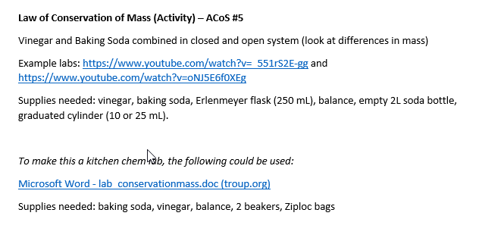
Labs by Standard

Slide 22
Template 2.0
Introduction/Background
Review concepts and enabling knowledge
Engage with prelab questions
Procedure
Review equipment purpose
Describe and show procedure
Iterate for multi-part experiments
Data
Display images or graphs
Prepare for analysis
Conclusions and report are outside of the interactive

Slide 23
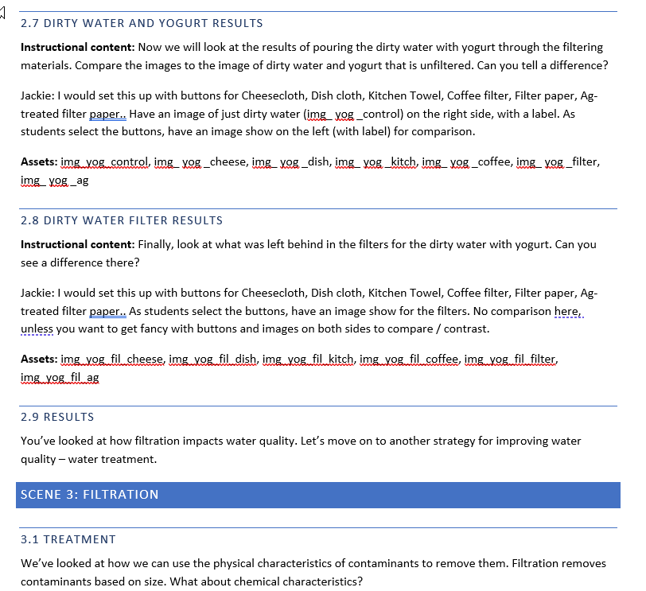
Script 2.0

Slide 24
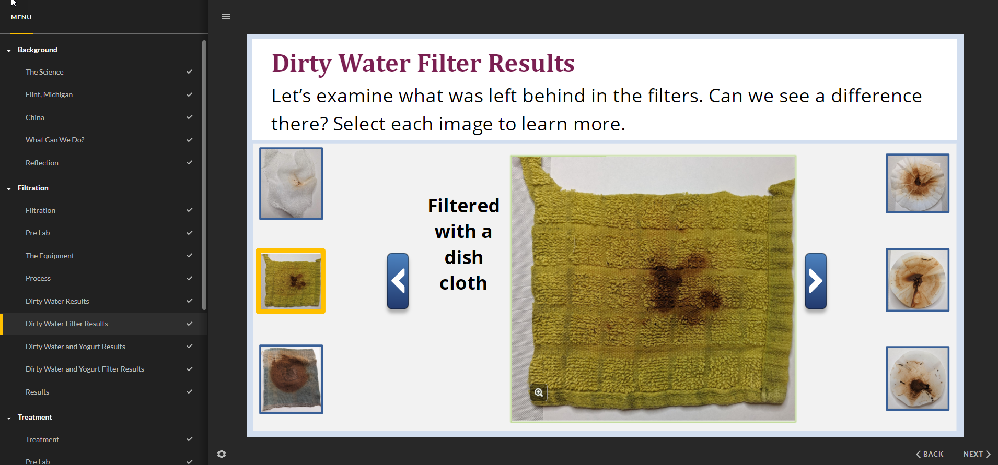
Final Product

Slide 25
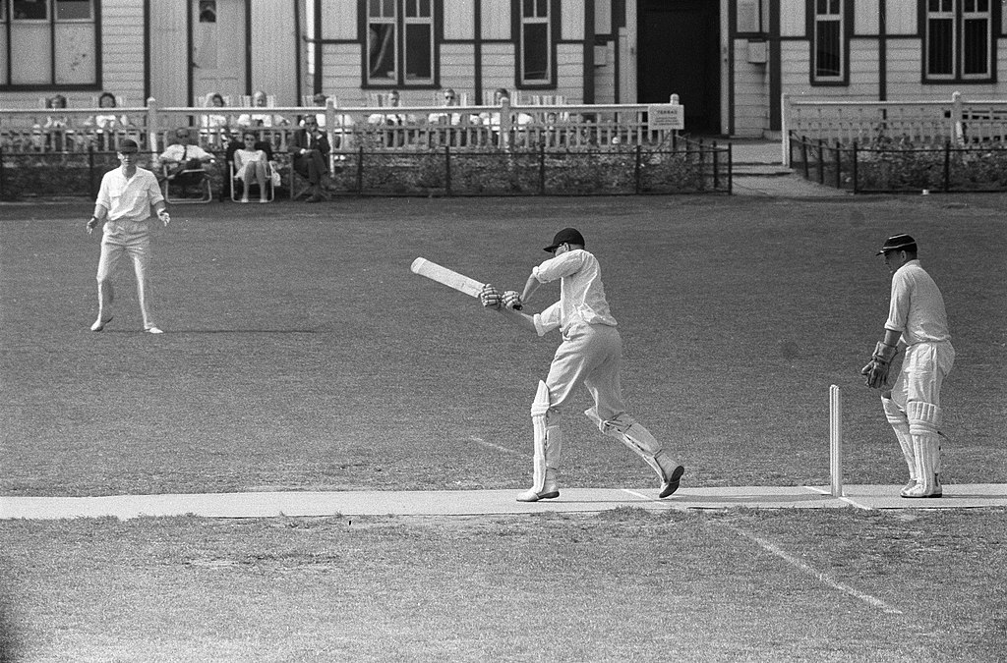
Teacher Feedback
Notes:
2 replies – mentioned unit 7 with lab

Slide 26
Student Feedback [sic]
Unit 9 and 10 because of the insects and lab.
Some of the labs were fun and helpful.
all of the assignments were my favorite because it involved looking at different labs .
I really liked doing all the different virtual labs. Since we didn't get to do these labs in person it was really good that we got to do virtual labs to show us how to the different processes work for different things.
Any of the labs, they were rather interesting.

Slide 27
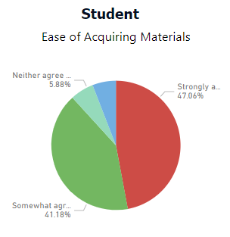
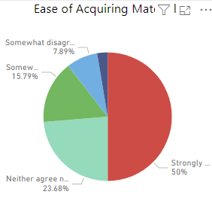
Survey Data – Materials
ACCESS Labs
Non-ACCESS Labs
Notes:
Discuss our limitations of data
Comparisons of science courses with ACCESS developed labs versus courses with hands-on/other virtual labs
Also not only factor
On this one, red and dark green

Slide 28
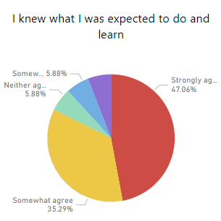
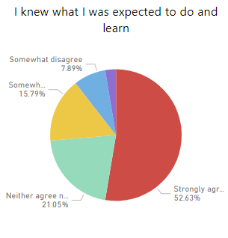
Survey Data – Alignment
ACCESS Labs
Non-ACCESS Labs
Notes:
On this one, red and yellow

Slide 29
Ongoing Challenges
Qualitative versus quantitative
Amount of process to show
Time investment
Design of lab interactive
Quality of images
Balance of interpretation

Slide 30
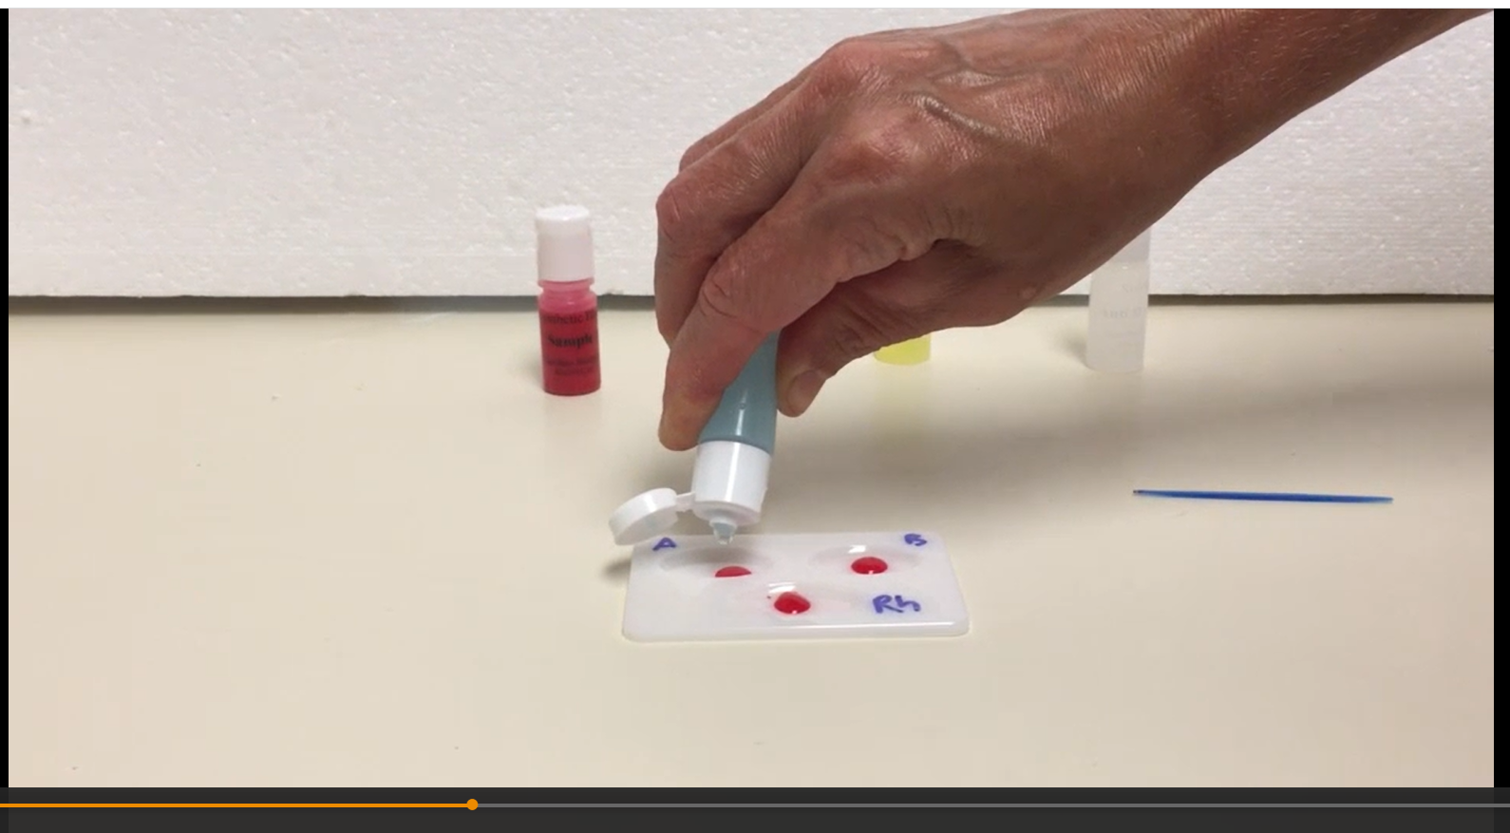
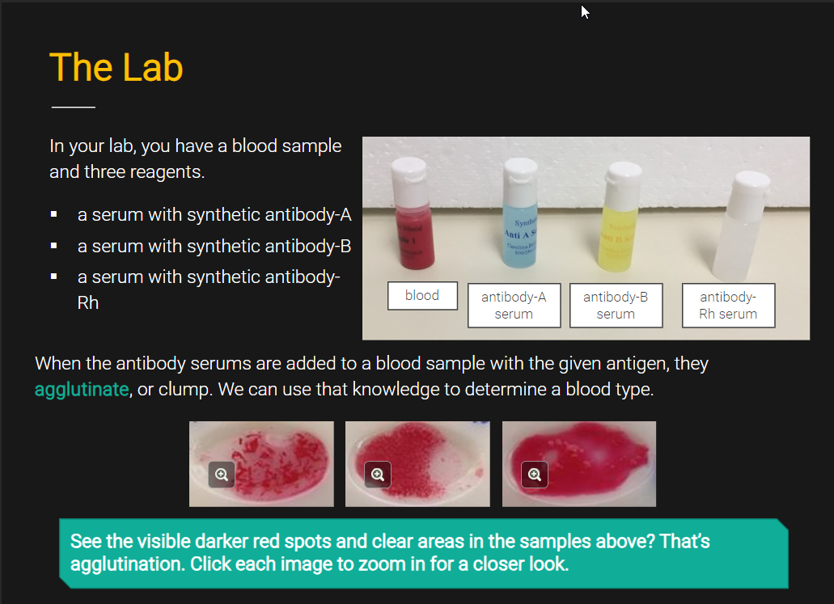
ACCESS’ Most-Viewed Video
Notes:
80,592 – 1,000-2,000 a week

Slide 31

Franchise Use
Finding Added Value and partnerships

Slide 32
Teacher Shortage
2021-2022 4.4% of teachers on emergency certifications (AL.com)
244 were science teachers (AL.com)
2023 Grades 6-12 science teachers at other schools receive $5,000 stipend
Notes:
During the 2021-22 school year - the most recent data available - data shows two schools, both located in Alabama’s Black Belt where poverty levels are high, had half of their teachers using emergency certificates.
Another 34 schools located in 16 districts, two-thirds of which are located in rural areas, had between one-quarter and one-half of their teaching staff using emergency certificates. In certain rural and urban counties, 20% of MS teachers are not certified

Slide 33
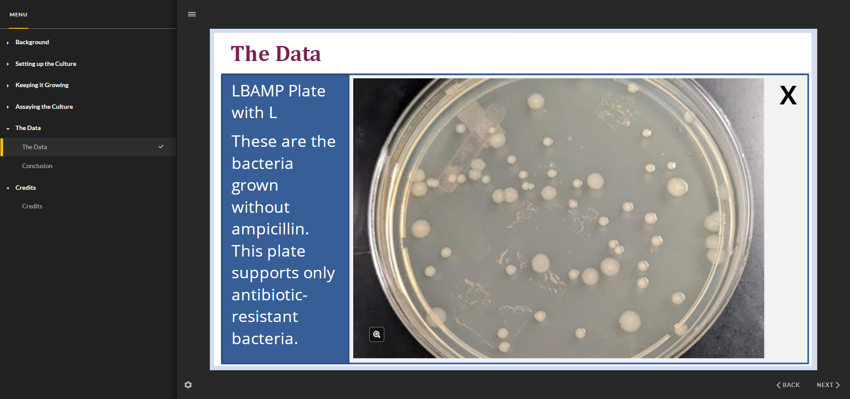
Strategy 1: Lab Replacement
Notes:
Maybe show the antibiotic resistance? On this – A way to replace a lab when equipment, like an incubator, is down; supplies are bad; a student it out; you are out; lab cannot be realistically done in a class period; danger factor

Slide 34
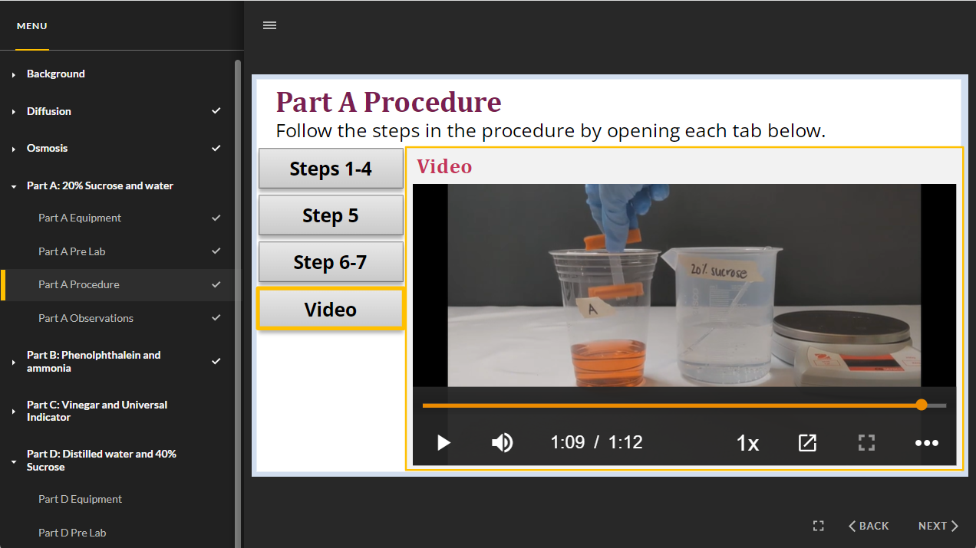
Strategy 2: Lab Equipment Demo
Notes:
Osmosis or photosynthesis? –
Maybe there is something you want the to see. Might do before, might have available during lab. Allow everyone to see close up/.

Slide 35
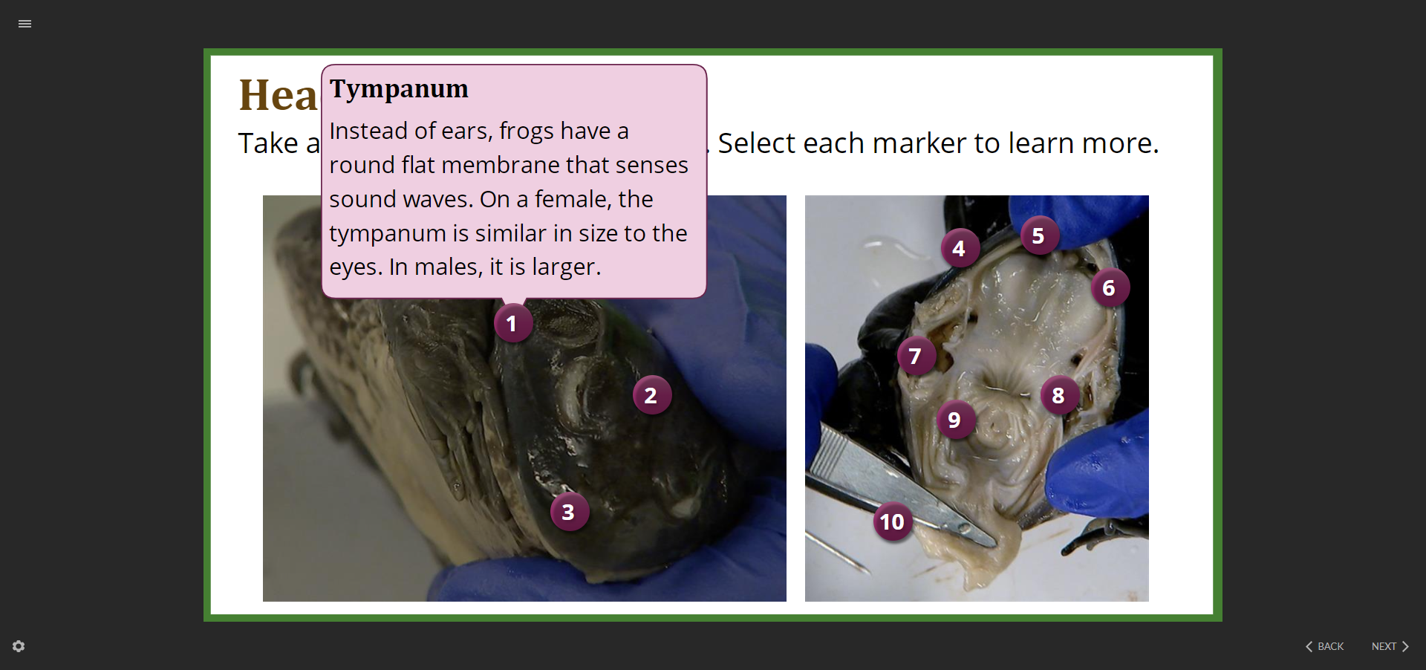
Strategy 3: Pre-lab Activity
Notes:
Maybe osmosis or photosynthesis, frog dissection? Get familiar, especially if time pressure

Slide 36
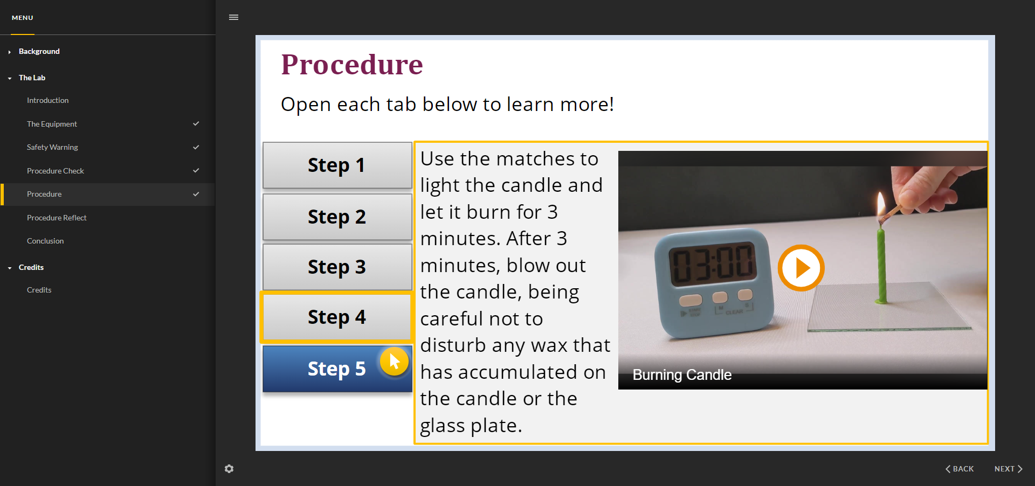
Strategy 4: Shift for Inquiry
Notes:
Maybe paraffin lab and/or silver filtration?

Slide 37
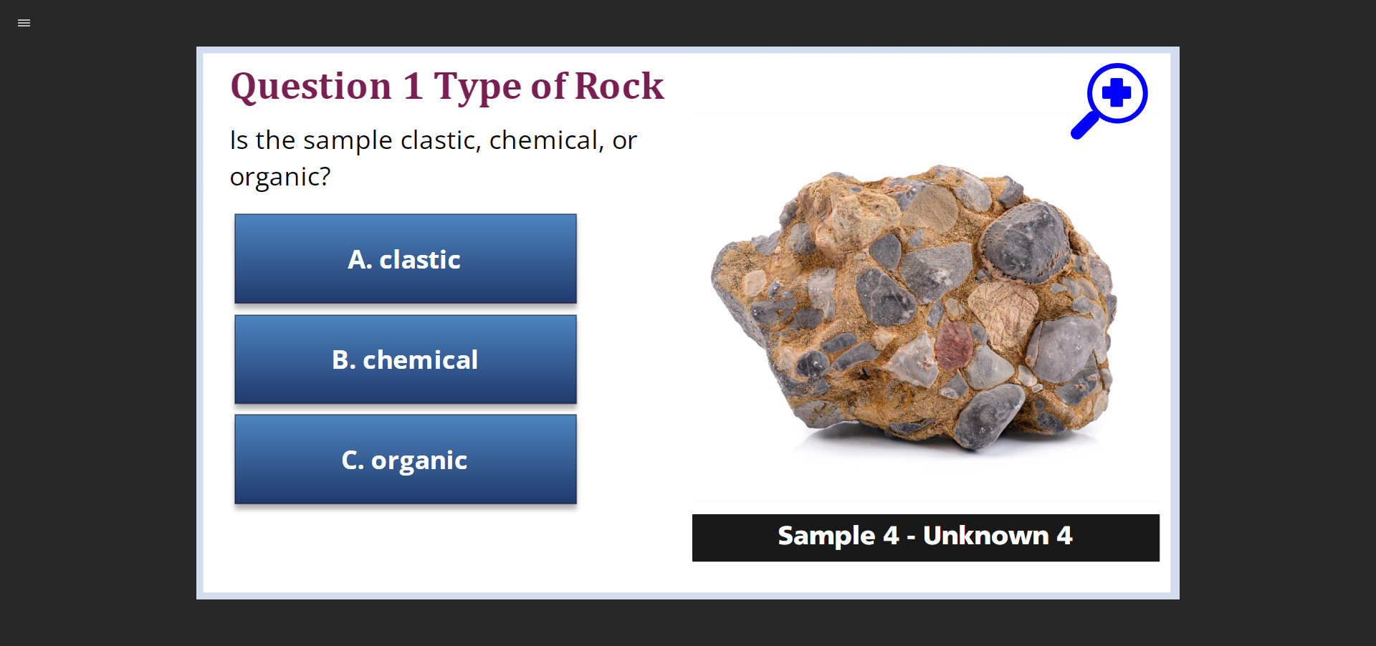
Strategy 5: Enrichment/Differentiation
Notes:
Maybe virtual pig? And rock ID for support?

Slide 38
List of Labs
Chemistry
Types of Chemical Reactions
Plastics by Density
Transfer of Thermal Energy
Ideal Gas Law
Specific Heat
Metal Activity Series
Types of Chemical Reactions
Exo and Endothermic Reactions
Paraffin Lab
And more
Earth and Space Science
Igneous Rock ID
Sedimentary Rock ID
Metamorphic Rock ID
Absorption and Radiation of Heat
Plate Density
Spectral Analysis
Half-life Lab
Physical Science
Gas Law Investigations
Law of Conservation of Mass
Forensic Science & Criminal Investigations
Hair
Soil
Toolmark Impressions and Striations
Shoe Impression
Fingerprint
Blood Typing
Electrophoresis
Ink Chromatography
Detecting Poison / Spectrometry
Simplified Drug Analysis
Entomology / Insect Decay Lab
Bioassessment
Life Science 7
Photosynthesis
Plant Dissection
Osmosis and Diffusion
Different Types of Cells
Exploring Cells
Biodiversity
Water Purification
Brine Shrimp
Antibiotic Resistance
Notes:
Add dynamic online lab list by QR
Mention we have around 20 Physics labs coming this year plus 8 biology labs and a small number of additional labs

Slide 39
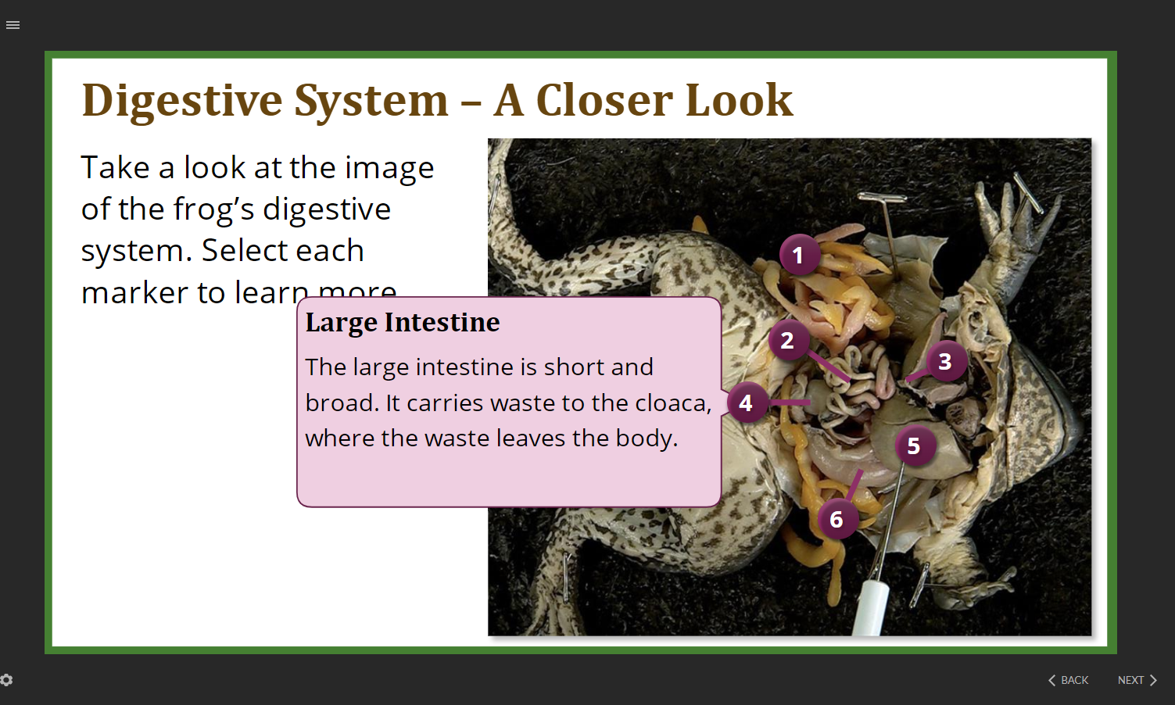
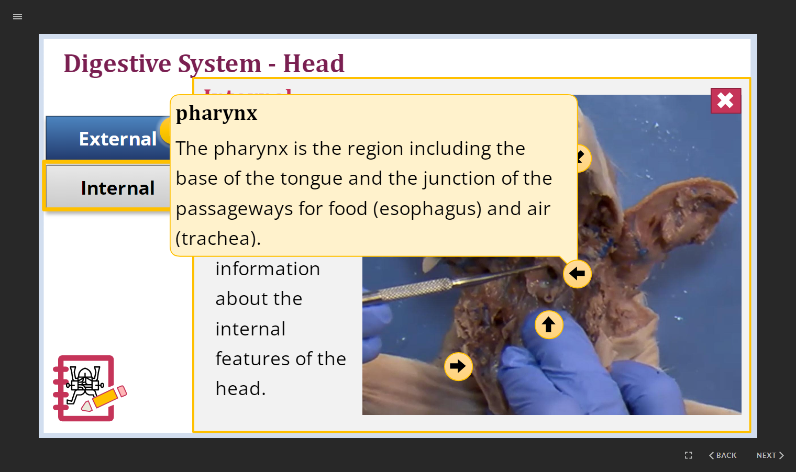
Human Anatomy and Physiology & Biology
Fetal Pig Dissection
Frog Dissection
Notes:
Mention similar views 200 – 400 / video, generally sticking through the video if they stay through first 30 seconds

Slide 40

Questions?

Slide 41
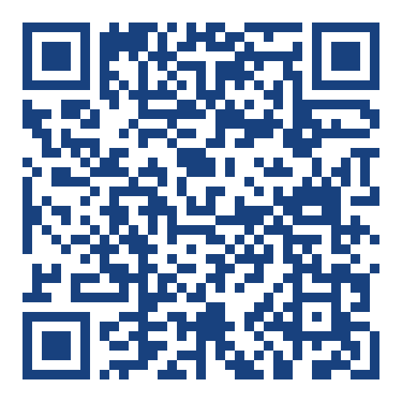
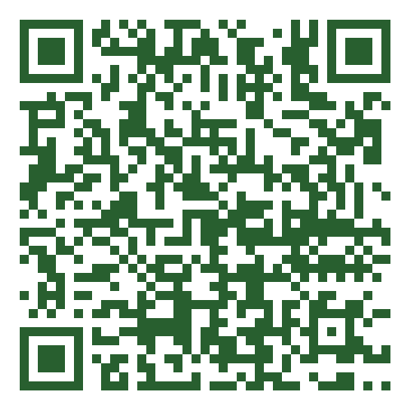

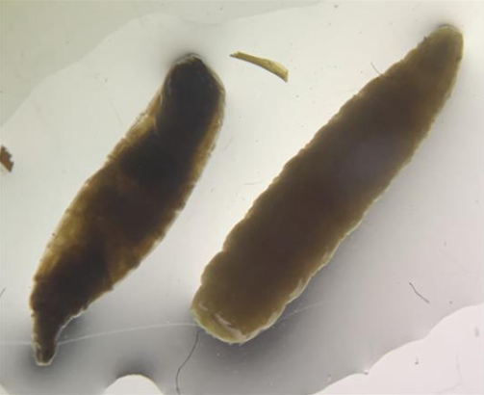
Scan for dynamic list of labs
Scan for presentation and materials
Rachel Walker Asst Director, Course Design & Development
walke101@ua.edu

