Slide 1

Unlocking Math for Everyone: Accessibility Strategies for Digital Content
Carly Fuller
Vice President, Product Development & Innovation
Edison Virtual Learning

Slide 2

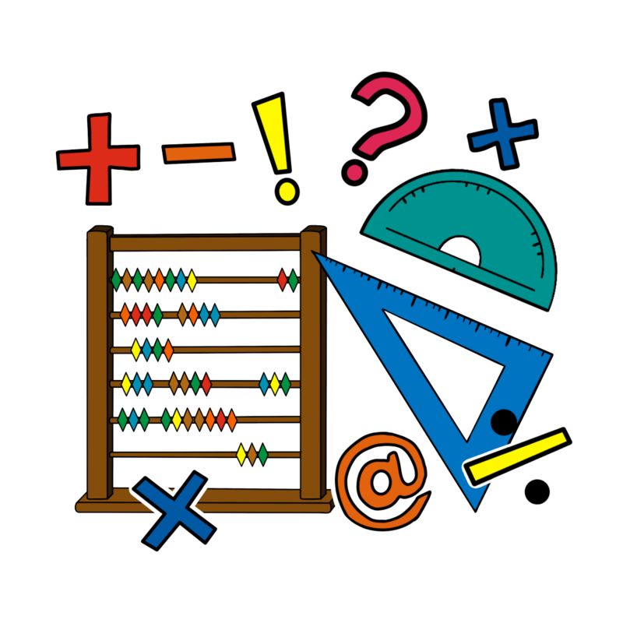
Outline
Introduction and Learning Objectives
Accessibility Guidelines in Mathematics Content
Challenges of Alt-Text
Reducing Reliance on Images
Practical Implementation Strategies
Discussion and Wrap-Up

Slide 3
Learning Objectives
Develop alt-text for mathematical expressions, equations, graphs, and other data displays based on the MathSpeakTM Initiative’s guidelines.
Write descriptive alt-text that aids in problem-solving without providing solutions.
Identify and implement opportunities to reduce reliance on images for teaching mathematical concepts.

Slide 4


Edison Virtual Learning
Edison is a digital learning solutions provider focused on providing equitable learning experiences to students. We provide online courses for original credit, credit recovery, CTE, Dual Enrollment, and more in grades 6 through 12 with accompanying certified teaching services.
Edison is proud to be a K-12 Publisher Member of Quality Matters. Our team has five Certified K12 Reviewers and one Certified K12 Master Reviewer. In the last three years, Edison has successfully submitted 12 QM certified eCourses and QM best practices are integrated into curriculum development and instructional operations.

Slide 5

A little bit about me
Former secondary math teacher
Product leader with over a decade experience overseeing curriculum development and other product development for Edison
Passion for creating equitable learning experiences through digital courses and tools
DLAC Executive Committee Member
Served on the QM K-12 Rubric, 6th Edition Committee
Certified QM K-12 Master Reviewer

Slide 6


What the research says
75% of visually impaired students are behind sighted peers in math by at least a full grade level
  US Department of Education study published in the Journal of Visual Impairment & Blindness (2017) https://files.eric.ed.gov/fulltext/EJ1156239.pdf
Mathematics can be a gatekeeper to a student’s success in high school and beyond. For example, if a 9th grader fails algebra, their chance of graduating high school drops to 20%.
  Back on Track Study: https://www.air.org/resource/brief/course-progression-students-who-fail-algebra-i-ninth-grade
Notes:
Not just an accessibility issue, but an equity issue . US Department of Education study published in the Journal of Visual Impairment & Blindness (2017) https://files.eric.ed.gov/fulltext/EJ1156239.pdf

Slide 7
Best Practices

Slide 8
Universal Design for Learning
Multiple means
Engagement
Representation
Action & Expression
Promotes learner voice and choice through accessible, inclusive, and equitable learning environments
Math is naturally multimodal allowing for multiple ways that understanding that be perceived or expressed.
“What is critical for some, is good for all.”
Notes:
Addresses the why, what, and how of learning by engaging different networks of the brain. How Teachers, Researchers, and Tech are Partnering to Make Math More Accessible.” by Lauren McMahon and Stefani Pautz Stephenson, Digital Promise, 12/15/2023, https://digitalpromise.org/2023/12/15/how-teachers-researchers-and-tech-are-partnering-to-make-math-accessible/

Slide 9
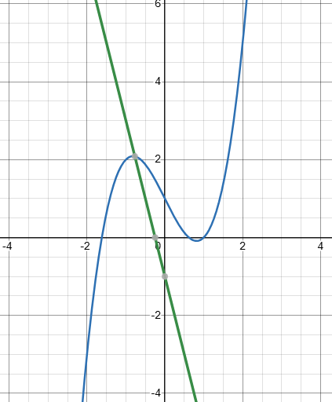
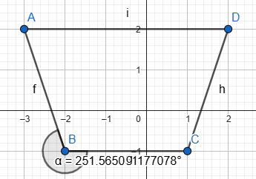
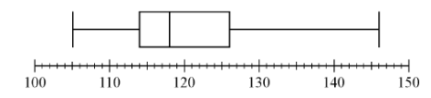

WCAG Compliance
Key principles: perceivable, operable, understandable, and robust
Considerations: Alt-text for images, high contrast colors, sufficient white space, high resolution images
$$x=\frac{−b±\sqrt{b^{2}−4ac}}{2a}$$
Notes:
Descriptive alt-text for images, use of high contrast fonts and colors, high resolution images; Need to ensure that students can understand the content regardless of how they’re navigating the course (screen reader, keyboard navigation, accessibility tools like screen magnification)

Slide 10

What does QM Say?
K-12 Rubric, 5th Edition:
  SRS 8.2 C – The course design facilitates readability.
  SRS 8.3 C – The course provides accessible text and images in files, documents, LMS pages, and web pages to meet the needs of diverse learners.
Similar guidance in standards 8.2 – 8.4 of the Higher Education Rubric, 7th Edition

Slide 11
Accessible Math Content

Slide 12

“Seeing” Mathematics
Consider the following expression:
Notes:
Consider a student with low vision. Mathematical expressions and equations are often inserted into curriculum as images. Students with low vision may use magnification tools, like that in TextHelp’s SpeechStream or Accessibe, but the resulting image may be pixalated and hard to read if saved as a JPEG.

Slide 13
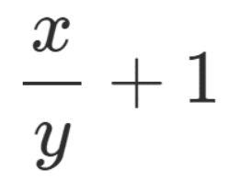
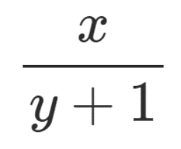
Alt-Text
Consider the expression, “x over y plus 1”
or
Notes:
Our guidance from WCAG and QM says that we need to provide descriptive alt-text for all images. This includes mathematical expressions and equations.

Slide 14
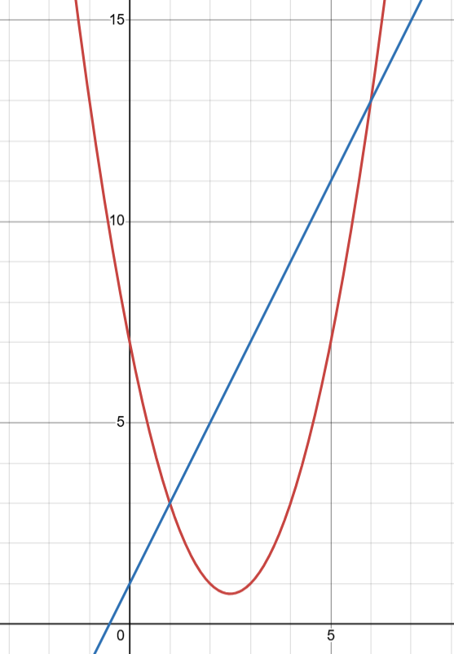
Think-Pair-Share:
Take a minute to think about what alt-text would best represent this graph.
Then, share with a partner what you would write as alt-text.
Did you and your partner describe the image in the same way? Be prepared to share your alt-text recommendations with the group.

Slide 15

Possible descriptions
Two equations graphed on a coordinate plane
A system of equations with one linear function and one quadratic
Two equations which intersect at (1, 3) and (6, 13)
A line with a slope of 2 and a y-intercept of 1 and a quadratic equation with the vertex (2.5, 0.75) and a y-intercept of 7
y = 2x + 1 and y = x² + 5x + 7

Slide 16
Context
Identify the graph which represents a system of equations.
Using the graph provided, identify the solution to the system of equations.
What types of functions are represented in this system of equations?
Notes:
It isn’t just the image, but the image’s context within the content, example problem, or assessment item.

Slide 17

SeeWriteHear
A company founded in the pursuit of information equality for those with disabilities
MathSpeakTM standard created for how to write alt-text for mathematical expressions and equations
Resource for ensuring that screen readers will accurately describe mathematics content
Notes:
Use the Grammer Rules on MathSpeak to inform alt-text written

Slide 18
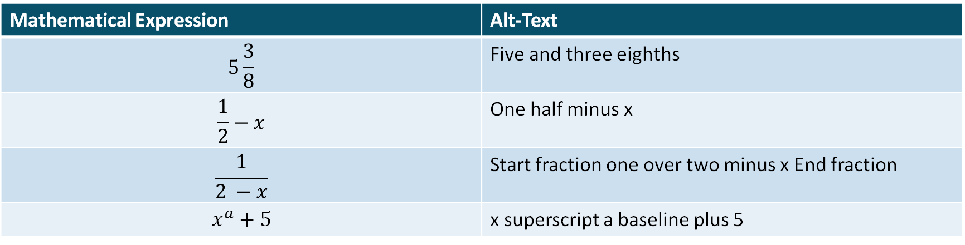
Examples from MathSpeak
Mathematical Expression | Alt-Text
$$5\frac{3}{8}$$ | Five and three eighths
$$\frac{1}{2}−x$$ | One half minus x
$$\frac{1}{2 −x}$$ | Start fraction one over two minus x End fraction
$$x^{a}+5$$ | x superscript a baseline plus 5

Slide 19
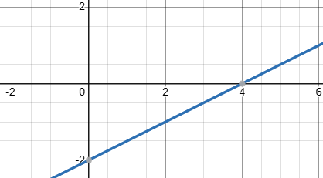
Descriptive Alt-Text in Assessments
The alt-text should not give away the answer to the problem.
Example: Calculate the slope given this graph of the linear equation.
Alt-Text: A line plotted on the coordinate plane with a slope of one half and a y-intercept of negative two.
Option 1: A coordinate plane with y equals one half x minus 2.
Option 2: A graph of a linear equation with a y-intercept of -2 and an x-intercept of 4.
Notes:
The corresponding lesson objective will help to guide what should be included in the alt-text.

Slide 20
Descriptive Alt-Text in Assessments
Descriptive alt-text which may give away the answer is preferred over vague or incomplete alt-text.
Example: Given the triangle, solve for x.
Alt-Text: This triangle has one side which measures 6cm, one side which measures 8cm, and the third side labeled x.
8cm
x
Revised Alt-Text: This right triangle has one side which measures 6cm, one side which measures 8cm, and the third side labeled x.
6cm

Slide 21
Descriptive Alt-Text in Assessments
If an image immediately follows a text description of the image, no additional alt-text is required. Simply include “decorative image.” as the alt-text.
s
Example: A square has four equal sides. If the area of the square is 9ft³, what is the length of a single side of the square?
s
s
Alt text: An image of a square with four equal sides labeled s.
s

Slide 22
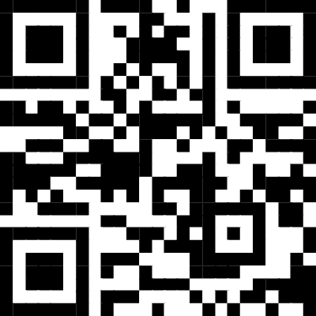
Huddle up!
Break into 4 groups.
Each gets an assessment question and corresponding image.
Create appropriate and descriptive alt-text for the image.
Be prepared to share your responses with the group.
https://tinyurl.com/mr2nvht9
Notes:
Note – the fourth group gets a music example in case we have any non-math people in the room!

Slide 23

Further considerations
Is it possible to eliminate the need for the image or is using the image a critical component of the learning objective for instruction or assessment?
If students are required to create an equation, model, or graph, can they use technology? (Graphing calculator, equation editor, Desmos, GeoGebra, etc.)
Could students use AI tools to demonstrate their mastery of mathematics concepts?

Slide 24

Time to Reflect
Consider the example images reviewed in your groups.
Are there other ways that we could assess the same concepts without relying on an image to convey meaning?

Slide 25

Questions and Wrap Up
Carly Fuller
Carly.Fuller@EdisonVirtualLearning.com
https://www.linkedin.com/in/carlyefuller/

Slide 26
Resources
https://files.eric.ed.gov/fulltext/EJ1156239.pdf
https://www.air.org/resource/brief/course-progression-students-who-fail-algebra-i-ninth-grade
https://usprogram.gatesfoundation.org/news-and-insights/articles/what-were-learning-math-should-be-a-gateway
https://a11y.pearson.com/mathxl/
https://digitalpromise.org/2023/12/15/how-teachers-researchers-and-tech-are-partnering-to-make-math-accessible/
https://www.seewritehear.com/accessible-mathml/mathspeak/examples/

