Slide 1

Persevering through the Pandemic: Maintaining Student Engagement through Quality Course Design
Roxanne Heimann, Assistant Professor
Faculty Fellow for Assessment
Quality Matters Conference 2021

Slide 2

New Course Modalities/Challenges
Hybrid
Online
High Flex
Web-Live
Face to face
How do we maintain student engagement with us, with peers, and with content in spite of the modality.
Notes:
Constantly changing - building the plane as we fly. One thing gets nailed down, and it completely switched and we have to adjust again. I get it. I’m in the same boat. Er….plane. Mixing metaphors. :) IN SHORT, QUALITY COURSE DESIGN AND BEST PRACTICES FOR ENGAGEMENT ARE MORE IMPORTANT THAN EVER. I don’t think we need to reinvent the wheel, but be more intentional than ever. We know student engagement is important -

Slide 3
Introduction
No shortage of research on student engagement!
  Increases student satisfaction, enhances student motivation, reduces sense of isolation, and improves overall performance (Martin & Bolliger, 2018)
  Strong correlation between student engagement and student-student and instructor-student communication (Dixson, 2010)
  Teachers who were more immediate had both greater frequency and breadth of student participation and engagement (Roberts & Friedman, 2013)
Notes:
I hope that someone is asking about what the heck immediacy is right now. Plug it within every conference presentation I do! It is SO IMPORTANT!!! I will come back to that.

Slide 4
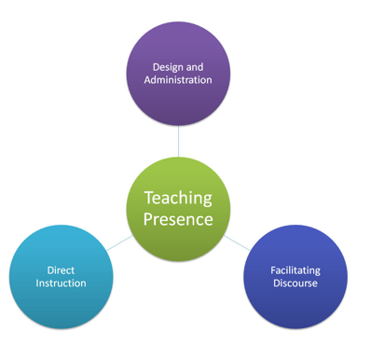
Fostering Engagement across Modalities
Engagement with YOU
  Don’t assume
Engagement with the course
  Avoid a course by checklist
Engagement with peers
  Often the first thing to go
Published on EdTechTalk (http://edtechtalk.com)
Notes:
Many of these strategies will also translate into face to face classrooms. Don’t tune out if you “only” teach face to face.
Of course, all of these work together and overlap categories but it gives us some sense of organization.

Slide 5

Instructor Presence
Make it EASY for students to be engaged and connected with you.
  QM 5.3 - Stating how you will interact (and then doing it)
Immediacy - lessening perceived distance between student and instructor
  How? Verbally and nonverbally
  Important face to face; more important when mediated
  Positive and substantial relationship between overall teacher immediacy and overall student learning in the online environment (Witt, Wheeless, & Allen, 2004)
Notes:
Talk about instructor immediacy in about every presentation I do.
Verbally - call students by name, encourage input and interaction, joke around with them. BE FRIENDLY.
Nonverbally - smile, walk around the room, gestures, relaxation , short response times, longer explanation. Treat your students like it’s your friend’s kid. LOOKING FRIENDLY
Online? Break out rooms, then drop in. Individuals, pairs, small groups. Love working one on one. Doesn’t have to talk a long time. ASK QUESTIONS. GET TO KNOW THEM. Don’t show up to Zoom at 1:29 for a 1:30 class. Don’t click end all and kick people out. You’d never be the first person out of the door in a face to face classroom. DON’T DO IT ONLINE.

Slide 6
Instructor Presence
“Don’t leave them alone too long.”
Response times/availability.
  Syllabus policy - do better
  Drop in times
  Link in email for appts
Be a real person - See them as real people
  Attendance prompts
  Feedback (use rubrics, add comments)
  Knowing their interests/making course connections, etc.
Notes:
I have the ability to connect class content easily. Topics for speeches -> major, personal interests related. Bit more of a struggle for other gen ed courses. WHAT can you do? Connections = engagement. Hosted a session bringing CTE and lib. Arts faculty together to make connections at our school. How can math be adapted to farmers? Have them calculate feed. How about video production folks? Editing/frames per second. Know your students.

Slide 7
Design/Structure
Make it EASY for students to know what’s going on and expectations!
  QM 1.3 & 5.4 - Student expectations for interaction
Importance of clarity in design
  Positive and proactive communication about class pragmatics
    Hybrid Web Live to FtF. Established from beginning
    Zooming expectations
Clarity in design decreases questions/uncertainty
Notes:
We went from a hybrid Web Live (Zoomed class) to FtF midsemester. Knowing that was on the horizon, I split them early. Also clear about what being in class looks like. You don’t get to Zoom and drive. You are seated, you are treating it like class.
Less questions = less email = less fatigue/burnout.

Slide 8
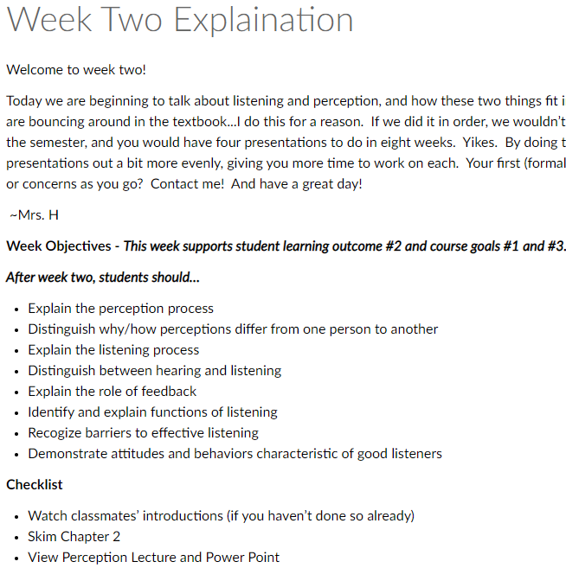
Beginning with Design/Structure
Weekly overviews - all modalities!
  QM 2.1-2.5 - Learning Objectives
    Overview
    Goals/Learning outcomes
    To do list
    Gives Context

Slide 9
Instruction and Interaction
Make it EASY for your students to be engaged with content.
  QM4.1 - Inst. materials add to achieving learning outcomes
  Flipped classroom and best practices with online lecturing
    Short videos -
      “Engagement time is at most 6 minutes” (Guo, Kim, & Rubin, 2014);
      “Up to 15 minutes” (Berg, 2014)
      “Majority of students believe videos helped them learn course content” (Berg, 2014)
    Encourage (or force) engagement!
Notes:
Saw a FB post last spring where an instructor at my former institution was saying she was so made because she recorded an hour and twenty minute video and realized Panapto froze at the 15 minute mark and she lost it all. I was horrified to see that she was recording an hour and 20 minute video - tons of comments and so I went to those and others were chiming in with similar situations. WHO is watching those videos!? Her students must be more interested than mine………...
These two sources and the articles in their entirety are on the QM website. Articles and Resources, Video length in Online Courses
Shocked to hear most people don’t include any video content in their courses! I get students stopping back by my office to thank me for having that.
Same instructional designer told me students generally won’t do something unless it has points tied to it. I have found that to be true as well.

Slide 10
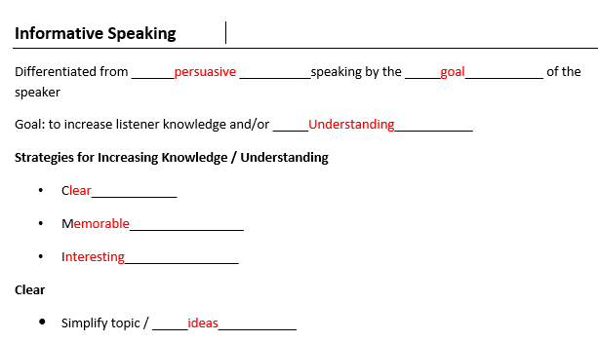
Instruction and Interaction
Strategies for engagement with lectures
  Integrate questions into video
    Panopto/Canvas Example
    H5P
  Lecture notes outlines
    Fill in blanks, submit for points
  Game Theory
    Hunting for Easter eggs
Notes:
In Video games, easter eggs are very hidden. In my videos, they are very not. :) Online classes, I tell them there are 6 eggs hidden throughout lectures. (These are in the forms of code words/phrases.) They email those to me for extra credit. You get all 6, you get a bonus. People go back and comb videos to find all six.) Find this works best with high school dual enrolled sections with high achieving students. My community college students were a mixed bag with this strategy. But this was a lazy/easy way to get them watching.

Slide 11
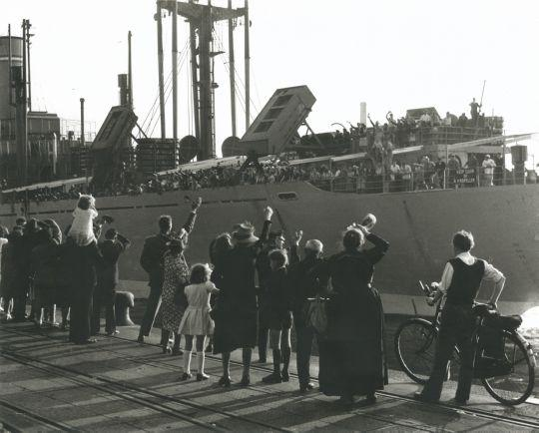
Instruction and Interaction
Make it easy for students to interact with their peers.
  5.2 - Opportunities for interaction to support active learning
    Application in teams/pairs
      Breakout rooms - docs, slides, Jamboard, etc.
    Encourage chat in the chat feature
    Open class early - don’t be the first person to leave!
    Ensure they know how to contact each other
Notes:
Peer to peer is the first thing to go when you are pressed for time, mediated situation.
In Video games, easter eggs are very hidden. In my videos, they are very not. :) Online classes, I tell them there are 6 eggs hidden throughout lectures. (These are in the forms of code words/phrases.) They email those to me for extra credit. You get all 6, you get a bonus. People go back and comb videos to find all six.) Find this works best with high school dual enrolled sections with high achieving students. My community college students were a mixed bag with this strategy. But this was a lazy/easy way to get them watching.

Slide 12
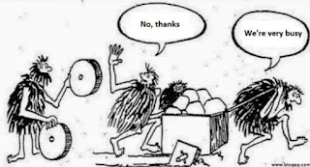
Share!
Learn from each other! Strategies for engagement, participation, what NOT to do.
  Share best strategies; what to avoid if applicable
  Google slides - Break Out Room Notes
    Recorder
    Presenter
  Share three great strategies
Notes:
Best part, worst part at dinner.
WHY I DO CONFERENCE PRESENTATIONS - I want to learn from my peers!
https://docs.google.com/presentation/d/12xiQsc2qAQbS7W8MaDwa5fjoZ1UeNNgmgpZyBhaLQpI/edit?usp=sharing

Slide 13
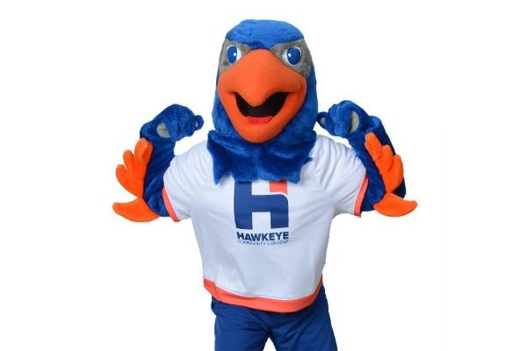
Conclusion
Work on your end to make things easier for students.
  Easy to connect with you.
  Easy to connect with content.
  Easy to connect with each other.
Pulls double duty
  Thank you for participating!
Roxanne.Heimann@hawkeyecollege.edu
Notes:
Work on our end but it pays out with student engagement and success. It’s also two birds, one stone. As we work to incorporate these things, we are at the same time meeting some of QM’s standards. Let me know if you have questions!!

