Slide 1
Moving beyond Open educational resources to course integration
Oregon State University Ecampus
Notes:
Welcome to the session “Moving beyond locating Open Educational Resources to Course integration.” In this session, we acknowledge that finding quality open educational resources is only part of the challenge when transforming course content using open educational resources. This interactive session will help you get started with defining, locating, evaluating, and integrating quality open educational resources into your existing courses.

Slide 2
Presenters
Ashlee Foster, Instructional Design Specialist
Stefanie Buck, Director of Open Educational Resources
Notes:
Stefanie: My name is Stefanie Buck and I am the Director of Open Educational Resources at Oregon State University. My unit provides support for faculty and instructors who want to move from a commercial textbook to open educational resources. We do this in the form of grant funding and a variety of support services. Prior to becoming the director of OER, I was an academic librarian for 25 years.

Slide 3
Audience Poll #1
Who
What
Where
Notes:
Before we get started, we’d like to know a little more about you…in the chat, please tell us who you are and what you do and where you are located

Slide 4
Audience Poll #2
On a scale of 1-5 (5 being wizard),
what is your experience with open educational resources?
Notes:
Our second question is

Slide 5
Open Educational Resources
Notes:
Let’s start by defining open educational resources. I am sure many of you know the definition but just so we are all on the same page….

Slide 6
Public Domain
“…public domain or released with intellectual property licenses that facilitate the free use, adaptation and distribution of resources.”
Notes:
“Open Educational Resources (OER) are teaching, learning or research materials that are in the public domain or released with intellectual property licenses that facilitate the free use, adaptation and distribution of resources.”
Full courses Course materials Modules Textbooks Images Ancillaries Streaming videos
Any learning materials can be licensed openly as long as the copyright holder chooses to do so.

Slide 7
Free versus open
Free ≠ Open
Notes:
One other thing to clarify is that the terms free and open are often used interchangeably when describing OER, but they are not the same thing. There are many free resources out there, which is great, but they do not allow you to make any changes to the content, therefore they are not open.

Slide 8
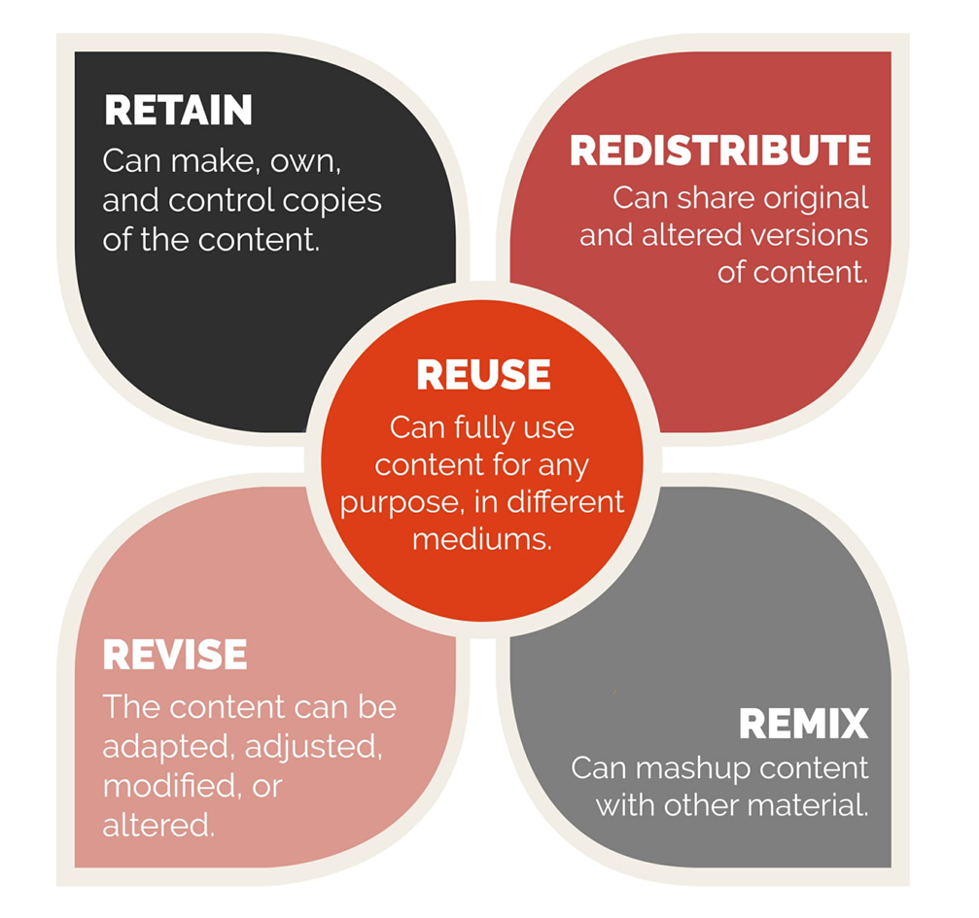
5 R’s of OER
Notes:
In order for something to be considered open, it must meet the 5Rs. Created by David Wiley, the 5Rs mean that an item is reusable, changeable, adaptable, it can be kept in perpetuity and it can be distributed freely all without having to ask the permission of the copyright holder. This makes OER very flexible and offers many new teaching possibilities as opposed to some commercially published works which do not allow for any change.

Slide 9

Creative Commons Introduction
Notes:
Most OER you will find have a Creative Commons license, which is a form of open license. There are other open licenses out there but this is probably the most widely used and recognizable one. A CC license is applied to a work by an author who wants to give people the right to share, use, and build upon a work that they have created. Instead of all rights reserved, the item is now some rights reserved. Keep in mind that it is still under copyright, just now the copyright holder has given you permission to do certain things with the work without needing to specifically ask for permission.

Slide 10




Attribution
Attribution
Notes:
There are 4 elements to a creative common license and it’s important to have an understanding of these so you know what you can and cannot do with a particular item, especially if you are remixing two or more OER.
Attribution: All CC licenses require that others who use your work in any way must give you credit the way you request, If they want to use your work without giving you credit, they must get your permission first.

Slide 11
Share Alike
ShareAlike
Notes:
Share Alike: You let others copy, distribute, display, perform, and modify your work, as long as they distribute any modified work on the same terms. If they want to distribute modified works under other terms, they must get your permission first.

Slide 12
Non Commercial
Non Commercial
Notes:
Non Commercial (NC)
You let others copy, distribute, display, perform, and (unless you have chosen NoDerivatives) modify and use your work for any purpose other than commercially unless they get your permission first.

Slide 13
No Derivatives
No Derivatives
Notes:
NoDerivatives (ND)
You let others copy, distribute, display and perform only original copies of your work. If they want to modify your work, they must get your permission first. The ND for many people means the work is no longer open, it’s free but it’s not open under the 5Rs mentioned earlier because it does not allow for revising or remixing .

Slide 14
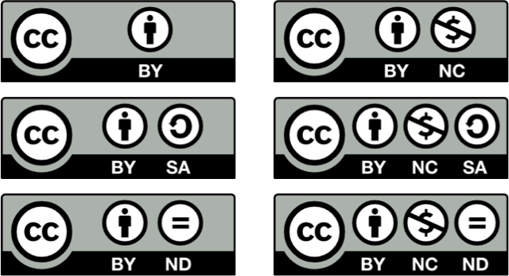
Creative Commons License Types
$
Notes:
These are the 6 CC licenses. Each is composed of one or more of the 4 elements. They tell you what you can and cannot do with a particular work and enable you to further build on existing content. You will notice that attribution is always required. Users must acknowledge you as the creator of the work.

Slide 15
Open
Is it open?
Notes:
It’s important to be able to recognize when something is truly open, verus just free. So if you are searching for truly reusbale and remixable materials, the first thing you need to ask yourself is Is it open
Let’s take a look at a few examples

Slide 16
Example #1
Marin, V., Orellana, M.L., & Pere, N. (2019). Open educational resources for research training: Quality assurance through a collaborative curriculum. Research in Learning Technology, 27. doi: 10.25304/rlt.v27.2271
This is an Open Access article distributed under the terms of the Creative Commons Attribution 4.0 International License (http://creativecommons.org/licenses/by/4.0/), allowing third parties to copy and redistribute the material in any medium or format and to remix, transform, and build upon the material for any purpose, even commercially, provided the original work is properly cited and states its license.
Notes:
Let’s take a look at a few examples. You want to copy this article and share it with a colleagues in your Linked In profile. Can you do that? Please enter into the chat…

Slide 17


Example #2
Notes:
You want to rearrange some of the sections in this textbook.. Can you do that?

Slide 18
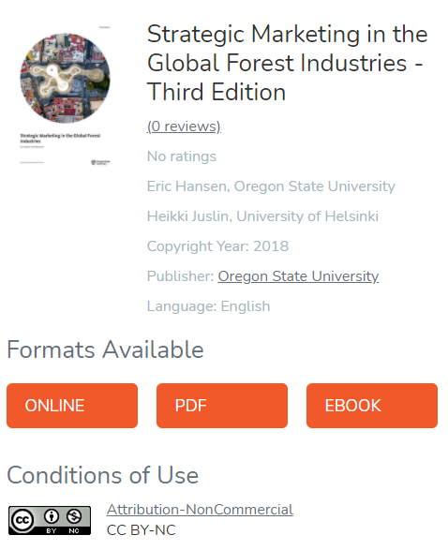
Example #3
Notes:
If you wanted to combine this text with another OER text on forest industry, could you do that?

Slide 19
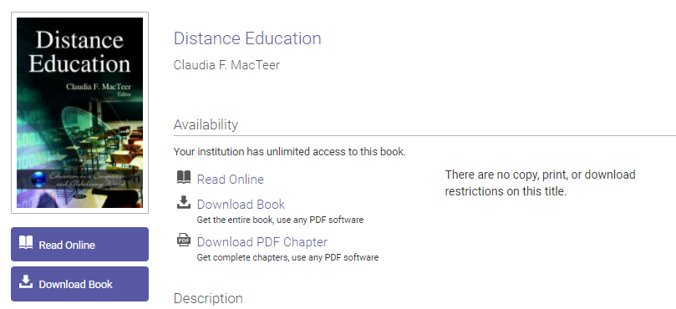
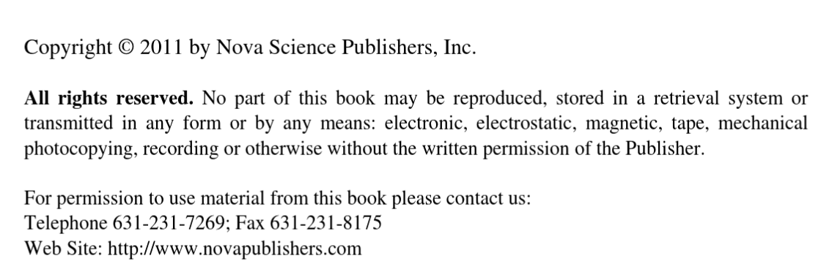
Example #4
Notes:
If you wanted to take a chapter from this e-book and put it into the anthology that you are creating, could you do that?

Slide 20


Example #5
Notes:
If you wanted to alter this image and then publish the image in you local magazine, could you?

Slide 21
Finding OER
Notes:
Now that we have established what OER is and is not, let’s turn to finding openly licensed materials.

Slide 22
Audience Poll #3
Which of the following have you used?
  OpenStax
  OER Commons
  Open Textbook Library
  MOM
  Other__________
Notes:
Go ahead and put the number(s) into the chat. Wait 30 seconds.

Slide 23
What’s the hardest part about finding OER?
Notes:
For many people just knowing where to look for an OER is the first big hurdle they have to overcome. Often the question is “where do I even start”?

Slide 24

Open Textbook Library
BCcampus OpenEd
OpenStax
OER Commons
Galileo Open Learning Materials
The New York Public Library Digital Collections
Notes:
Generally speaking, a google search for “art” and “open educational resources” won’t bring you particularly satisfying results. For the best results, you will want to use a repository. Some of these will already be familiar to you.
OER repositories – are specifically designed to help you locate openly licensed educational materials.
Institutional repositories- Are repositories manage by an institution, usually a college or university. Generally these are designed to store material created at the institution, such as theses and dissertation but your institutional repository may also include material that is openly licensed. Check with our local librarian.
Museums and archives – have lots of online digitized materials that is often available for use under a Creative Commons or other open license. Be careful to check the licenses on these items since not everything that has been digitized will be openly licensed or there may be additional restrictions on how the work can be used.
There are many more options, however, there is not one place where you can search for all OER.

Slide 25
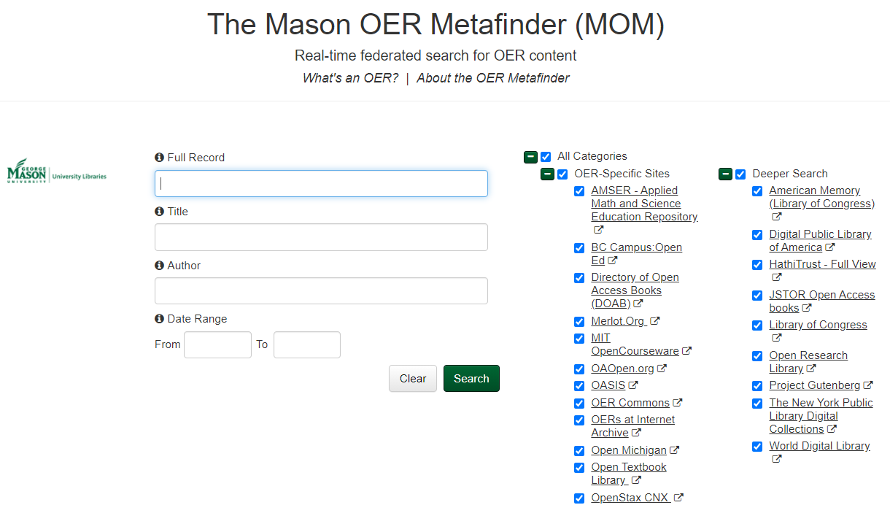
MOM #1
Notes:
One useful tool I’d like to share with you is the Mason OER Metafinder or MOM. This is a federated search tool designed at George Mason University to help with the issue of “there are too many places to look.” or “I don’t know where to start.” MOM searches across many OER repositories, all of which you can see listed on the right, although again, not all OER repositories are included. I do want to share with you a few tips on how to get the most out of MOM because it can be quite overwhelming.

Slide 26
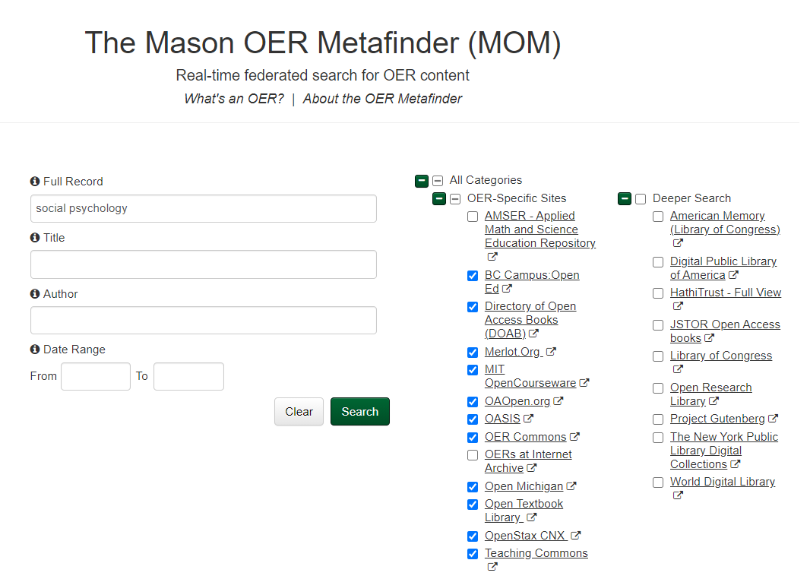
Notes:
Tip 1- Uncheck the Deeper search. Unless you are looking for primary source material or things in the public domain, you probably don’t need the deeper search
Tip 2- Uncheck any other repositories that are irrelevant – e.g. AMSER
Tip 3- Keep your search terms broad

Slide 27
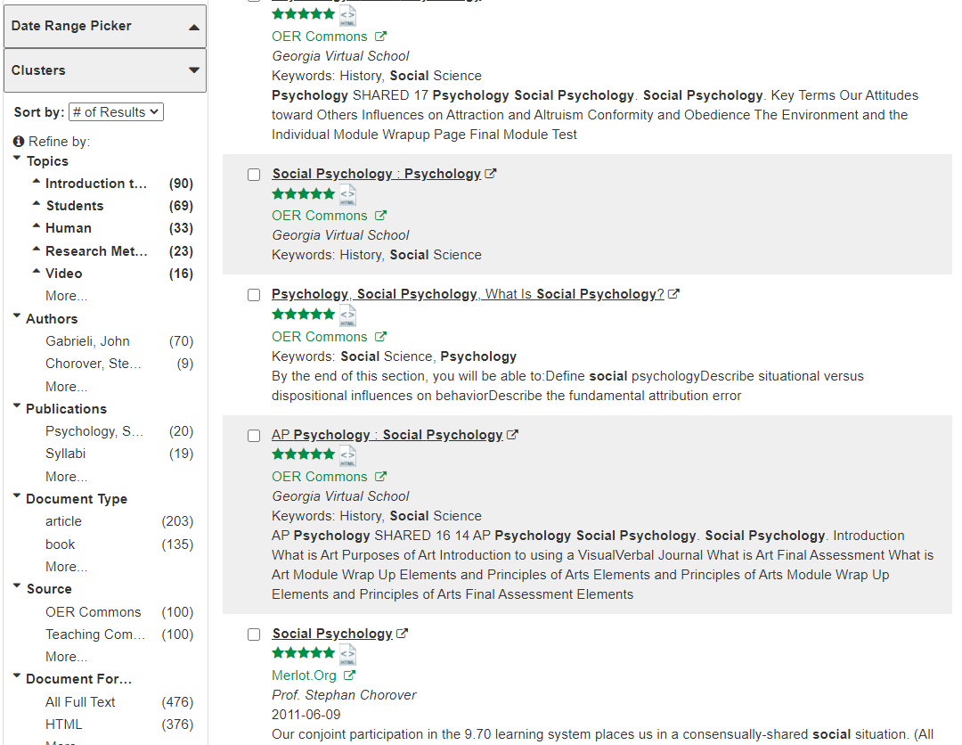
Search Filters – Document Type
Notes:
Tip 4 – Use the facets on the left to refine your search. For example, you can refine by document type, so if you are trying to find a textbook, then refine to book. It’s not perfect but it will narrow things down.

Slide 28
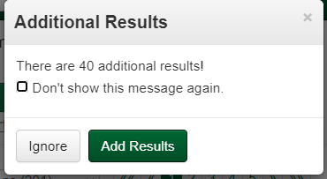
Search Filters – Additional Results
Notes:
Tip 5 – If you get a message to add additional items, you can probably ignore it. I have found on occasion that it messes up the results and chances are you are only going to look through the first 3-4 pages of results anyway.

Slide 29
Quality
Notes:
Once you have found one or more potential OERs, the next question is usually is it quality?

Slide 30
Audience Poll #4
What are indicators of a quality textbook?
Notes:
Wait 20 seconds

Slide 31
Frameworks & rubrics for quality review
Notes:
There are many indicators of quality and to guide you there are a number frameworks and quality checklists out there, someone counted at least 30, but I suspect there are more. I have included links to some in our guide. Some rubrics and frameworks are more nuanced than others. I am going to share 2 examples with you that are I find very useful. The reason I like these frameworks or rubrics is because they go beyond the checklist. They provide user support in the form of a scoring guide or user manual.

Slide 32
Rubrics
Yuan, M., & Recker, M. (2015). Not all rubrics are equal: A review of rubrics for evaluating the quality of open educational resources. International Review of Research in Open and Distance Learning, 16(5), 16-38. https://doi.org/10.19173/irrodl.v16i5.2389
Notes:
This is important because as Yuan and Recker point out, the use of rubrics does not always lead to improved evaluation. An important consideration is a rubric’s validity and reliability. There are questions to ask about the rubric itself, such as did it undergo any kind of outside review, when was it last updated, etc. I refer you to this article for a deeper discussion on quality rubrics.

Slide 33

TIPS
Teaching and learning process
Information and material content
Presentation product and format
System technical and technology
Notes:
The TIPS framework, authored by Paul Kawachi, a Professor of Instructional Design, is really designed for creators of OER but can be used to evaluate OER as well. TIPS has 4 dimensions and 38 criteria for creating quality OER.

Slide 34
TIPS (continued)
Course overview and introduction
Learning objectives (Competencies)
Assessment and measurement
Teaching and learning process
Information and material content
Presentation product and format
System technical and technology
Learner support
Instructional materials
Learner activities and learner interactions
Course technology
Accessibility and usability
Notes:
In the interest of time, I will not go through all 38 dimensions but if you look at the QM general standards, you can see there is a great deal of overlap with the TIPS framework so evaluating an OER is not all that different than evaluating a course. It equally takes time and rigor to determine if an OER is “quality.” The TIPS framework includes a rubric to guide you through scoring the different dimensions.

Slide 35

Achieve Introduction
Achieve is an independent, nonpartisan, nonprofit education reform organization dedicated to working with states to raise academic standards and graduation requirements, improve assessments, and strengthen accountability.
Notes:
Achieve rubric was created by a nonprofit education reform organization and many of the quality checklists for OER that you can find on the internet derive from the Achieve framework.

Slide 36
Achieve OER Rubric
Degree of alignment to standards
Quality of explanation of subject matter
Utility of materials designed to support teaching
Quality of assessments
Quality of technical interactivity
Quality of instructional and practice exercises
Opportunities for deeper learning
Assurance of accessibility
Notes:
Like TIPS, the Achieve framework asks very similar questions to the Quality Matters framework. It also includes guidance on how the rubric should be used. Each rubric has a guide that explains the scoring process. This Is very helpful when you want to be consistent in your scoring practices. The rubric gives you examples of thing to look for. Achieve also provides a handbook to help you use the rubrics more effectively.

Slide 37
Common Frameworks
Content
Technology
Pedagogy
Notes:
As I mentioned, there are many rubrics and scoring guides out there but really all the frameworks have the following in common

Slide 38
Common Frameworks - Pedagogy
Content
Technology
Pedagogy
Overview and Introduction
Learning Objectives (Competencies)
Assessment and Measurement
Instructional Materials
Learning Activities and Learner Interaction
Notes:
Ask yourself: Has the material has been structured in a way that matches a pedagogical model , does it lay out appropriate learning outcomes and ways of assessing those
outcomes?
Overview and Introduction
Learning Objectives (Competencies)
Assessment and Measurement
Instructional Materials
Learning Activities and Learner Interaction

Slide 39
Common Frameworks - Technology
Content
Technology
Pedagogy
Learning Activities and Learner Interaction
Course Technology
Learner Support
Accessibility and Usability
Reusability
Notes:
3. Is the way the material presented through the chosen media helpful in enabling learners to meet the learning outcomes? Is it accessible? Is it reuseable or remixable? (Lane 2009)
Learning Activities and Learner Interaction
Course Technology-can it be easily integrated into your course management system
Learner Support-Does it have a help section?
Accessibility and Usability*

Slide 40
Common Frameworks - Content
Content
Technology
Pedagogy
Current
Relevant
Accurate
Notes:
1. Does the materials cover the body of knowledge for the topic within the parameters established by the work? Here you are looking for content that is current, relevant and accurate. If you are an instructional designer, you may not be able to judge the quality of the content. Leave that to the SMEs. Ashlee will talk more about these. But you can at least examine the currency of the work when making a quality determination.

Slide 41
Peer Review
But is it peer-reviewed?
Notes:
Faculty will want to know if OER has gone through a peer-review process. The answer is sometimes. There are many types of peer-review processes, as Alger and Ljung point out. A check-edit procedure, where the OER is published but under edition is more commonly employed than the traditional double blind peer-review process of many scientific journals. This procedure is a kind of open peer review conducted after publication, which has also been introduced for some scientific journals (Smith, 2006).

Slide 42
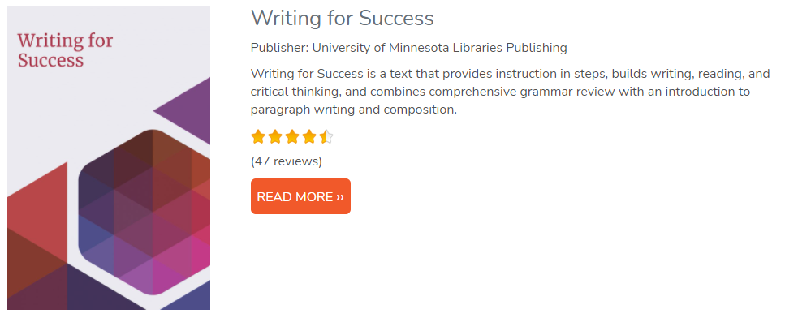
Peer Review Example #1
Notes:
Some publishers of OER like OpenStax do go through pre-publication review but most have a post production review process. How can you find out if a work has gone through a post production review? This example is from the Open Textbook Library. So if your instructor is looking for a writing text, check to see if the OER has been reviewed and look at the post-production reviews because these are often written by instructors who have or are using the material in class and/or by Subject matter experts. The reviews are not anonymous but they do need to meet certain standards in order for the OEN to publish them.

Slide 43
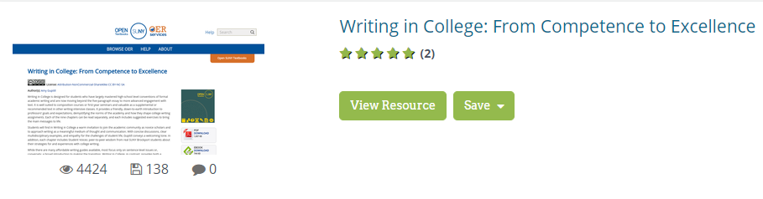
Peer Review Example #2
Notes:
OER Commons, another well-known OER repository, also has a place for people to write post-publication reviews. In fact, any OER that are submitted to the OER Commons go through a review before even being posted. Many other OER repositories do this as well.

Slide 44
Fit for purpose
Notes:
Really the most important question, and I am quoting David Wiley here, is that
There can be one and only one measure of the quality of educational resources, no matter how they are licensed:
How much do students learn when using the materials?
There are two ways of thinking about this definition of quality.
One is to realize that no matter how beautiful and internally consistent their presentation may be, educational materials are low quality if students who are assigned to use them learn little or nothing.
The other way to think about it is this: no matter how ugly or inconsistent they appear to be, educational materials are high quality if students who are assigned to use them learn what the instructor intended them learn.
For educational materials, the degree to which they support learning is the only meaning of quality we should care about.

Slide 45
MEANINGFUL INTEGRATION OF OER IN COURSE DESIGN
Oregon State University Ecampus
Notes:
When deciding to move from expensive textbooks to integrating Open Educational Resources in your course (regardless of the modality), it is important to make intentional and purposeful decisions. Today we will look to instructional design best practices to inspire and guide the integration of OERs in course design. By the end of our time together today, our goal is you will have some takeaways to help guide your decisions regarding OER.

Slide 46


Evaluating Best Fit
Notes:
First step – Evaluating Best Fit
We will want to start with an inventory of the course. Conducting an initial review will create a baseline for comparison down the road when OER selection, evaluation, and integration are considered.
Let’s begin with reflecting on some foundational questions that will help to establish the current state and future state of a course.

Slide 47

Learning Outcomes
Learning Outcomes
What are the learning outcomes?
What knowledge and skills do students need to acquire?
What do students need to demonstrate?
Will the outcomes change?
Notes:
Learning outcomes
What do we want students to be able to do or know after experiencing this course?
Nod to backwards design – alignment to the learning outcomes
Starting with the goal in mind
This will help to identify the appropriate learning materials for the level (undergraduate, graduate) and type (introductory, seminar, special topics, skills based) of course.

Slide 48

Context
Context
Audience
Modality
Type
Level
Academic Program
Technology
Access
Notes:
Course Context
This includes the many details that will help to guide best fit decisions for the course.
Audience
Who are the learners? (all the elements that speaks to the diversity of students) > associated needs and preferences
Modality (online, hybrid, face to face)
Type (seminar, skills based, internship, traditional course, curriculum core)
What level? (grad, undergrad, doctorate)
Academic Program
Program requirements or constraints
Course placement and purpose within a program
Technology
Delivery mode
Affordances
Academic Program
Student support and success
Learning curve?
Technical support
Learning guidance
Alignment with pedagogical approaches AND support the learning outcomes
Not using a tool to use a tool.
Access
Technological access
Accessibility for all learners

Slide 49

Pedagogy
Pedagogy
What are the current strategies?
Will there be a change?
Are there any gaps?
How will new learning materials support those strategies?
Notes:
Pedagogy
What are the current strategies in play?
Will those shift?
Are you planning on innovating your approaches?
How do the learning materials effectively support those instructional strategies?
If they don’t, what are the gaps?

Slide 50

Learning Materials
Learning Materials
Are the learning materials adequate?
Are there any gaps?
How do students currently interact with the learning materials?
Notes:
Learning Materials
Important to take a close look at the materials and reflect on
Are there any current gaps?
This speaks to the adequacy of the current learning materials
Do the materials effectively support student learning?
Stefanie referred to this when she examined what is a “quality” OER.
Relevancy
How old are the current materials?
Are the materials still relevant?
Has there been new research, discoveries, and theories immerge in the domain?
Interactivity
How are students engaging with the learning materials?
Will the way students interact change?
Importance
This question will help to evaluate the level and type of interactivity with content in the course.
We want to look at if there is a way to have students be active participants in learning versus passive consumers of content.
Future state
Again, what is the current and future state of the learning materials in the course?
How can new materials address issues related to any learning gaps, relevancy, and interactivity?
This is a consideration whether you are looking to completely replace the current learning materials or whether you are planning to supplement.
If you are considering supplementation this will be important when it comes to the development phase (which we will talk about a little later)
Determine
Will you need to piece together several resources?
Create additional content (lecture, video, podcasts)
Integrate interactives?

Slide 51

Assessment
Assessments
How are students currently assessed?
How are the learning materials integrated into the assessments?
How do the learning materials reinforce the assessments?
Notes:
Assessments
How are students currently assessed?
How are the learning materials integrating into the assessments?
Will integration change?
How do the learning materials reinforce the assessments?
How can the addition of different materials foster learning, bolter the student’s success with the course assessments, and ensure the attainment of the learning outcomes?
Let’s consider this the information gathering phase. This is a process of collecting all of those relevant bits and important details that will help support your intentional design decisions.

Slide 52

Integration Plan #1
Integration Plan
High level blueprint
Detailed integration plan
  Unit of study
  Learning outcomes
  Activities
  Assessments
  OER
  Engagement/interaction
Notes:
The goal is purposeful planning!
First, we hope that if you take anything away from today it is the spirit of intentionality.
There are different methods and strategies you can take when integrating OER into your new or existing courses. As we discuss different strategies today, we do encourage you to choose a path and method that works best for you.
Regardless of the strategy you choose for your planning process holistic integration is a paramount.
There are different strategies you can take depending on your preference.
High level blueprint (macro level)
All of which take into consideration the different course elements we discussed when reflecting on best fit (i.e., learning outcomes, course context, pedagogy, learning materials, assessments) but not necessarily spelled out
Identifies high level integration touch points
Forms
Cognitive map
Storyboarding
Course schedule (breakdown of the unit of study, outcomes, learning materials, activities/assessments
Micro level
Gets to the heart of the matter. Details out the various course elements and articulates comprehensive details regarding OER integration.

Slide 53
Integration Plan #2
Integration Plan
Unit of study
Notes:
Unit of study
Topic
Focus
Goal
Elements
Tasks
Activities
Assessments
Workload
Where it the unit situated in the course? What came before? What will come after?
What role do the learning materials currently play in the unit?

Slide 54
Integration Plan #3
Integration Plan
Unit of study
Learning outcomes
Notes:
Module Learning Outcomes
How are they aligned with the course learning outcomes/ competencies?
Are there any other constraints that need to be considered? (e.g. accreditation standards)
How are they aligned with the learning materials, activities, and assessments?

Slide 55
Integration Plan #4
Integration Plan
Unit of study
Learning outcomes
Learning activities/assessments
Notes:
Learning Activities and Assessments
Identify how the materials will support the understanding of specific topics, themes, and concepts.
Provide context on how the course activities and the learning materials support each other.
We would normally do this face to face, but in online learning we have to be intentional. The context guides learning. Otherwise, students are trying to figure out well why is this information relevant, how does it fit in with the course, and how am I going to use this information.
We don’t want students guessing.
Identify how the learning materials will ensure students success with course assessments and meeting the course learning outcomes/ competencies.

Slide 56
Integration Plan #5
Integration Plan
Unit of study
Learning outcomes
Learning activities/assessments
Current content
OER
Notes:
Identification of current content AND Identification OER replacing current content
Rationale for selecting the OER
Compare and contrast the current learning materials with the new OER (identify gaps in either)
Identification of attributes that are relevant to the course and domain
Goal: maintain the focus and intent
Licensing
Stefanie spoke a little to this when reviewing the creative commons licenses.
The licensing on OER is important to know and understand
This will indicate how the OER can be used in a course
Determine if modification, revision, or supplementation is needed.
If modification is needed
For example, you if find a resource you really like (interactives). However, maybe some of the content is relevant and doesn’t necessarily fit your pedagogical approach.
You may steer clear of Attribution-Non Commercial-NoDerivs
CC BY-NC-ND. This would limit your ability to remix, adapt, and build upon the work. You would be limited to sharing with attribution.
In this case, you may consider Attribution-Non Commercial
CC BY-NC. Allows for the individual to remix, adapt, and build upon the work, for non-commercially purposes, and provide attribution
Important to think about what is the end goal, and does the licensing allow you to use the materials in a way that meets the intended purpose.
Identify elements of the OER that is and isn’t a best fit with the course
Remember you do not need to include all of a resource or all OERs that have some level of relevancy. Consider using the amount that is pedagogically relevant or necessary for the course.

Slide 57
Integration Plan #6
Integration Plan
Unit of study
Learning outcomes
Learning activities/assessments
Current content
OER
Engagement and interaction
Notes:
Engagement and interaction
Articulate student engagement and interaction with the materials
Identify varied ways in which students to interact (e.g., media, podcasts, websites, text, lectures, videos, demonstrations, simulations, images, graphs, animations)
Examine opportunities where students can actively engage with the content and each other. For example, collaborative learning.
Speaks to
Peer-to-peer interaction
Peer-to-content interaction
Design to foster motivation and curiosity
Open Pedagogy
“access-oriented commitment to learner-driven education AND as a process of designing architectures and using tools for learning that enable students to shape the public knowledge commons of which they are a part.”
Affords students the opportunity to become active participants in their learning and contribute to the world’s knowledge commons in a meaningful way.
An example of a renewable learning opportunities (one that has impact outside of the classroom) could be to have students create or even edit an OER.
There are so many ways the OER can be leveraged. Creativity is the limit.
Strategies!
Create your own plan!
Use a planning template!
We have linked to a couple of different templates that are currently available through Creative Commons. If starting from scratch doesn’t sound ideal, we encourage you to take a look at these resources which have been created to ease the integration of OER.
Considerations
There is an initial time investment with course planning and learning content analysis. However, the investment will pay dividends in terms of effectiveness. Consider the learning content as one piece of a larger puzzle that all work together toward a common goal to motivate and engage students as active participants in the learning process and not as passive consumers of content.

Slide 58
Establish a Process
Analysis
Design
Notes:
Establish a Process
There are recommended processes available that folks that can use as a framework or guidepost for integrating OERs. You can also create your own process based off of those existing resources that works best for you.
For today, we are going to use the ADDIE model for inspiration. ADDIE stands for Analysis, Design, Development, Implementation, and Evaluation. ADDIE is an instructional design model that is commonly used as a tool in course design. At first glance, this model may look linear, but that isn’t accurate. After each phase you can revise. As an instructional designer, I have found this to be a very flexible guide that supports continuous improvement.
So far, today we have touched on
Course analysis
Which includes the current and future state of the course
An inventory of the course elements
Outcomes
Context
Underlying pedagogy
Learning Materials
Assessments
Intentional design
Planning strategies
Holistic course maps
Detailed OER integration plan

Slide 59

Establish a Process (continued)
Develop
Implement
Evaluate
Notes:
Establish a Process (continued)
Development
Reuse, revise, remix, and redistribution of the OER
Actual integration into the course
Creation of additional material and resources (e.g., interactives)
Considerations
Develop a draft and have a colleague, instructional designer, or training and development specialist review the design and integration.
Remember to share your vision, intention, pedagogical approach, and course context.
This information will be essential for folks to give meaningful and useful feedback.
Implementation
As you move towards implementing OER for the first time consider…
Test drive the OERs
Do not necessarily do a clean sweep of all materials.
Consider starting with a few OER to replace expensive course materials that students have to purchase.
Take the time to thoughtfully and intentionally design the materials into one course at a time.
Then, consider expanding to other courses after you have evaluated the first iteration of the integration.
Evaluation
Consider integrating a feedback loop for students (survey, discussion).
Take the formal and information/data you gather and make decisions for the next iteration.
Consult with colleagues or an ID if you encounter challenges with integration.
Goal: Conduct an incremental implementation plan as part of a continuous improvement process.
Now, we are going to transition into a group activity where we will continue our discussion around OER integration.

Slide 60

Group Activity
Group Activity
Description
You are part of a support team. An instructor comes to your team asking for recommendations to integrate OERs into a course.
Objective
Collaboratively develop a list of questions and considerations to support the faculty/instructor with the OER integration.
Notes:
Group Activity
So far, today we have reflected on:
Defining, identifying, locating, and evaluating (i.e., license compatibility, quality, effectiveness) OERs
Examining best fit, intentional course design, and the implementation of best practices
We are going to continue the conversation by reflecting on what types of meaningful questions and considerations can guide the effective integration of OERs.
Activity
Small groups = Faculty Support Team (e.g., Faculty Peer Review, Faculty Training and Development, Instructional Designer)
Faculty or instructor comes to the group with an inquiry regarding OER
Goal
Collaboratively create a list of questions and considerations to help guide the instructor as they consider OER integration.
Process
Select a spokesperson
Review the scenarios (there are two)
Select a scenario
In the chat, there is a link to a shared document that has the two scenarios from which each group will choose one to use for the activity.
Generate a list of questions and considerations to share with the faculty member
Below the scenarios in the shared document is a section for each group to take notes.
Feel free to select a note taker or have everyone contribute to the group notes.
(optional) Make a recommendation for or against integration
If after generating the guiding questions/considerations, groups can feel free to make a recommendation for integration. We would love to hear why you made that recommendation and how you came to that decision.
Share!
Logistics
Break everyone into small groups (5-6)
For about 10 minutes
We will provide a 2 minute warning before pulling everyone back to the room.
After small group discussions are wrapped up, we will come back together and have a discussion as a large group.

Slide 61
References
Algers, A. & Ljung, M. (2015). Peer-review of OER in a contested domain: An activity theoretical analysis. Journal of Interactive Learning Online, 13(4): 21-38.
Branch, Robert Maribe. Instructional Design: The ADDIE Approach. New York: Springer, 2009. Print.
Distance Education, edited by Claudia F. MacTeer, Nova Science Publishers, Incorporated, 2010. ProQuest Ebook Central, https://ebookcentral.proquest.com/lib/osu/detail.action?docID=3020967.
Lane, Andrew (2008). Who puts the education into open educational content? In: Katz, Richard N. ed. The Tower and the Cloud: Higher Education in the Age of Cloud Computing. Boulder, Colorado: Educause, pp. 158–168.
Mays, E. (2020) A Guide to Making Open Textbooks with Students. The Rebus Community for Open Textbook Creation. Retrieved from https://press.rebus.community/makingopentextbookswithstudents/
QM Higher Education Rubric, Sixth Edition, 2018. Quality Matters. Used under license. All rights reserved. Retrieved from MyQM.
UNESCO. (2009). Open Educational Resources. Retrieved from https://en.unesco.org/themes/ict-education/oer
Wiley, D. (n.d.). On quality and OER. [blog post]. Retrieved from https://opencontent.org/blog/archives/2947
Yuan, M., & Recker, M. (2015). Not all rubrics are equal: A review of rubrics for evaluating the quality of open educational resources. International Review of Research in Open and Distance Learning, 16(5), 16-38. https://doi.org/10.19173/irrodl.v16i5.2389
Zhadko, Olena; Ko, Susan. Best Practices in Designing Courses with Open Educational Resources (Best Practices in Online Teaching and Learning) (p. iv). Taylor and Francis. Kindle Edition.

Slide 62
References
Attributions
‘5 R's of OER’ by Kiersten Merkel is licensed under a CC BY 3.0 license
‘Achieve Framework’ by Achieve Inc. is licensed under the Creative Commons Attribution 3.0 Unported License. Retrieved from https://www.achieve.org/publications/achieve-oer-rubrics
A People’s history of Modern Europe by William A. Pelz is licensed under a CC-BY-NC-ND 3.0 license
Center for Open Education (n.d.). Open textbook Library Logo. University of Minnesota College of Education and Human Development. Licensed under CC BY 4.0
Creative Commons license icons by Creative Commons/Noun Project are licensed under a Creative Commons Attribution 4.0 International license
Kawachi, P. (2014). Open Educational Resources TIPS Framework. [digital image].Commonwealth of Learning. Retrieved from https://www.col.org/sites/default/files/styles/large/public/Cover_QA-Guidelines-OER_web_0.JPG?itok=gdShqDep
‘InnerMongolia’ by Diane Kuthy is licensed under a CC-BY NC-SA license. Retrieved from Oregon Digital. ChinaVine Collection.
‘Pathway free icon: Flaticon.com'. The integration plan icon has been designed using resources from Flaticon.com
Strategic Marketing in the Global Forest Industries – Third Edition by Eric Hansen and Heikki Juslin is licensed under a CC BY-NC license

