Slide 1




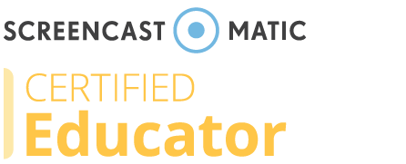


USING A TECHNOLOGY INTEGRATION PLAN to ALIGN COURSE COMPONENTS for ENHANCED STUDENT LEARNING
Melony Shemberger, Ed.D.
Associate professor, mass communication
Murray State University

Slide 2
Writing a plan that integrates the right technology to align with Quality Matters Standards can assist instructors to design powerful lessons that would encourage and challenge students cognitively.

Slide 3
In this session, you will be guided on constructing lessons that comprise a unit in which a lesson has a technology anchor. Examples of tech-integrated plans will be provided, and a list of free or least expensive tech tools that instructors and students could use will be available.

Slide 4
By the end of this session, you will be equipped to do the following:
1. Select an appropriate technology tool for instruction based on objectives.
2. Write a technology integration content plan for at least one lesson.
3. Consider free or less expensive tech tools to use for learner interaction.

Slide 5
Quality Matters Standards
Standard 5: Learning Activities & Learner Interaction
Standard 6: Course Technology
Standard 8: Accessibility & Usability
Standard 3: Assessment and Measurement
Standard 4: Instructional Materials
Standard 2: Learning Objectives (Competencies)

Slide 6
What’s in your Tech Toolkit?
What problem are you seeking to solve?

Slide 7
Theoretical approaches
Web 2.0 Technologies (Tim O’Reilly, 2005) – social networks, media sharing, creative content – all more oriented to participation, collaboration
Connectivism (George Siemens, 2004) – a learning theory for the digital age; knowledge is distributed, cognitive development
Common theme: Creating and sharing; visual learning
Cognition + emotions = learning

Slide 8
Uses of Technology (Dewey Taxonomy)
Inquiry
Communication
Construction
Expression
Bruce, B. C., & Levin, J. A. (1997). Educational technology: Media for inquiry, communication, construction, expression. Journal of Educational Computing Research 17(1), 79-102.

Slide 9
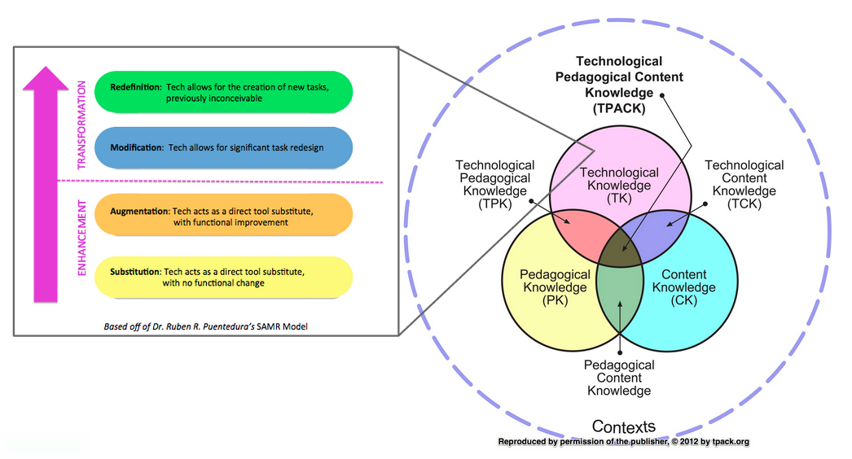

Slide 10
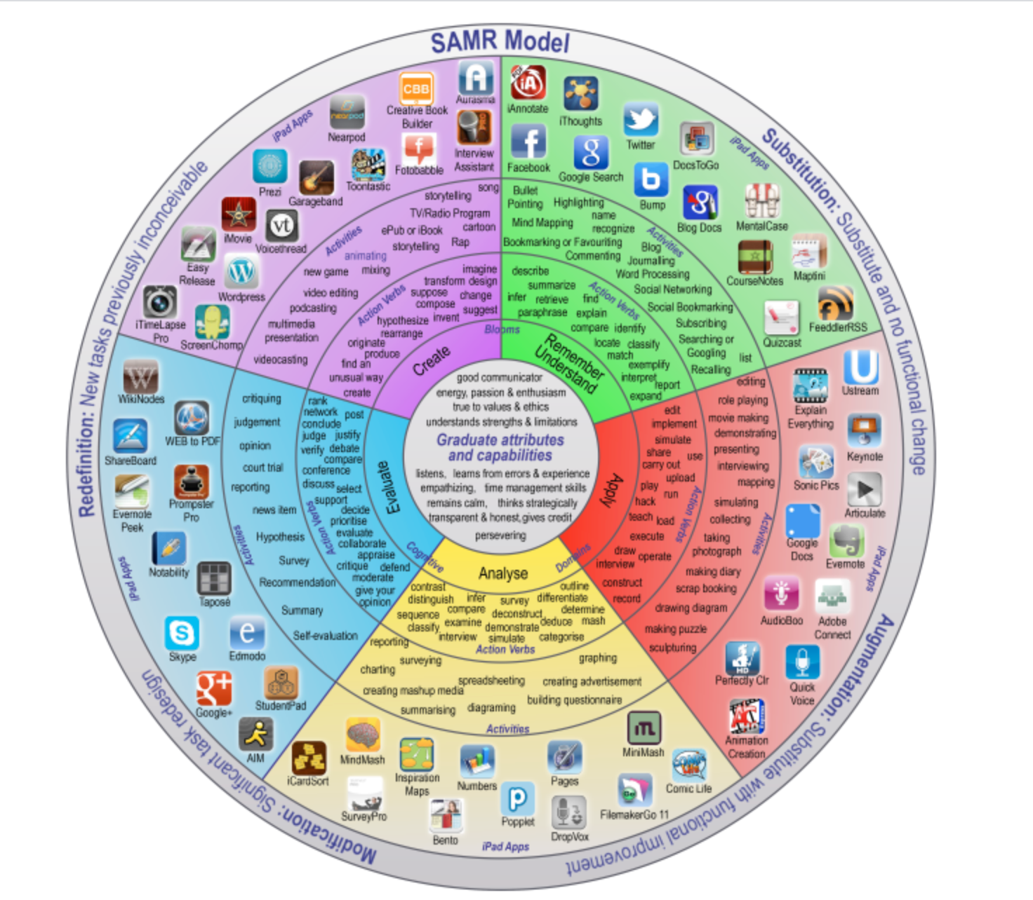

Slide 11
Elements of a Tech-integrated Instruction Plan
Title
Purpose
Objectives
Agenda
To transform technology use from instructor centered to learner centered

Slide 12
Mel’s Tech Toolkit
Google Education
Wakelet
Padlet
Twitter
Wikipedia
Adobe Spark Video
EdPuzzle
Scratch
Kahoot!
Piktochart
Zoom
VoiceThread
Google Trends
BlogTalkRadio
Screencast-O-Matic
Canvas
Moodle
YouTube
Facebook
Microsoft Office
Canva
Book Creator

Slide 13
Bottom line
Whichever technology you use, make sure it’s rooted in pedagogy.
Using technology because it’s “shiny and new,” yet unfounded in pedagogy, is dangerous.
Technology must support instruction, not be the instruction.

Slide 14
Alignment
Find the right tech tool for the job. “ … technology tool categories that accomplish specific pedagogical purposes (Darby, Small Teaching Online, 63).”
  Align to your objectives.
  Align tech tools with the cognitive domain of Bloom’s taxonomy.
  Start with LMS tools.

Slide 15
Principles
Identify the objective.
Avoid “harmful” technology — difficult log-ins, fees, etc.
Provide alternative means of access — Universal Design for Learning; alternative options (even “unplugged” options)

Slide 16
Recap
Use technology to support and re-energize your teaching.
Don’t be afraid to try something new.
Have fun, and always be on the search for what else could work for you and your students.
Know your goal. Make a plan.

Slide 17
Review of session outcomes:
1. Select an appropriate technology tool for instruction based on objectives.
2. Write a technology integration content plan for at least one lesson.
3. Consider free or less expensive tech tools to use for learner interaction.

Slide 18
What lesson will you redesign for technology integration for the learner? Why?
What’s in your Tech Toolkit?

Slide 19
Contact information
Telephone: 270-809-6874
Email: mshemberger@murraystate.edu
Twitter: @DrMelShemberger

