Slide 1
Step-by-Step: Guiding Students through Online Course Content
Jacklyn R. Pierce, Assistant Professor of English
Lake-Sumter State College, Leesburg, Florida

Slide 2

Learning Outcomes
Define
Define strategies for helping students follow the content of online courses effectively.
Construct
Construct online modules designed to take students through the course step-by-step.
Design
Design assignments and activities that ensure step-by-step completion of a course.

Slide 3

What’s the problem?
Notes:
In recent online classes, learners seem to be skipping over course content and just attempting to complete the graded assignments, so my mission is to work on design elements in my courses that will ensure that learners are engaging with the learning materials and activities prior to attempting graded work. Other educators have, no doubt, encountered similar problems; therefore, this session will allow for sharing experiences and ideas about what can be done to solve the issue.

Slide 4

Solution 1: Start on Modules
Notes:
Also known as SKIP THE HOME PAGE

Slide 5

Solution 2: The Power of Buttons
Notes:
Using visual buttons on the home screen to make the Modules easy to reach.

Slide 6

Solution 3: Step-by-Step
This Photo by Unknown Author is licensed under CC BY-SA-NC
Notes:
Build modules so that they literally go one step at a time.

Slide 7

Solution 4: Items on Lockdown
Notes:
Discuss releasing things one at a time

Slide 8

Solution 5: Weekly Walkthroughs
This Photo by Unknown Author is licensed under CC BY

Slide 9
Other Ideas
GETTING CHUNKY
Cutting assignments into smaller pieces submitted separately
LEARNING ACTIVITIES
Interactive, low-to-no stakes activities that have to be completed before moving on
MIRROR MIRROR
Required self-reflections for learning materials

Slide 10

Final Thoughts & Questions?

Slide 11
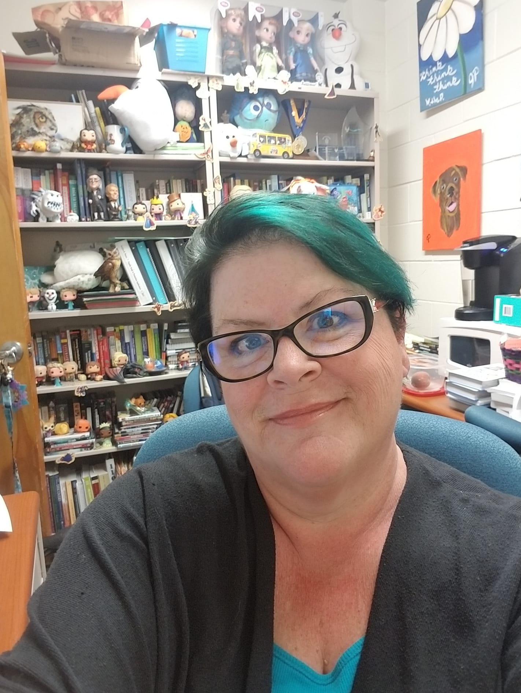
Thank you for your time today!
Jackie Pierce
piercej@lssc.edu

