Slide 1








Review Readiness
Establishing internal review
processes to prepare for QM certification reviews
Review Readiness: Establishing internal review processes to prepare for QM certification reviews is a poster that shares one institution's strategy for structuring an internal review process that drives faculty buy-in and course certification.
Objectives
1. Discuss the dichotomy and intersection of academic freedom and structured course design
Objectives
2. Strategize structured course design initiatives that promote team trust and collaboration
Objectives
3. Appraise institutional internal course review processes that promote evidence-based course design
Jami Nininger, DNP, RN
jnininger@mccn.edu
with Missy Mohler, MS, RN
and Miriam Abbott, MA
Mount Carmel College of Nursing
Jami

Slide 2
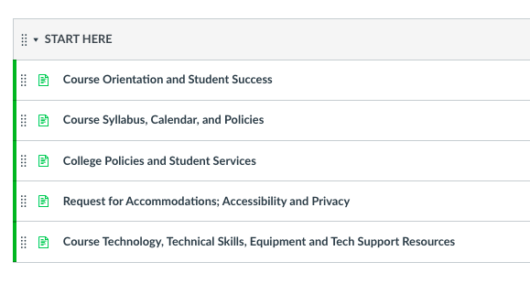
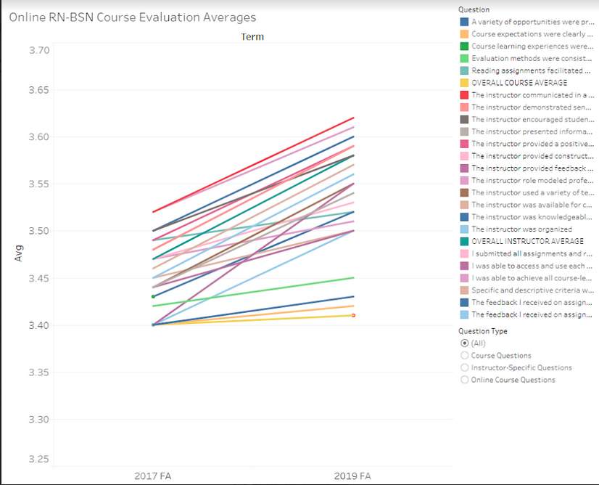

QUESTION . . .
Review Readiness
Establishing internal review
processes to prepare for QM certification reviews
Step One: D &D . . .
DISSEMINATE and DISCUSS evidence for the defining features of course quality
How does a small college, with
one instructional designer,
achieve unified quality assurance certification in 18 months?
,
Step Three: D & D, the Sequel
DEVELOP and
DISTRIBUTE templates
that support success
Step Four: Enlist Educators . . .
Identify peer auditors to provide colleague-to-colleague support
*SUPPORT is our SUPERPOWER*
Step Two: A Third D . . .
DISTINGUISH between protected Academic Freedom in content, and issues pertaining to design.
INTERNAL REVIEW!!!
PEER MENTORS!!!
COURSE TEMPLATES!!!!
Jami Nininger, DNP, RN
jnininger@mccn.edu
with Missy Mohler, MS, RN
and Miriam Abbott, MA
Mount Carmel College of Nursing
100%
Faculty Satisfaction
and
The STUDENTS say . . .
Jami

