Slide 1
Transforming Online Classes-Looking Forward with a Focus on Implementing Culturally Responsive Teaching
Dr. Kinsey Hansen
Kinsey.Hansen@angelo.edu

Slide 2
Learning Objectives
Examine the importance of culturally relevant pedagogy
Evaluate the role of student relatedness
Identify and discuss ways to implement activities that build sense of relatedness in an online class

Slide 3
Importance of Culturally Relevant Pedagogy
Bridging cultural gaps to develop academically validating relationships
•Relatedness - "Fostering supportive and positive relationships between professor, students, and rigorous content” (Salazar & Berryhill, 2020, p. 46).
Notes:
Higher education institutions, HSIs serve students experiencing cultural gaps such as cultural framework gaps and relatedness gaps. This presentation addresses the significance of relatedness gaps which impacts students’ sense of belonging.
Cultural framework gaps exist between high context learners and low context institutions

Slide 4
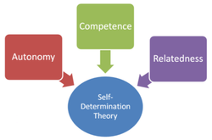
Significance of Relatedness
•Relatedness is fundamental to developing intrinsic motivation and persisting in difficult tasks (Deci & Ryan, 1985).
•Student-peer relationships contribute to self-sustaining engagement in high-quality learning, characterized by focused hard work, constructive responses to challenges and setbacks, and resilience (Skinner & Pitzer).
•Learning communities improve learning
outcomes and relatedness to faculty and
peers is a strong predictor of academic
development and student preparedness
(Beachboard et al. 2011).
Deci & Ryan (1985)
Notes:
Social Capital – this ties back to LatinX Assets
Bullet one: The relationships that matter the most to students are 1)positive relationship they have with the learning material, developing confidence as learners and
2) the positive relationship they develop in the environment..this includes professor but also includes peers.

Slide 5
Student Relatedness & Peer Review
Benefits of Peer Review
•Student-to-student interactions are positively related to general learning, cognition, racial identity, academic self-identity, well being, moral, retention.
•Peer-to-peer relationships keep students-especially marginalized students-from letting each other fail.
•Purposeful peer interaction enhances learning, increases sense of belonging, and improves student confidence.
(Felton & Lambert, 2020)

Slide 6
Group Activity

Slide 7
Peer Review - Background Course Information
Course: EDG 6340 - Structure and Organization
Who Takes this Course:
•Master’s level course in the department of Curriculum & Instruction
•Administrative Leadership majors
•Course is taken at any point in the degree
•8 week term; 100% online

Slide 8
Peer Review Project
Part One:
Construct Professional Development on Four Frames
What points did you expect the presenter to cover regarding each frame?
Part Two:
Design/Include Engagement Activity
What feedback can you provide the presenter regarding the activity? What recommendations do you have for improvement?

Slide 9
Lessons Learned
•Students loved peer review in this course
•Benefits of peer review from this course specifically
Students gained new perspectives
Peer review improved students’ assignments
Received beneficial feedback
Increased clarification on assignment
Provide a second set of objective eyes on assignment

Slide 10
Course Survey Results
•Course survey included 7 questions
•Survey addressed peer review on presentation and activity component of project
•Responses received = 9
•Qualitative and quantitative data received

Slide 11
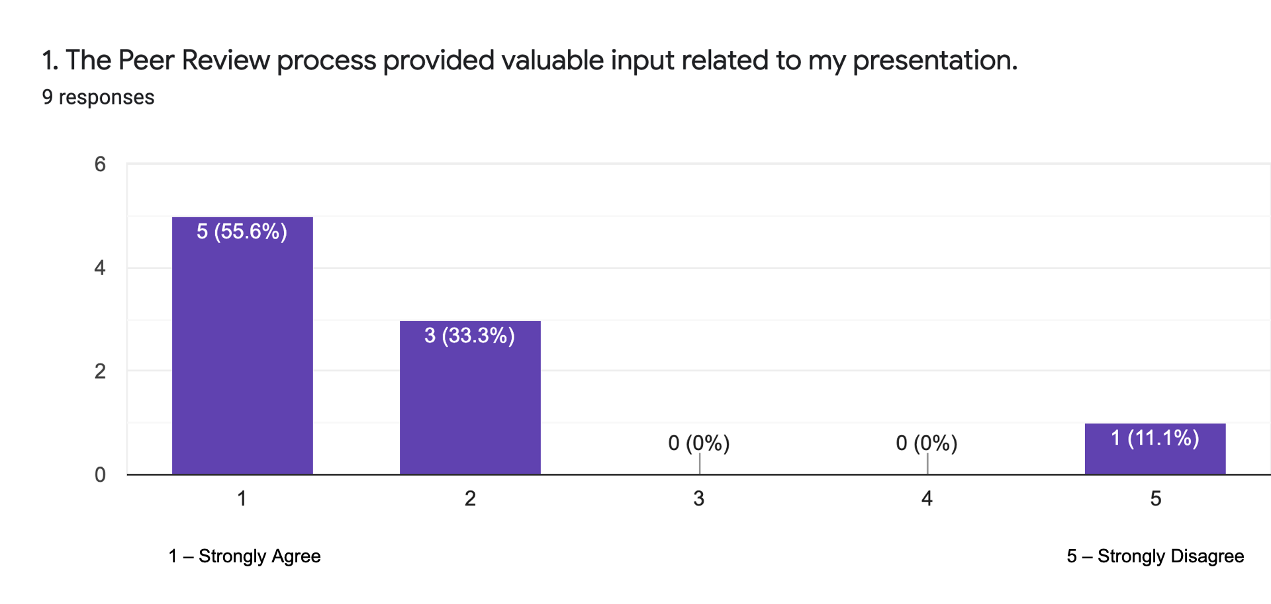
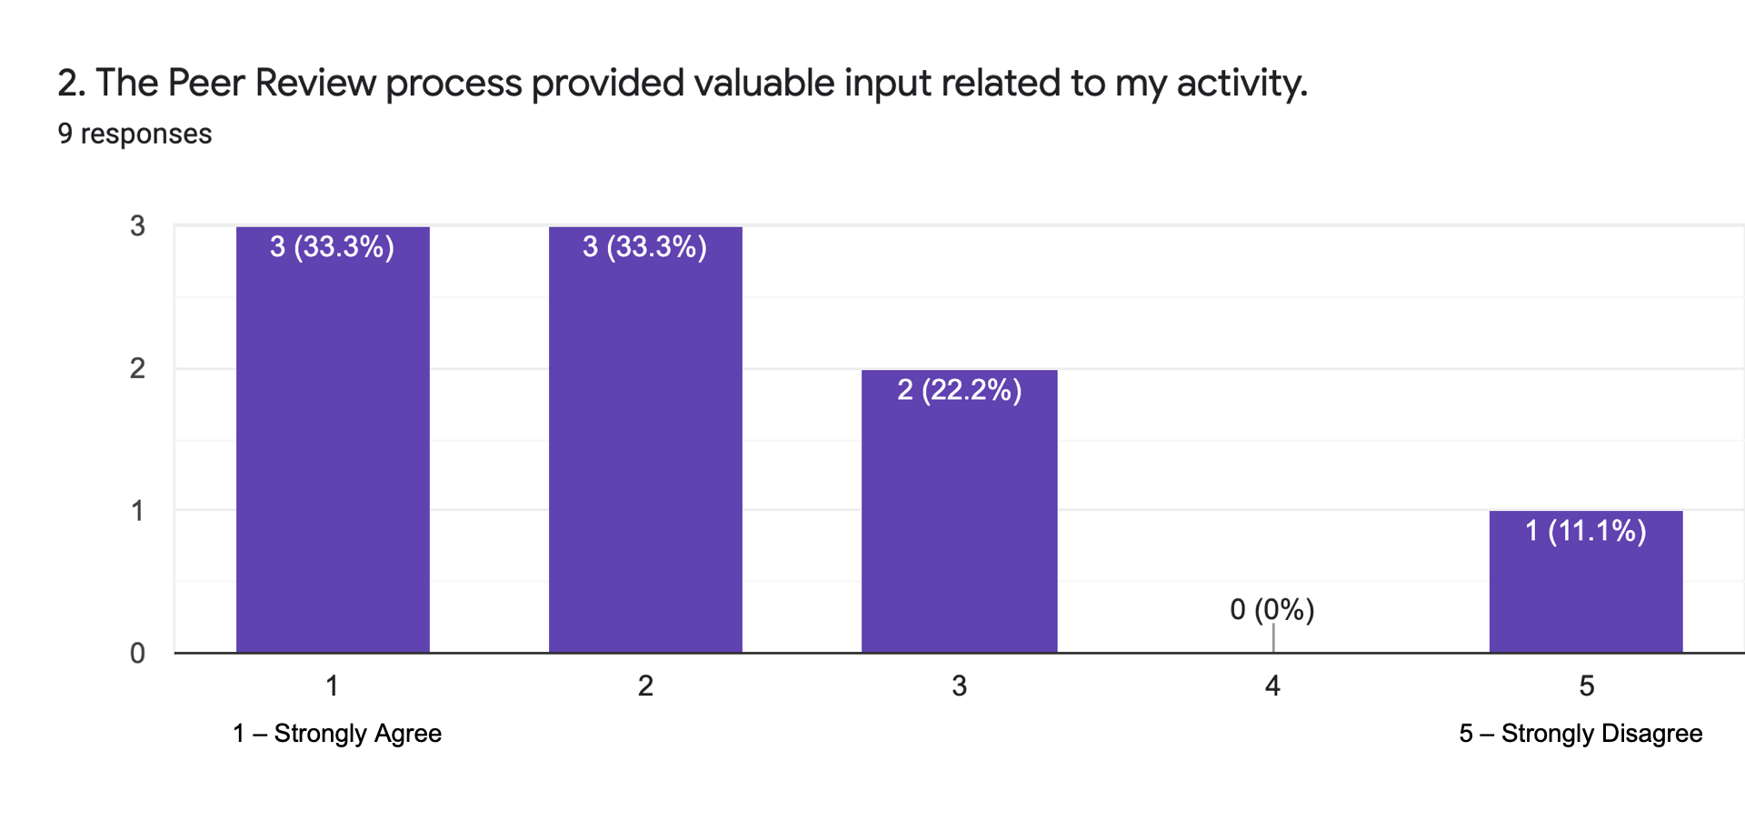
Question 1 and 2

Slide 12
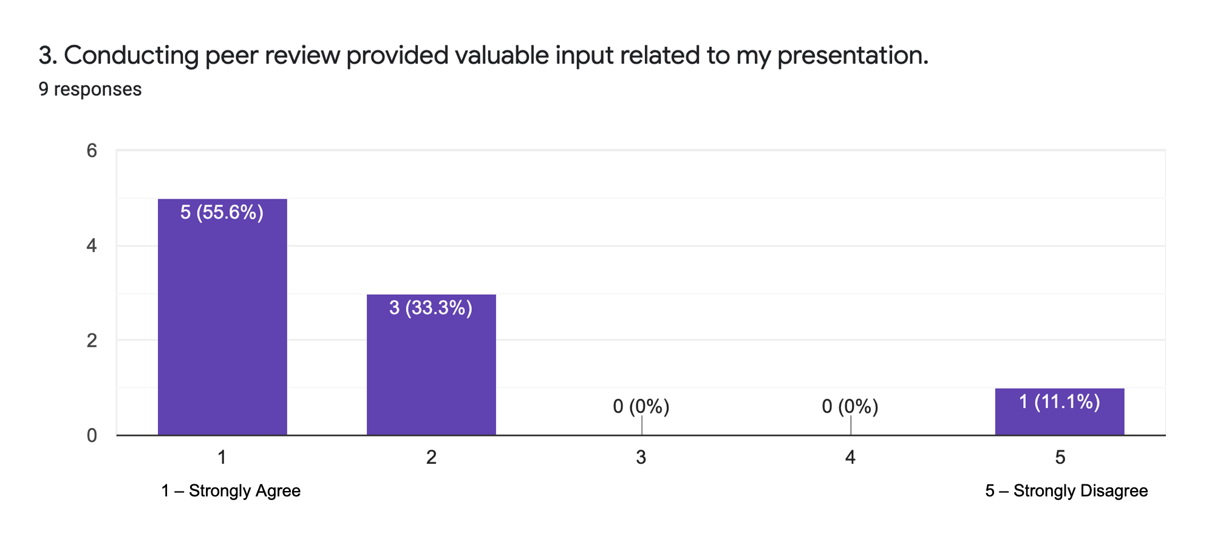
Question 3.

Slide 13
4. What (if anything) about the Peer Review process was beneficial? (Please explain)
•I was able to see my peer's work and relate it to mine. I was able to see how my peer's reflection of the 4 frames was different or similar to my personal reflection. I gained different perspectives that I hadn't thought of.
•Viewing others’ take on the assignment and receiving feedback to help my assignment improve.
•Seeing what other people thought about your presentation before you submit. It provides you the ability to make changes before submitting for the final grade.
•Being able to have a "sounding board" to bounce ideas off of has been integral to my success in this program. Peer review assignments are one of my favorite ways to get feedback.
•I found the Peer Review beneficial to listen to other perspectives and additional feedback to strengthen my presentation.
•I had over-complicated this presentation in a big way. In fact I wasted several hours overcomplicating this presentation. Thank goodness for the peer review process which helped me clarify what was needed for this assignment.
•It gave me a chance to have someone other than a "loving non-critical" family member review my work.

Slide 14
5. What (if anything) about the Peer Review process was ineffective? (Please explain)
•Technology
The technology part of it seemed to be a bit of an issue, but it was resolved quickly. (2 students):
•Short answers
Lack of detailed feedback (2 students)
•Nothing (3 students)

Slide 15
6. As a peer reviewer I learned....
•A different view or perspective about the course. I was able to see how my peer's viewed leadership in their organization.
•That other individuals’ ideas may compliment my work and allow for me to expand my ideas. I learned to be open minded and how to consider suggestions and/or constructive criticism.
•Someone always has a better presentation than you! I also learned to provide construct, thoughtful, and useful feedback.
•How to provide feedback for others and get glimpses of what I was doing well, or not, on my assignment based upon seeing others in the class.
•It made be aware of other people’s way of thinking when they made their own presentation. It also provided more information to add in my own work.
•I learned that there are several ways to accomplish the same task.
•We all need help.
•How difficult it is to be as helpful as possible. I really wanted my people to do their best and it was a big responsibility to give them as much feedback as possible.
•How to better improve my own work

Slide 16
7. Would you recommend Peer Review in future courses? Why?
•Yes, because it allows others to see their peer's work and learn from it in a way that can be beneficial to them. It is also reassuring that you have similarities in your work when it comes to not being confident in your work or assignments.
•Yes because it allows students to receive feedback from others. This can help the student gain a better understanding on how others think. The review was short, sweet, and to the point. It also allows students to become open minded.
•Yes, it's beneficial if done right.
•Absolutely!! Please see above.
•Yes, this makes me think critically when looking at others work and will make me want to apply more work into my own presentation.
•Yes I definitely recommend the peer review process. It's a great way to get feedback before submitting the assignment for a grade.
•Absolutely!
•Yes I would. Just like any group project, you always run the risk of having someone not do their part. However, since there is two people doing your reviews, it is possible to get good feedback and it is very helpful to see it from the other side as a reviewer.
•Yes, it allows you to get a better understanding of the expectations

Slide 17
Future Improvements to Peer Review
Technology
Requirement for Peer Review Responses
  Enhance peer review criteria
  Increase minimum word requirements
  Reword directions
  Increase points associated with Peer Review

Slide 18
Looking Forward
Include student relatedness in each course
(integrate a focus on instructional materials and instructor-peer)
Diversify each student relatedness approach in each course
Peer Review
Group Project
Pilot Weekly Small Group Tasks
What are you currently doing in your online courses that incorporates student relatedness with a focus on peer to peer relatedness?

Slide 19
References
•Fedesco, H.N., Bonem, E.M., Wang, C., & Henares, R. (2019). Connections in the classroom: Separating the effects of instructor and peer relatedness in the basic needs satisfaction scale. Motivation & Emotion, 43(5), 758-770. Doi: 10.1007/s11031-019-09765-x.
•Nicol, D., Serbati, A., & Tracchi, M. (2019). Competence Development and Portfolios: Promoting Reflection through Peer Review. AISHE-J: The All Ireland Journal of Teaching & Learning in Higher Education, 11(2), 1–13.
•Peter Felten, & Leo M. Lambert. (2020). Relationship-Rich Education : How Human Connections Drive Success in College. Johns Hopkins University Press.

