Slide 1
Mary Culshaw, PhD, OTR/L
Bernie Cantens, PhD
Sarah Rentz, M.A.T.
Finding the Tipping Point in Adoption Through the Health Sciences

Slide 2
Outline
Moving into QM at Moravian
Initiatives at Moravian
Why the Health Sciences as Early Adopters
Other Factors That Encourage Adoption of QM
Examples of Adoption - IPE and OT course master

Slide 3
Moving Into QM
The Moravian Story
Who are the major stakeholders/decision makers at your institution?
Moravian: (1) President/Provost and ( 2) Faculty
At what stage of development is your institution’s online program?
Here are the central argument we made:
  Maximizing organizational resources (president)
  Showcasing the quality of online courses and programs (president)
  Improving the students experience (dean of student success, accessibility office, administrators, faculty)
  Creating an evidence-based process for maintaining online learning quality (faculty)
  Consistency in course design (instructional designers, program directors, president)
  Supports accreditation process (program directors and chairs and VP of Accreditation)

Slide 4
University-Wide Initiatives
Incentive: Stipend for APPQMR and PRC
Supporting workshops by Instructional Design and Technology teams
Some faculty felt overwhelmed by QM courses on top of current workloads
Creation of an internal Moravian University mini- course for faculty: Best Practices in Online Course Design

Slide 5
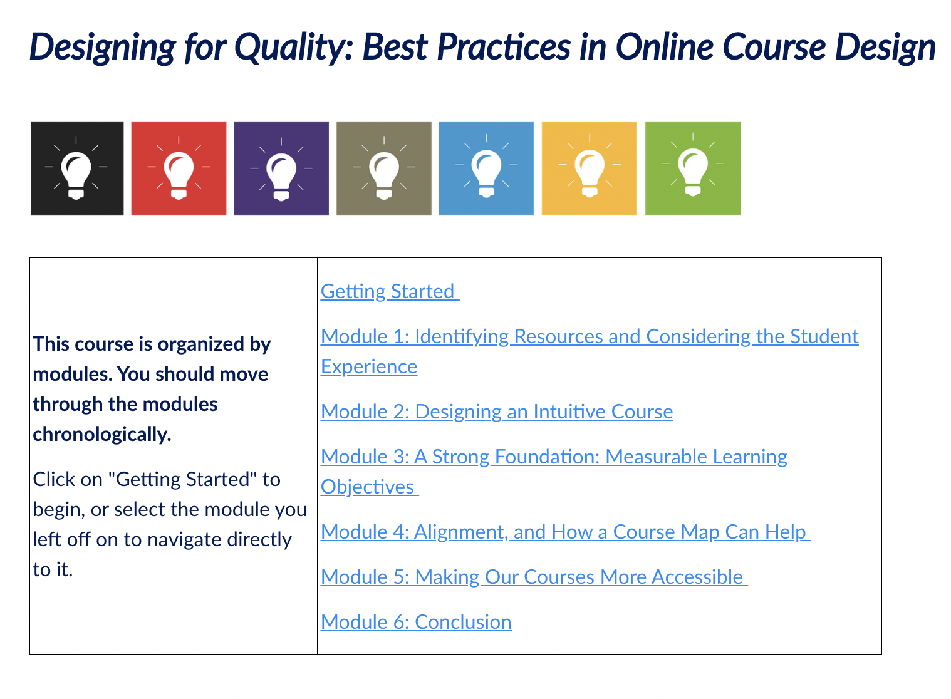
Designed by ID with faculty input
Facilitated by faculty and ID
Asynchronous
Less time commitment while still introducing key course design elements

Slide 6
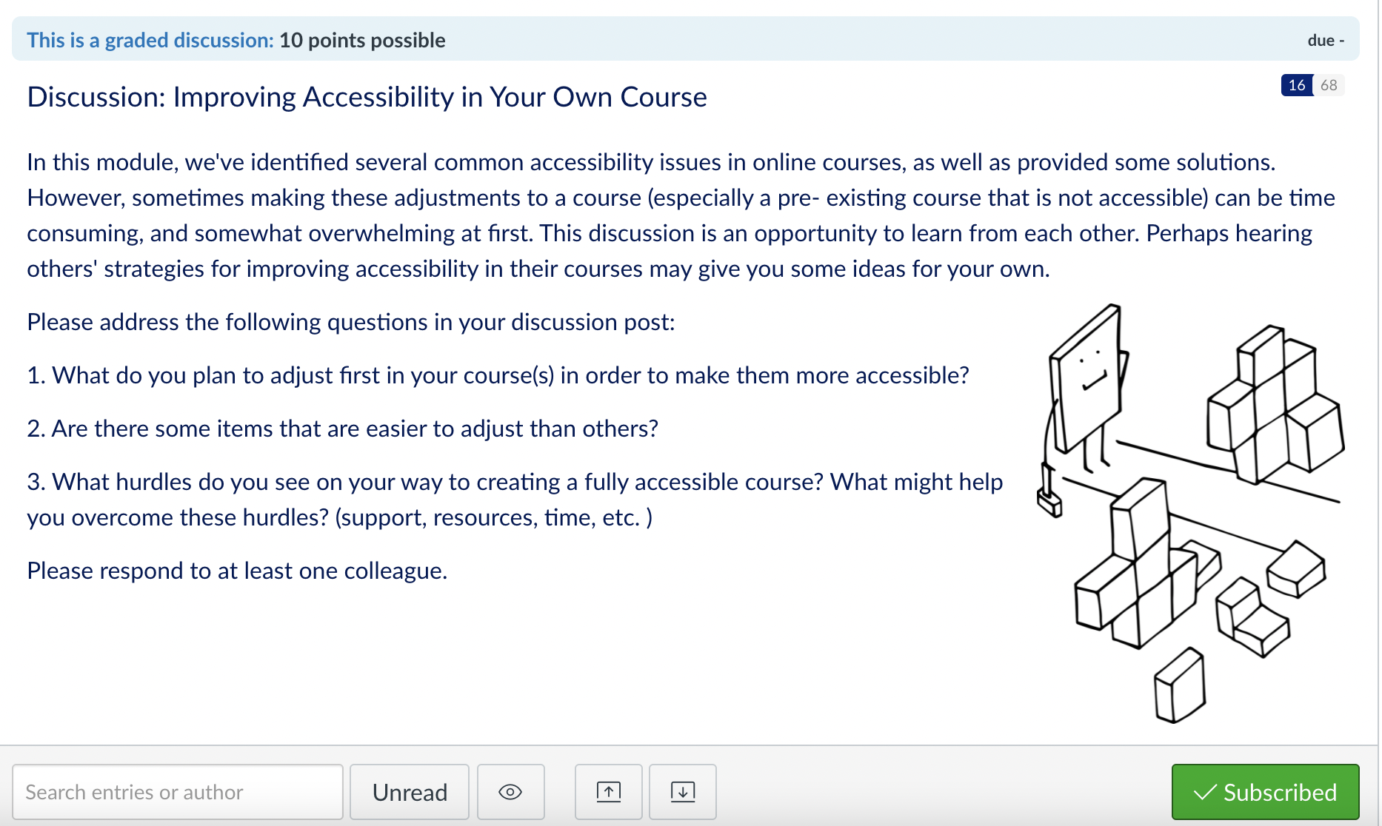
Key Features:
Active discussions
Informal review activities
Friendly feedback from fellow colleagues
Real- world applicability: assignments that ultimately produce something that can be used in a current or future course

Slide 7

Why the Health Sciences as Early Adopters?
Accreditation Requirements
Already Have Standards to Meet
Clinical Faculty

Slide 8



Why the Health Sciences?
Accreditation Requirements

Slide 9
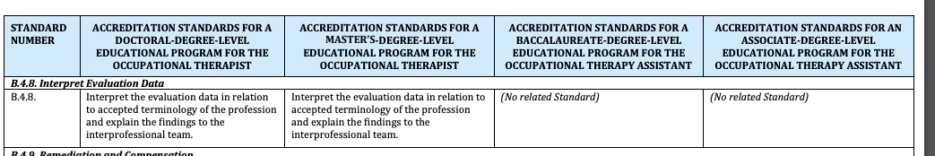
Why the Health Sciences?
Already Have Standards to Meet

Slide 10
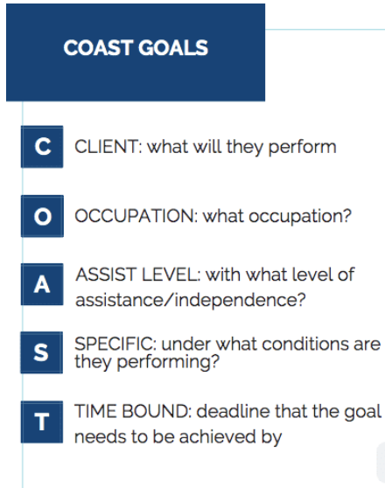
Why the Health Sciences?
Clinical Faculty
SMART: Significant, Measurable, Achievable, Relates to person, Time based

Slide 11
Other Points That Encourage Early Adoption of QM
Supporting key faculty
Stipend for course

Slide 12
Other Factors That Contributed to Early Adoption
Concept of QM as framework for teaching all courses not just online

Slide 13
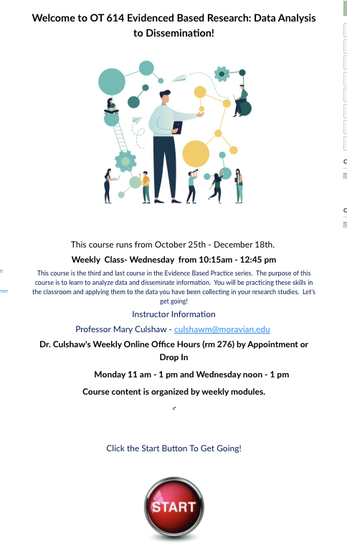
Two Examples of How We Adopted QM

Slide 14
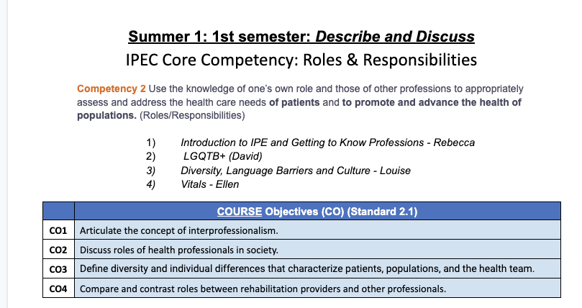
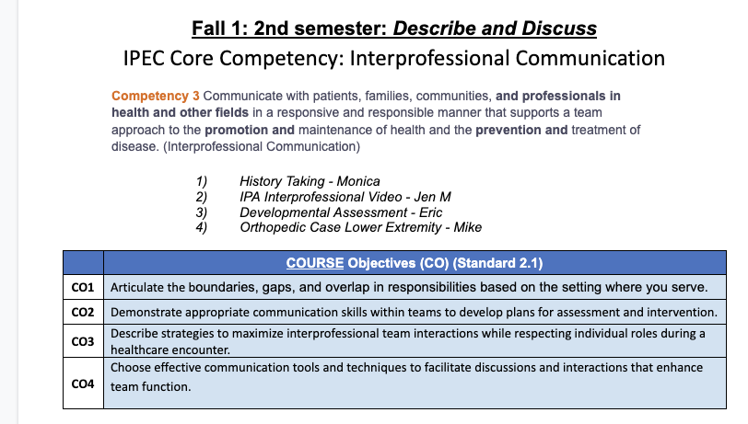
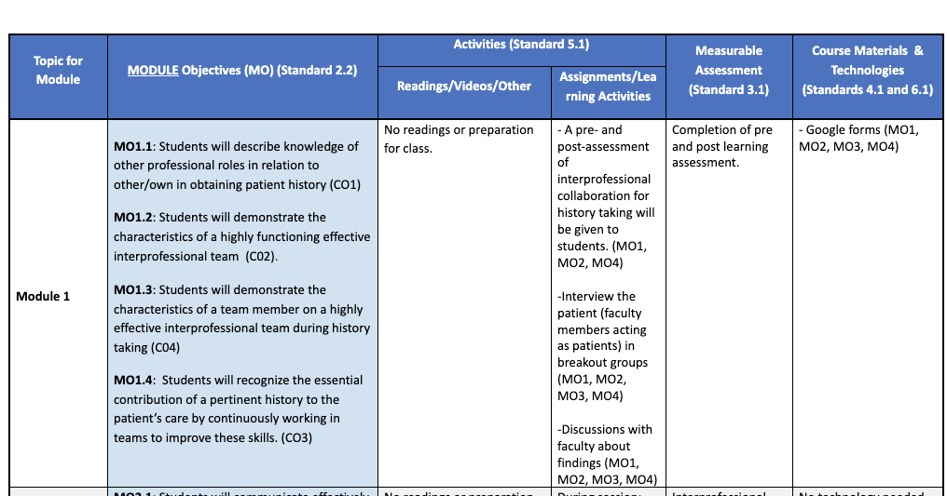
Two Examples of How We Adopted QM

Slide 15
Summary
Health Sciences and Early Adoption
Accreditation needs
Already have standards to meet,
Health care personnel familiar with goals
Other points that contribute to adoption
  Targeting people to support
  Stipend for course
  Concept of QM as framework for teaching not just online
Campus wide with support from Administration
Ongoing support at all levels
Initiatives
  Different levels of inclusion
  Stipend

Slide 16
Thank You!!
Sarah Rentz, M.A.T
Senior Instructional Designer
rentzs@moravian.edu
Mary Culshaw, PhD, OTR/L
Assistant Professor, Occupational Therapy
culshawm@moravian.edu
Thank You!!

