Slide 1
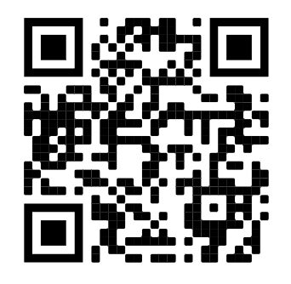
You had me at “Hello” – Maximizing the Power of QM Introductions
Social presence, social capital, and use of introductions
Vicki Mason, D.HSc and Mary Amick, Ed.D.
Introduction
The purpose of this poster is to explore
social presence, social capital, and using
QM course introductions to build
community and assist instructors. Social
presence is related to “the individual’s
perception of how they feel in interaction
with others” (Kim, 2011, p. 764) or “a
perception that others are real and there”
(Lowenthal & Dunlap, 2018, p. 282). Social
capital reflects the“ value derived from
membership” (Jenson & Jetten, 2015., p.2).
Methods
The survey was informed by Kim, (2010),
Lowenthal & Dunlap (2018) and McCoy (2021).
The survey was piloted with 74 students
and yielded a 16% response.
One section focused on perceptions
regarding instructional techniques (i.e.,
synchronous sessions, group projects,
discussions, peer review of projects and
assignments, introductions) and feeling a
part of the learning community. A 5-point
Likert scale was used.
Open-ended questions were asked
as follow up.
RESULTS
What is the best introductory question an instructor
has ever asked and why?
What’s your family holiday tradition? - It made the class more personal.
What would you bring to a potluck? -
The question and answers made me relax and feel more connected.
Are you a dog or cat person? - It gave me a connection with peers,
and I liked hearing the stories of other people’s pets.
Conclusion
While further investigation is needed
preliminary data suggest that QM
introductions offer benefit in building
social presence and social capital.
Scan the QR code for more information.
Discussion
Course introduction prompts are course-
related, course-related fun, or simply fun.
Serious and humorous approaches gauge
students’ interest and confidence levels
regarding course topics. Faculty gain
valuable insights to tweak emphases and
instructional approaches. Intentional
selection of topics and judicious use of
audio/video introductions are incorporated
to build social presence, and foster
social capital.
Which topic in the Table of Contents are you
most interested in?
Self-confidence ratings ranging from math phobic
to future finance guru for the finance course
Favorite cookie
The most fun you have ever had.., that you
can talk about
Two truths and a tall tale
References
Jensen, D., & Jetten, J. (2015). Bridging and bonding interactions in higher
education: Social capital and students' academic and professional identity
formation. Frontiers in Psychology. 6,126 doi:10.3389/fpsyg.2015.00126
Kim, J. (2010). Developing an instrument to measure social presence in
distance higher education. British Journal of Educational Technology. 42(5),
763-777. doi:10.1111/j.1437-8535.2010.01107.x
Lowenthal, P.R., & Dunlap, J.C. (2018). Investigating students’ perceptions
of instructional strategies to establish social presence. Distance Education.
39 (3), 281-298. doi:10.1080/01587919/.2018.1476844
McCoy, S. (2021). Relationship between the length of the course (term),
collaboration, social presence, and satisfaction among RN-BSN students in a
cohort-based online environment. Unpublished doctoral thesis.
Acknowledgement
The authors acknowledge the work of Morrison (2019) on poster presentations.
Accessed at https://www.youtube.com/watch?v=1RwJbhkCA58
 | Strongly disagree | Disagree | Neutral | Agree | Strongly agree
Course introductions help me feel connected to my instructors and course colleagues | 0 | 8.3% | 8.3% | 33.3% | 50%
I feel a part of the learning community in my program | 0 | 0 | 16.6% | 41.7% | 41.7%

