Slide 1

Building Quality Relationships and Courses
Bethany Single

Slide 2
Introduction
Background on Bethany
  Working in Instructional Design since 2012
  Worked for Colleges and now Pearson
  Currently Lead Instructional Designer
Objectives
Discuss the importance of positive working relationships.
Identify strategies to build confidence during consultations.
Explore the use of the QM rubric to enhance ID and SME relationships.

Slide 3
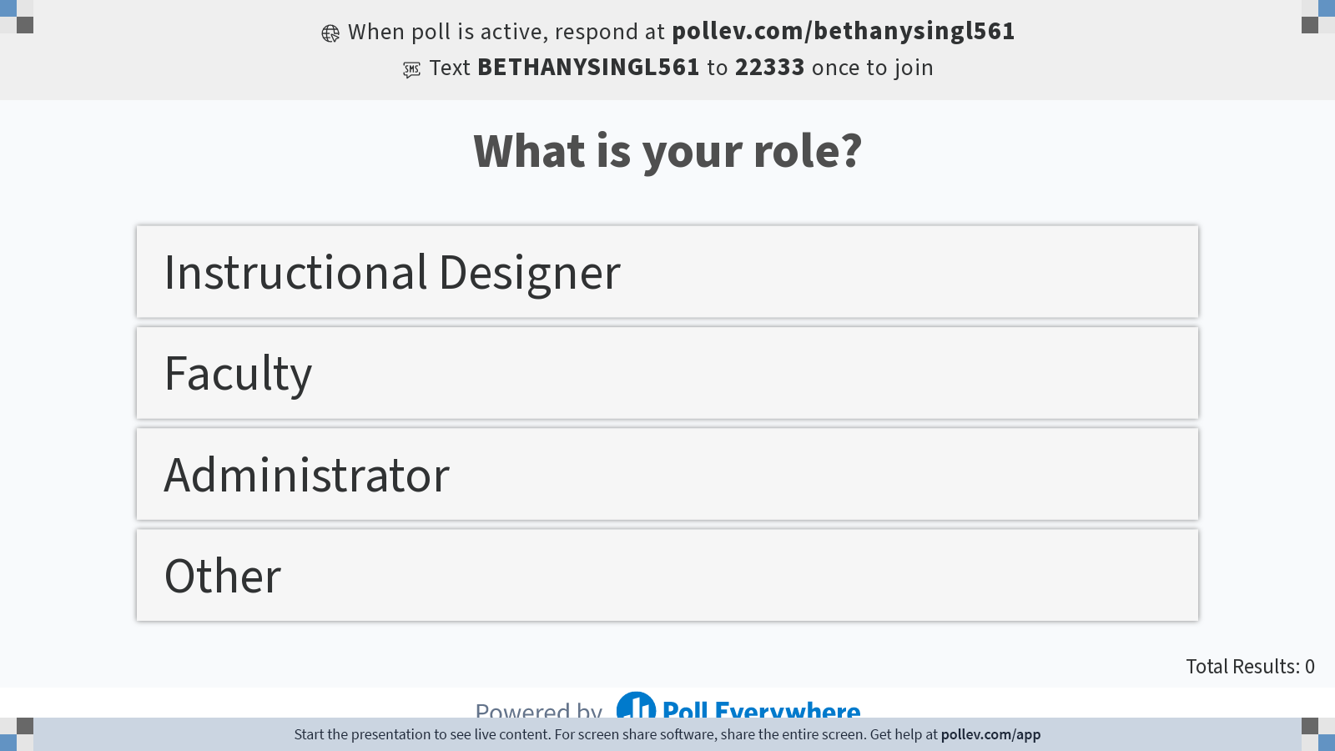
Notes:
Poll Title: Do not modify the notes in this section to avoid tampering with the Poll Everywhere activity.
More info at polleverywhere.com/support
What is your role?
https://www.polleverywhere.com/multiple_choice_polls/f4s8ktQ2eSQ2OmUfHyZ2G?flow=Default&onscreen=persist

Slide 4
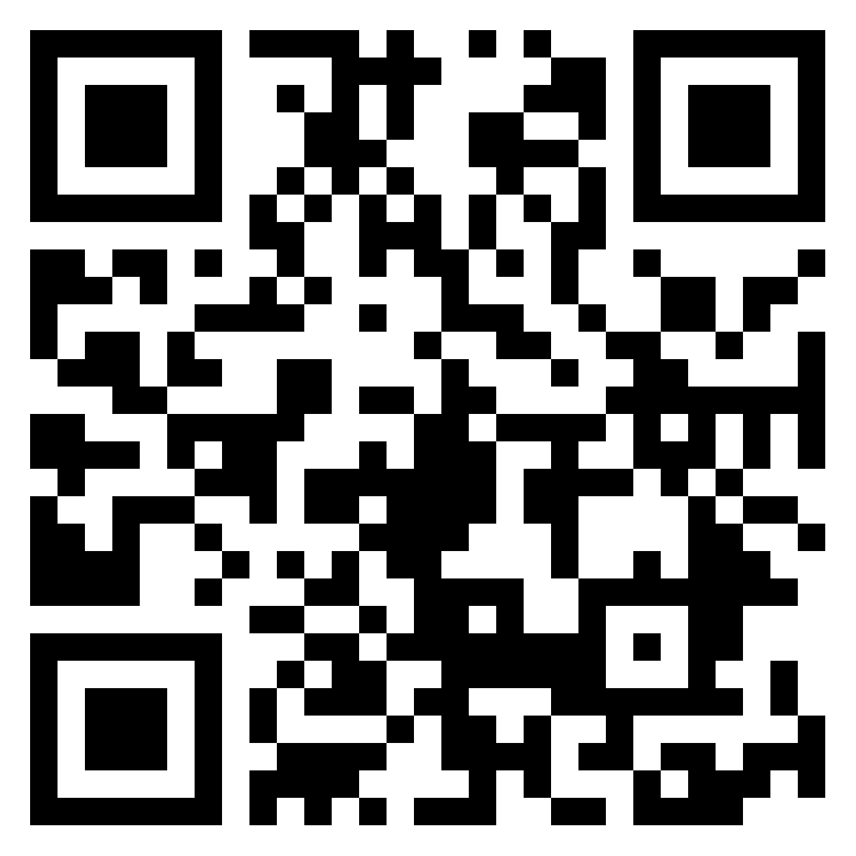
Padlet
Open discussion questions
Post throughout the presentation
https://tinyurl.com/mhvejunr

Slide 5
Establishing Positive relationships
It is time to get personal!
What constitutes a positive or a negative relationship?
Strategies for building a positive relationship
Why are relationships important in course design?
  How does a positive or negative relationship affect a course?
Notes:
Let’s take a moment and reflect on the Keynote.

Slide 6
Tools for confidence
How do you stay current in your field?
How do you prepare for consultations?
What tools do you keep in your tool belt?

Slide 7
Using the QM Rubric as a guide
What Standards are typically met?
How to encourage meeting other Standards?
Standard 1.8 & 1.9
Standard 2
Standard 3.2
Standard 6.2
Approaching the standards as guidelines
Making it a conversation
Show examples
Don’t push
Notes:
Emphasize that IDs and faculty are already doing a lot of these things.

Slide 8
How can the rubric help you?
Show your expertise
Have examples of quality course design
Build trust
Opportunity for faculty development

Slide 9
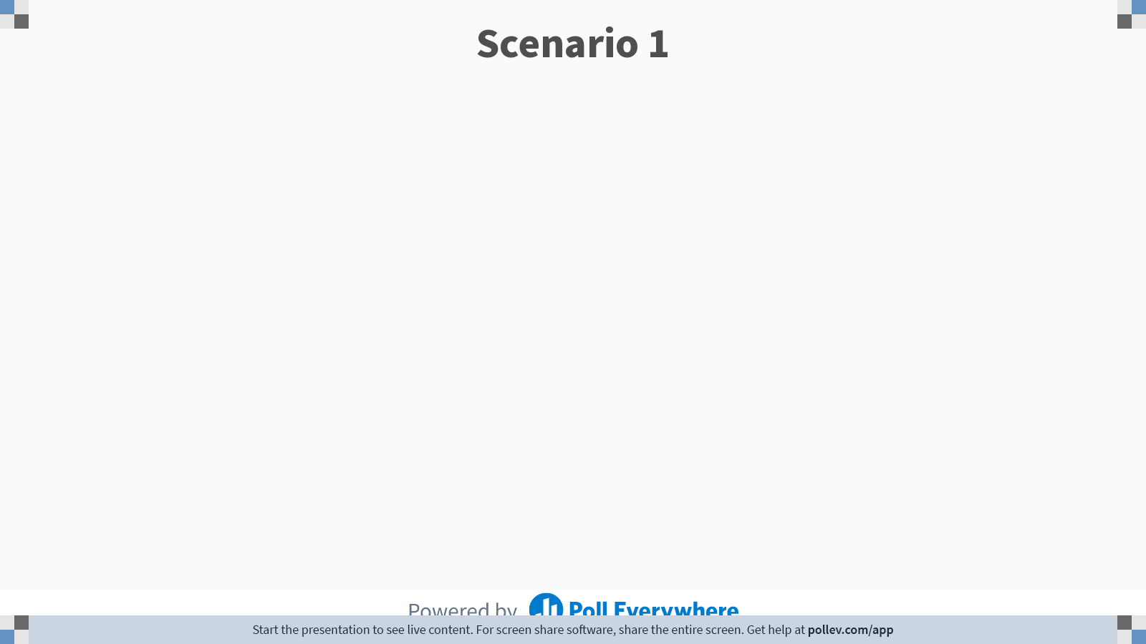
Notes:
Poll Title: Do not modify the notes in this section to avoid tampering with the Poll Everywhere activity.
More info at polleverywhere.com/support
Scenario 1
https://www.polleverywhere.com/free_text_polls/C54ovjsMGf9uZwUcrwHCe
Ellen scenario

Slide 10
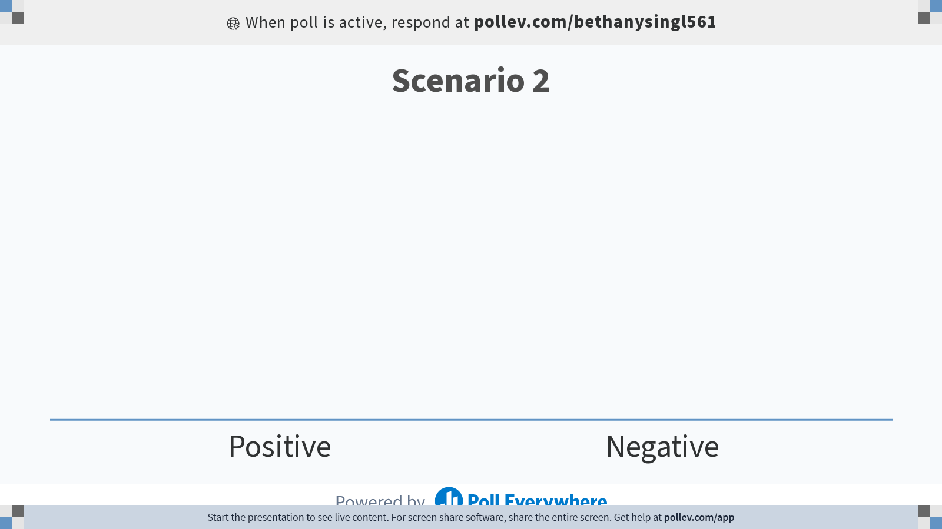
Notes:
Poll Title: Do not modify the notes in this section to avoid tampering with the Poll Everywhere activity.
More info at polleverywhere.com/support
Scenario 2
https://www.polleverywhere.com/multiple_choice_polls/4jKBd3R3QMgkTGm82B8Vf?flow=Default&onscreen=persist

Slide 11
Padlet
Let’s review!
https://tinyurl.com/mhvejunr

Slide 12

Questions
Contact
Bethany Single
Bethany.single@pearson.com

