Slide 1
So That Is My Instructor!
Using Videos to Improve Asynchronous Courses

Slide 2
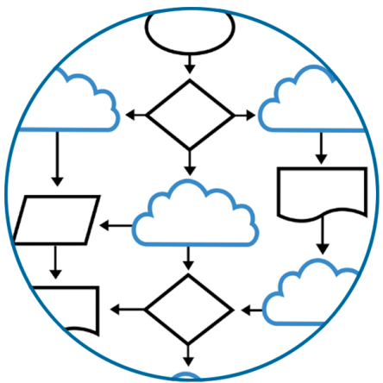
Lecture Objectives
By the end, we’ll cover:
Our Video Development Journey
Compare Results of Video Journey
Video Creation Tools and Techniques
Resource Sites for Video Creation

Slide 3

Exploring Video Pros and Cons
Video Benefits and QM Alignment:
Videos vs. Text Based Material
QM Standards 4, 5, and 6
  Materials
  Activities and Engagement
  Course Technology
Impact on Standard 8 (ADA)

Slide 4

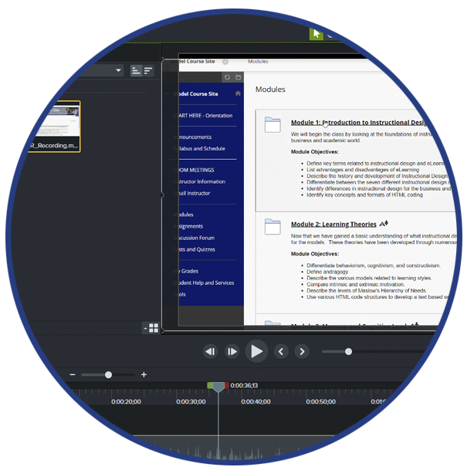
Video Creation – Version 1
The World of Screencasting:

Slide 5

Video Creation – Version 2
Are You Ready for Your Close Up:
Triggers: Camtasia and ACUE
Face on Camera / No PPT
Personalization / Story Telling
Begin Use of Stock Media

Slide 6

Video Creation – Version 2
Benefits of Being on Camera:
More Personalization
Quicker Assistance
Increased Approachability
Build Stronger Relationship

Slide 7
Video Creation – Version 3
Areas of Exploration:
Increase Creation Efficiency
Repository / Collaboration
Quizzing Features / Discussions
Grading Feedback and Clarification

Slide 8

Video for Every Occasion
When to Use Videos in a Course:
Lectures
Content Introductions
Instructions
Grading Feedback
Others???

Slide 9
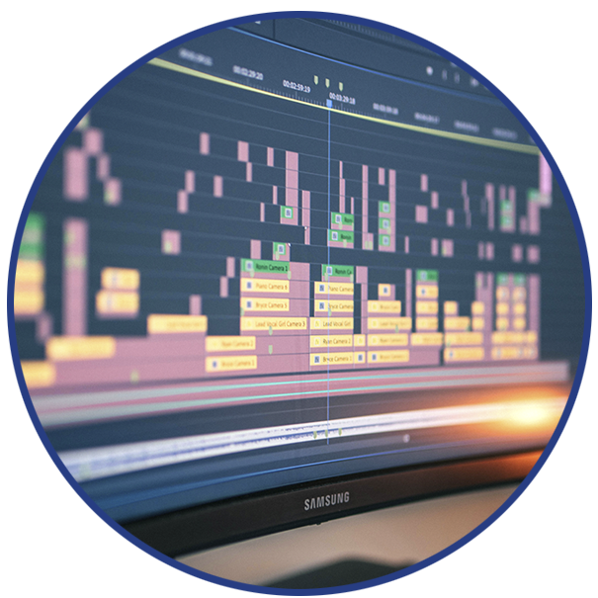
Video Development Process
Preparing and Capturing Video:
Storyboard Your Idea
Capture Video Clips
  Danger of Perfectionism
Gather Supplemental Media
  Graphics
  Video
  Audio

Slide 10

What About Copyright?
Copyright on Supplemental Media:
QM Standard
Creative Commons
Public Domain
Fair Use
Pay for the Clips You Need

Slide 11
Resources for Supplemental Media
Stock Media Websites (Images):
Unsplash (Creative Commons)
Flickr (Searchable Creative Commons)
Shutterstock (Pay and Creative Commons)
Thinkstock (Pay and Creative Commons)

Slide 12
Resources for Supplemental Media
Stock Media Websites (Video and Audio):
YouTube Audio Library (Creative Commons)
Sound Bible (Pay and Creative Commons)
Videvo (Pay and Creative Commons)

Slide 13
Video Development Process
Editing and Enhancing a Video:
Camtasia Primary Software
Follow Storyboard for Layout
Camtasia Assets for Effects
Site Sources at End of Video

Slide 14

Tips on Creating Course Videos
When Creating Videos, Remember the Following:
Tell a Story
15 Minutes of Less
Setting the Scene
Formal vs. Informal
Course Placement

Slide 15
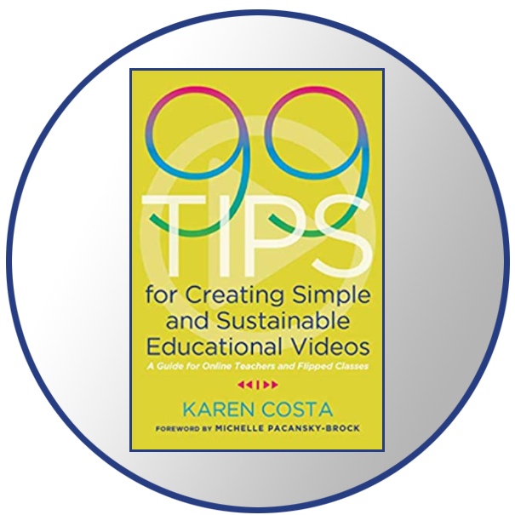

Additional Readings
Books that Inspired Us:
99 Tips for Creating Simple and Sustainable Educational Videos
by Karen Costa
How to Shoot Video that Doesn’t Suck
by Steve Stockman

Slide 16
Wrapping Up
Module 4
Summary

Slide 17
Lecture Objectives
By the end, we’ll cover:
Our Video Development Journey
Compare Results of Video Journey
Video Creation Tools and Techniques
Resource Sites for Video Creation

Slide 18
Works Cited
Images Used:
Slide 2, 16: Flowchart Image
  https://www.vectorstock.com/royalty-free-vector/cloud-flowchart-charts-vector-1013538
Slide 3: Quality Matters Logo
  Image found in Wikimedia Commons
Slide 4: Speaker Hand at computer
  Photo by Headway on Unsplash
Slide 4: Camtasia screenshot

Slide 19
Works Cited (p. 2)
Images Used:
Slide 5: Instructor video screen
  Photo by mohamed Hassan on Pixabay
Slide 6: Students at computer
  Photo by Mimi Thian on Unsplash
Slide 8: Student watching lecture
  Photo by Ralston Smith on Unsplash
Slide 9: Video editing software
  Photo by Axel Vazquez on Unsplash

Slide 20
Works Cited (p. 3)
Images Used:
Slide 10: Creative Commons logo
  Photo by Umberto on Unsplash
Slide 13: Camtasia screenshot
Slide 14: Online course
  Photo by Dylan Ferreira on Unsplash

Slide 21
Contact Information
Dr. Mark Gale - mark.gale@athens.edu
Dr. Letitia Bergantz – letitia.bergantz@athens.edu
Dr. Gary Valcana – gary.valcana@athens.edu

