Slide 1
Content Engagement
5 Simple Tricks to Engaging Online Video Lectures/Tutorials
Jun Yang
Instructional Designer
University of Maryland
QM Connect 2018
St. Louis, Missouri

Slide 2
What Are the Greatest Challenges with Online Video Lectures?
If you produce them, will they watch them?

Slide 3


Video Lecture Issues
Passive Learning experience:
No engagement between content and students
Too long
Have students watched videos?
How well do they understand video lectures?

Slide 4
Instructional Videos
Two things with instructional videos:
You want your students to actually watch the video all the way through.
In order to achieve the # 1, you need to get your students to follow-up the video with some kind of activities.

Slide 5
What Makes an Engaging Online Lecture?
What does engagement mean to you?
Group Pair/Share

Slide 6

Tip 1
Tip
1
Keep the video lectures 6 minutes or less long.
Short Chunks
Notes:
Length really matters!

Slide 7
Research-based Findings
Shorter is better: By far, the biggest factor in engagement is the length of your videos. (Researchers from MIT, edX and the University of Rochester)
VIDEO LENGTH | % OF STUDENTS ATTEMPTING THE ACTIVITY
0-3 mins | 56%
3-6 mins | 48%
6-9 mins | 43%
9-12 mins | 41%
12+ mins | 31%
Notes:
Researchers from MIT, edX and the University of Rochester

Slide 8

Tip 2
Tip
2
Instructor’s tone and enthusiasm (this may not be a tip, yet
many of us forget.)
  Keep an exciting, passionate, positive, and upbeat tone
  In your lectures will make your students react in a
  more engaged manner.
Add visuals and visual signposts
Talking head
Whiteboard style videos work better
The Seminar-style: with discussions on the lectures
Vary the presentation format
Personality & Visuals

Slide 9
Course Content Video Formats
PowerPoint Slide Presentation
PowerPoint Slide Presentation with Instructor’s Talking Head
Classroom Lecture Capture
Tutorials + Screencasts
Talking Head Videos (best used for marketing “about” videos)
Khan_Style with Digital Table Drawing Tutorials
Seminar style of instruction
Vary the presentation format

Slide 10
Examples

Slide 11
The Seminar-style instruction
https://voicethread.com/about/library/Higher_Ed_from_Della_Curtis/
The Seminar-style instruction
https://voicethread.com/#q.b908650.i4836718
Notes:
Pump up Your Online lectures and Discussions with VoiceThread

Slide 12

Tip 3
Tip
3
Add clickable areas in the lectures to enable users engage with the content or simulate the process.
Camtasia:
  Camtasia Hotspots:
  Camtasia Quiz Branching off to other related content
  based on the quiz result.
  Captions
  Table of Content
Adobe Captivate Simulations: “Watch-Try-Do”
http://cp8.demo.knowhow.s3-website-us-east-1.amazonaws.com/
Demo: Training Simulation & Assessment Simulation
Watch-Try-DO

Slide 13

Tip 4
Tip
4
Embed guided questions in the video lectures
Build break points and reflective activities
Embed Assessment

Slide 14
Tip 5
Tip
5
Using interactive templates:
eLearning Brothers Templates
Templates

Slide 15
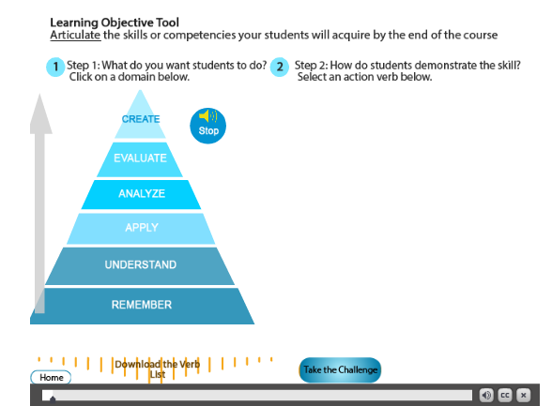
Examples

Slide 16
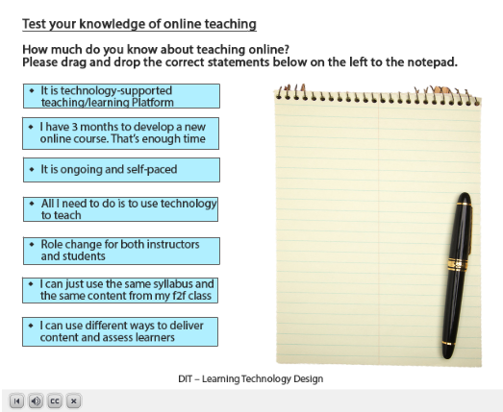
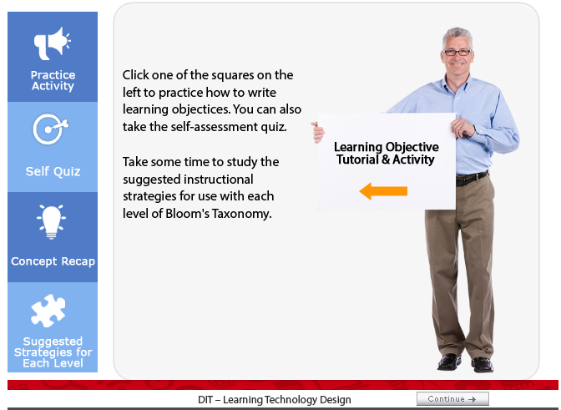
Examples
Interactive Tutorial Examples

Slide 17
Final Advices
Don’t be afraid to try something new
Leave plenty of time for development
Make your multiple lectures accessible

Slide 18



“Don’t cry because it’s over.”
“Smile because it happened.”
© 2012 All Rights Reserved. ForensIQ, Inc. - Thomas P. Mauriello

Slide 19

Thank You and Questions?
Jun Yang
Instructional Designer
Quality Assurance
University of Maryland
Instructional Designer
Quality Assurance
University of Maryland
Email: junyang8@umd.edu

