Slide 1



Use QM CPE Rubric
to Guide the Design of a MOOC
Developmental Course
Yaping Gao, EDD
District Director, Instructional Design
Notes:
Self-introduction

Slide 2
About Broward College
Headquarters in Ft. Lauderdale, FL
Multiple campuses & county centers
Various international affiliates
68,000+ students annually (28,000 FTE)
18 Online Programs & Certificates (since 2000)
QM subscriber since 2008
Broward College Online since January 2013
Notes:
About BC

Slide 3
Florida Legislative Change
Florida Senate Bill – SB 1720
http://www.flsenate.gov/Committees/BillSummaries/2013/html/501
Students who are not required to be tested or to enroll in developmental education may request assessment and may enroll in developmental education if they wish. The bill requires:
By March 1, 2014, Florida College System institutions to submit developmental education plans to the Chancellor of the Florida College System for implementation beginning no later than Fall 2014;
Each Florida College System institution and the Florida College System Chancellor to submit annual accountability reports to the state beginning in 2015.
Notes:
Florida legislation changes about developmental education.
Two groups of students will not be required to take developmental courses:
Students who entered 9th grade during 2003-2004 = graduated in 2007.
These on active military duties

Slide 4
Is MOOC the Solution?
  Groundwork
  0
    Virtually No Budget
    Contract with Canvas as LMS (free)
    FL PERT Competencies (Postsecondary Education Readiness Test)
    Reading, Writing & Math
    Faculty Developers (2 SMEs for each area)
    Instructional Design Team (3 Senior IDs)
    Instructor Team (3 Online Instructors)
Notes:
Assemble teams, secure LMS for MOOC, identify developer and instructional support and instructor teams

Slide 5
Yes, MOOC It Is!
  Project Timeline 0
  0
    Jan. – Feb. Assemble teams
    Mar. – Apr. Content development
    May – Review and fine-tune
    June 3rd – Launch 1st session (4 weeks)
    July 15th – Launch 2nd session (6 weeks)
    Sept. 23 – Launch 3rd session (12 weeks)
Notes:
Timeline

Slide 6
College Foundations:
Reading, Writing & Math
  Course Design
  0
    QM CPE Rubric (Continuing & Professional Education)
    Canvas Network Course Design Checklist: Initial Review
    Canvas Network Checklist:
    Before Course Launch
Notes:
QM CPE Rubric and Canvas checklists used during MOOC development; more in later slides.

Slide 7
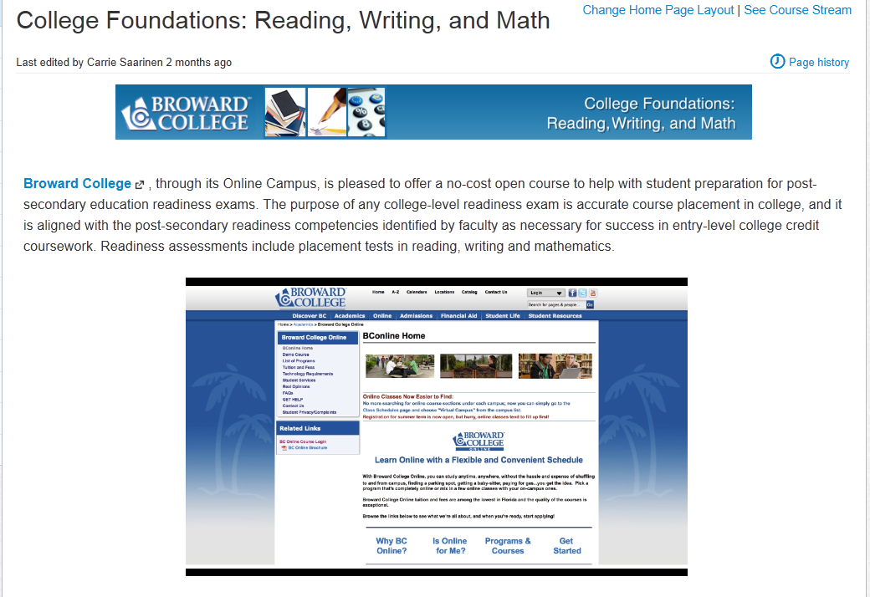
College Foundations:
Reading, Writing & Math
Notes:
Landing page (course homepage) with video to introduce Broward College and the purpose and structure of the MOOC.

Slide 8
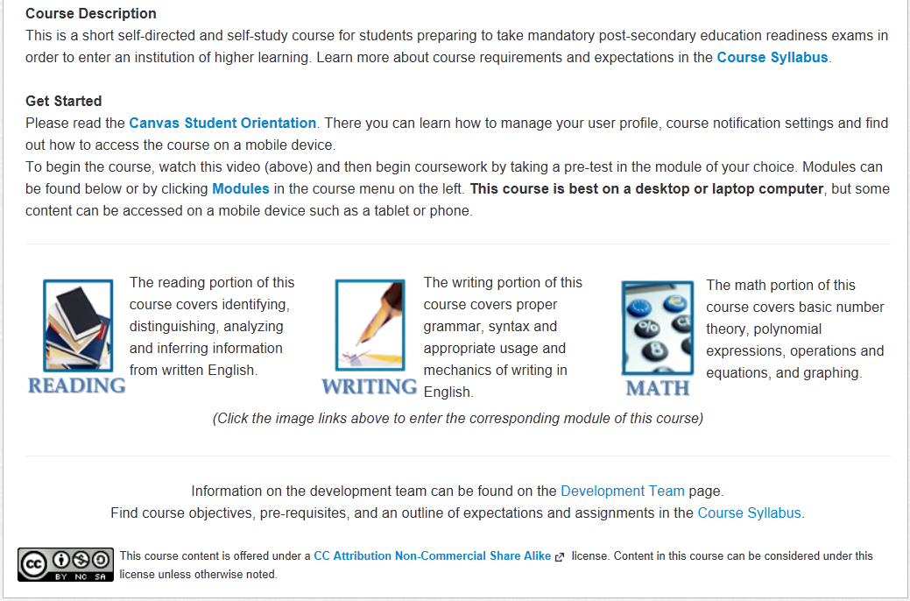
College Foundations:
Reading, Writing & Math
Notes:
2nd part of the landing page (course homepage) with icon/link to each module.

Slide 9
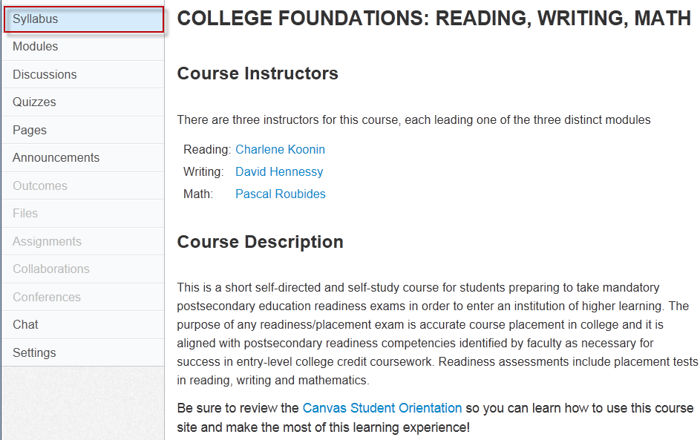
College Foundations:
Reading, Writing & Math
Notes:
Syllabus

Slide 10
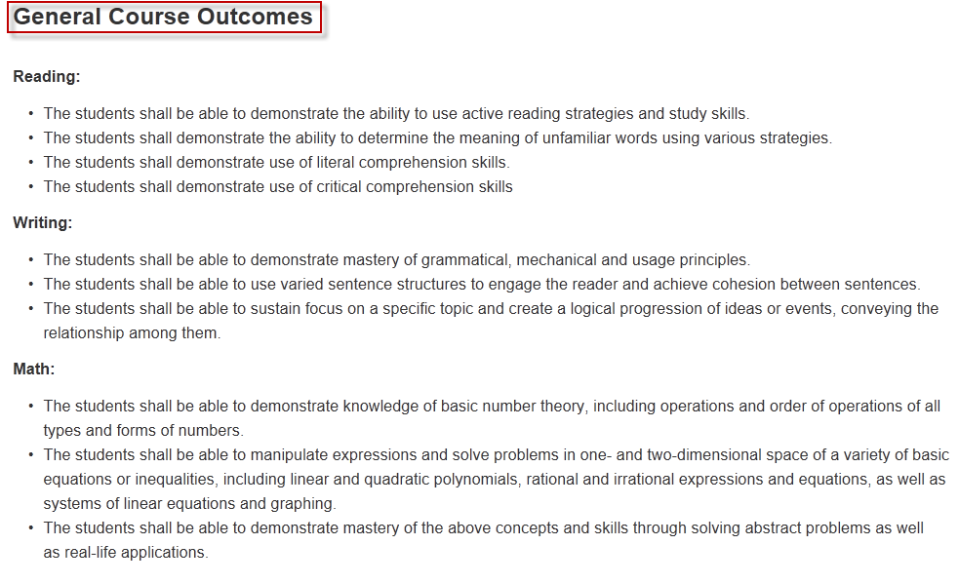
College Foundations:
Reading, Writing & Math
Notes:
Syllabus

Slide 11
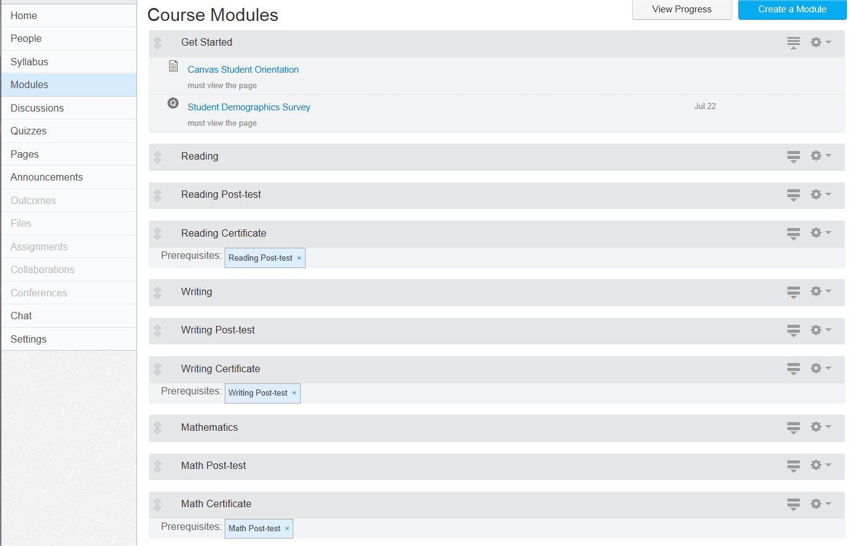
College Foundations:
Reading, Writing & Math
Notes:
Layout of three modules – pre-test is within the module content

Slide 12
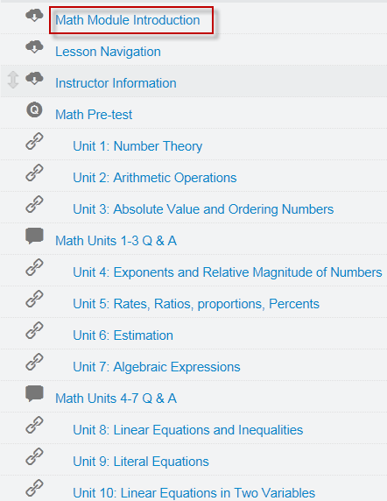
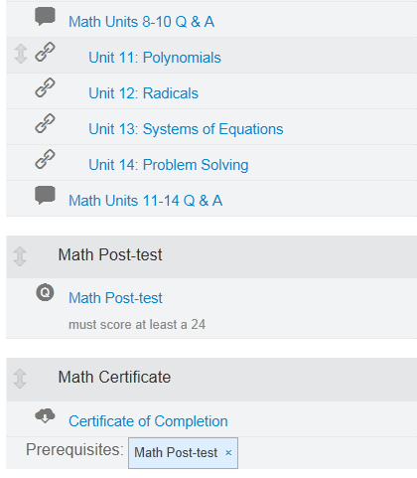
College Foundations:
Reading, Writing & Math
Notes:
Math module as an example

Slide 13
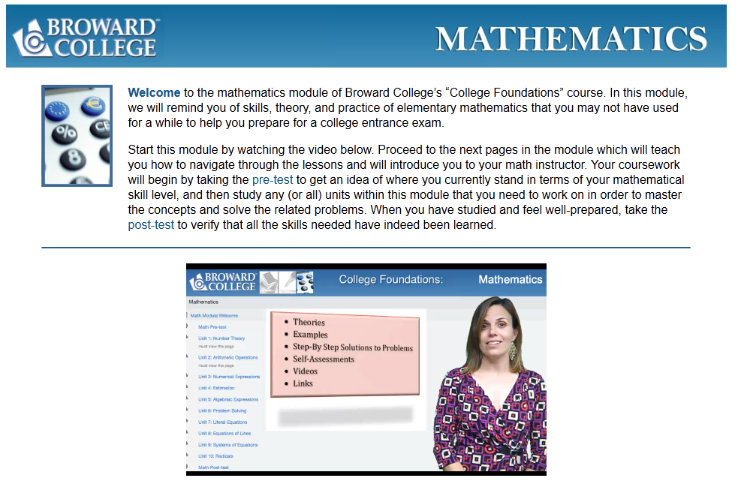
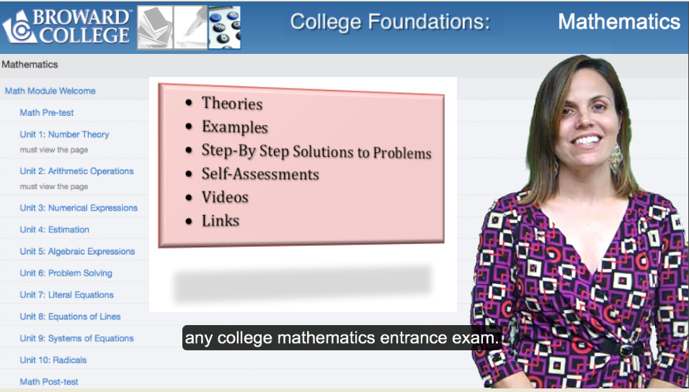
College Foundations:
Reading, Writing & Math
Notes:
Video introduction to Math module.

Slide 14
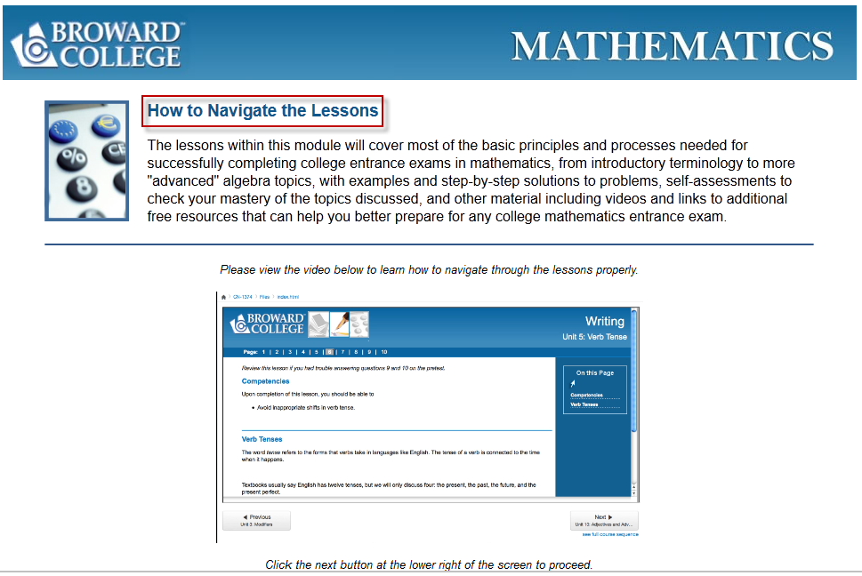
College Foundations:
Reading, Writing & Math
Notes:
Video introduction on how to navigate the lessons (all content are developed with SoftChalk).

Slide 15

College Foundations:
Reading, Writing & Math
Notes:
Introduction to the instructor who facilitates the Math module.

Slide 16
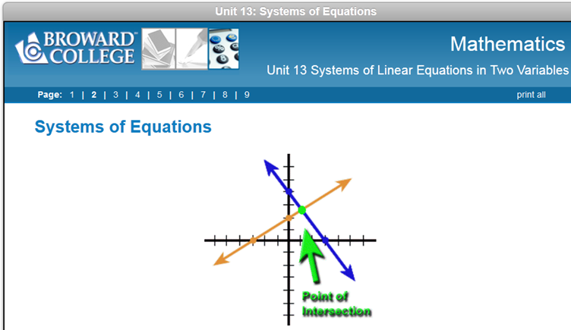
College Foundations:
Reading, Writing & Math
Animation created by Math faculty, Broward College
Notes:
Sample content page with animation produced by BC Math faculty. Only screenshot.

Slide 17
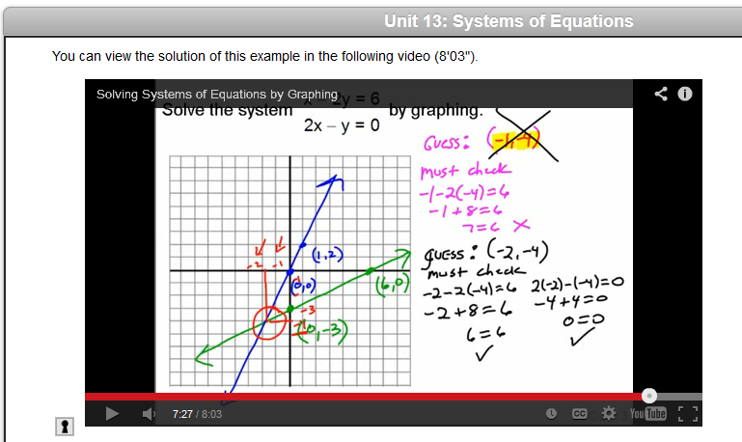
College Foundations:
Reading, Writing & Math
Video created by Math Faculty, Broward College
Notes:
Sample content page with video illustration produced by BC Math faculty. Only screenshot.

Slide 18
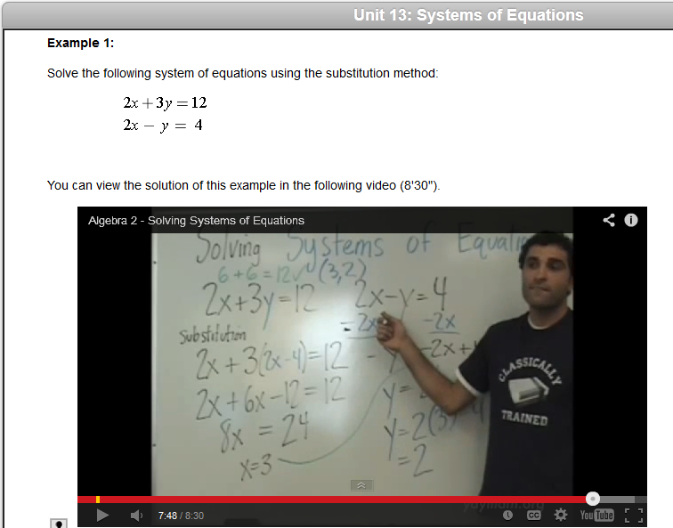
College Foundations:
Reading, Writing & Math
http://www.youtube.com/watch?v=XQ7aNAxZ0s0 – YouTube video by yaymath.org
Notes:
http://www.youtube.com/watch?v=XQ7aNAxZ0s0
YouTube video illustration by yaymath.org.
Only screenshot.

Slide 19
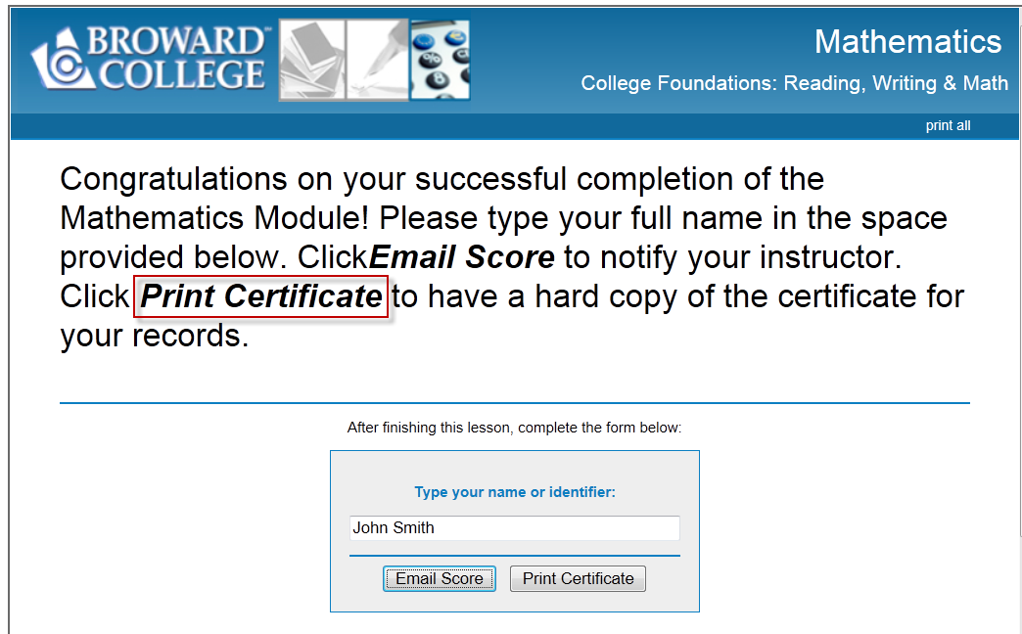
College Foundations:
Reading, Writing & Math
Notes:
If students get 24 questions correct out of 30 for the Post-Test (80% or higher), they will be able to Print Certificate.

Slide 20
College Foundations:
Reading, Writing & Math
  QM CPE Rubric as Design Guide
  0
    Majority standards apply
    Less emphasis on certain standards:
      1.4 institutional policies related
      1.5 prerequisite (developmental)
      1.6 minimal technical skills
      1.8 learner self-introduction
Notes:
Lesson emphasis on certain QM CPE standards.

Slide 21
College Foundations:
Reading, Writing & Math
  QM CPE Rubric as Design Guide
  - Continued -
  0
    Less emphasis on certain standards:
      5.4 required for learner interaction
      7.2 institutional accessibility policies
      7.3 support services & resources
      8.1 accessible technology & accommodations (Canvas)
Notes:
Lesson emphasis on certain QM CPE standards.

Slide 22

Ready to Launch!
canvas.net
Free
Anyone can register
Only requires email
Notes:
http://www.canvas.net for registration.

Slide 23
College Foundations:
Reading, Writing & Math
  1st Session, June 3 – June 30, 2013 (4 weeks)
    996 student accounts
    281 completed demographics survey
    Time spent: 1 hour - 10 hours+
    174 Female / 107 Male
    118 plan to attend Broward College
    124 live in Broward County
Notes:
Student demographics.

Slide 24
College Foundations:
Reading, Writing & Math
  1st Session, June 3 – June 30, 2013 (4 weeks)
Notes:
Students demographics - nationality

Slide 25
College Foundations:
Reading, Writing & Math
  2nd Session, July – Aug. 24, 2013 (6 weeks)
  1673 students
Notes:
Students demographics - nationality

Slide 26
College Foundations:
Reading, Writing & Math
  Instructor Impressions of Students
    Group 1: no-interest
    Group 2: interested in certain sections
    Group 3: serious and diligent
Notes:
Group 1: registered, no-interest, no show, or no participation or completion
Group 2: interested in gaining knowledge from certain sections; no interaction or participation in discussion unless have questions
Group 3: serious and diligent, completion of everything; ask questions, participation in all

Slide 27
College Foundations:
Reading, Writing & Math
  Lessons Learned
  0
    It takes a village but can be done!
    Self-motivation = Success
    Technical issues
    Instructor presence
    Course design matters
    Majority QM Standards apply
Notes:
Lessons learned

Slide 28
FL State MOOC
  Florida’s Statewide
  Developmental Education MOOC
  What’s Ahead
    January 2013, FL State RFP for a state funded ($300,000) developmental course to be shared
    by all Florida State College System Institutions
    Broward College won!
    College Readiness through Game-Based Learning
Notes:
Broward College won Florida state grant to develop a developmental course.

Slide 29
FL State MOOC
  Florida’s Statewide
  Developmental Education MOOC
  What’s Ahead
    January 2014 – December 2015
    Hire Project Manager
    Game-based content development (outsourcing)
    Modular approach with pre-assessments
    3 separate MOOCs: Reading/Writing/Math
Notes:
FL state MOOC

Slide 30
Credits
Design & Support Team Lizette Foley Teri Goodchild Sharon Rifkin Nova Lishon-Savarino Instructional Team Reading: Charlene Koonin Writing: David Hennessy Math: Pascal Roubides | Reading SME Team Jennifer Solley Stacey Stember Writing SME Team Ana Cowo James Martin Math SME Team Jody Harris Pascal Roubides
Notes:
Without the dedication and the hard work of all the teams involved, nothing could have happened.

Slide 31
Contact Information
Yaping Gao
ygao@broward.edu
Questions?
Notes:
Contact info.

