Slide 1

Before We Start
Access your academic institution's website and locate the mission, values and standards.
Please take a few minutes to write your organization’s mission on the yellow index card provided.
If your academic department has a specific mission, please also list this on the yellow index card.

Slide 2
A Caring Faculty Environment and Success Online: Staying True to the College Mission
Karen Crowley, DNP, APRN-BC, CNE

Slide 3
Objectives
1) Identify regulatory hallmarks and standards addressing the governing organization mission.
2) Evaluate the importance of developing strategies that reflect the institution mission to ensure retention of faculty and students.
3) Identify best practices for ensuring quality programs focusing on faculty and student retention.

Slide 4
Regis College Online Programs
Master’s (SP17) Doctoral (FA17) and Post-Master’s (FA17) Nursing Programs
  5 Nurse Practitioner Tracks
    5 entry points
    2 exit points
  Nurse Educator Track (SP18)
    1 entry and exit point
  Students:
    Initial cohort: 30
    Current student population:
    MSN- 1293
    DNP-112
Faculty: 122 total faculty
States: 43 states
Master of Science in Applied Behavioral Analysis (MSABA) SP19 17 students
Master of Health Administration (MHA) FA17 33 students
Master of Social Work (MSW) FA18 35 students
Master of Public Health (MPH) – launching this FA19 10 students anticipated

Slide 5
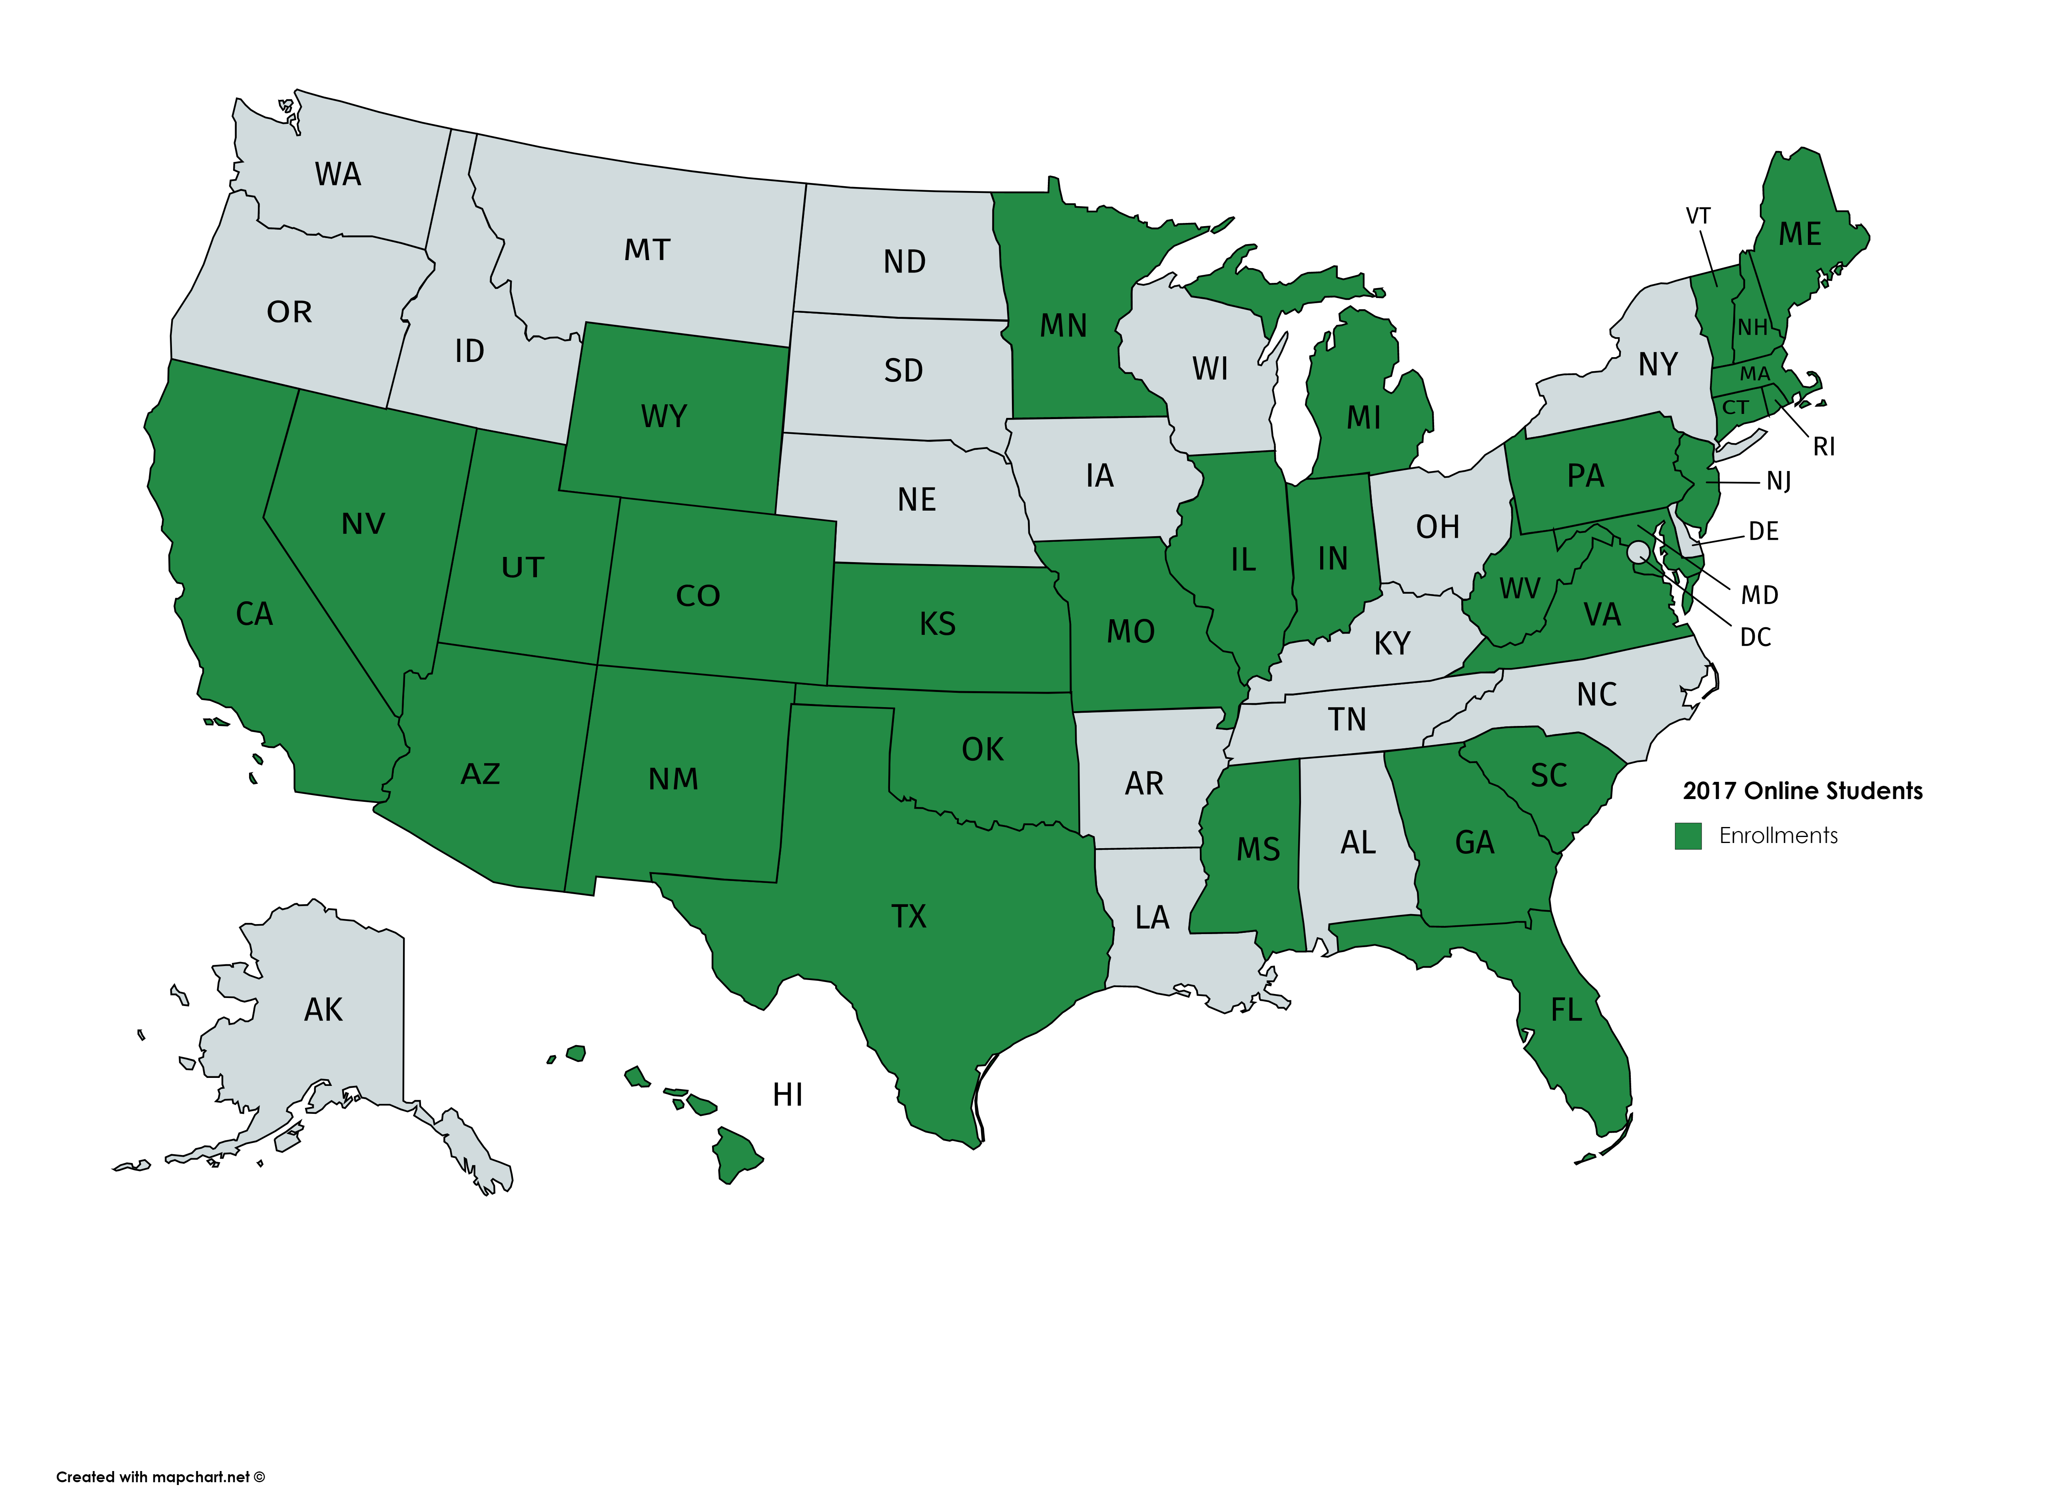
Spring 2018
Online Student Population 2018

Slide 6
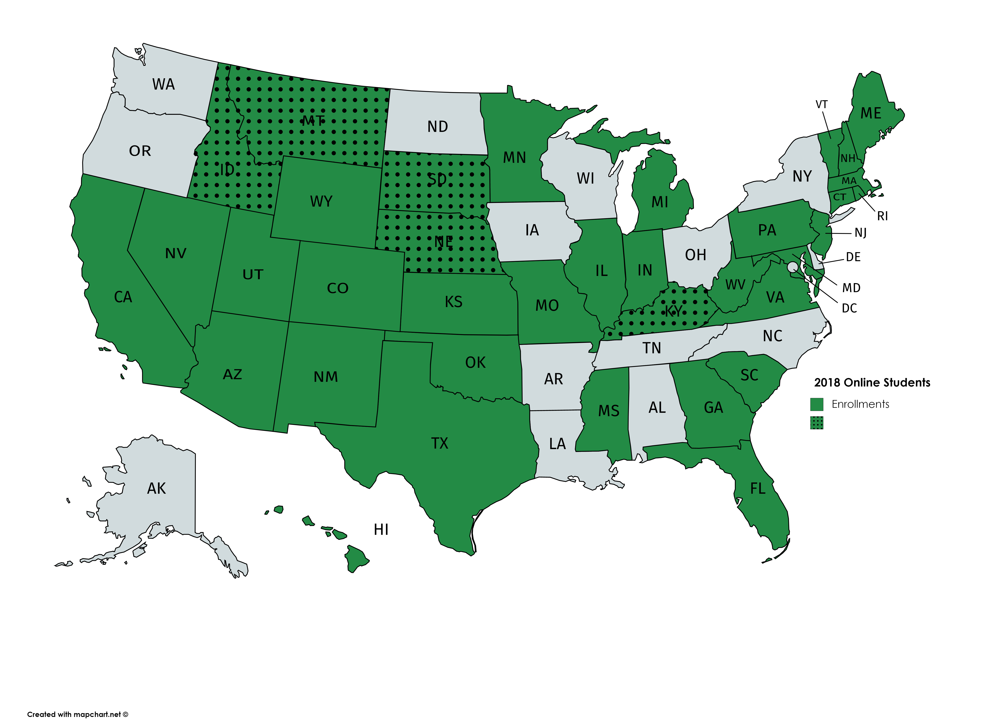
Spring 2018
New states 2019
Online Student Population 2019

Slide 7
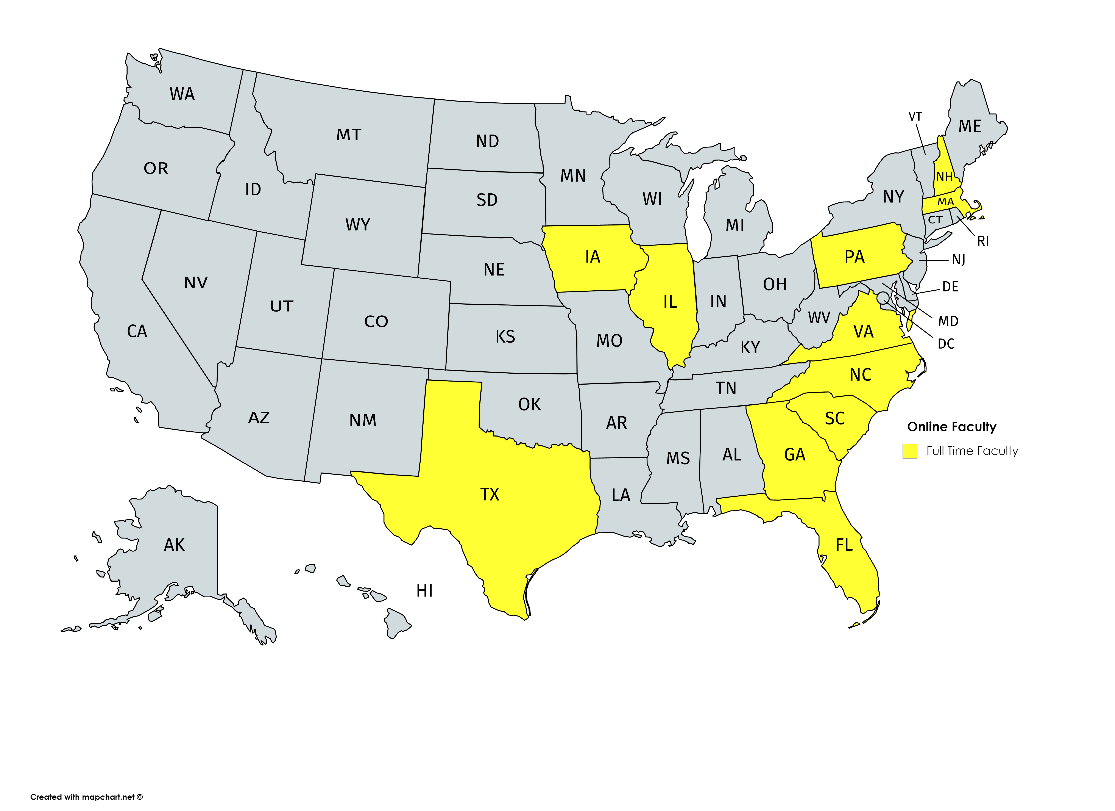
Spring 2018
Online Student Population End of 2018
Full Time Online Faculty US

Slide 8

Spring 2018
Full Time Online Faculty Europe
Online Student Population End of 2018

Slide 9
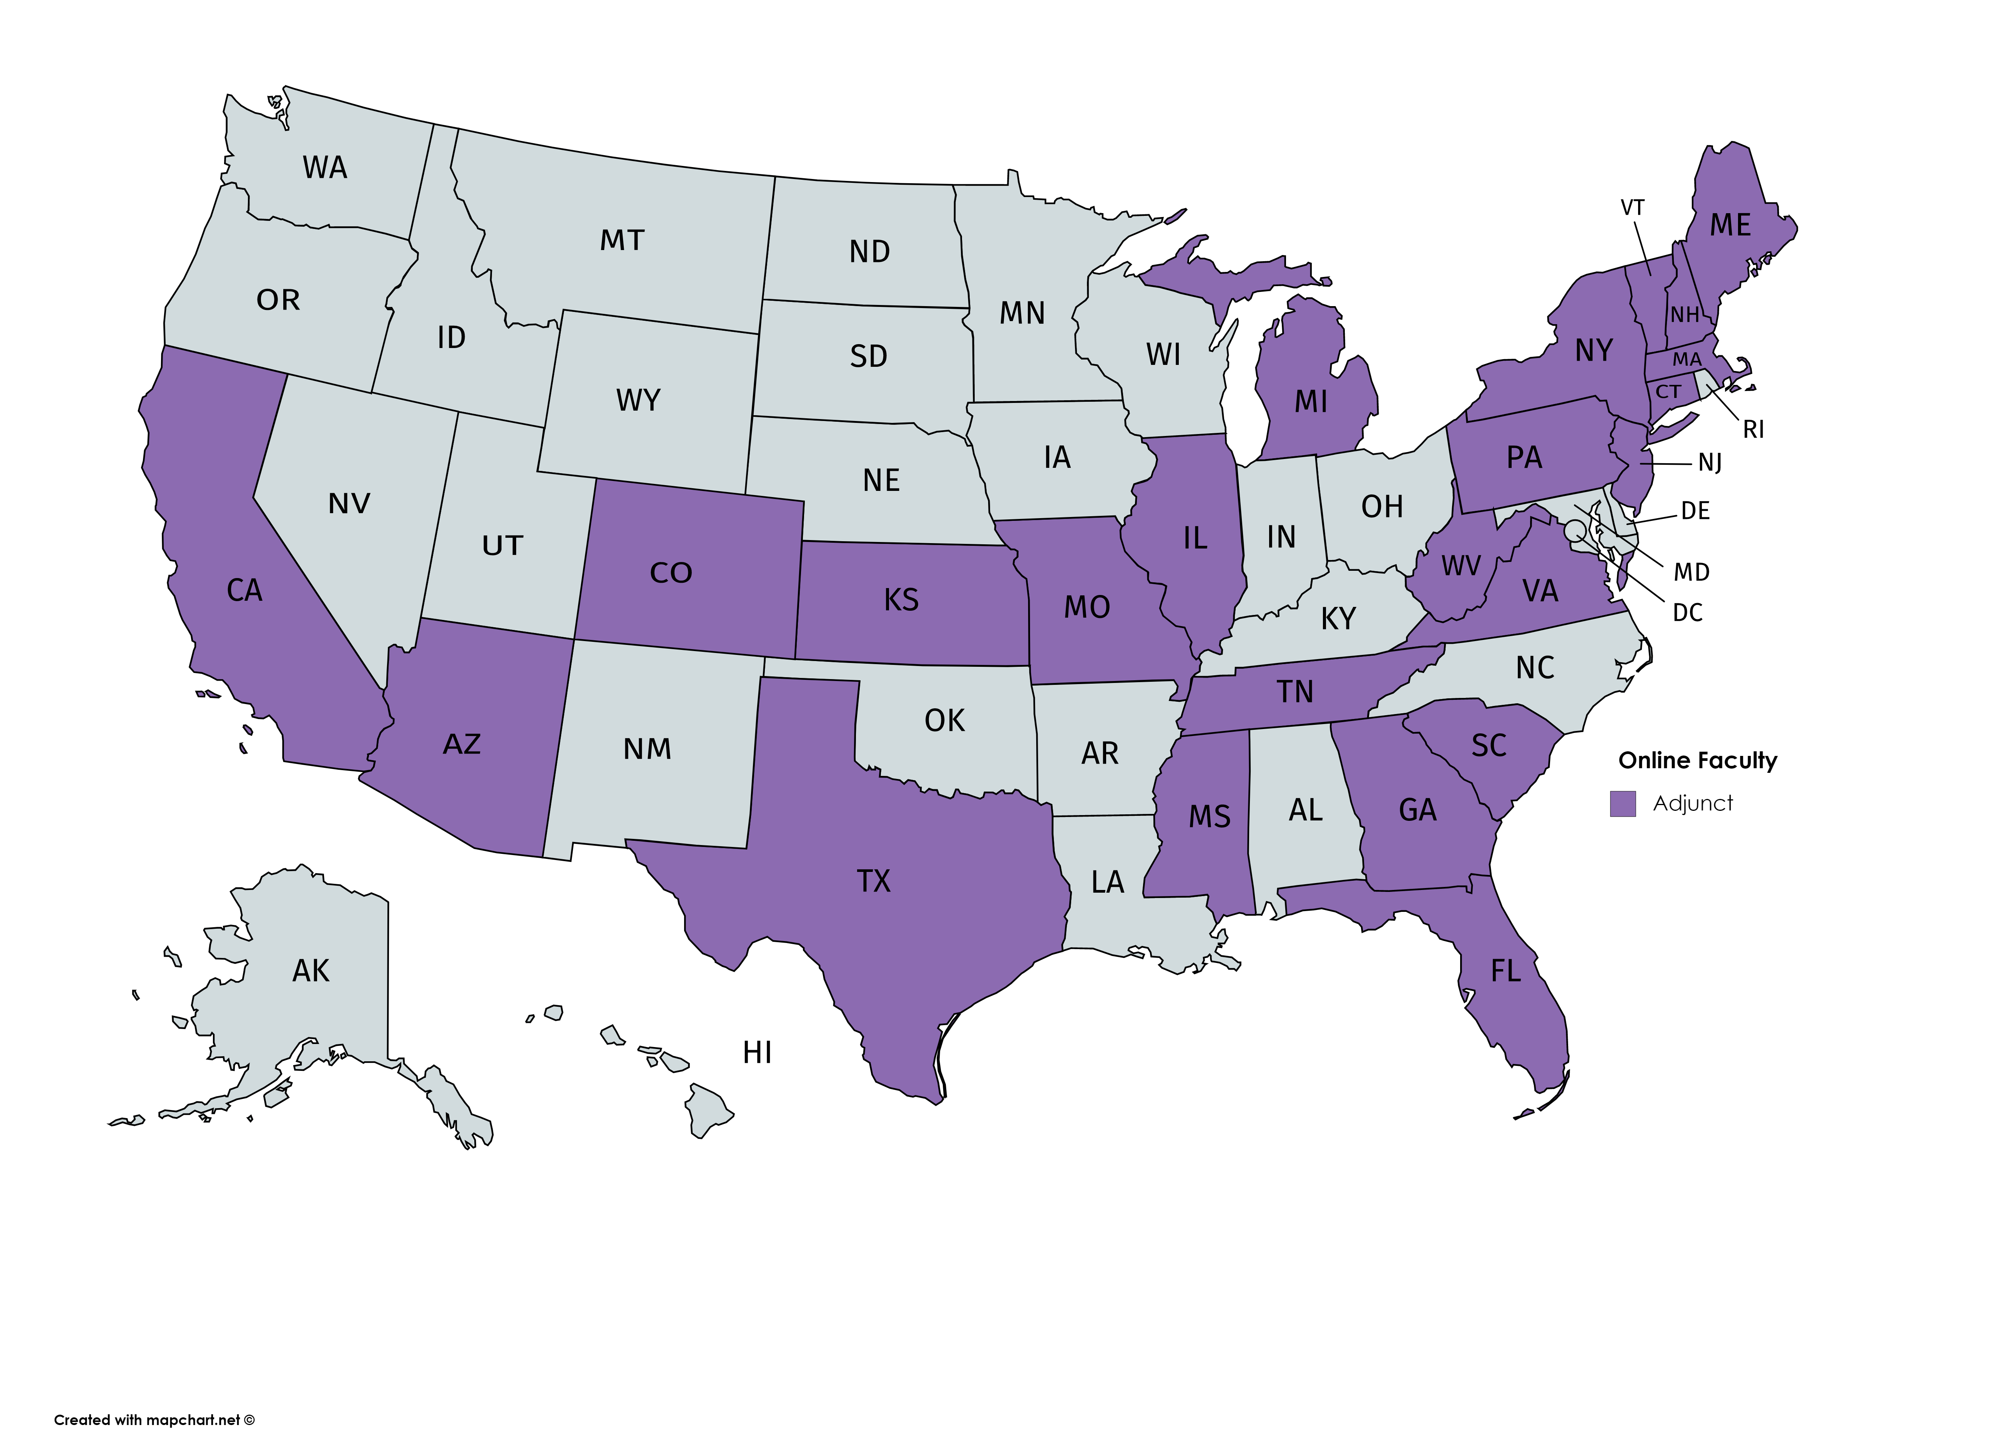
Spring 2018
Online Student Population End of 2018
Adjunct Online Faculty US

Slide 10
The Mission
Why have a mission?
What is the purpose of a mission?
Where is the mission operationalized?

Slide 11
Regis College Mission
  Regis College, through education in the arts, sciences, and professions, empowers women and men to challenge themselves academically, to serve and to lead. A Catholic university, Regis is a diverse and welcoming community guided by the values of the Sisters of St. Joseph of Boston.
  Core Values:
    Gracious hospitality
    Love and service of the Dear Neighbor without distinction
    Peaceful resolution of conflict
    Care for all God’s creation
  Mission Standards:
    Pursuit of Truth
    Social Justice
    Community
    Formation of the Whole Person
    Sacramental Vision of Life

Slide 12
Mission
Please access your academic institutions website and locate the mission. Write the mission, values, standards on the yellow index card provided.
In addition, if your academic program has a specific mission, include this on the yellow index card.
Do you have any additional values and standards to add? Add these to your yellow index card.
Discuss your mission, values and standards with a colleague.

Slide 13
Regulatory hallmarks and standards addressing the governing organization mission
Higher Learning Commission (HLC) Guidelines for the Evaluation of Distance Education (On-line Learning) (2009)
  Developed by the Council of Regional Accrediting Commission (C-RAC)
  Provide guidance for assessment and evaluation of online programs
  9 Hallmarks addressing Quality and examples of evidence to support meeting the hallmarks
Quality Matters (QM) Standards
  Based on Evidence Based Research and Best Practices for online learning
  Provides resources, review processes and professional development for creating quality courses and programs
  Quality Matters Rubric for Higher Education consists of 8 standards
  Focuses on course design

Slide 14
HLC Nine Hallmarks and Mission
On-line learning is appropriate to the institution's mission and purposes.
The institution's plan for developing, sustaining and, if appropriate, expanding on-line learning offerings are integrated into its regular planning and evaluation process.
On-line learning is incorporated into the institution's systems of governance and academic oversight.

Slide 15
HLC Nine Hallmarks and Mission
Curricular for the institution's on-line learning offerings are coherent, cohesive, and comparable in academic rigor to programs offered in traditional instructional formats.
The institution evaluates the effectiveness of its on-line learning offerings, including the extent to which the on-line learning goals are achieved, and uses the results of its evaluations to enhance the attainment of the goals.
Faculty responsible for delivering the online curricular and evaluating the students’ success in achieving the on-line learning goals are appropriately qualified and effectively supported.

Slide 16
HLC Nine Hallmarks and Mission
The institution provides effective student and academic services to support students enrolled in on-line learning offerings.
The institution provides sufficient resources to support and, if appropriate, expand on its on-line learning offerings.
The institution assures the integrity of its on-line learning offerings.

Slide 17
Quality Matters Standards
Course Overview and Introduction
Learning Objectives
Assessment and Measurement
Instructional Materials
Learning Activities and Learner Interaction
Course Technology
Learner Support
Accessibility and Usability

Slide 18

Aligning your Mission to the HLC Hallmarks and QM standards
Please take a few minutes and identify links between the HLC hallmarks and QM standards related to the mission of your governing organization on the green index card. (5 minutes)
Take 10 minutes discussing these links with your colleague.

Slide 19
Regis College Examples
HLC Hallmark | Regis College Examples | QM Standard
1 | -The mission to serve the Dear Neighbor without distinction explains the inclusion and importance of the addition of on-line offerings. -Offering 5 Tracks, 5 Entry points and 2 exit points. -Admission criteria and recruitment practices target potential applicants across the nation -Primary focus is on student experience-ice breakers | Standard 5 and 7
2 | -Strategic Plan 2016-2021-Expand Regis footprint through multiple routes to increase access to higher education -continual assessment of technology and quality -Addition of other programs launched or pending | Standard 4, 5 and 6

Slide 20
Regis College Examples
HLC Hallmark | Regis College Example | QM Standard
3 | -Faculty completed QM online teaching certificate prior to developing courses. -Course Maps -Courses undergo major revisions after first offering and then every third semester to ensure quality. -The Contractual relationship with the Online partner (OLP) guarantees the programs are responsible for academic quality. Faculty develop entire courses- Subject Matter Experts (SME) | Standard 2, 3, 4, 5, 6 Standard 3 Standard 2, 3, 4, 5, 6
4 | -Three cohort calendar, courses offered every semester to facilitate timely completion, asynchronous offerings, no campus requirement, Faculty own the curriculum, all faculty have input in course enhancement, varied Learning materials, assessment and engagement Adherence of course capacity established | Standard 5 and 7

Slide 21
Regis College Examples
HLC Hallmark | Regis College Examples | QM Standard
5 | -Evaluation of academic and support services are conducted each semester through course evaluations and each year in a full student progression evaluation tool and end of program evaluation. -Faculty evaluation | Standard 3 and 5
6 | -Purposeful hiring based on academic and experiential qualifications -Mentoring and orientation program -Input in course enhancement and involvement course coordination -Completion of QM Teaching online course - Best practice online course for faculty to complete within the first year. | Standard 3, 5, 6, 7 and 8

Slide 22
Regis College Examples
HLC Hallmark | Regis College Example | QM Standard
7 | -Student orientation -Use of Turnitin, Pearson Writer, Pearson Tutor, Smarthinking -Academic advisors and student coaches -24/7 help desk -Talk 1to1 -synchronous (Zoom) review sessions and study sessions -financial aid, registration, career services, career fair | Standard 6, 7 and 8
8 | -Building of the infrastructure is on going -Contending with challenges along the way | Standard 7
9 | -Student identification, Respondus lockdown and proctoring, student orientation course, academic integrity policy, netiquette and code of conduct | Standard 1

Slide 23

Ensuring faculty and student rentention through the mission
Please take a few minutes to identify 1-2 strategies to incorporate in your program to enhance the visibility of the governing organizations’ mission related to HLC hallmarks and/or QM standards on the red index card.
“The online asynchronous Master of Health Administration program at Regis College is filled with opportunities and challenges as well as balance for full time working individuals. From passionate discussion forums where students can learn from the experiences and opinions of others, to research projects and papers where students can exercise their research skills and hone their understanding, this program truly has it all. Personally, I’ve been very impressed with the level of “connectedness” I’ve felt despite my experience being mostly online and on my own time.” Meaghan Drees, Online MHA Student
"After all of these years working at Regis, the mission of the college continues to resonate with me. The 'dear neighbor' has been of particular value and meaning to me in my practice as a faculty member. I see this every day in the classroom, as we have students from diverse backgrounds learning with and from each other. They are able to share their amazing experiences of treating diverse populations. I also see reaching out to the marginalized 'dear neighbor' through work that Regis faculty are doing in our Massachusetts community, across the country, and internationally. From these interactions with my students and colleagues, it is apparent to me that we are actually living the mission and meeting its objectives. I am proud to work at Regis.“ Cassandra Godzik, FT Nursing Faculty
“I love teaching and learning every day of my life!”, adjunct nursing faculty

Slide 24
Faculty and Student
Strategies used to ensure success specific to the mission
Association of Colleges of Sisters of St. Joseph National Gathering June 2019
Orientation, wrap around services, synchronous session available as needed, flexible programming, three cohort model
mentoring faculty, inclusion of faculty in curricular decision, course coordination

Slide 25
Student Quotes
“I would like to thank Dr. P for her hard work and dedication to teaching. You can tell that she thoroughly enjoys caring for her patients and teaching. She is invested in all of her students. You only find a teacher like her once in a lifetime. You can see the pure excitement in her face each week as she watches us learn and come across new experiences during our live sessions. She goes above and beyond in helping us understand the content, giving us case studies from her personal experience, and adding other information that is informative and helpful. She even goes above and beyond by easing our anxieties during this difficult transition from experienced nurse to novice student provider” J. Bethea, PNP student FL
I had the best experience with the Regis College Master of Science in Nursing online program. From the moment I inquired about the Regis College’s Post NP Certificate Program there was someone communicating with me every step of the way. The application process was clear and without complications. At the start of the program there is an orientation that guides you through the process. After commencing of the classes there was always someone available to answer questions. There is also clear and organized material for every week of the program from the beginning. The faculty is approachable and I loved the review for the quizzes online. The Regis College MSN Online program is an amazing program that would allow you to obtain a high quality education while in the comfort of your home. I strongly recommend this program because while it is an "online" program there is always an specialist at the other end of the phone and every one is committed to your success. E. Avellen, Post-Master’s PMHNP FL
“I wanted to thank you for all of the advice, support and encouragement that you provided me over the last semester. I remember in one live session, you told us that your colleagues were surprised when you told them that your live sessions are consistently attended by your students. They asked you why, and you could not explain it to them. I have thought about that, and there are numerous reasons why, here are just a few:
  1. You are enthusiastic and well versed on the course material.
  2. You encourage and welcome questions, and then provide clear explanations for questions.
  3. You treat all of your students as respected colleagues. You are genuine and disarming.
  4. You offer pearls of wisdom that aren’t written down anywhere, that are very helpful.
  5. You continuously encourage all of us that we can do it and remind us what a great feeling of accomplishment we will experience when we finish the program.
  6. You are working in the real world and share your experiences with us.
  7. You tell us what to worry about and what not to worry about.
  8. You are ALWAYS available to answer questions and offer guidance.
  9. You are clear about your expectations.
  10. Most importantly, you are kind and it shows.
All of this helped me to stay grounded and enthused as I continued to move forward. So, if your colleagues ask you again why your live sessions are always attended - just give them this email.” K. Heffernan, PMHNP student MA

Slide 26
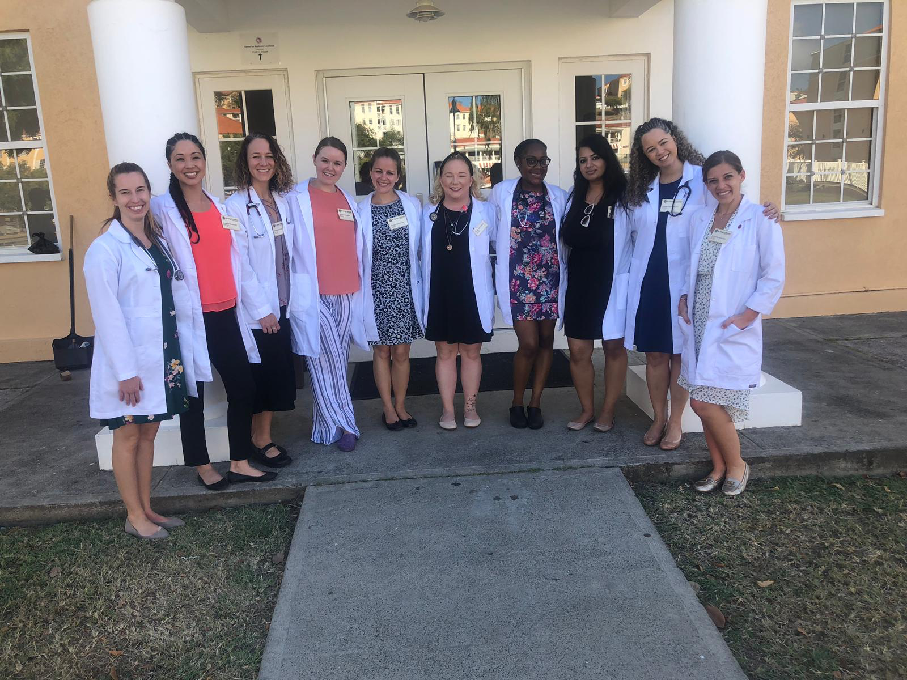
Service and Leading -Global Presence
Grenada
“I volunteer weekly through the American Red Cross here in Germany in an effort to give back. I work with a team of mental health providers to help Service Members in all branches deal with the lasting effects of traumatic events.”
Alternative Spring Break trip to Houston to help rebuild houses damaged in Hurricane Harvey
Member Nashua School District Occupational Health Advisory Committee
Annual Cyclist/Fundraiser for the Hill Country Ride for AIDS.
Volunteer community educator for Alzheimer's Association
“I am a member of Post 22 of AM VETS, my husband is a disabled Veteran and we spend time giving back to our community of Veterans. I am also a volunteer at our local Salvation Army.”

Slide 27
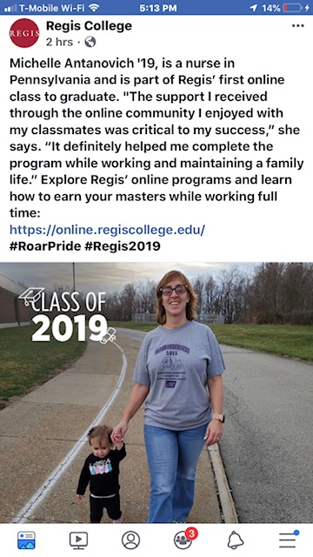
Identify best practices for ensuring quality programs focusing on faculty and student retention.
I'm proud to be part of the Regis family! Ruben Tobillo, PMHNP student ‘19, FL.
What are ideas do you have?

Slide 28
References
Council of Regional Accrediting Commissions (C-RAC), (2009). Guidelines for the evaluation of Distance Education (online learning) retrieved from http://download.hlcommission.org/C-RAC_Distance_Ed_Guidelines_7_31_2009.pdf
Garret, R., Legon, R, & Fredericksen, E.E., (2019). CHLOE 3 Behind the Numbers: The Changing Landscape of Online Education 2019. Retrieved from Quality Matters website: qualitymatters.org/qa-resources/resource-center/articles-resources/CHLOE-3-report-2019
Quality Matters, (2018). QM Higher Education Rubrics, (6th ed.). MarylandOnline, Inc.

