Slide 1

A New Dawn Rises:
Education Following COVID-19

Slide 2
COVID-19 Transition to Remote Learning
Speed!
It was not true “online” learning.
It may happen again.
What lessons did we learn?
Turn Necessity to Opportunity

Slide 3
Learning Objectives
Discuss methods used to assist technology resistant faculty in transitioning to online learning during COVID-19.
Examine how this experience has changed the way faculty teach their courses after the pandemic is over.
Identify strategies to continue this adoption of new instructional technologies into future academic years.

Slide 4

Faculty Survey
38% had never taught an online or hybrid course.
14% were not at all
  Prepared for remote
  Instruction.
36% only somewhat
prepared.

Slide 5

How to Help?
Online Resources Page
Within our LMS
  Relevant Third Party Info
    QM
    Publishers
    Crossing Silos

Slide 6
How to Help?
36% rated this as “extremely helpful”
44% as “somewhat helpful”
80% Effective Effort

Slide 7
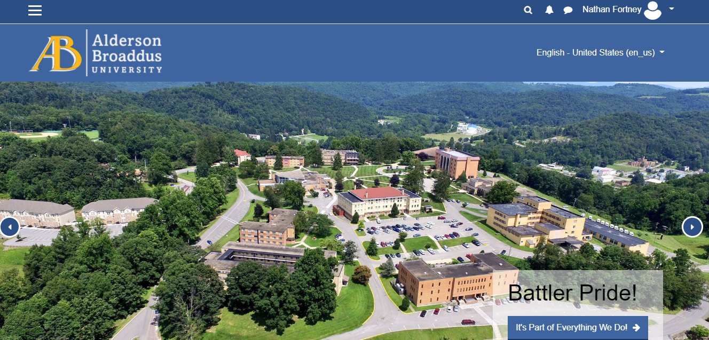
A Closer Look

Slide 8

Assistance of “Superusers”
Small Instructional Design and IT offices
One-on-one assistance
  44% extremely helpful
  20% somewhat helpful

Slide 9

Superusers
Experienced with online learning and usage of the LMS.
            Identified at least one per college.
            First line of assistance

Slide 10
Impact in Traditional Instruction
Which of these online features or technologies do you plan to continue using in future FACE-TO-FACE courses?
Links to External Websites | 87%
Online Submission of students work | 85%
Online Tests/quizzes | 52%
Lecture Capture | 48%
Online Discussions | 43%
Synchronous class sessions | 26%

Slide 11

Fall 2020 Status
The pandemic continues.
Use of educational technology is even more important.
  All virtual Instruction
  For Students under quarantine/isolation

Slide 12
What Have We Learned?
Most valuable items in planning for another transition to remote learning.
Active learning techniques
Access to digital materials
Assistance with accessibility requirements.

Slide 13

Conversation
Questions.
Suggestions from
your own experiences.

Slide 14
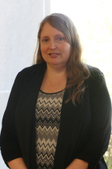
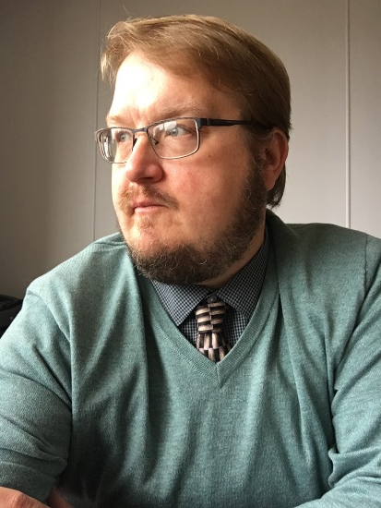
Contact Us:
Dr. Andrea Bucklew, Provost bucklewaj@ab.edu
Nathan Fortney, Director of Instructional Design fortneynd@ab.edu

