Slide 1
ENSURING ACADEMIC INTEGRITY & QUALITY COURSE DESIGN in the AGE OF AI
Robert Gibson Dean, Instructional Design and Technology WSU Campus of Applied Science and Technology
QM Master Reviewer; Quality Matters Coordinator; QMAAC
wgibson2@wsutech.edu LinkedIn: robgibson1

Slide 2
WHERE ARE YOU AT WITH GEN AI & COURSE DESIGN?
1
You’re familiar with and use AI, but not in course design and development
2
You use AI in some areas of course design and development, but only occasionally
3
You employ AI throughout all phases of course design and development

Slide 3
ACADEMIC INTEGRITY | QUALITY COURSE DESIGN
Given that an AI can now complete assignments and assessments in some of our courses, how confident are you that your course still meets Quality Matters standards for authentic assessment and measurable learning outcomes?

Slide 4
ACADEMIC INTEGRITY | QUALITY COURSE DESIGN
“Why do students cheat? Maybe the better question is:
Why do we keep designing systems that make them want to?”
Clara Lin Hawking
Co-Founder, Kompass Education

Slide 5
ACADEMIC INTEGRITY | QUALITY COURSE DESIGN
“We need to get in front of this quickly and realize that the days of asynchronous learning (and particularly asynchronous assessment!) are over. That is, if you want learning confirmed and trusted evidence of skills or knowledge."
Tricia Bertram Gallant
Opposite of Cheating: Teaching for Integrity in the Age of AI

Slide 6

ACADEMIC INTEGRITY | QUALITY COURSE DESIGN
“The opposite of cheating is …learning”
Tricia Bertram Gallant
David Rettinger
Opposite of Cheating

Slide 7
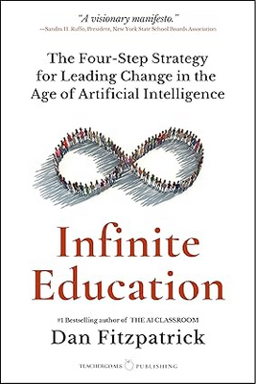
ACADEMIC INTEGRITY | QUALITY COURSE DESIGN
Dan Fitzpatrick's "Infinite Education" emphasizes the need for a transformative approach to course design in the era of artificial intelligence (AI). He advocates for moving away from traditional, finite educational models centered on grades and exams, towards "infinite" strategies that promote lifelong learning, creativity, and adaptability.
Dan Fitzpatrick
Infinite Education

Slide 8
ACADEMIC INTEGRITY | QUALITY COURSE DESIGN
“Teachers don’t need to secure every assessment task or even every little thing that we need to confirm a student has successfully learned on their journey to graduation. In fact, any efforts to do this – most recently by using far-from-perfect AI detection tools – are almost certainly making the everyday lives of students pretty intolerable.
Instead, teachers need to rethink their assessment practice such that students are given multiple opportunities to demonstrate their learning in tasks where little or even no effort to stop or detect cheating is made, but the obligation for students to put in the work – the hard effort that genuine learning requires – is there.”
Kath Ellis
Pro Vice-Chancellor, Quality and Integrity Western Sydney University

Slide 9
ACADEMIC INTEGRITY | QUALITY COURSE DESIGN
“…better assessment is not going to eliminate cheating, but bad assessment is almost begging students to commit misconduct.”
David Rettinger
Opposite of Cheating: Teaching for Integrity in the Age of AI

Slide 10

ACADEMIC INTEGRITY | QUALITY COURSE DESIGN

Slide 11
ACADEMIC INTEGRITY | QUALITY COURSE DESIGN
Agentic refers to someone or something capable of achieving outcomes independently
(“functioning like an agent”)
or possessing such ability, means, or power (“having agency").

Slide 12

ACADEMIC INTEGRITY | QUALITY COURSE DESIGN

Slide 13
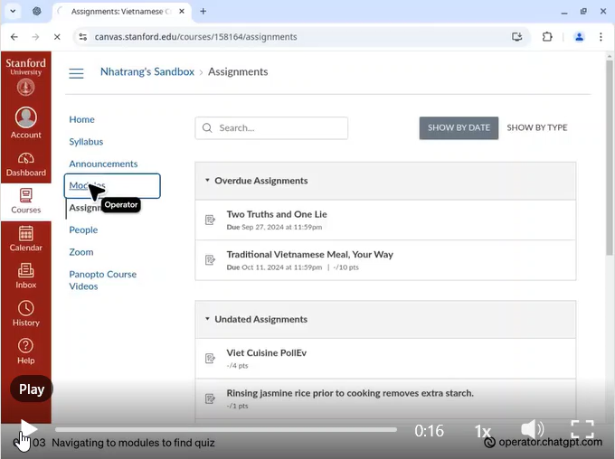
ACADEMIC INTEGRITY | QUALITY COURSE DESIGN
Nhatrang Nguyen Stanford Tinkery

Slide 14
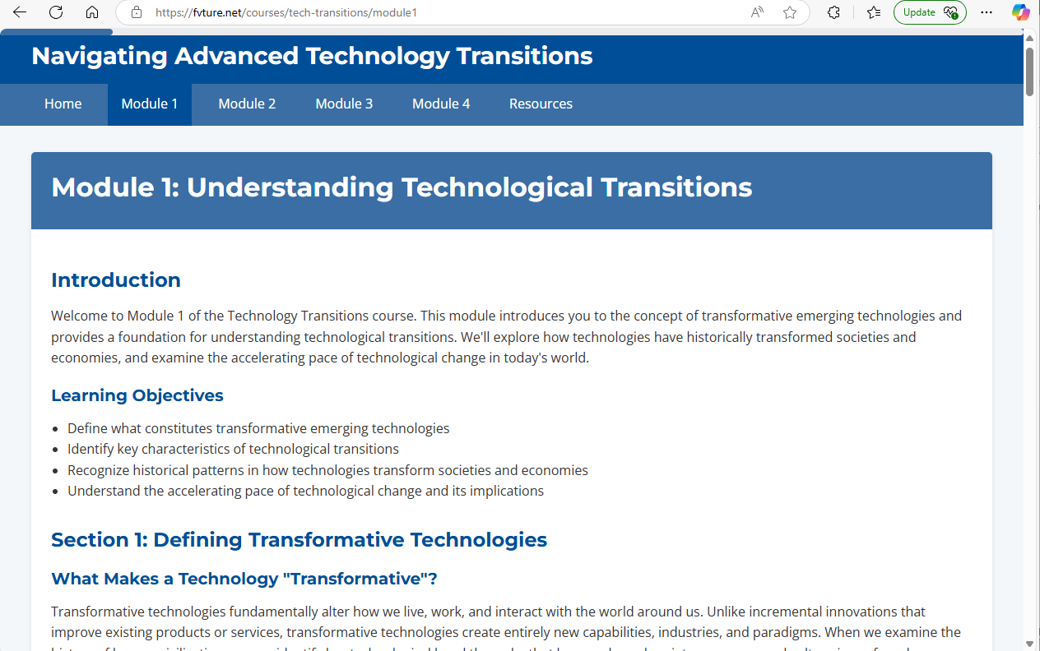
ACADEMIC INTEGRITY | QUALITY COURSE DESIGN
Andrew Maynard Arizona State University

Slide 15





THERE ARE COUNTLESS WAYS TO LEVERAGE AI
AI COPY EDITING
Human generates a composition that an AI edits
AI BRAINSTORM
AI generates ideas that drive a human composition
AI COMPOSITION
AI generates a composition almost entirely without human involvement
LOW AI USE
HIGH AI USE
AI CRITIQUE
AI gives opinion on the ideas of a human composition
AI ROUGH DRAFT
AI generates an initial composition that a human revises
Created by Dominic Slauson (dominic@codaptivelabs.com). © 2024 Codaptive Labs (www.codaptivelabs.com), All rights reserved. Icons made by Freepik from www.flaticon.com

Slide 16
THE GREAT ONLINE LEARNING RESET?
Agentic AI is forcing us to reimagine online learning – for the better
Online Learning Era
Agentic AI Era
Content + Quiz Model
Cognitive Decoupling (learning is separate from real-world tasks)
Performance Metrics for Assessment
Distinct Modes (learning modes are delineated)
LMS-Centric Content
AI-Generated Practice and Feedback
Cognitive Recoupling (learning in the context of real-world tasks)
Competency Based Assessment
Blurring Modes (learning modes dynamically merge to maximize effectiveness)
Death of the Static LMS and Rise of AI Learning Agents
Philippa Hardman Epiphany/DOMS

Slide 17
PRODUCT-ORIENTED PEDAGOGY…
…to a PROCESS-ORIENTED PEDAGOGY
Nick Potkalitsky Pragmatic AI

Slide 18
USE AI FOR PROCESS-ORIENTED PEDAGOGY
Rather than seeing AI as a shortcut that students might misuse, we can reframe assessment to emphasize how knowledge is formed and applied. This means prioritizing:
Process over final product—capturing how students arrive at ideas, not just the end-result.
Iteration over single submissions—allowing students to refine and revise work through structured feedback.
Real-time engagement—assessing learning through discussion, reasoning, and in-the-moment articulation.
Multimodal expression—expanding beyond text-based assignments to oral, visual, and collaborative demonstrations of understanding.

Slide 19
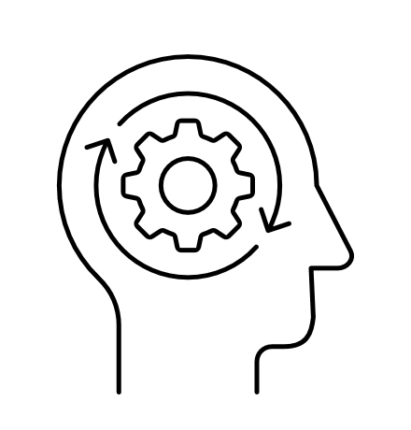
USE AI FOR PROCESS-ORIENTED PEDAGOGY
Process over final product—capturing how students arrive at ideas, not just the end-result.

Slide 20
USE AI FOR PROCESS-ORIENTED PEDAGOGY
Journals & Reflection Logs: Students write short daily or weekly reflections on their evolving understanding, noting moments of insight, confusion, or revision.
Think-Alouds & Video Reflections: Students verbally articulate their reasoning as they analyze texts, solve problems, or interpret data. These recordings provide a raw look at their in-the-moment thinking.
Iterative Drafts & Annotations: Instead of submitting a single final essay or report, students revise work based on feedback, tracking how their thinking evolves.
Peer Feedback & Self-Assessment: Students engage in structured peer reviews and self-reflection, explaining what changed between drafts and why.

Slide 21
USE AI FOR PROCESS-ORIENTED PEDAGOGY
Example: Instead of a single history paper, students annotate primary sources, document how their perspectives shift across discussions, and submit a final synthesis alongside notes on how their thinking changed.

Slide 22
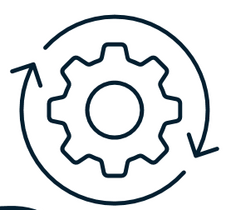
USE AI FOR PROCESS-ORIENTED PEDAGOGY
Iteration over single submissions—allowing students to refine and revise work through structured feedback.

Slide 23
USE AI FOR PROCESS-ORIENTED PEDAGOGY
Multiple Submission Points: Students turn in initial drafts, receive feedback, and refine their work before final submission.
Teacher & Peer Reviews: Feedback is integrated into the learning process, emphasizing revision as a skill, not just a requirement.
Metacognitive Reflections: Students explain why they made specific revisions and how their understanding evolved.

Slide 24
USE AI FOR PROCESS-ORIENTED PEDAGOGY
Example: Instead of a single science lab report, students conduct an experiment, document findings, present preliminary results for peer feedback, refine their approach, and submit a final report, explaining what changed and why.

Slide 25
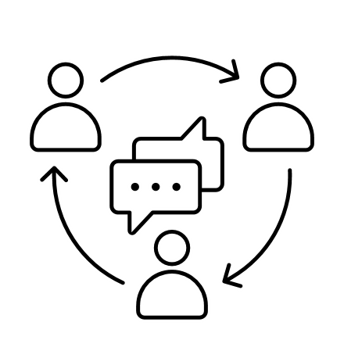
USE AI FOR PROCESS-ORIENTED PEDAGOGY
Real-time engagement —assessing learning through discussion and reasoning. AI cannot replicate spontaneous reasoning and interactive discussion.

Slide 26
USE AI FOR PROCESS-ORIENTED PEDAGOGY
Oral Defenses & Socratic Seminars: Students present ideas and respond to live questioning, requiring them to demonstrate adaptability and depth of thought.
Debates & Role-Playing Exercises: Rather than writing static argumentative essays, students defend positions in a live setting, engaging in direct discourse.
Collaborative Problem-Solving: Students work in groups to tackle real-world challenges, explaining their reasoning and refining solutions through discussion.

Slide 27
USE AI FOR PROCESS-ORIENTED PEDAGOGY
Example: In a math class, students develop a model for real-world data, then present their reasoning and answer live questions about their approach, forcing them to engage beyond pre-written responses.

Slide 28

USE AI FOR PROCESS-ORIENTED PEDAGOGY
Multimodal expression—expanding beyond text-based assignments to oral, visual, and collaborative demonstrations of understanding.
Nick Potkalitsky

Slide 29
USE AI FOR PROCESS-ORIENTED PEDAGOGY
Oral Presentations & Podcasts: Students articulate insights verbally, explaining key concepts to an audience.
Visual & Digital Storytelling: Infographics, video essays, or interactive digital timelines allow students to synthesize ideas in creative formats.
Applied Demonstrations & Simulations: Hands-on, experiential learning activities help reinforce concepts through real-world application.

Slide 30
USE AI FOR PROCESS-ORIENTED PEDAGOGY
Example: Instead of a written essay on The Great Gatsby, students create a digital storyboard tracing thematic development, supported by oral analysis.

Slide 31
WHAT DOES THIS MEAN FOR QUALITY MATTERS?
Redesign Strategy | Description | Aligned QM Standard(s) | How It Reduces Cheating
1. Use authentic assessments | Replace traditional tests with projects that mimic real-world tasks (e.g., case studies, portfolios, community-based problems). | 3.1 (Assessments measure stated learning objectives), 5.1 (Learning activities promote achievement of objectives) | AI tools are less effective at completing complex, context-specific tasks; promotes originality and personal reflection.

Slide 32
WHAT DOES THIS MEAN FOR QUALITY MATTERS?
Redesign Strategy | Description | Aligned QM Standard(s) | How It Reduces Cheating
2. Scaffold assignments with checkpoints | Break assignments into smaller parts with required drafts and feedback cycles | 3.2 (Grading criteria clearly stated), 3.5 (Opportunities for learner feedback) | Makes it harder to outsource the entire task; encourages continuous engagement and accountability.

Slide 33
WHAT DOES THIS MEAN FOR QUALITY MATTERS?
Redesign Strategy | Description | Aligned QM Standard(s) | How It Reduces Cheating
3. Incorporate oral reflections or viva voce | After submitting a paper or project, require students to discuss their process and findings in a short recorded or live session. | 5.2 (Learning activities provide opportunities for interaction) | Personalizes the assessment and makes it harder to use AI-generated content without understanding.

Slide 34
WHAT DOES THIS MEAN FOR QUALITY MATTERS?
Redesign Strategy | Description | Aligned QM Standard(s) | How It Reduces Cheating
4. Use randomized and adaptive quizzes | Employ question banks and adaptive technology to deliver different questions to each student. | 3.1 (Assessments align with objectives), 3.3 (Assessments provide multiple opportunities) | Reduces the chance of students sharing answers or relying on pre-written solutions.

Slide 35
WHAT DOES THIS MEAN FOR QUALITY MATTERS?
Redesign Strategy | Description | Aligned QM Standard(s) | How It Reduces Cheating
5. Emphasize process over product | Grade based on logs, drafts, and reflections rather than just the final product | 3.1, 5.1 | AI-generated final products become less useful if the process is evaluated and documented.

Slide 36
WHAT DOES THIS MEAN FOR QUALITY MATTERS?
Redesign Strategy | Description | Aligned QM Standard(s) | How It Reduces Cheating
6. Integrate academic integrity education | Include modules that teach ethical use of AI tools, citation, and consequences of dishonesty. | 1.8 (Policies on academic integrity are clearly stated), 1.6 (Technology requirements clearly stated) | Encourages responsible use of AI and builds a culture of trust and transparency.

Slide 37
ACADEMIC INTEGRITY | QUALITY COURSE DESIGN
Kath Ellis
Michelle Kassorla
Camilla Roberts
Jason Gulya
Clara Lin Hawking
Tricia Bertram Gallant
David Rettinger
Kane Murdoch
Melanie Dusseau
Nik Peachy
ICAI
OLC
QM
Learning Development Accelerator

Slide 38
ACADEMIC INTEGRITY | QUALITY COURSE DESIGN
Three immediate steps instructional designers can take:
Audit current assessments to identify and redesign tasks that AI can easily complete.
Integrate process-based and personalized assessment strategies into course structures.
Collaborate with faculty and learners to foster a shared culture of academic integrity grounded in trust and transparency.
Ruchir Bakshi
Team Carney, Inc.

