Slide 1

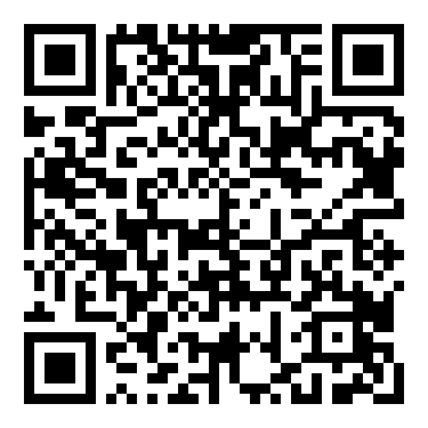
AI Stands for Anxiously Innovating
Best Practices for Course Development
Notes:
Add QM code to folder with resources

Slide 2

Goals
Discuss motivations for incorporating AI into course development processes
Discuss the development of institutional documentation and practices
Evaluate effectiveness of current AI initiatives in course development
Share effective practices from our institutions

Slide 3
Full Disclosure
Does AI suffer from imposter syndrome?
Notes:
Mention here that I thought in the spirit of things I should ask AI to help generate the content, even though I feel like this is a pretty personal case study.

Slide 4
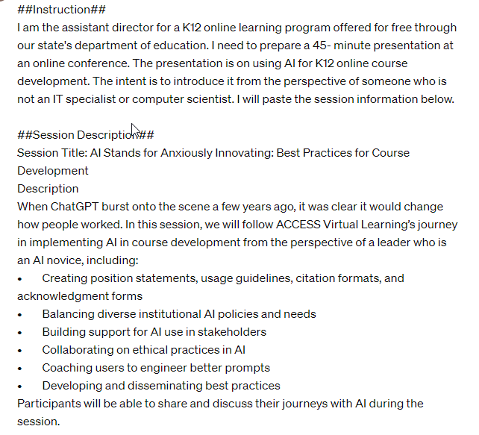
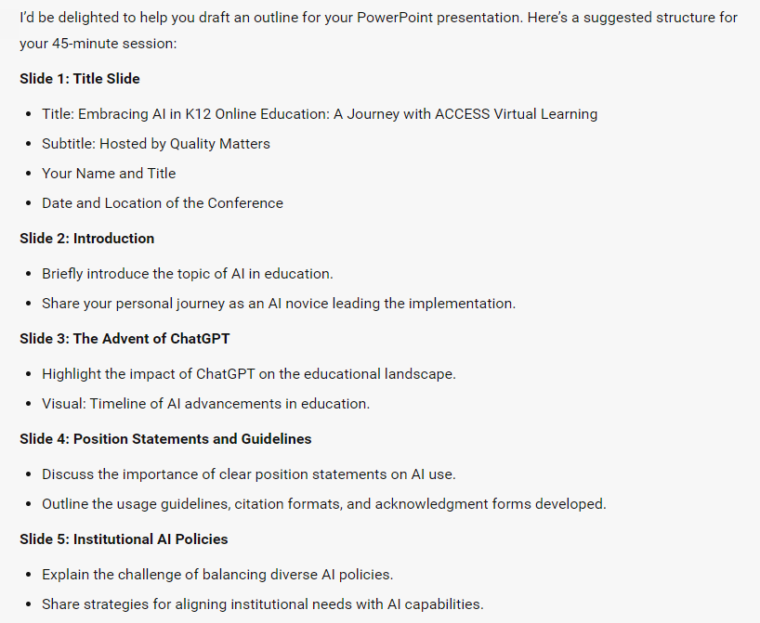
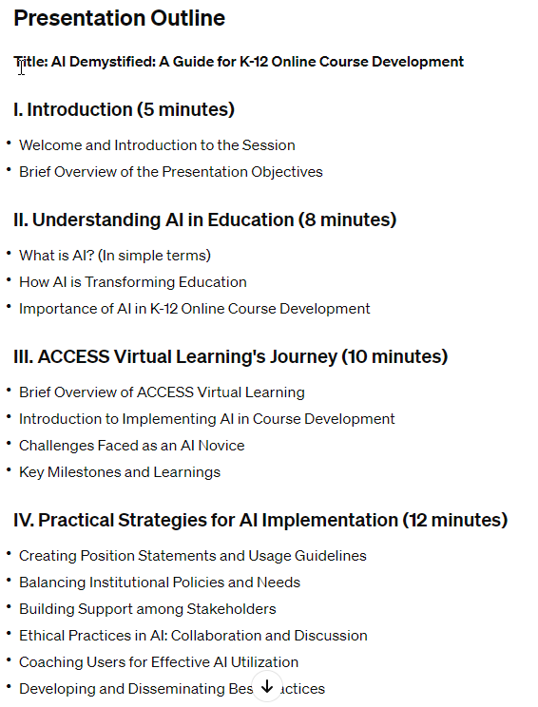
Notes:
Discussion here of consulting with AI to help develop this presentation. Mention that the first is ChatGPT3.5 while the second is Microsoft Copilot. Wonder about the consensus there

Slide 5
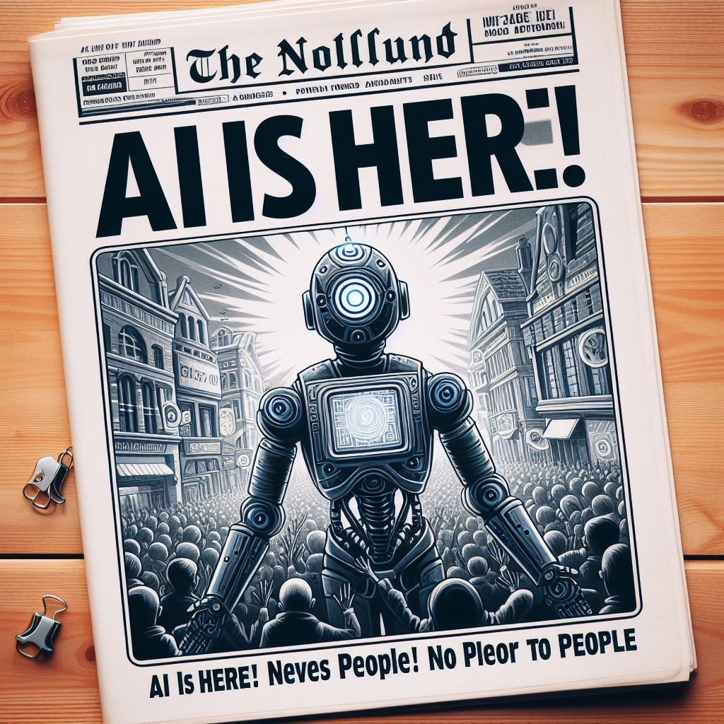
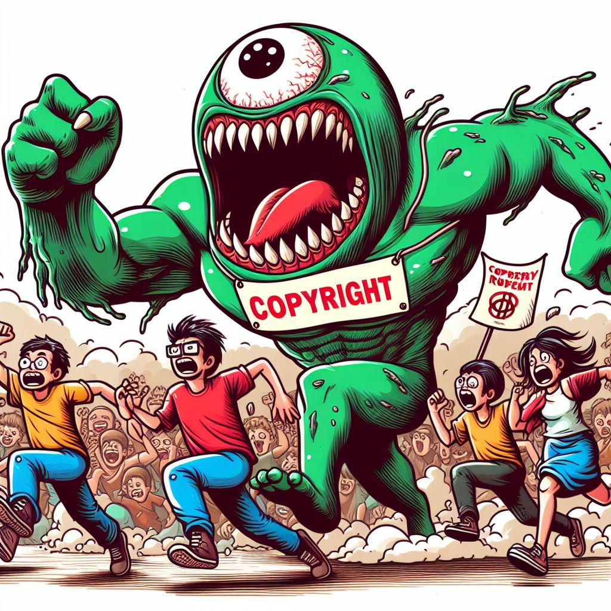

Setting the Scene
Notes:
Talk about how about 1.5 years ago Chapt GPT came on scene. Did not want to enter for a variety of reasons, including technical expertise and legal issues, especially around copyright. (Mention icon and Jason from Montana) But then….
Copilot credit on image

Slide 6






What Changed My Mind?
Notes:
Talk about how the concern about experience and copyright became outweighed by the fact that some of our SMEs were already using it and we had not addressed this. And then someone told me that it was out of our hand. But really, we hold the responsibility, especially since our SMEs were coming from different schools and backgrounds. So we needed to take ownership.

Slide 7
Three- Pronged Attack
Develop guiding documentation
Encourage experimentation and exploration
Evaluate practices worth keeping

Slide 8
Documentation
Wow! Exciting!

Slide 9
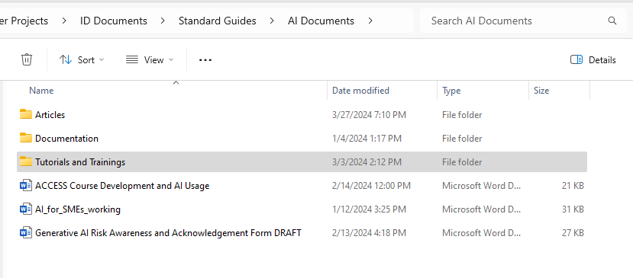
Documentation
ACCESS Course Development Usage and Citation
Generative AI Risk Awareness and Acknowledgement
Tutorials
Create automatic version/timestamp
Use from cloud
Notes:
List here add caveat of institutional policies. Mention working with former librarians. From here, open documents and share

Slide 10
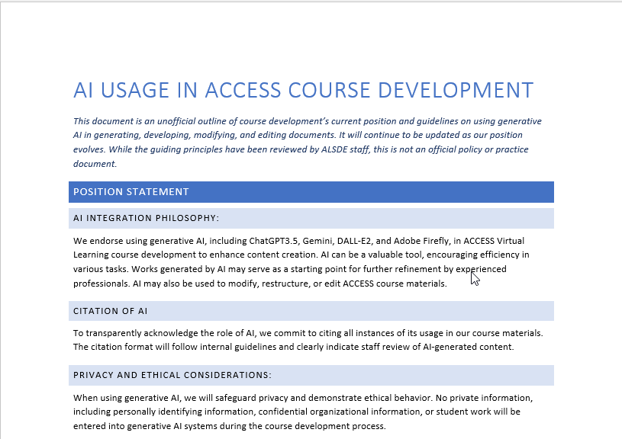

AI Usage and Citation
Position Statement
  AI Integration Philosophy
  Citation of AI
  Privacy and Ethics
Guidelines
  Content Review
  Citation
Notes:
Talk first about this. Open the document here. Since institution didn’t have policy, needed to draft something to have guidance in the meantime. Did run by for review. Iterated this with AI. Talk about mentioning the importance of ethics and transparency
Ask others if they have something similar. Hat differs. Mention that the credited was based off materials shared by Virtual Arkansas, but adapted based on some needs. In particular, since SMEs are temporary, not labeling them specifically as the reviewer. Wanted to take the responsibility on the CD team.

Slide 11
Risk Awareness and Acknowledgement
Adapted from University of Illinois System
PII and IP
Bias
Accuracy
Attribution
All work products developed with generative AI must be reviewed by university/ACCESS staff for accuracy, bias, and quality before distribution and use.
Notes:
List my major contribution – guardrails. Desire from others to not put entire assessments into external AI. Mention Read.AI. Mention still in process. Anything similar?

Slide 12
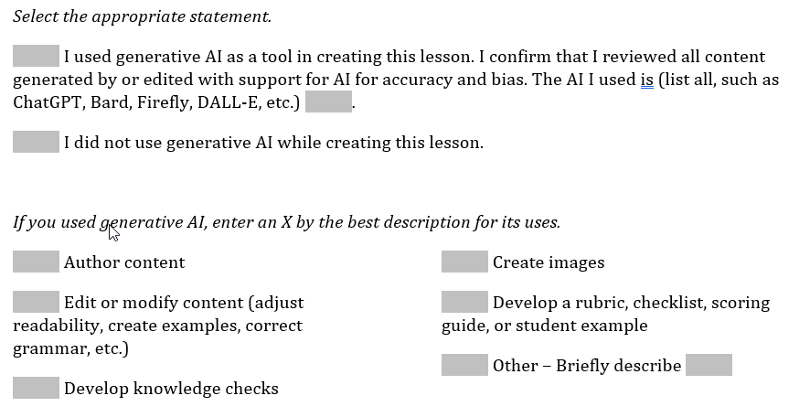
Downstream Effects
Communicate with SMEs
AI is not cheating
BUT you need to cite it
Update development templates
Credits slide
Snippets
LMS tools
Icons
Add space on LOT

Slide 13
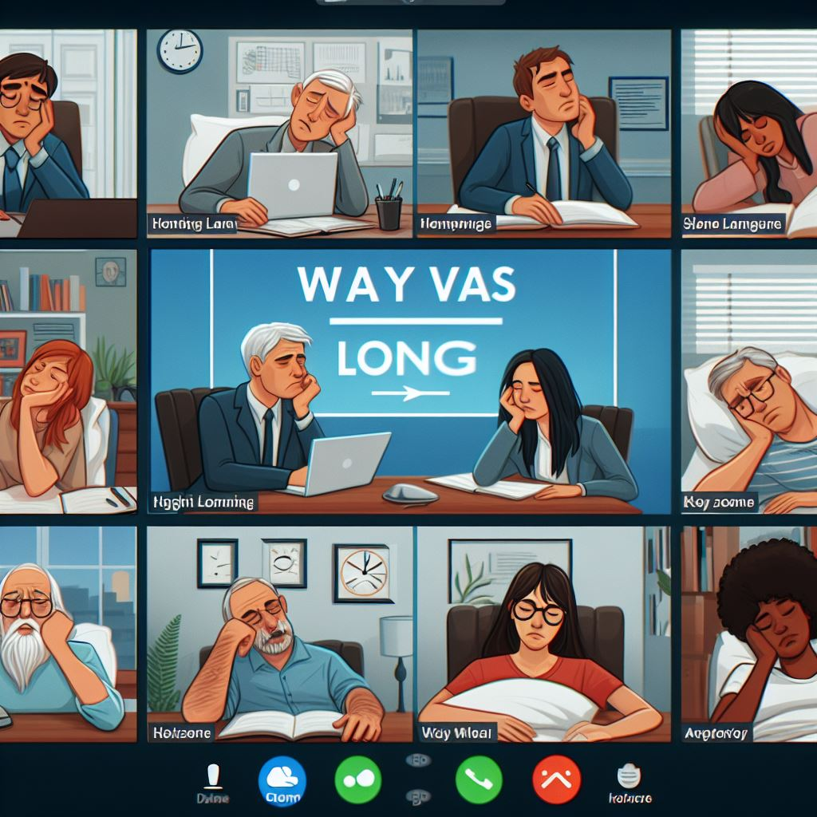
Questions?
Could you make a cartoon version of about 9 adults on Zoom in wa web conference? The presentation should be titled "Way Too Long" and all participants should look bored. At least one should be sleeping and drooling. They should be dressed in business casual with no ties or jackets. The image needs to be in landscape orientation.

Slide 14
Encouraging Exploration and Experimentation
A little less dull

Slide 15
Experimentation and Exploration
Professional Development
Dedicated Time
“But have you…”
Notes:
Mention AI Discussions for Course Dev, worksops

Slide 16
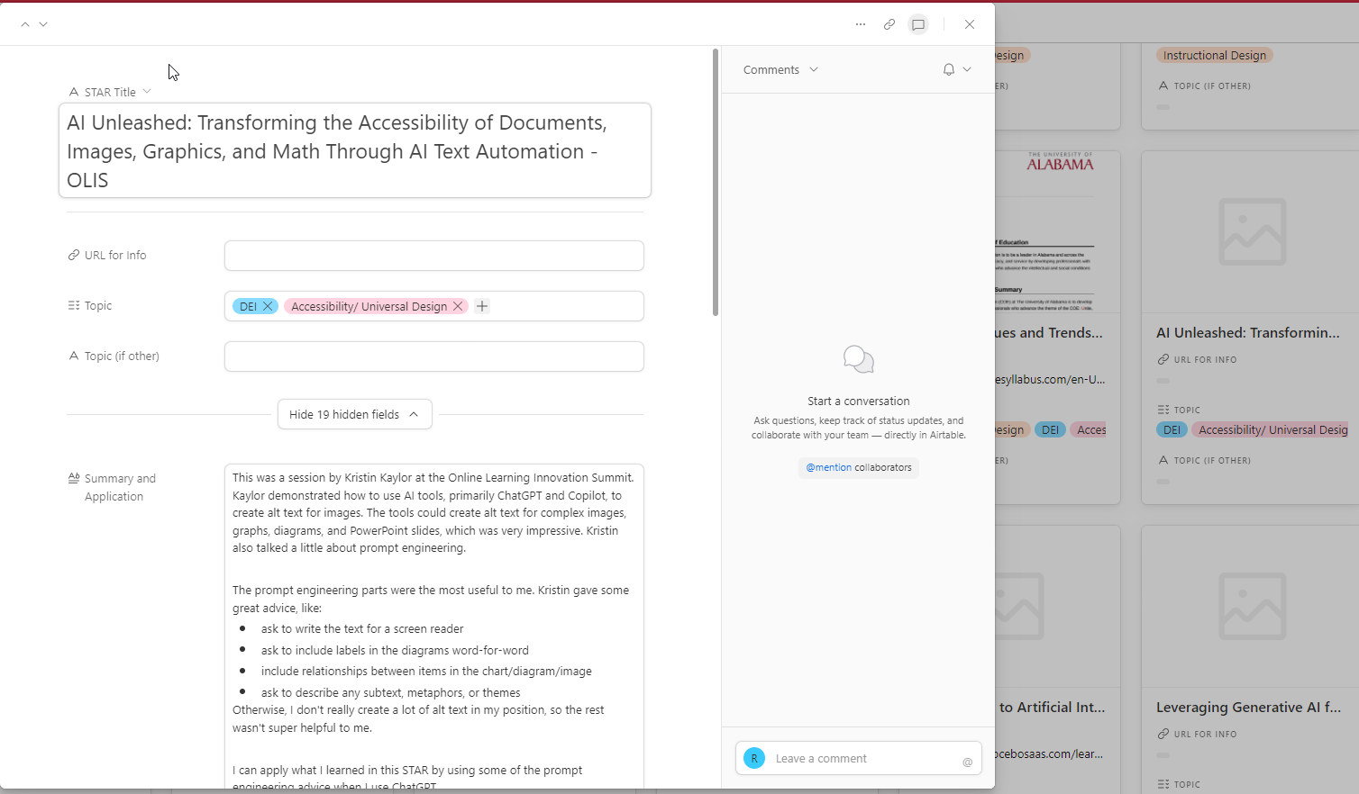
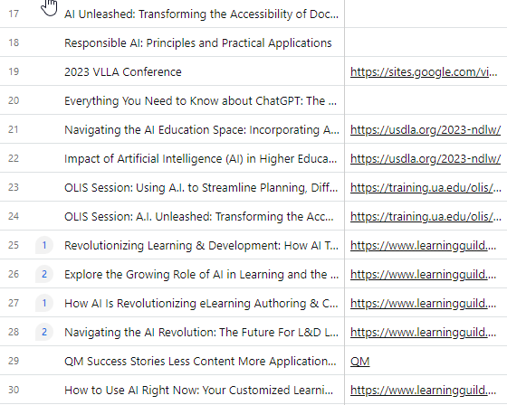
Professional Development
Notes:
74 PDs across our staff for a total of 174 hours
Mention STAR hours
Took things even if not in K12 context. IBM AI Fundamentals, corporate. Mention readings, The Algorithm

Slide 17
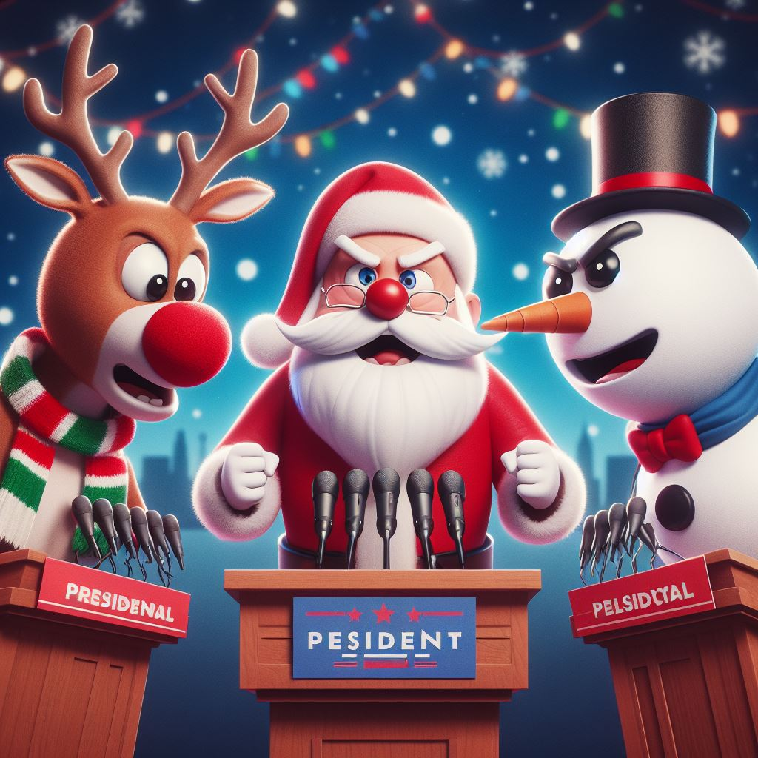
AI Discussion
Biweekly Meeting
Optional
General Agenda
  Ice Breaker
  Focus Topic
  Interesting PD
  Experiments
Notes:
Talk generally about this structure. Has been a place to ensure this isn’t dropped and a reminder of it as a tool. Has allowed us to nail down details, like whether every slide needs to be labelled with an icon, handling when SMEs are not specific in their usage, identifying needed documentation and guidance, identifying best practices. Explain the importance of some of the brainteasers

Slide 18

“But have you….”
“I have bullet points but not a script.”
“SME is late”
“I have nothing to start from.”
“Writing tests takes so long.”
“We need alt text.”
“There is no answer key.”
“Readability is too high.”
“SME didn’t write knowledge checks.”
“I don’t have the audio for that.”
Notes:
Take a second – what is your biggest barrier?
Talk about using the broken record approach to asking about usage when encountering issues. The biggest barriers are SME timeliness and thoroughness. Sometimes we cannot go back for everything .If we can initiate something for them to review / respond to, it takes away the “blank page”

Slide 19
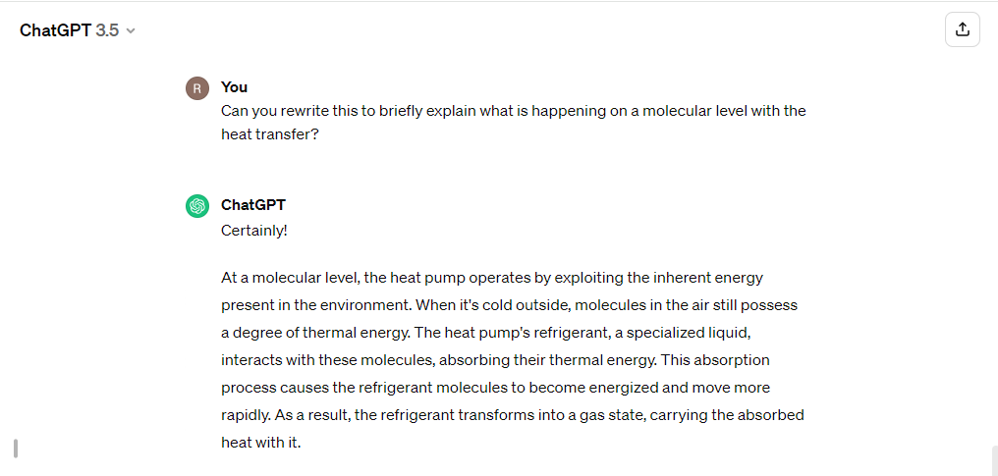
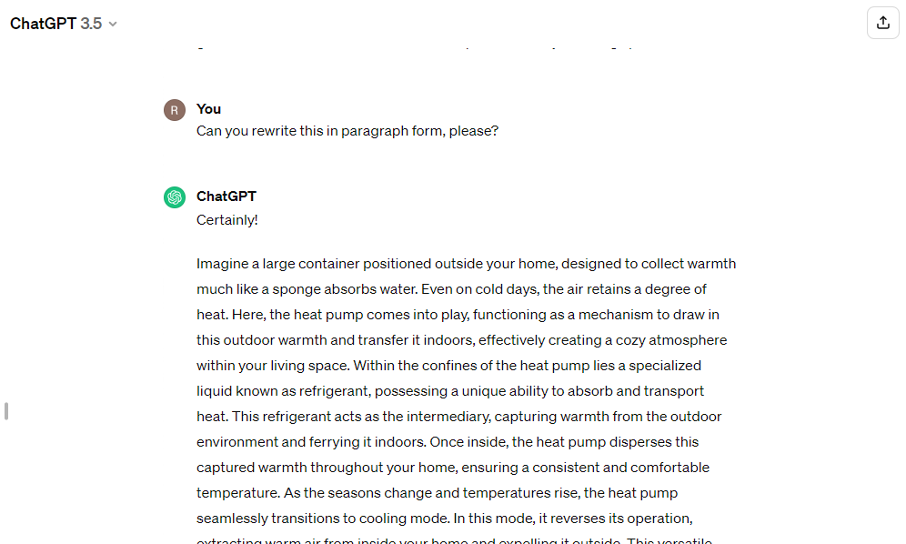
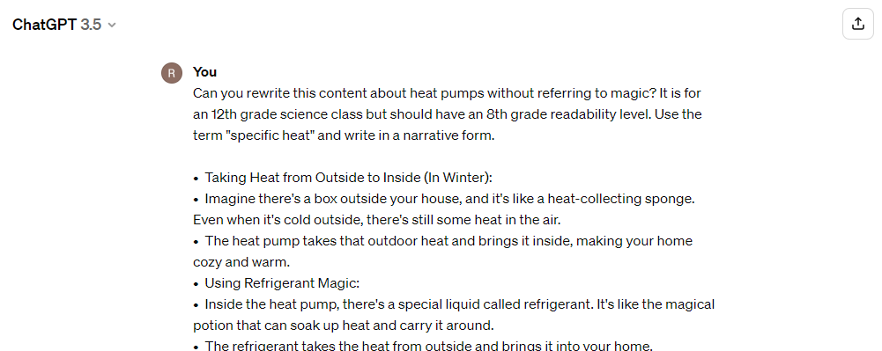
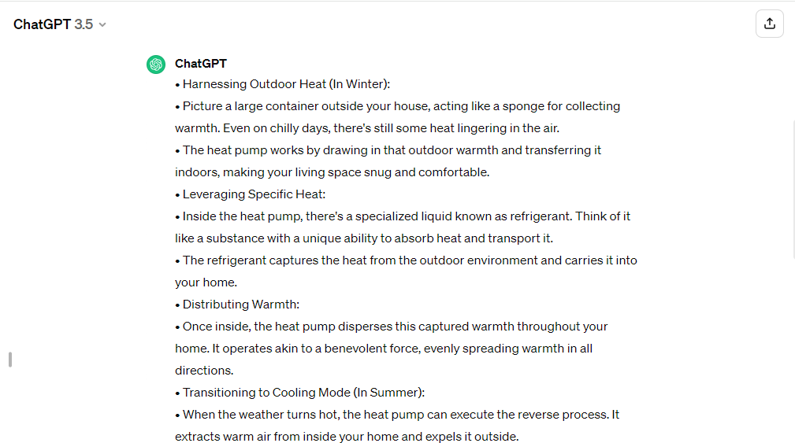
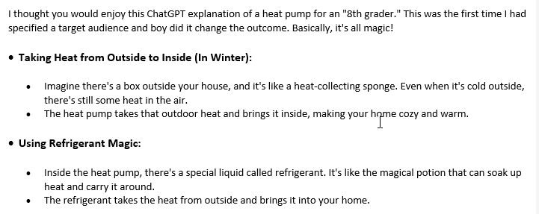
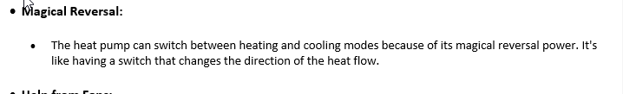

Slide 20
What’s worth keeping?
What sparks joy?

Slide 21
Practices Worth Keeping
Dedicated time
Normalized use
Professional development
Template prompt structure for SMEs/IDs
Transparency
Notes:
Talk through what is worth keeping

Slide 22
Where are we going?
Planning
Data analysis
Unit outlines
Measurable objectives from state standards
Enduring understandings and essential knowledge
Brainstorming
Authoring
Initial lessons
Question cloning
Reading level adjustment
Sample texts
Alt text
Teacher support materials
Work Exemplars
Evaluation
Content gaps
Additional support materials
Dark data

Slide 23
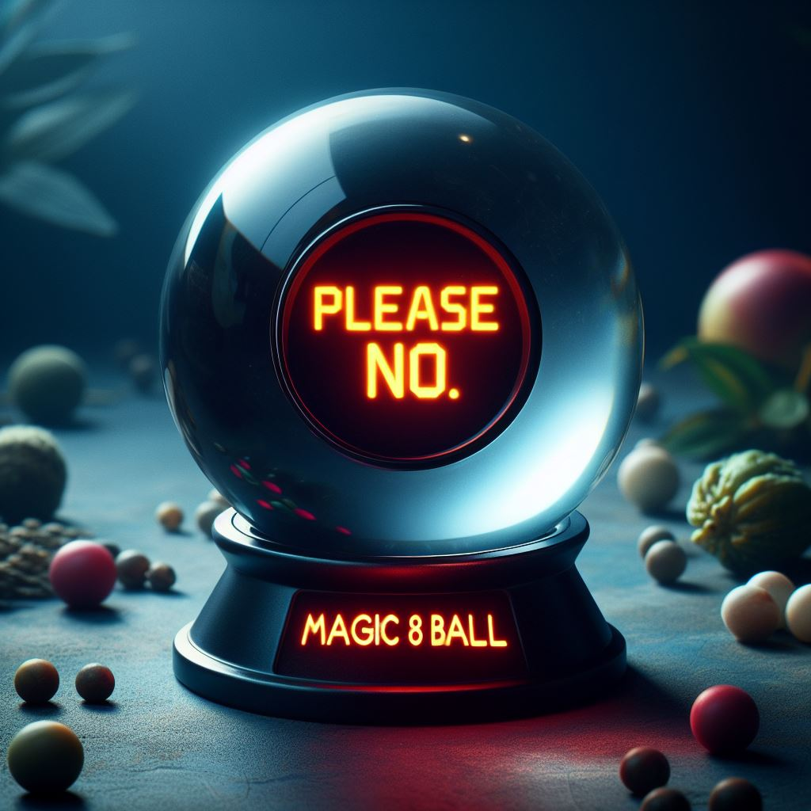

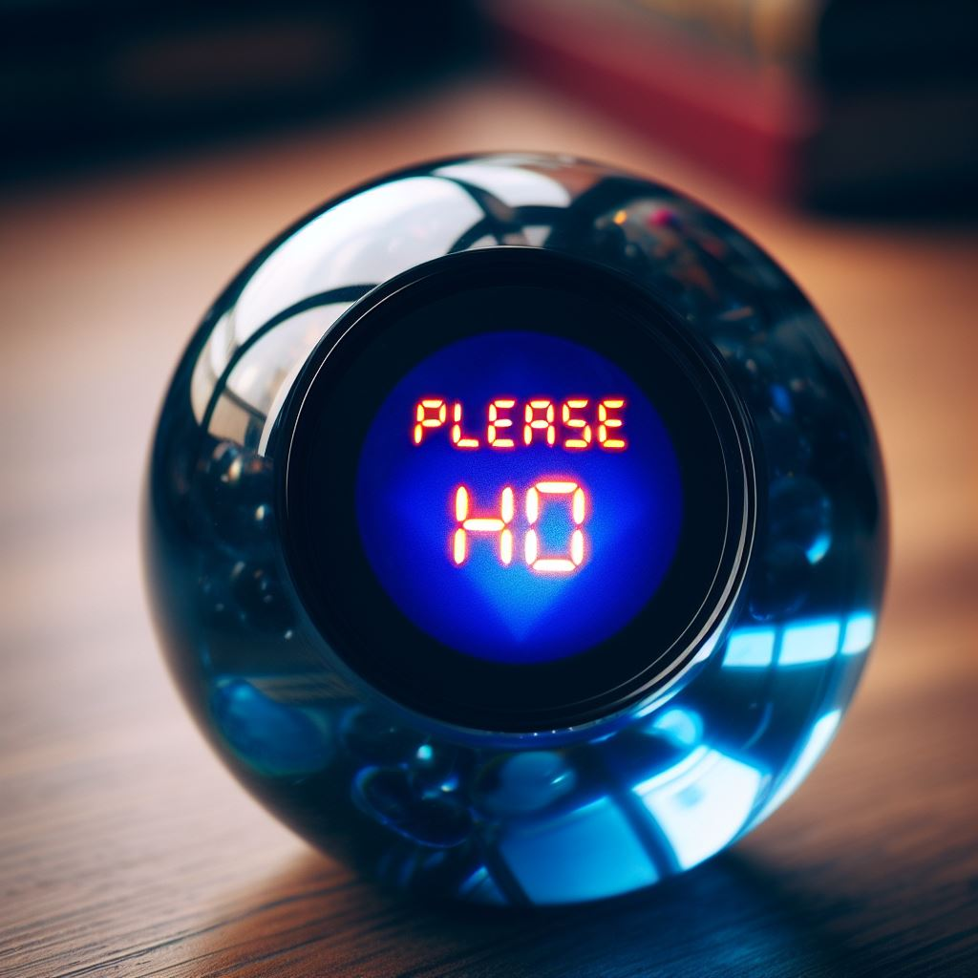
Questions?
Notes:
When this comes up, mention that I gave it vague instructions to look more like a magic 8-ball and got this one. Say I am choosing to believe the third one is a reference to Santa Claus.

Slide 24

Thank You
Rachel Walker
walke101@ua.edu

Slide 25
Resources
Prompt Engineering Guide
Principled Instructions Are All You Need for Questioning LLaMA-1/2, GPT-3.5/4
Large Language Models Understand and Can be Enhanced by Emotional Stimuli
Notes:
Mention that I am pretty sure I got these from Jason, so part of this is being on listservs, even if you are a lurrker

Slide 26
Credits
AI IS HER, Copyright Monster, and Debate Between Santa, Bored Zoom Call, Rudolph, and Frosty, Magic 8 Ball 1, Magic 8 Ball 2, and Inappropriate Magic 8 Ball generated by Microsoft Copilot. Reviewed by ACCESS Virtual Learning.
AI Usage in ACCESS Course Development editing assistance provided by ChatGPT-3.5. Reviewed by ACCESS Virtual Learning.
Generative AI Risk Awareness and Acknowledgement Form adapted with permission from Generative AI Risk Awareness and Acknowledgement Form by University of Illinois System (https://uofi.app.box.com/v/UISystemGenAIForm)

