Slide 1
AI v AI
Balancing Academic Integrity with Preparing Students for the Generative AI Age
Presented by:
Alaina Pascarella, Manager of Academic Quality Services

Slide 2
Learning Outcomes
Examine AI's impact on academic integrity for learners and institutions.
Examine how developing generative AI skills would impact learner success in the 21st century workplace.
Develop some potential strategies for preparing learners for work in an AI-rich environment, while maintaining academic integrity in the classroom.
Notes:
We’re going to start “wide” and taper into practical examples

Slide 3
The State of Generative AI and Academic Integrity

Slide 4



What Is Generative AI? Large Language Models
  Analyzes large amounts of text for patterns and connections between words and phrases.
  Creates text responses to prompts based on algorithmic probability of those patterns (Priest, 2024).

Slide 5
The Trouble with AI Detection Tools
Lack of transparency
  Little information is available about how the algorithm to detect AI was developed
Lack of reliability
  Incidences of false positives
Potential for bias
  Studies have shown bias in inaccurately identifying non-native English writers work as being AI (Myers, 2023)

Slide 6
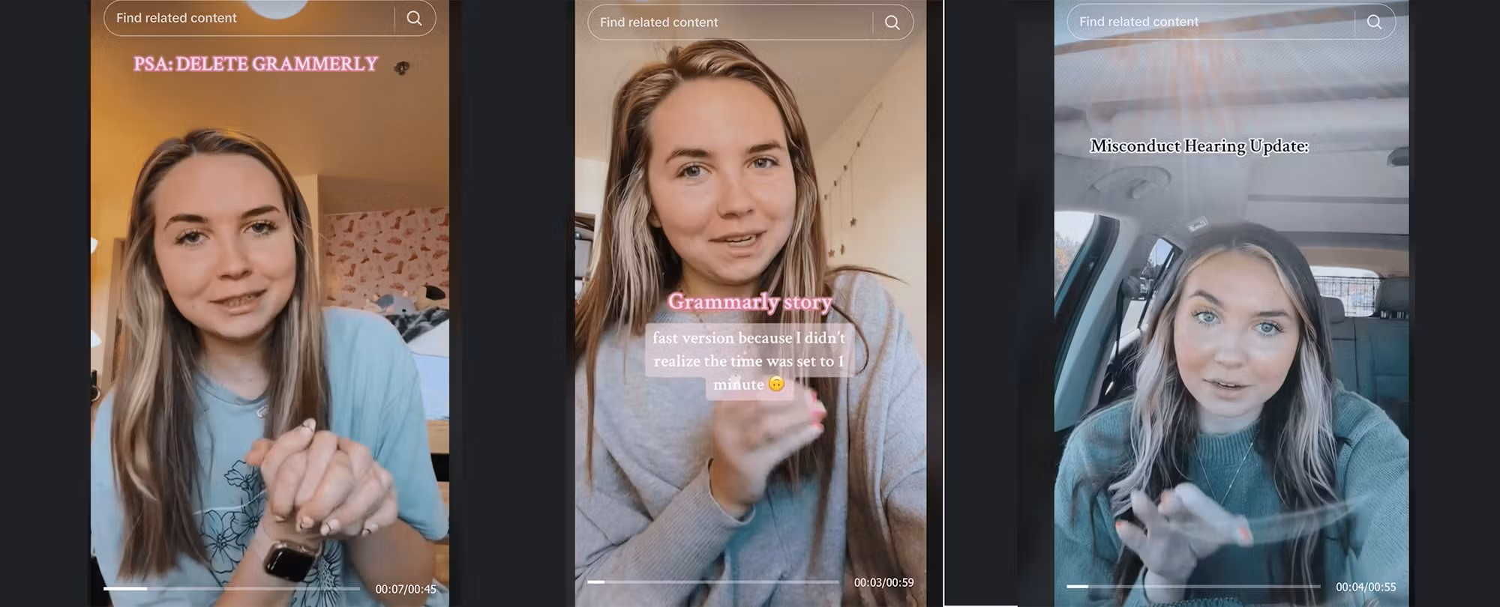
A Case Study
University of North Georgia Plagiarism Case
University of North Georgia student, Marley Stevens, accused of academic integrity violation based solely on Turnitin AI detection
Student placed on academic probation for a year and lost scholarship
Made national news headlines
Stills from Marley Stevens TikTok Account

Slide 7
Total Citations by Academic Integrity Violation: Q1 of 2024-25 AY

Slide 8
Total Academic Integrity Violations: Citation Issues: Q1 of 2024-25 AY

Slide 9
Where Do We Go From Here
Back to Basics Approach
What is it about the student’s writing that requires feedback?
  Impersonal tone
  Lack of depth and critical thinking
  Lack of citations
  Fabricated resources

Slide 10
Building a Framework

Slide 11
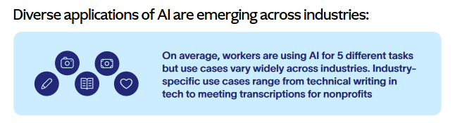
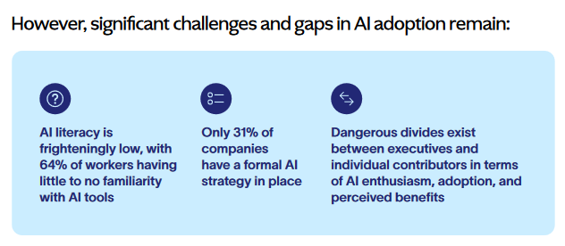
Source: Hinds (2024)

Slide 12
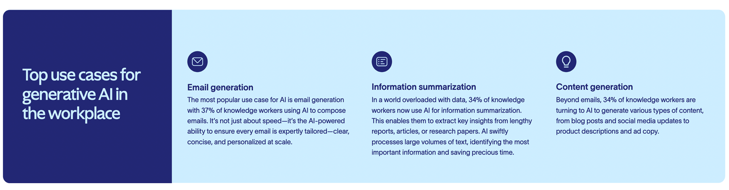
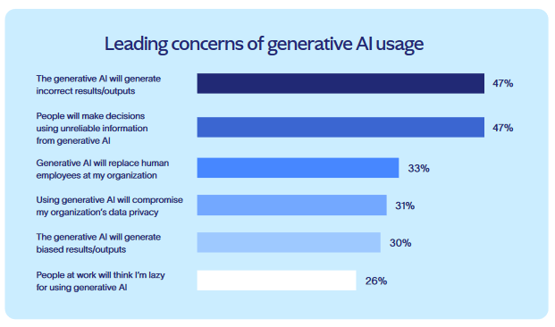
Source: Hinds, 2024

Slide 13
Human in the Loop
A practice which requires the active involvement of human beings in the development, training, and operation of AI systems.
Why do we need the human in the loop?
  Ensure accuracy
  Reduce bias
  Provide ethical oversight
  Improve understanding of why AI has made the decisions it made
What is the human in the loop. Infobip. (2024, March 24). https://www.infobip.com/glossary/human-in-the-loop

Slide 14
How can we Help Students Build Generative AI Skills?

Slide 15
Explore and Learn
Go For The Goals
Dig Deeper
A Winning Routine
Figure out where AI might help… and where it won’t!
Build confidence through use… even if it doesn’t work the way you wanted!
Track your data…so you can see the impact!
Take stock of existing resources…training wheels for your own use!
Recognize existing implementations…and imagine what comes next!
Develop a habit…and take the time to let it truly grow!
Each step counts…even a step back!

Slide 16
Research-Based Learning Activities
Fact Checking and Knowledge Checks
Learning Activity: Select a topic about which you feel you have a reasonable amount of knowledge and create a question about the topic which you might ask a generative AI tool. Using the free version of ChatGPT, gather background information on your selected topic based on your question. Evaluate the information provided by ChatGPT. Are there details that are missing or inaccurate? How might you improve your prompt to get a better response?
Skills: Evaluating information for accuracy and Prompt engineering

Slide 17
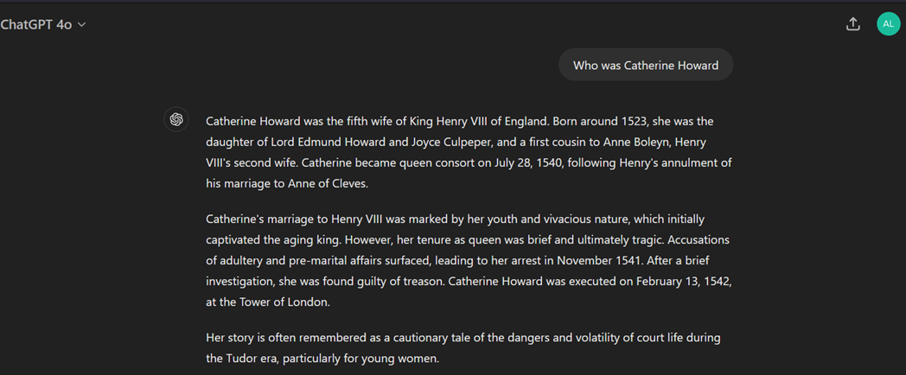
Research-Based Learning Activities
Fact Checking and Knowledge Checks

Slide 18
Research-Based Learning Activities
Identifying Bias
Learning Activity: Select a topic on which there are varying perspectives. Create a prompt to generate an argument on the topic using the free version of ChatGPT. What are areas of the argument that been overlooked? Does the output include diverse perspectives? Whose perspective is not included?
Skills: Identifying Bias and Prompt Engineering

Slide 19
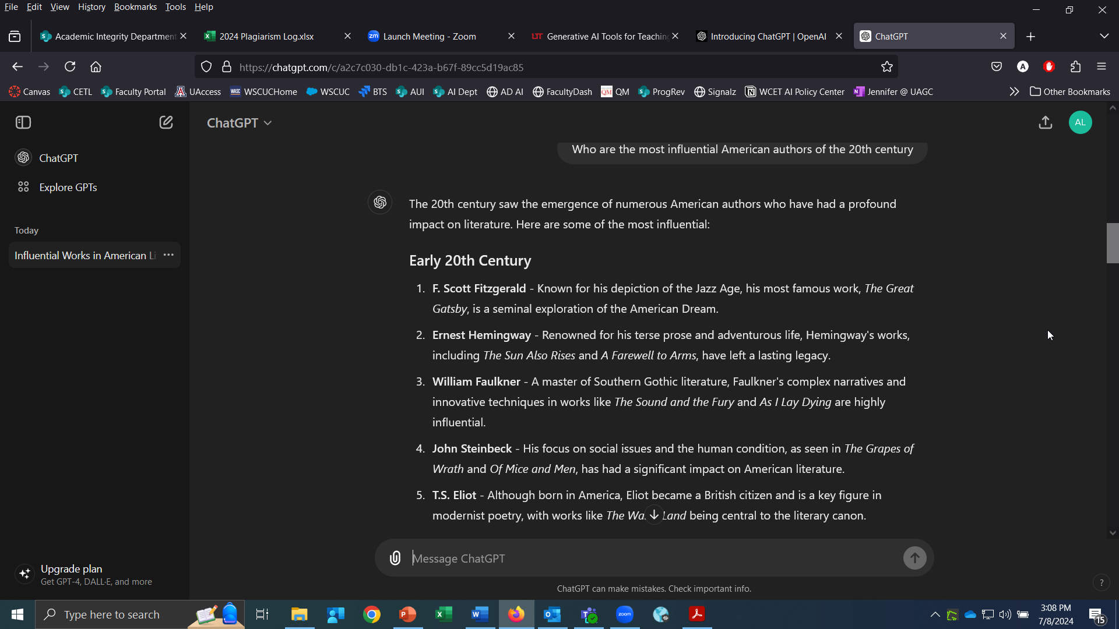
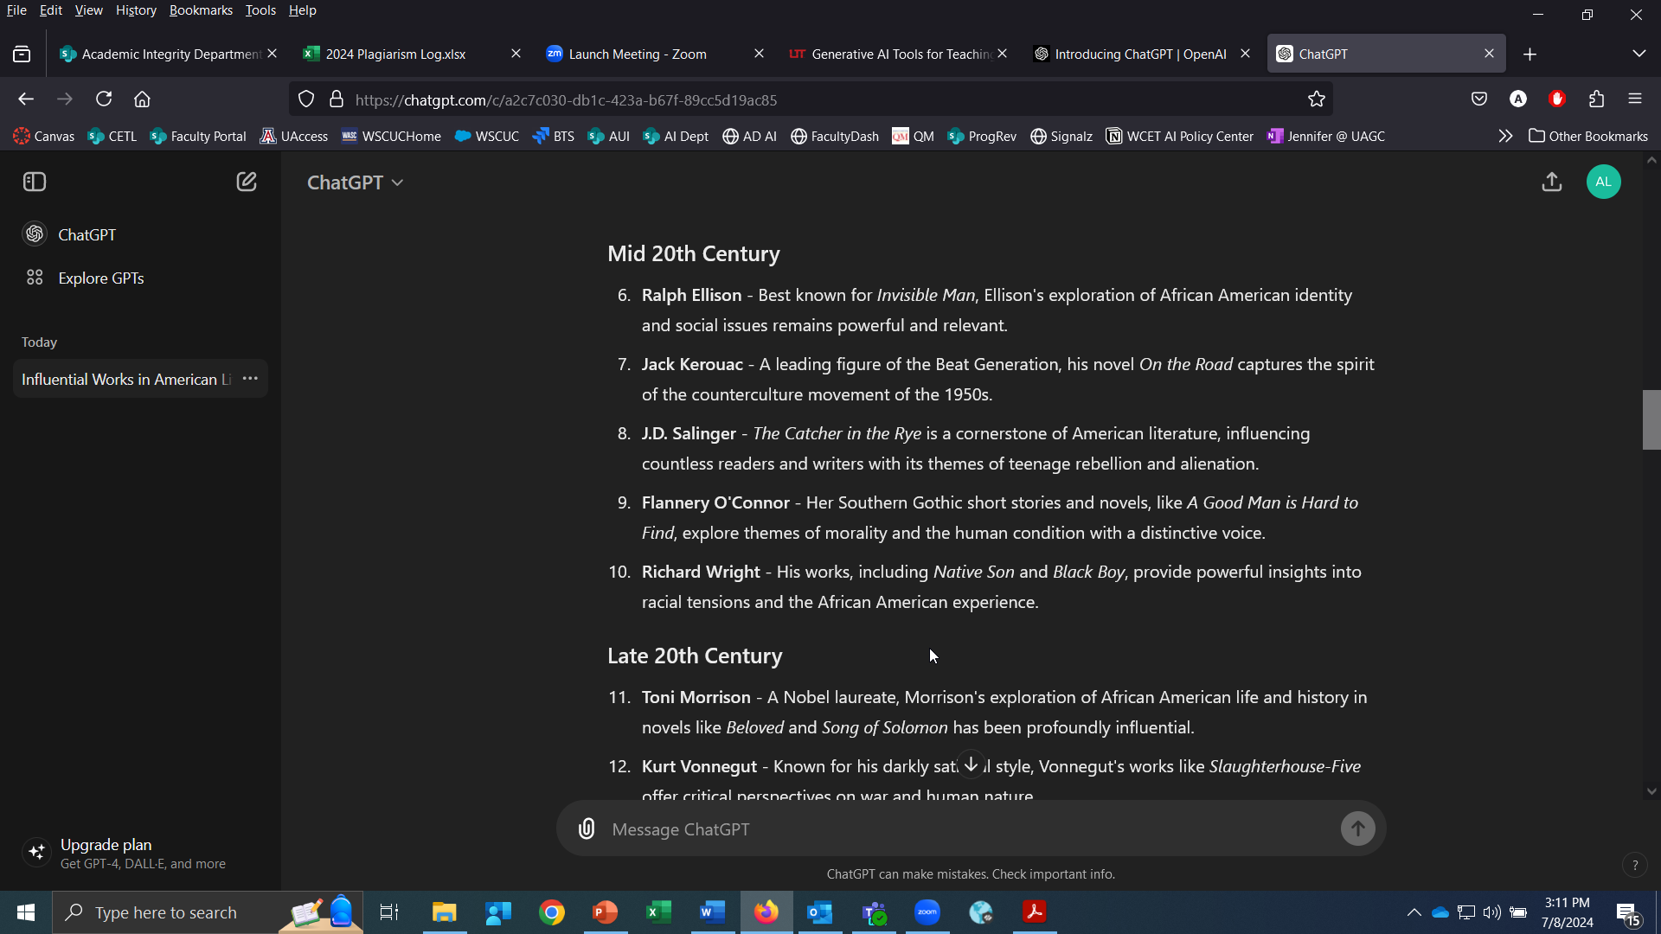
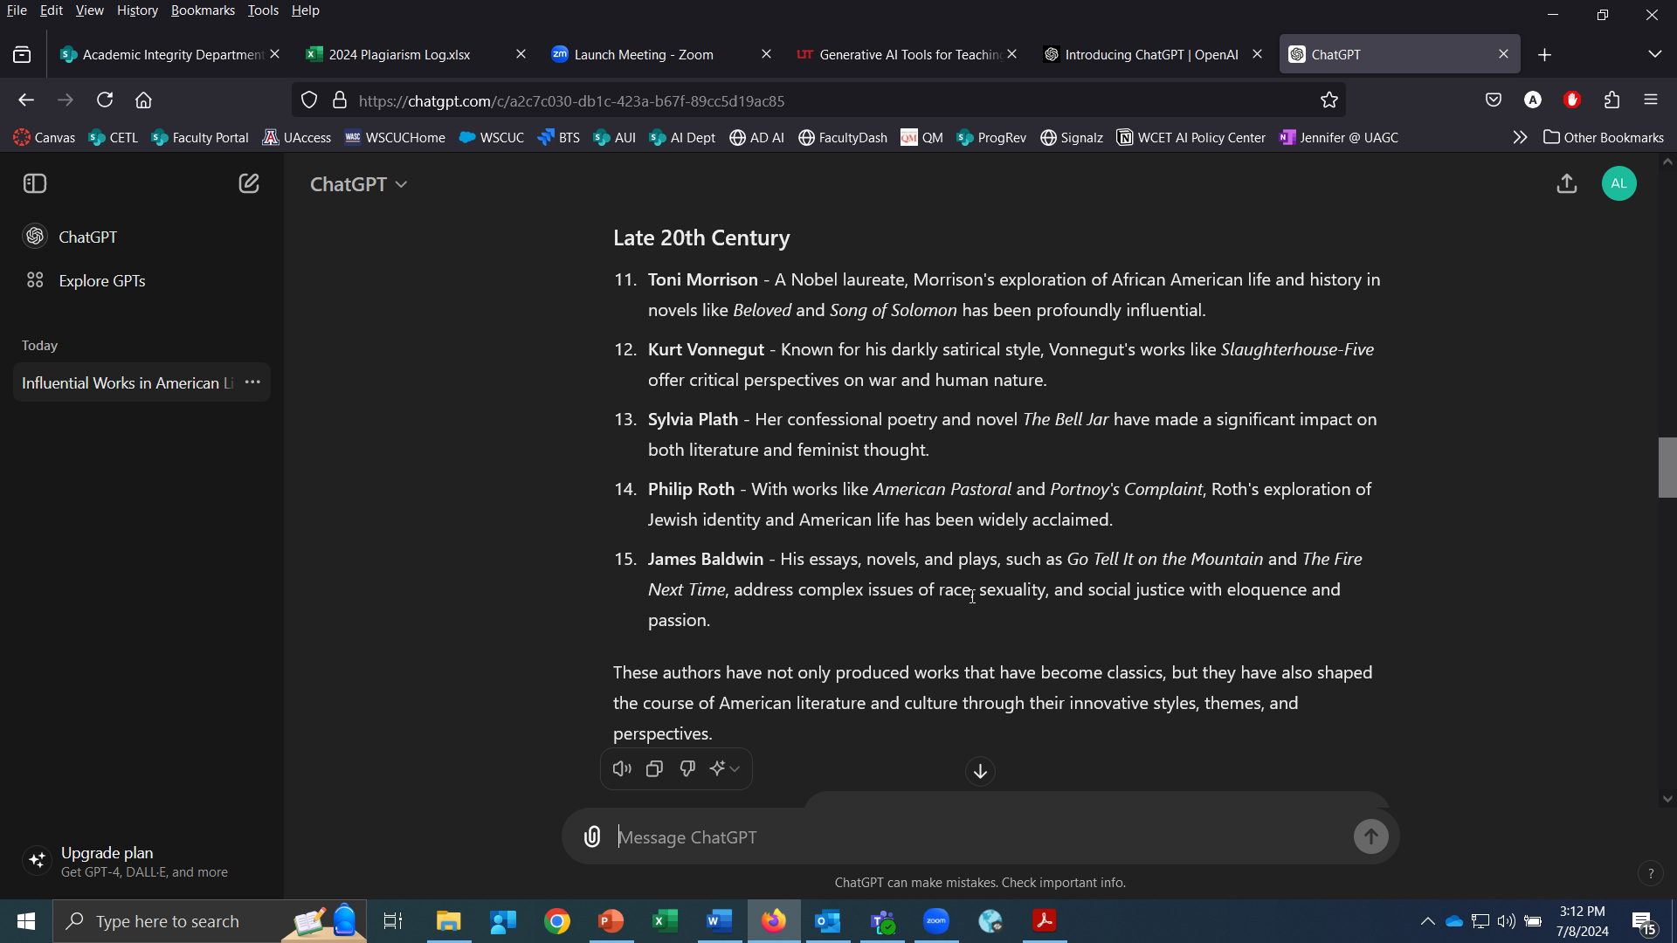
Research-Based Learning Activities
Identifying Bias

Slide 20
Writing Process Learning Activities
Brainstorming
Learning Activity: As you explore potential topics for your paper, it can be beneficial to collaborate with generative AI to narrow your focus. Using one of the broad topic suggestions for the paper, create a prompt to help you brainstorm some potential more focused topics for your paper.
Skills: Narrowing a focus and Prompt engineering

Slide 21
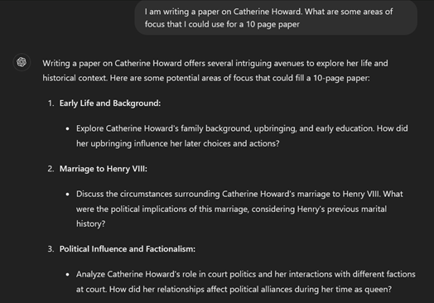
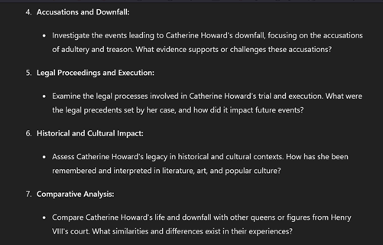
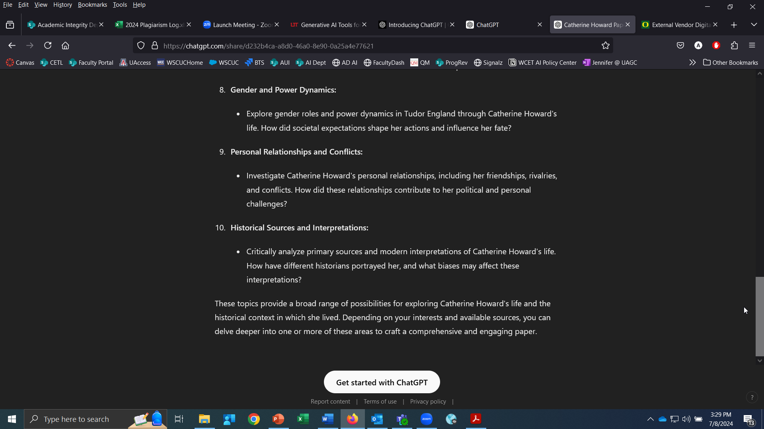
Writing Process Learning Activities
Brainstorming

Slide 22
To Use or Not To Use

Slide 23
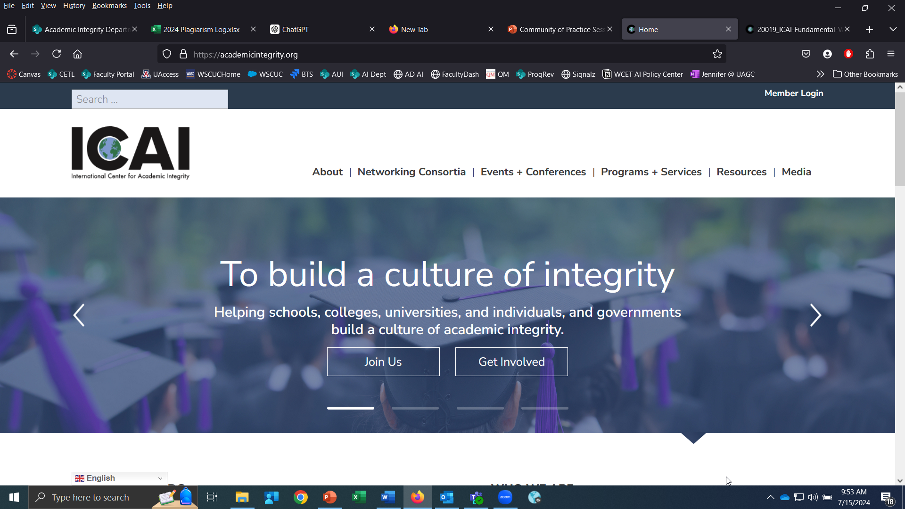
Fundamental Values of Academic Integrity
International Center of Academic Integrity
Honesty
  Give credit to the owner of any work used
Trust
  Promote transparency
Fairness
  Apply policy consistently
Respect
  Recognize the consequences of your actions on others
Responsibility
  Model good behavior
Courage
  Be willing to take risks and risk failure

Slide 24
Fundamental Values In Action
Honesty, Respect, and Responsibility
Honesty
Respect
Responsibility
How did the developer train its tool?
  What is the source of information?
  Find original sources if using for background resources.
What is the impact of your use on creators and users?
  Does the tool disclose any permissions to use the work of others?
  How does the tool utilize user data?
How should you model good behavior for your students?
  Disclose any use of generative AI including how you used generative AI and what tools you used.

Slide 25
Fundamental Values In Action
Trust, Fairness, and Courage
Trust
Fairness
Courage
How do I promote transparency in the classroom?
  Set clear expectations including noting in assignment instructions whether or not the use of generative AI is allowed
How do I apply any policies with consistency?
  Applying the policies with consistency means abiding by the same expectations you set for your students.
How can I take risks and accept any failure?
  Recognize that we are all learning with this new technology.
  Be willing to acknowledge where you may fall short of your own expectations.

Slide 26
Quality Matters
SRS 3.6: The assessments provide guidance to the learner about how to uphold academic integrity.
What are the expectations for maintaining academic integrity in the assignment?
  Should students be allowed to use generative AI to complete the assignment?
    If generative AI use is allowed, what are the parameters for its use?
    Is there an expectation that students disclose what generative AI tool they used and how?
What resources should I provide to students to help them maintain academic integrity in the assignment?
  Disclosure statement
  Resources on appropriate generative AI use

Slide 27
Disclosing Use of Generative AI
Sample Statement
I, [STUDENT NAME], confirm that I have used the following generative artificial intelligence (AI) [AI TOOL USED] to assist in my academic writing. In this assignment, AI was used to [INSERT REASON FOR USE e.g. initial research, spelling and grammar correction, idea collection/ brainstorming, outlining, etc.]. I have only used AI for the reason(s) listed and not to produce, replace, or substitute my own work and original thought. I understand the importance of academic integrity and ensure I have upheld the university’s Academic Integrity Policy by adhering to principles outlined in Academic Use of AI.

Slide 28
What else should we consider?

Slide 29
Additional Considerations
Ethical concerns – Does the tool that you are asking students to use utilize creative works which might be under copyright?
Privacy concerns – Consider whether or not the student using a generative AI tool would require students to provide personal information to a third party
Equity issues – Is the tool that you are asking students to use accessible to all students? If there is both a free and paid version, does using the free version place students at a disadvantage from using the paid version?

Slide 30
References
Hinds, R. (2024). State of AI at work 2024. Asana.com https://asana.com/work-innovation-lab/state-of-ai-at-work/
International Center for Academic Integrity [ICAI]. (2021). The fundamental values of academic Integrity. (3rd ed.). https://academicintegrity.org/images/pdfs/20019_ICAI-Fundamental-Values_R12.pdf
Leoffler, K. (2024). Georgia student used Grammarly, now she is on academic probation. Fox 5 Atlanta. https://www.fox5atlanta.com/news/grammarly-georgia-college-student-academic-probation-plagiarism-allegations
Myers, A. (2023). AI detectors biased against non-native English writers [blog]. Human-Centered Artificial Intelligence Stanford University. https://hai.stanford.edu/news/ai-detectors-biased-against-non-native-english-writers
Priest, M. (2024). Large language models explained [blog]. Boost AI. Retrieved on February 29, 2024 from https://boost.ai/blog/llms-large-language-models/

