Slide 1

“A Rose By Any Other Name Smells as Sweet”:
Introducing QM to Reluctant Faculty
Wren Mills, Ph.D., Assistant Director
Alicia Pennington, Instructional Designer
Center for Innovative Teaching and Learning
Western Kentucky University

Slide 2
Session Objectives
Describe the faculty learning community model.
Discuss methods of engaging reluctant faculty with the Quality Matters program.
Identify strategies for and programs where “hiding” QM might be beneficial for reluctant faculty.

Slide 3
Our Experience with QM
Wren
Master and Peer Reviewer
Certified Facilitator
QM Coordinator
QM Course Review Manager
ENG 300 course recognized in 2010 and 2016
Alicia
Peer Reviewer
QM Coordinator
QM Course Review Manager

Slide 4
Instructional Design Team and QM
Our ID Team uses QM
  All IDs and Support Specialists complete the QM APPQMR course with Wren
  All IDs complete the Peer Reviewer Course (not required to be come a Peer Reviewer)
  In their daily work on courses
  In consultations with faculty

Slide 5
Our QM PD Strategy
“Intro to QM” webinars
Standard-by-Standard workshops to revise course
APPQMR once a year
Integrated QM into all of our webinars, workshops, conferences, and camps, and our online teaching certificate program
Moved toward the PLC model because our faculty said they wanted more than “one and done” webinars and workshops
  Some PLCs have QM integrated into them

Slide 6

And then one day…

Slide 7
Cox’s Faculty PLC Model
A small group of interdisciplinary faculty who commit to several meetings over a given teaching and learning topic
Can involve “homework” to do between meetings
Discussion- and reflection-based– no “sage on the stage”
Lots of collaboration, sharing, and support
Learn about Cox’s model at http://www.units.miamioh.edu/flc/

Slide 8
Strengthening Your Online Course PLC
Co-facilitated by a faculty developer and instructional designer
Did not use the words “Quality Matters” or “Rubric” at all in our advertising the PLC or during it
4 meetings, 2 hours each, weekly for a month
Light refreshments (coffee, iced tea, water, cookies or brownies)

Slide 9
Our Design
Provided Best Practices checklist based on the QM Rubric’s Standards and Annotations
“Star” system
Changed wording and tone of the standards
Realigned some standards to meet the needs of the topic we discussed that day
Strengthened Standard 8’s ADA requirements

Slide 10

Week 1 – Introduction to PLC and Overview
QM Standard Covered:
1 – Course Overview and Introduction (all of the elements)
Homework:
Watch video on instructional alignment

Slide 11
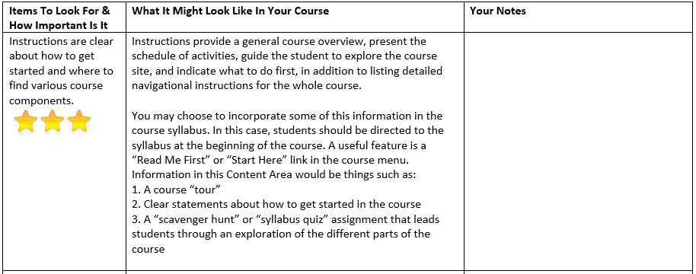
Example of our Best Practices Worksheet

Slide 12

Week 2 – Instructional Alignment & Active Learning
QM Standards Covered:
Covered material in standards 2-6 but only the essential ones
2 – Learning Objectives (only covered standards worth 3 points)
  2.1 + 2.3 + 2.5
  2.2
  2.4
5 – Course Activities and Learner Interaction (only 5.2)
6 – Course Technology (only 6.2)

Slide 13

Week 3 – Course Policies and Accessibility
QM Standards Covered:
Course Policies
  3 – Assessment and Measurement
    3.2 and 3.3
  7 – Learner Support
    7.1 and 7.2
Accessibility
  8 – Accessibility and Usability
    8.1 covered in general
    8.2 covered as it meets CITL standards for accessibility

Slide 14

Week 4 –
The Big Reveal
At the final meeting, after participants shared their “biggest change” that they’d be making to their courses, we asked if they’d heard of QM.
Did a “QM Quickie” 15 minute overview presentation
Discussed the Self-Review Tool
Provided copy of the Rubric Workbook
Encouraged them to consider doing a review
Reaction to QM: Positive!

Slide 15
Could it work for you?
Do you have an instructional designer or faculty development center to collaborate with?
Do you have experience with someone who is antagonistic?
Do you have faculty who want a deeper PD experience than “one and done” workshops and webinars?

Slide 16

Questions?

