Slide 1

Defining and implementing academic rigor: a 5-year update
Quality Matters Research Online Conference 2024
Dr. Andria F. Schwegler
Associate Professor of Psychology

Slide 2

Agenda
Welcoming Newcomers to the Conversation
  Research Basis Overview
  A Working Definition of Academic Rigor
    Location in the Higher Education Landscape
Checking-In on Impact
  Local Discussions
  Broader Conversations
Applying Concepts for Continuous Improvement
Inviting Critical Review and Revision

Slide 3

Learning Outcomes
Define academic rigor.
Distinguish among constructs typically confounded with academic rigor.
Identify examples of contexts where definition has been applied.
Recognize applications at your institution.
Critically evaluate definition and suggest research for continuous improvement.

Slide 4
Defining Academic Rigor
Academic rigor has a negative connotation (e.g., rigor mortis).
  Wraga (2010)
Academic rigor is widely used but hard to define.
  Graham & Essex (2001); Draeger et al. (2013)
There is no consensus on the definitions of academic rigor that do exist.
  Hechinger Institute (2009)
Academic rigor in higher education is assumed to exist even in the absence of evidence to document it.
  Labaree (1997); Whitaker (2016)

Slide 5
Defining Academic Rigor
Academic rigor as a negotiable standard is a threat to student learning.
  Schnee (2008)
    Students reported having weak academic preparation for college.
    Teachers, with few resources to assist, reported lowering expectations for work.
  Schutz et al. (2013)
    44.5% of faculty members in a community college sample (N = 1,559) reported sometimes assigning grades higher than students actually earned.

Slide 6
Defining Academic Rigor
Prior definitions confound teacher responsibilities with student responsibilities.
  Teachers are responsible for creating conditions to support academic rigor.
  Students are responsible for learning.
    Academic rigor is not synonymous with student learning, which is influenced by multiple factors.
Prior definitions confound curriculum with course delivery.
  Curriculum is set collaboratively by program faculty and may include other stakeholders.
    Pushing higher-level curriculum down to a lower-level course is not academic rigor.
  Course delivery is determined by individual faculty members.
    Curriculum and/or student learning can be threatened by lack of “implementation fidelity” (Mathers et al., 2018, p. 1224)

Slide 7
Defining Academic Rigor
Subjective interpretations of effective learning are misleading.
  Roediger & Karpicke (2006, p. 199)
    “…people often do not voluntarily engage in difficult learning activities, even though such activities may improve learning.”
  Kornell & Bjork (2008, p. 591)
    “…individuals responsible for the design and evaluation of instruction that involves induction are susceptible to being very misled by their own intuitions and subjective experiences.”
  Kornell & Bjork (2009)
    Humans fail to predict how much their memory can change over time (i.e., stability bias).
  Bjork & Bjork (2011)
    “Desirable difficulties” facilitate learning.

Slide 8
Defining Academic Rigor to…
Unconfound Teacher Responsibilities and Student Responsibilities
Unconfound Curriculum and Course Delivery
Avoid Subjective Interpretations to Reduce Bias via Grounding in Research
Be Observable, Measurable, and Subject to Continuous Improvement
Prioritize Student Learning

Slide 9
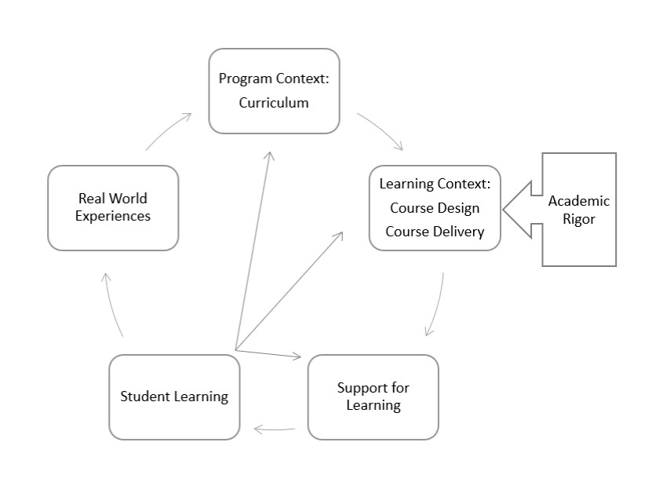
Locating Academic Rigor
Used with the permission of Quality Matters

Slide 10
A Working Definition
Academic Rigor is…
intentionally crafted and sequenced learning activities and interactions that are supported by research and provide students the opportunity to create and demonstrate their own understanding or interpretation of information and support it with evidence.
White Paper 1 - Academic rigor: A comprehensive definition. Quality Matters. https://www.qualitymatters.org/index.php/qa-resources/resource-center/articles-resources/academic-rigor-white-paper-part-one

Slide 11

Academic rigor is… intentionally crafted and sequenced learning activities and interactions that are supported by research and provide students the opportunity to create and demonstrate their own understanding or interpretation of information and support it with evidence
Teacher responsibilities are distinct from student responsibilities.
A teacher’s decisions regarding academic rigor can be observed, measured, and revised for continuous improvement.
Curriculum is distinct from course delivery.
A research basis reduces subjective interpretations and bias and facilitates new advances in SoTL (Hutchings et al., 2011).
Student learning is the purpose of teaching.
Students actively construct knowledge, not passively receive it.
Students justify positions, not merely accept them.

Slide 12
Impact: Local discussions
Institution Level Applications
  Teaching Philosophies
  Course Assessment Practices
  Observations of Teaching

Slide 13

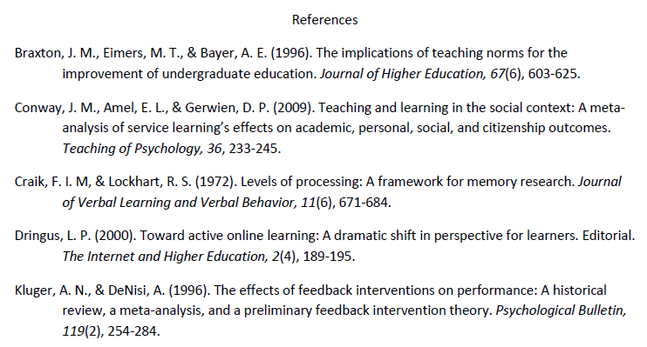
Local discussions
Teaching Philosophies
  Idiosyncratic and anecdotal
  Vs.
  Scholarly narratives documenting effective teaching practices

Slide 14
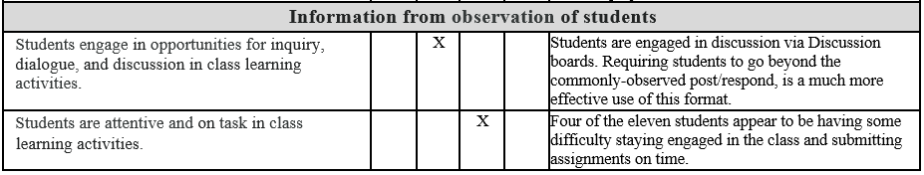
Local discussions
Observation of Faculty Teaching
  Distinguish teacher responsibilities from student responsibilities (e.g., online, asynchronous course)
Good
Average
Excellent
Poor

Slide 15
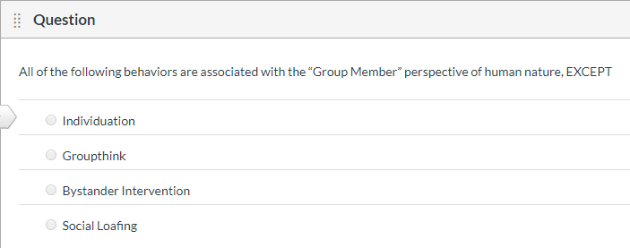
Local discussions
Course Learning Assessment
  Does a graduate course with only multiple-choice exams lack rigor?
  What research supports this design?
    Is Roediger & Karpicke’s (2006) work on the testing effect sufficient?
  What evidence are students providing to demonstrate their understanding or interpretation of information?
    Is “I clicked A” sufficient evidence?

Slide 16
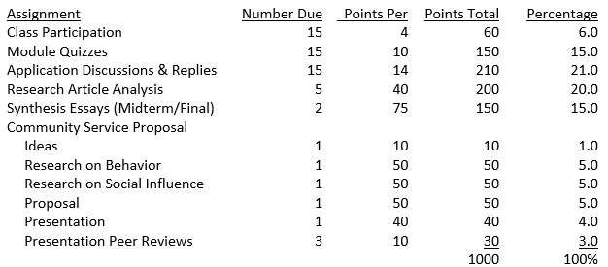
Local discussions
Course Learning Assessment
  Example of a graduate course with evidence of rigor (i.e., intentionally crafted and sequenced learning activities and interactions that are supported by research and provide students the opportunity to create and demonstrate their own understanding or interpretation of information and support it with evidence)
Roediger & Karpicke (2006)
Testing effect
Donovan & Radosevich (1999)
Spaced practice
Taylor & Rohrer (2010)
Interleaving content
Kluger & DeNisi (1996)
Task feedback
Pan & Rickard (2018)
Transfer

Slide 17
Local discussions
Academic Rigor as a Continuum
  Where do we need to be?
  What evidence is relevant?
  What evidence is missing but needed?
  What is the impact on student learning?
Reframes conversation from personal focus to task focus (i.e., research-based with measurable outcomes; see Kluger & DeNisi, 1996)
Less support
for rigor
More support
for rigor

Slide 18
Impact: broader conversations
Conversations at Other Institutions
  Standards for Graduate Programs
  Equitable Teaching
  Universal Design for Learning
  Characteristics of Good Teaching
  Institution Accreditation

Slide 19
Broader Conversations
Standards for Graduate Programs
  “Faculty and departments develop new graduate programs in response to scientific, industrial, societal and/or governmental needs. New programs should be rigorous, by which is meant ‘intentionally crafted and sequenced learning activities and interactions that are supported by research and provide students the opportunity to create and demonstrate their own understanding or interpretation of information and support it with evidence’ and will result in the depth of knowledge outlined above expected of graduate level study upon completion.”
  2020-2022 Graduate Studies Handbook, University of Arkansas at Pine Bluff

Slide 20
Broader Conversations
Equitable Teaching
  “A caring environment provided for students needs to be associated with supporting students’ ability to meet high standards instead of lowering academic standards under the mistaken assumption that doing so would be helpful to students” (Schwegler, 2019a, p. 9).
  Artze-Vega, I., Darby, F., Dewsbury, B., & Imad, M. (2023). The Norton guide to equity-minded teaching. W. W. Norton & Company.
  Free ebook for instructors: https://seagull.wwnorton.com/equityguide

Slide 21
Broader Conversations
Universal Design for Learning
  “It is worth noting that neither Schwegler nor Moore agrees to controlling the ways learners acquire or demonstrate information, in order to be academically rigorous. In other words, the methods and materials…should be tools, whose purpose is to support learners to reach the CLRs [course learning requirements] in the most effective ways possible…”
  Algonquin College. Universal Design for Learning. https://www.algonquincollege.com/lts/udl/

Slide 22
Broader Conversations
Characteristics of Good Teaching
  RISE Framework at Lindenwood University:
    Rigor, Inclusiveness, Support, Engagement
  “Lowered expectations for academic performance have damaging implications because they perpetuate the inequalities students have already experienced when they apply to and enroll in college. Holding some students to lower academic standards because they have insufficient prior preparation…fails to close these gaps, and it is a social justice concern because all students are not provided access to a rigorous educational experience” (Schwegler, 2019a, p. 9).
  https://www.lindenwood.edu/human-resources/lindenwood-learning-academy/teaching-and-learning/rise-project/the-rise-guides-definitions-research-and-teaching-resources/

Slide 23
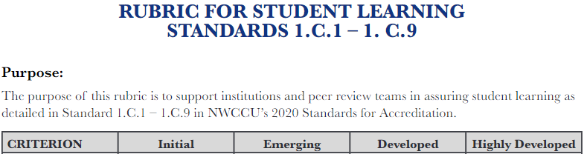
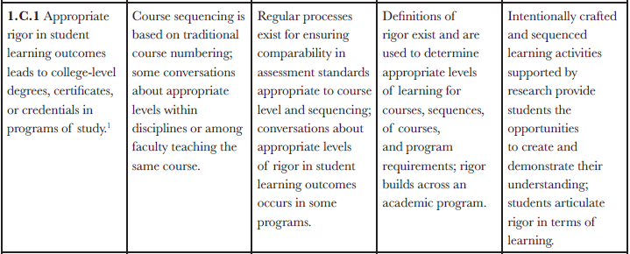
Broader Conversations
Institution Accreditation
Northwest Commission on Colleges and Universities
https://nwccu.org/accreditation/standards-policies/standards/

Slide 24
Applying concepts for continuous improvement
Conversations to be Had; Research to be Performed
  Student Underutilization of Co-Curricular Support
  Student - Faculty Behaviors that Impact Learning
  Faculty Research to Support Teaching and Learning
  Faculty Uses of Assessment Data
  Faculty Underutilization of Professional Development Activities

Slide 25
Applying concepts
White Paper 2 - Contextualizing academic rigor. Quality Matters. https://www.qualitymatters.org/qa-resources/resource-center/articles-resources/academic-rigorwhite-paper-part-two
  Student Underutilization of Co-Curricular Support
    Remedial Coursework
    Student Support Services

Slide 26
Applying concepts
White Paper 3 - Aligning institutional processes to support academic rigor. Quality Matters. https://www.qualitymatters.org/qa-resources/resource-center/articlesresources/academic-rigor-white-paper-part-three
  Student - Faculty Behaviors that Impact Learning
  Faculty Research to Support Teaching and Learning
  Faculty Uses of Assessment Data
  Faculty Underutilization of Professional Development Activities

Slide 27
Applying concepts
How might you apply the definition of academic rigor or related concepts at your institution?
Please add ideas in the chat!

Slide 28
Inviting critical review

Slide 29
Critical Review
Clark & Talbert (2021). Rigor. Grading for Growth. https://gradingforgrowth.com/p/rigor
  “There’s a lot going on there.”
  “Don’t use rigor at all.”
  Key Pillars of Grading Systems
    Clearly defined standards with marks that indicate progress
    Helpful feedback and reattempts without penalty

Slide 30
Critical Review
Elkhoury, Ali, & Sutherland-Harris (2023). Exploring faculty mindsets in equity-oriented assessment. Journal of University Teaching & Learning Practice, 20(5). https://doi.org/10.53761/ 1.20.5.12
  “Academic challenge that supports learning and growth in students…made more effective by an equity-informed approach that takes student diversity seriously”
  “This definition aligns with, but is more open-ended, than that of Schwegler….”
  “Equity-informed assessment practices can in fact enhance academic rigor by ensuring alignment with learning outcomes and assessment reliability…”
Notes:
https://ro.uow.edu.au/cgi/viewcontent.cgi?article=2852&context=jutlp

Slide 31
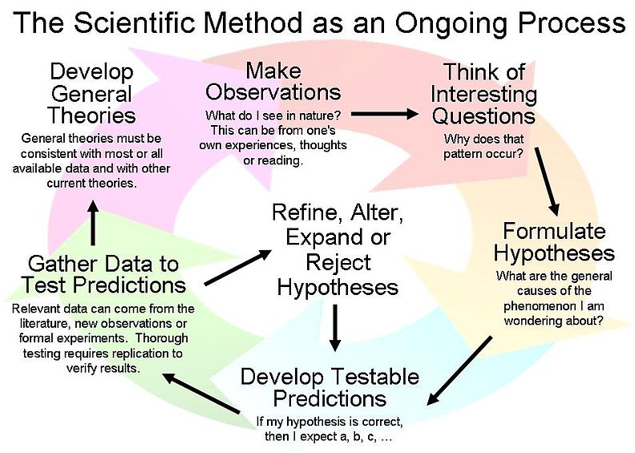
critical review and revision
Make it better!
  Apply concepts in the Rigor White Papers
  Determine the limits
  Empirically test the techniques
  Revise the definition and context
  Share the results so we all learn
https://commons.wikimedia.org/wiki/File:Scientific_Method_3.jpg

Slide 32
Critical review and revision
What are the shortcomings?
How can we improve these ideas for the benefit of student learning?
Please add ideas in the chat or email me!

Slide 33
Defining and Implementing Academic Rigor: a 5-year update
Thank you for attending!
Dr. Andria F. Schwegler
Schwegler@tamuct.edu

Slide 34
References
Bjork, E. L., & Bjork, R. A. (2011). Making things hard on yourself, but in a good way: Creating desirable difficulties to enhance learning. In M. A. Gernsbacher, R. W. Pew, L. M. Hough, & J. R. Pomerantz (Eds.) Psychology and the real world: Essays illustrating fundamental contributions to society (pp. 56-64). New York, NY: Worth.
Donovan, J. J., & Radosevich, D. J. (1999). A meta-analytic review of the distribution of practice effect: Now you see it, now you don’t. Journal of Applied Psychology, 84(5), 795-805.
Draeger, J., del Prado Hill P., Hunter, L. R., & Mahler, R. (2013). The anatomy of academic rigor: The story of one institutional journey. Innovative Higher Education, 38, 267-279.
  Graham, C., & Essex, C. (2001). Defining and ensuring academic rigor in online and on-campus courses: Instructor perspectives. Annual Proceedings National Convention of the Association for Educational Communications and Technology, 1-2, 330-337.
  Hechinger Institute. (2009). Understanding and reporting on academic rigor. Retrieved from http://hechinger.tc.columbia.edu/primers/Hechinger_Institute_Rigor_Primer.pdf
  Kornell, N., & Bjork, R. A. (2008). Learning concepts and categories: Is spacing the “enemy of induction”? Psychological Science, 19(6), 585-592.
  Kornell, N., & Bjork, R. A. (2009). A stability bias in human memory: Overestimating remembering and underestimating learning. Journal of Experiemental Psychology: General, 138(4), 449-468.

Slide 35
References
  Kluger, A. N., & DeNisi, A. (1996). The effects of feedback interventions on performance: A historical review, a meta-analysis, and a preliminary feedback intervention theory. Psychological Bulletin, 119(2), 254-284.
  Labaree, D. F. (1997). Public goods, private goods: The American struggle over educational goals. American Educational Research Journal, 34(1), 39-81.
  Mathers, C. E., Finney, S. J., & Hathcoat, J. D. (2018). Student learning in higher education: A longitudinal analysis and faculty discussion. Assessment & Evaluation in Higher Education, 43(8), 1211-1227.
  Pan, S. C., & Rickard, T. C. (2018). Transfer of test-enhanced learning: Meta-analytic review and synthesis. Psychological Bulletin, 144(7), 710-756. doi: 10.1037/bul0000151
  Roediger, H. L., & Karpicke, J. D. (2006). The power of testing memory: Basic research and implications for educational practice. Perspectives on Psychological Science, 1, 181-210. doi: 10.1111/j.1745-6916.2006.00012.x
  Schnee, E. (2008). “In the real world no one drops their standards for you”: Academic rigor in a college worker education program. Equity & Excellence in Education, 41(1), 62-80. doi: 10.1080/10665680701764502
  Schutz, K. R., Drake, B. M., & Lessner, J. (2013). Do community college full-time and adjunct faculties differ in their perceptions of rigor in assigning grades? American Journal of Educational Studies, 6(2), 59-77.

Slide 36
References
  Schwegler, A. F. (2019a). Academic rigor: A comprehensive definition. Quality Matters. https://www.qualitymatters.org/qa-resources/resource-center/articles-resources/academic-rigor-white-paper-part-one
  Schwegler, A. F. (2019b). Contextualizing academic rigor. Quality Matters. https://www.qualitymatters.org/index.php/qa-resources/resource-center/articles-resources/academic-rigor-white-paper-part-two
  Schwegler, A. F. (2019c). Aligning institutional processes to support academic rigor. Quality Matters. https://www.qualitymatters.org/index.php/qa-resources/resource-center/articles-resources/academic-rigor-white-paper-part-three
  Taylor, K., & Rohrer, D. (2010). The effects of interleaved practice. Applied Cognitive Psychology, 24, 837-848.
  Whitaker, M. (2016). (Re)defining academic rigor: From theory to praxis in college classrooms. Currents in Teaching & Learning, 8(1), 4-17.
  Wraga, W. G. (2010). What’s the problem with a “rigorous academic curriculum”? Paper presented at the meeting of the Society of Professors of Education/American Educational Research Association, Denver, Colorado. Retrieved from https://eric.ed.gov/?id=ED509394

