Slide 1
Aligning Course Design and Faculty Development with Middle State's 9 Hallmarks of Quality
Melissa Kaufman, MS – Instructional Designer
Ray Lum, MPhil, MS – Director of eLearning and Associate Teaching Professor

Slide 2
Learning Objectives
Discuss aligning accreditation standards for online education with the Quality Matters Rubric.
Identify areas where online course design needs improvement.
Create a plan for faculty professional development.

Slide 3
Middle State's 9 Hallmarks of Quality
Institution evaluates the effectiveness on its online offerings
Institution provides sufficient resources to support and expand its online offering
Faculty responsible for delivering online learning curricular are appropriately qualified and effectively supported.

Slide 4
Participant Poll
Does your institution currently offer professional development training around course design?
What kind of training does your institution offer?
www.menti.com use the code 45 05 95
Notes:
Just in time, in-house workshops, external workshops, job aids
https://www.mentimeter.com/app

Slide 5
#1: Institution evaluates the effectiveness on its online offerings
Do you think that having the same faculty who teach the face-to-face course as the online course is sufficient in evaluating the effectiveness of the online offering?
What would be the a way to introduce faculty at your institution to the benefits of Quality Matters Alignment principles in a meaningful just in time manner within a DIY culture?
Notes:
Take 5 minutes for participants to discuss with their neighbor.

Slide 6
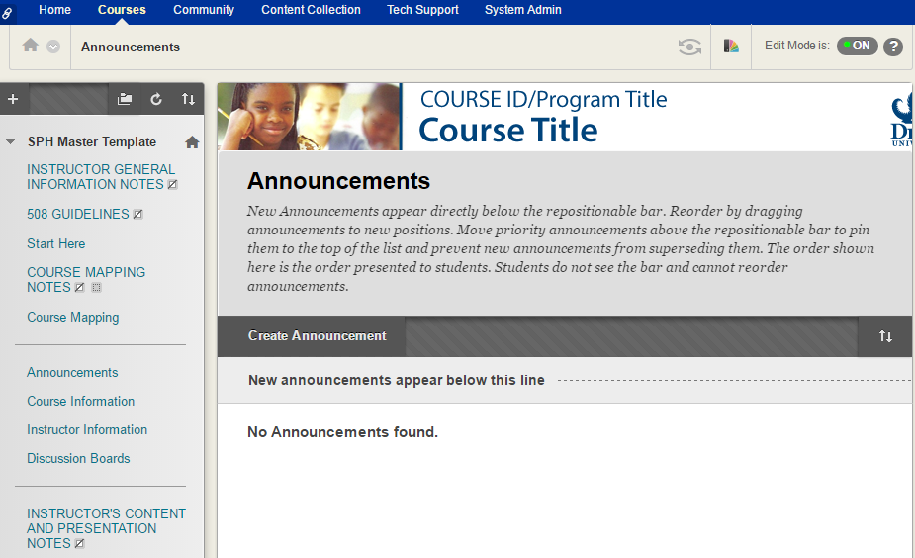
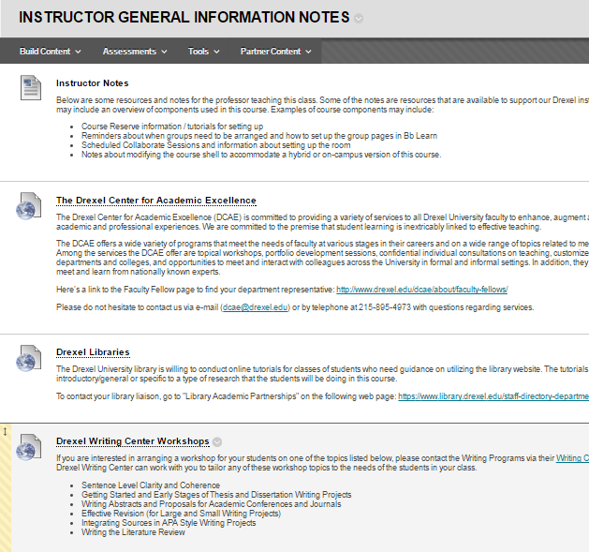
#1 Solution: Master Course Template
Notes:
Design a Master Course Template based on Quality Matters Standards that involved stakeholders such as faculty, instructional designers, staff from the Provost Office of Assessment, staff from the University’s Office of Accessibility.
Frame the Course Master Template as a Dashboard for One Stop Information.
General Instructor Information

Slide 7
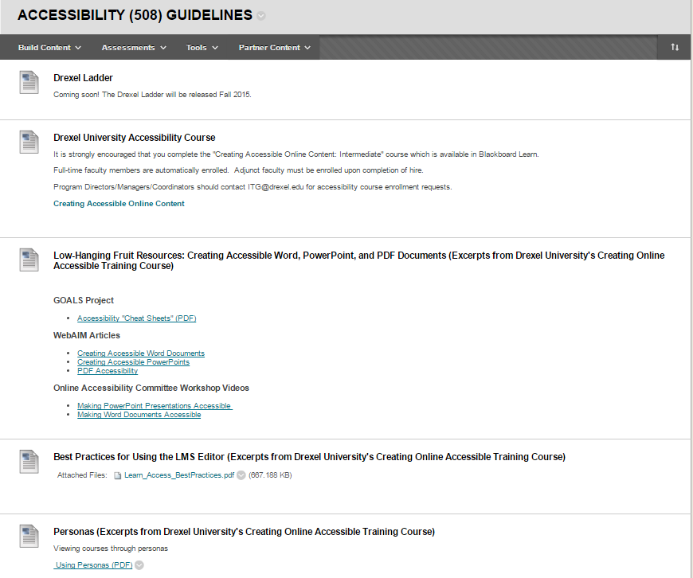
#1 Solution: Master Course Template
Notes:
Accessibility (508) Guidelines

Slide 8
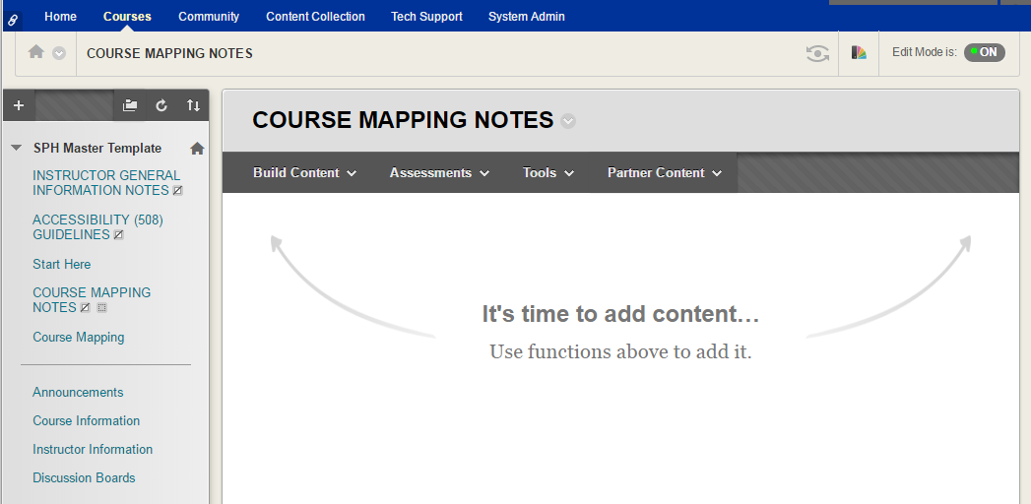
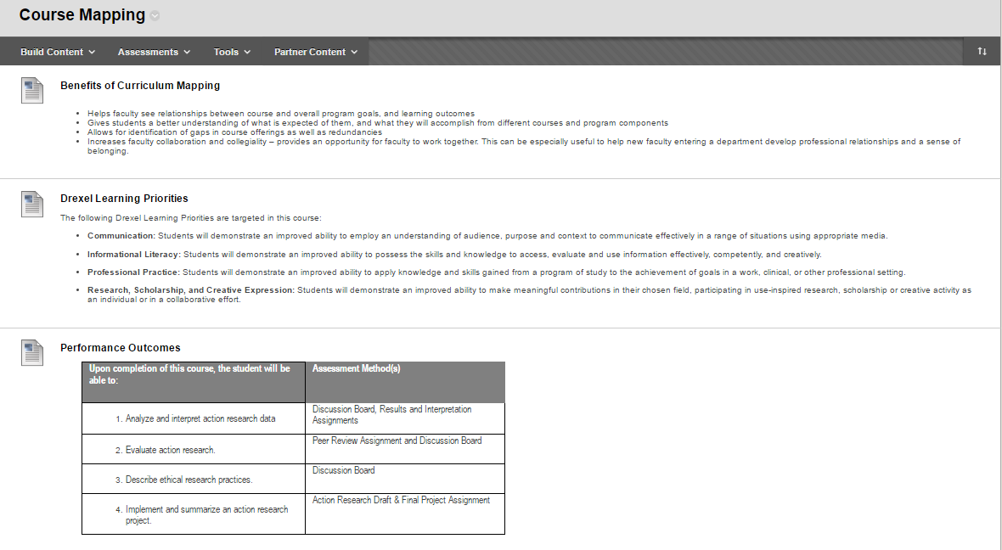
#1 Solution: Master Course Template
Notes:
Course Mapping

Slide 9
#2: Institution provides sufficient resources to support and expand its online offering
How do you assure the quality of compliance to a Master Course Template in a collegial manner?
What is the tone of your message regarding awareness of the Master Course Template?
Notes:
Take 5 minutes for participants to discuss with their neighbor.

Slide 10
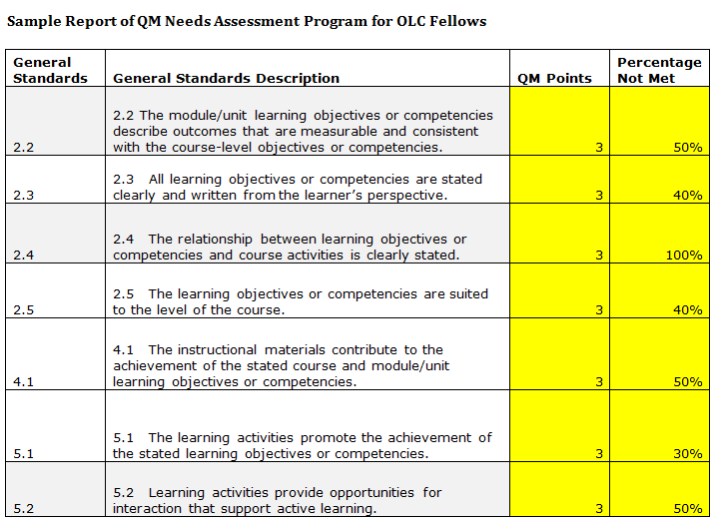
#2 Solution: Needs Assessment
Notes:
Perform a Quality Matter Needs Assessment on those courses that implemented the Master Course Template and roll up data at the Program Level rather than the course level.

Slide 11
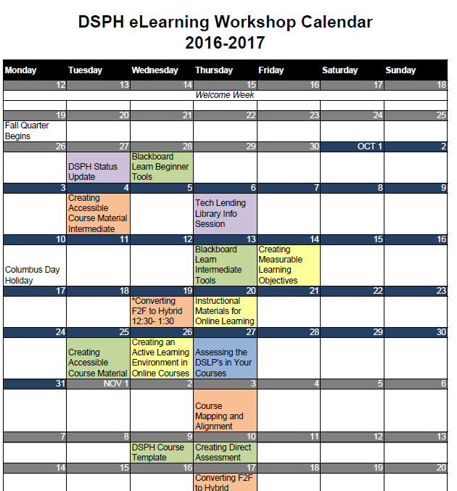
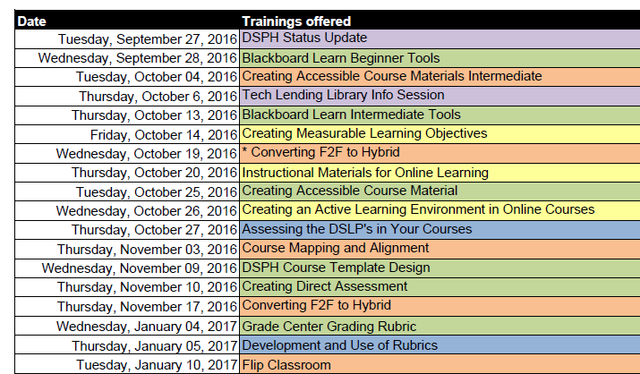
#2 Solution: Grid of Outcome of the General Standards
Notes:
Identify key General Standards that do not meet a 80% threshold and provide trainings to address the deficiency.
Roll out a series of trainings that address the gaps found in the needs assessment.

Slide 12

#2 Solution: Grid of Outcome of the General Standards

Slide 13
#3: Faculty responsible for delivering online learning curricular are appropriately qualified and effectively supported.
How do you assure that professional development trainings for online teaching are having an impact on the learning outcomes?
Notes:
Take 5 minutes for participants to discuss with their neighbor.

Slide 14
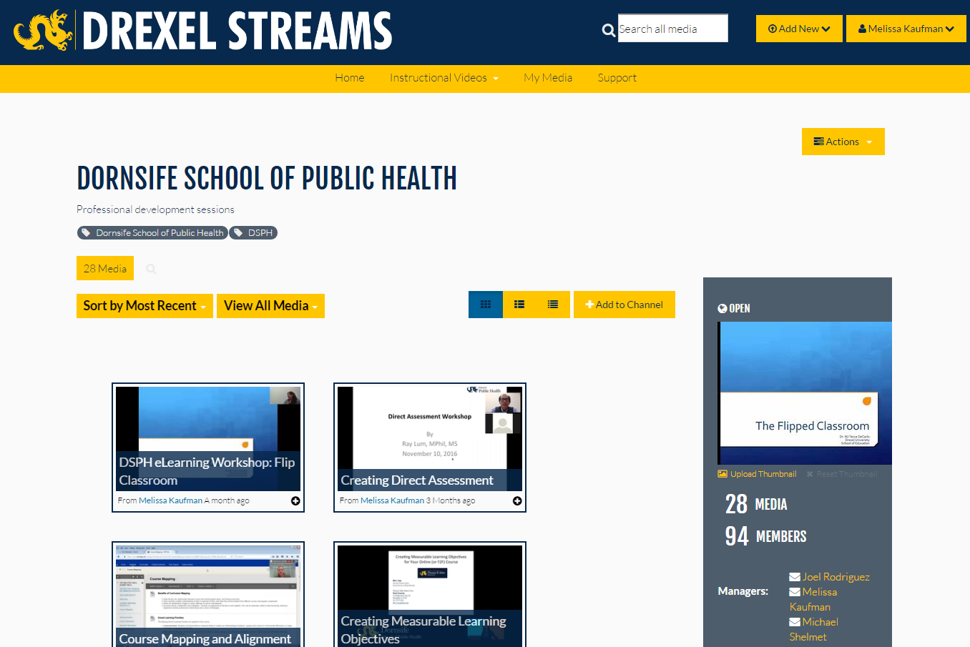
#3 Solution: Video Archives
Notes:
We developed a calendar weekly training into several tracks. We created opportunities to watch archived presentations

Slide 15
#3 Solution: Workshop Evaluations
Notes:
We are evaluating the training workshops.

Slide 16

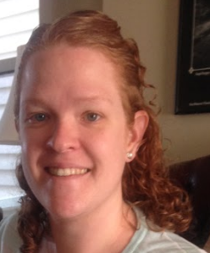
#3 Solution: Instructional Designers
Just-In-Time Support & Course Development
Notes:
We have two instructional; designers committed to support individual needs.
We will perform another QM Need Assessment to see the impact of the trainings towards quality improvement of the courses.

Slide 17
Small Group Discussion
How could you implement some of these solutions at your institution?

Slide 18
Thank you
Ray Lum, rl27@drexel.edu
Melissa Kaufman, mjk397@drexel.edu

