Slide 1

Scaling UP Training & Support:
Running with the COLT Course
Certificate for Online Learning & Teaching
Salisbury University

Slide 2
In the Saddle
Becky Anthony, PhD, LCSW, MEd, CST
Assistant Professor, MSW Online Coordinator
Social Work Department
rsanthony@salisbury.edu
Safaa Said, Instructional Designer
Quality Matters Master Reviewer
sssaid@salisbury.edu
Deborah Turner
Social Work Instruction Designer
Quality Matters Master Reviewer
daturner@salisbury.edu
Notes:
Each will introduce self

Slide 3
In the Stable
The Start of the COLT Course

Slide 4
Started in our Social Work Department
Results from MSW student survey
Instructors in need of training, especially in:
  Pedagogy for online courses
  Instructor presence and student engagement
Notes:
Intro to SU – Becky
Slide – Becky

Slide 5
Creative Commons & Textbook
Peer Reviewed Articles
Videos from Online Instructors
Sources for the COLT course content
COLT – based on QM Standards
Notes:
Deb talk about reviewed 3 courses in the Commons

Slide 6
Included in the COLT course
Five modules
Orientation
Technology Skills
Online Pedagogy
Instructor Presence & Student Engagement
Quality Matters & Best Practices
Notes:
Deb – emphasize Quality Matters information along with best practices is the last module

Slide 7
Out of the Gate!
Offering the COLT Course

Slide 8
Social Work COLT Pilot was offered to:
Adjunct teachers
Full-time teachers
Social Work COLT procedures:
Receive the book
Complete the course in one month
Take the Survey for feedback
Adjuncts receive a $250 stipend
Notes:
Becky

Slide 9
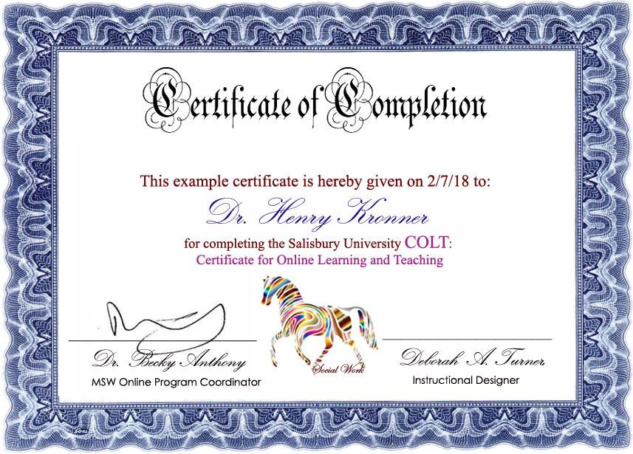
Notes:
Becky

Slide 10
Social Work COLT Survey Responses
Out of 28 participants 82% were adjuncts
100% said the presentation of information was extremely or very clear
68% said the information will make a big improvement in their teaching, 32% said some of the tips will help
100% said they would recommend the course to a colleague
Notes:
Deb

Slide 11
Social Work COLT Quotes
“I absolutely loved the course. It validated many of my current practice and also gave me many ideas and strategies for improvement”
“Very informative, relevant, helpful, easy to navigate and easily completed in a timely manner.”
“The course was extremely helpful and provided practical teaching methods. Great job!”
“I enjoyed the material with the tops to more successfully engage in discussions with students, as this can be difficult. I also enjoyed the section about putting your own personality into the learning to help with engagement (I think this something I’ve been hesitant to do in the past and will consider more important moving forward).”
“Appreciate the opportunity to grow and improve as an instructor.”
“I wish it was mandatory for everyone teaching.”
Notes:
Becky

Slide 12
Riding with the Wind
COLT takes off!

Slide 13
COLT is turned into a “Blueprint” course in Canvas to share with other departments
COLT is adopted by Salisbury University for all adjunct and full-time instructors
The Social Work Department now requires all adjuncts to complete COLT to teach any courses
A new module will be added to COLT for Satellite Distance Education
Scaling
Support for
University Faculty
Notes:
Safaa

Slide 14
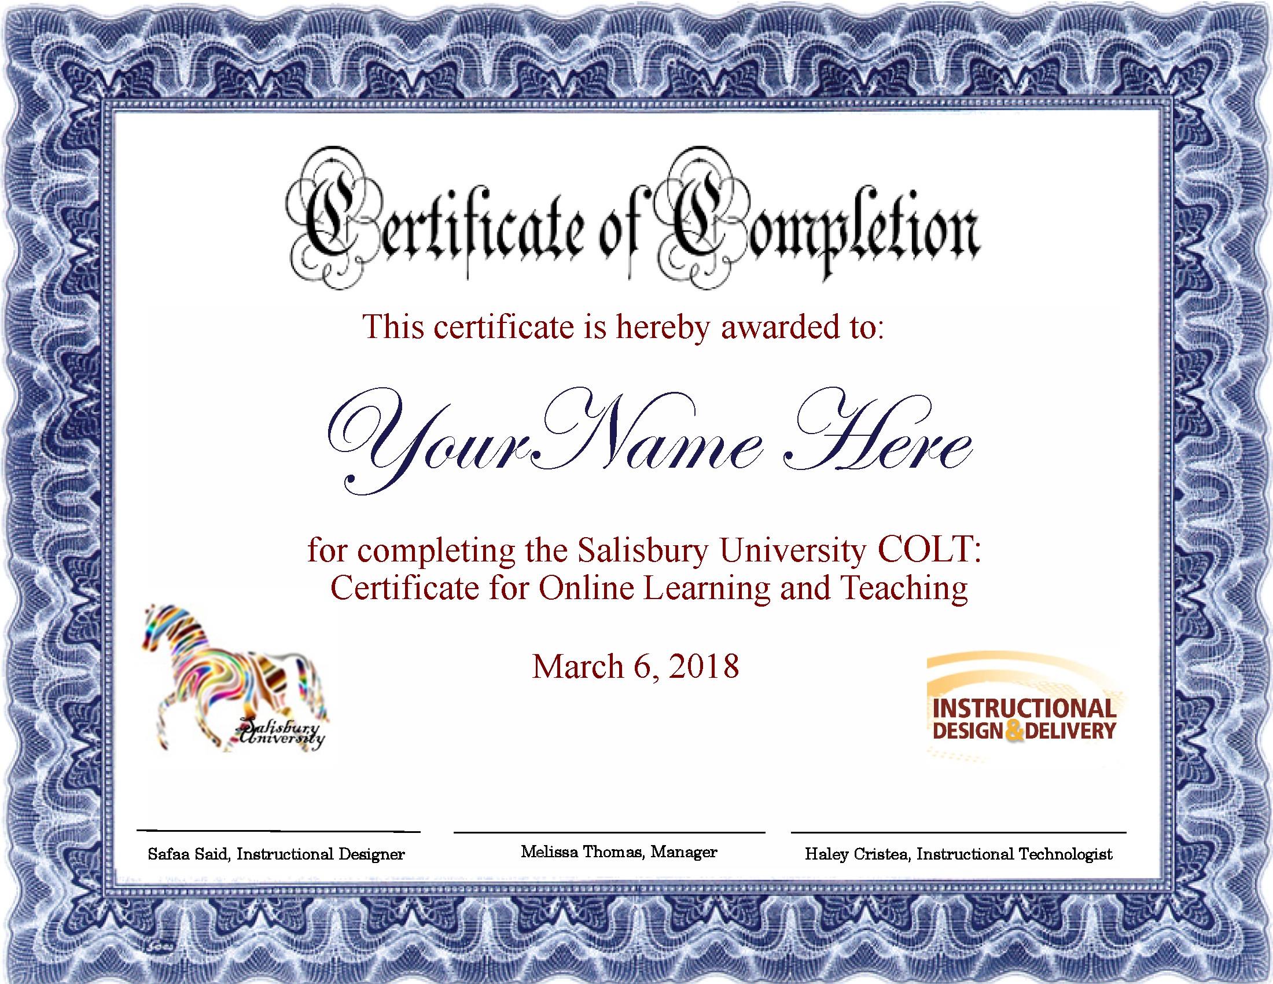

Slide 15

Questions?
Notes:
All

