Slide 1


Applying Universal Instructional Design (UID) Principles to address Standard 8 and Heoa 2008
Quality Matters Regional Conference
April 25 – 26, 2019
Dr. Ruth Best

Slide 2

Agenda
Welcome & Introductions
The Higher Education Opportunity Act (HEOA) of 2008
Universal Instructional Design (UID) Principles
Examining course design through the lens of HEOA, UID, & QM Standard 8.
Wrap Up/Q & A

Slide 3

Expected Outcomes
By the end of this session, participants will be able to:
Apply Universal Instructional Design principles to enhance the learning experience for all students.
Evaluate web-enabled, hybrid, and online course design elements to ensure they meet accessibility standards.
Create learning environments that are inclusive, flexible, and adaptable.

Slide 4
Universal Design
Universal Design for Learning
Universal Instructional Design
Universal Design for Instruction
Notes:
UD – The Center of Universal Design at North Carolina State University - https://projects.ncsu.edu/design/cud/about_us/usronmace.htm
UDL – Center for Applied Special Technology (CAST) http://www.cast.org/udl/index.html
UDI – University of Connecticut
Curriculum Transformation and disability: Implementing Universal Design in Higher Education by Jeanne L. Higbee
www.cehd.umn.edu/crdeul/books-ctad.html

Slide 5
HEOA’s Official Definition of UDL
The term Universal Design for Learning (UDL) means a scientifically valid framework for guiding educational practice that:
  Provides flexibility in the ways information is presented, in the ways students respond or demonstrate knowledge and skills, and in the ways students are engaged.
  Reduces barriers in instruction, provides appropriate accommodations, supports and challenges, and maintains high achievement expectations for all students, including students with disabilities and students who are limited English proficient.
  Source: HEOA, 2008, 122 STAT.3088
Notes:
Link to HEOA’s definition http://www.udlcenter.org/aboutudl/udldefined
The Higher Education Opportunity Act (HEOA) was the first federal legislation to define and endorse UDL. The HEOA spelled out a number of ways that UDL should be incorporated into preservice preparation of teachers, in-service teacher training, and in postsecondary instruction.

Slide 6
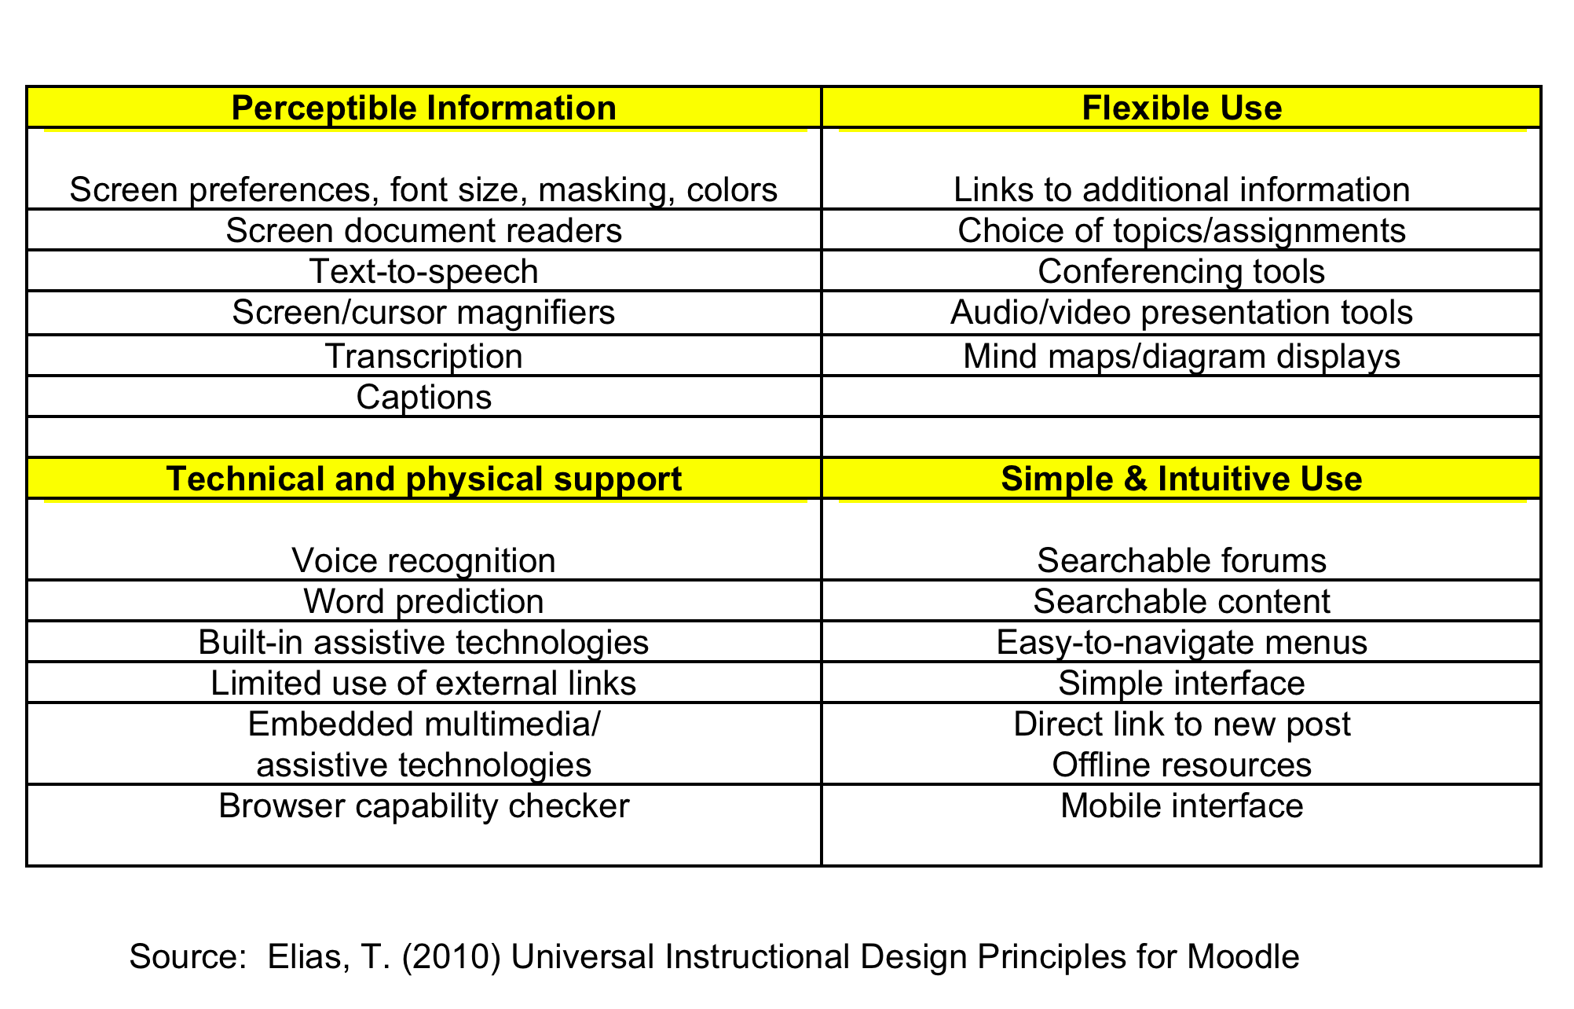
Applying Universal Instructional Design Principles WITHIN the virtual environment
Notes:
Link to Video – Real Connections: Making Distance Learning Accessible to Everyone by Sheryl Burgstahler
http://www.washington.edu/doit/Video/index.php?vid=22
“Present content and accept assignments in multiple formats … providing the learner with flexibility and choice.... Learners with sensory disabilities, learning disabilities, and diverse learning styles can still all benefit from content presented in redundant forms” (Elias, 2010, p. 116)
“Offer choice and additional information. Offering links to additional information and choices to assignments and topics of study allows learners to be more active participants in the process. It also allows them to meet course requirements in a way that is best suited to their individual abilities, disabilities and needs” (Elias, 2010, p.116)
“Offer text-only, mobile, and offline options. The current Moodle interface and other course resources are effective for online learners with fast Internet connections. In areas that lack high bandwidth connections, however, Moodle’s loading speed creates a barrier to access” (Elias, 2010, p.117)
“The design must be useful to and accessible by people with diverse abilities and diverse locations” (Elias, 2010, p.115)
“Incorporate assistive technologies. Although external assistive technologies can be used in conjunction with online course materials, these tools should be integrated into the LMS itself, according to the principles of UID (Council for Exceptional Children, 2005)….
Add captions, descriptors, and transcriptions. Video and audio-conferencing can present a significant obstacle to accessibility… Poor connections and language barriers can be exacerbated by LMS features. A conferencing system with transcriptions would help to make conference recordings more searchable for all users. (Elias, 2010, p.118)
“Although online course materials can be accessed using external assistive technologies, their use is likely to lead to higher levels of mental fatigue if they are not integrated into the course platform. For example if the text size in a discussion forum reply box cannot be increased, a visually impaired student may have to 1)increase the size of the text, 2) copy it into external word-processing software, and 3) return to the Moodle site to paste it in the box for uploading. Extensive use of external links and external programs in this way increases the technical effort required by users.” (Elias, 2010, p.120)

Slide 7
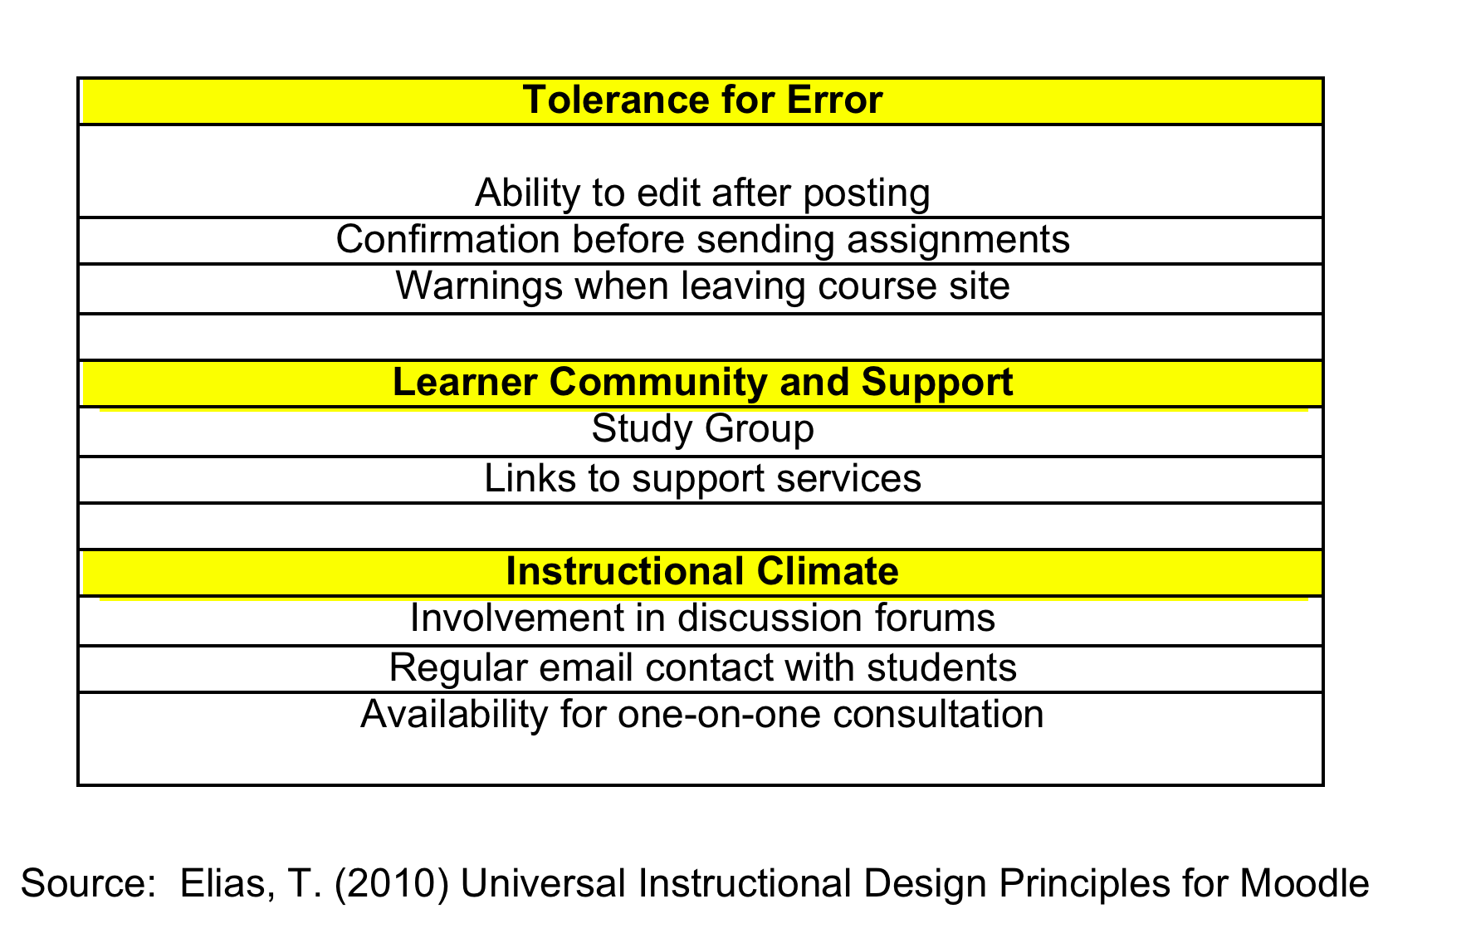
Characteristics of UD in the virtual setting/learning management system
Notes:
“Allowing learners to correct [edit posts] and correct mistakes is essential because it supports learner confidence in the use of technology” (Elias, 2010, p. 119)
“Provide study groups and tools… Such features can help to develop a sense of purpose and cohesiveness among small groups and can enable learners with diverse needs and disabilities to feel less of a burden to the group. Developing stronger ties among learners in this way could also create a peer support network for solving technical problems, for example, when other assistance is available.” (Elias, 2010, p. 121)
“Links for students to services, including administration, library, and other supportive services, need to be accessible to online students directly from the LMS… Links to these services should be prominently and consistently placed on every course page” (Elias, 2010, p.121).

Slide 8
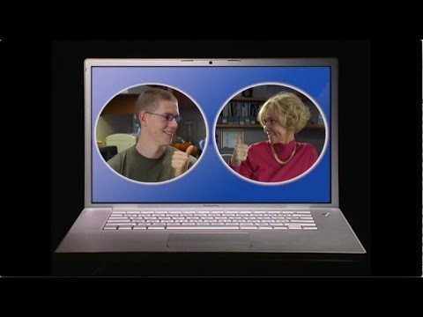
Real connections – Making distance learning accessible to everyone
Source: The DO-IT Center, University of Washington

Slide 9

Accessibility
&
Usability
QM Standard 8
Notes:
https://www.qualitymatters.org/sites/default/files/PDFs/StandardsfromtheQMHigherEducationRubric.pdf

Slide 10
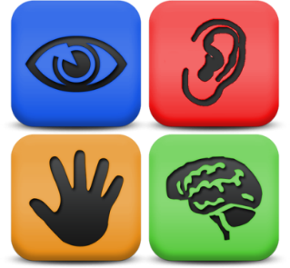
QM Standard 8: Accessibility & Usability
Course navigation facilitates ease of use.
The course design facilitates readability
The course provides accessible text and images in files, documents, LMS pages, and web pages to meet the needs of diverse learners.
The course provides alternative means of access to multimedia content in formats that meet the needs of diverse learners.
Course multimedia facilitate ease of use.
Vendor accessibility statements are provided for all technologies required in the course.

Slide 11

Examining course design through the lens of HEOA, UID, & QM Standard 8.
This Photo by Unknown Author is licensed under CC BY-SA-NC

Slide 12


Slide 13


Questions and Answers

Slide 14
References
Burgstahler, S. (2015). 20 tips for teaching an accessible online course. DO-IT: University of Washington. Retrieved from https://www.washington.edu/doit/20-tips-teaching-accessible-online-course
Center for Applied Special Technology. (CAST). (2006). What is universal design for learning? Retrieved from http://www.cast.org/udl/index.html
Coombs, N. (2010). Making Online Teaching Accessible: Inclusive Course Design for Students with Disabilities. San Francisco, CA: Jossey-Bass.
Designing for Inclusion (2011). Web Accessibility Initiative. Retrieved from http://www.w3.org/WAI/users/Overview.html.
DO-IT, University of Washington (2019). Real Connections: Making Distance Learning Accessible to Everyone. Retrieved from https://www.washington.edu/doit/videos/index.php?vid=22
Elias, T. (2010). Universal Design Principles for Moodle. International Review of Research in Open and Distance Learning. 11(2), 110 – 124. Retrieved from http://www.irrodl.org/index.php/irrodl/article/view/869
Scott, S., McGuire, J.M., & Embry, P. (2002). Universal design for instruction fact sheet. Storrs: University of Connecticut, Center on Postsecondary Education and Disability. Retrieved from http://caite.cs.umass.edu/files/udi2_fact_sheet.pdf
U. S Department of Education, Office of Educational Technology, Transforming American Education: Learning Powered by Technology, Washington, D.C., 2010.

