Slide 1


Baking QM Into Every Course in The LMS
Dr. Selom Assignon
Dr. Scott Standifer

Slide 2
Have you tried implementing a standard template in your LMS?

Slide 3
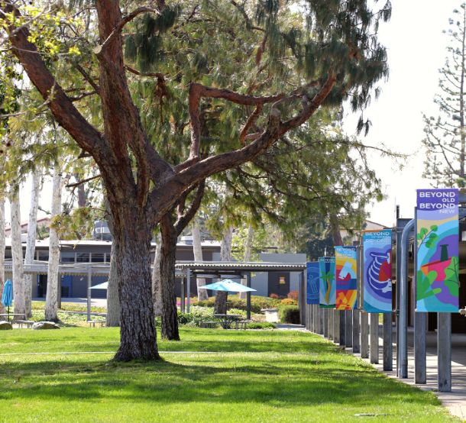


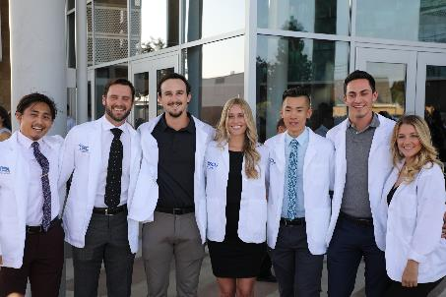
Background
Whittier, California
  Just East of Los Angeles
Student Enrollment 1,600
Faculty – 160 full &
part time
Southern California University of Health Sciences

Slide 4
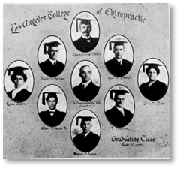

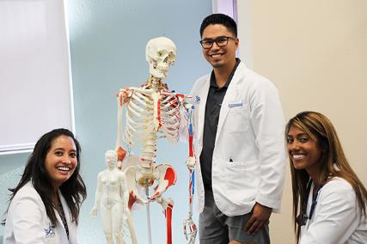
Background
Founded1911 as
Los Angeles
College of
Chiropractic
Institutionally accredited by Western Association of Schools & Colleges
Southern California University of Health Sciences

Slide 5

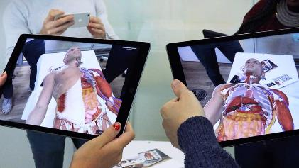

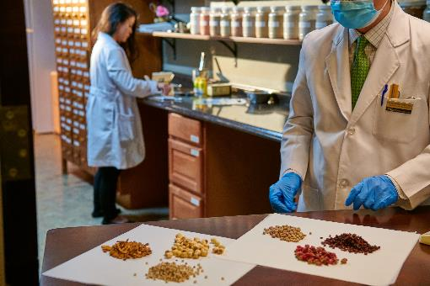
Name Change
2000 became Southern California University of Health Sciences
  Umbrella title to expand programs (all professionally accredited)
    Acupuncture and Chinese Herbal Medicine (AcCHM)
    Ayurvedic Medicine
    Physician Assistant
    MS in Medical Science
    Dr. of Occupational Therapy
    MS in Human Genetics & Genomics
    BS in Health Sciences

Slide 6
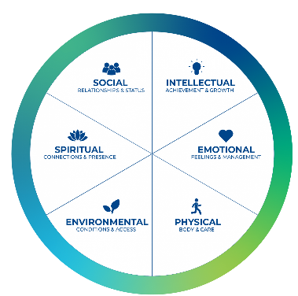




Current Expansion
New Programs in Active Development
    MS in Genetic Counseling
    Dr. of Whole Health Leadership
    Dr. of Physical Therapy
    Dr. of Medical Science

Slide 7

Online Courses
  Spring 2018 – adopted Canvas LMS
  General template provided
    Little oversight of use
  Spring 2019 - Outsourced IT
  Pandemic Transition to Online

Slide 8
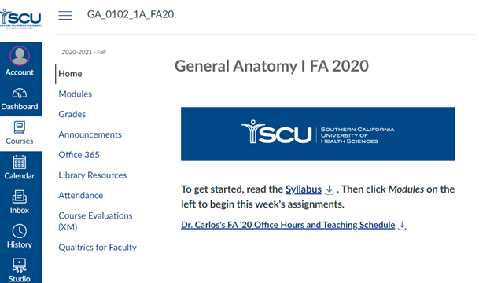
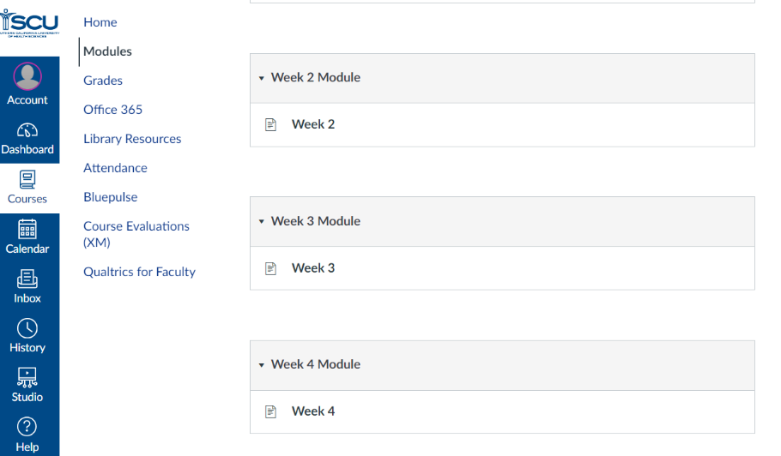
Original Template
  “To get started, read the Syllabus. Then click Modules on the left to begin this week’s assignments.”

Slide 9

Great Transition
Thrown in without warning
Overwhelming
Not best course design

Slide 10
Post Pandemic
2021 - Online Ed team created, grew in resources, authority
Awareness of inconsistent use of template, structure of courses
Online and hybrid courses became standard part of programs
Face-to-Face returned where needed

Slide 11
Uplift Initiative
Developed standardized new template
Embedded QM standards for consistency, student resources, clear alignments
QM faculty training

Slide 12

Template Design Process
Backward design
Overbuild
  Anticipate faculty needs for module content
Embed QM standards
  6th edition of QM

Slide 13
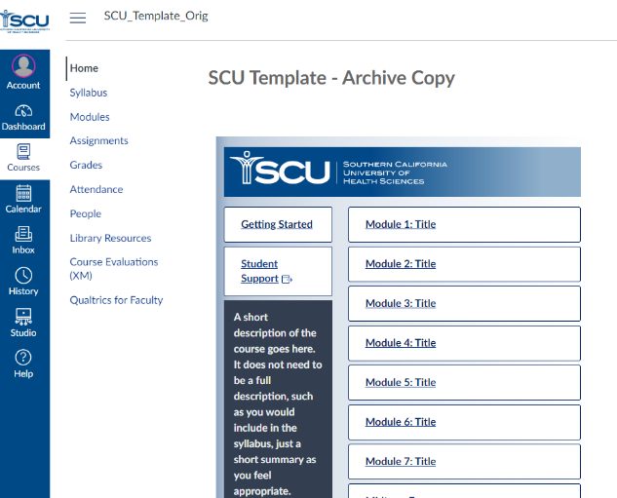
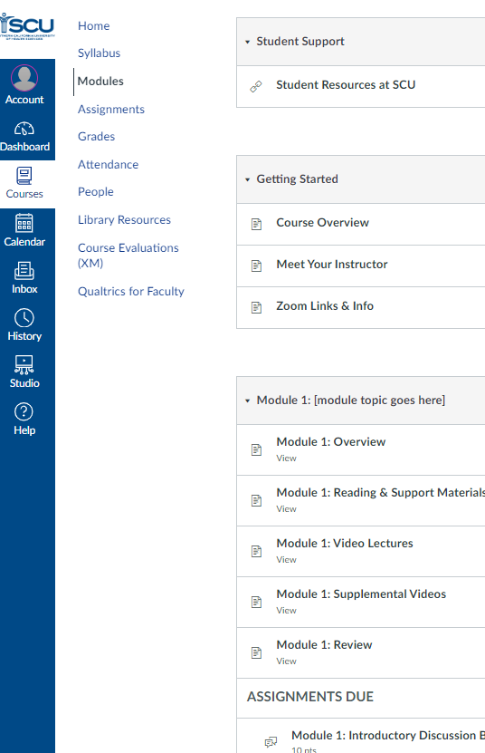
New Template
QM Features Built In

Slide 14
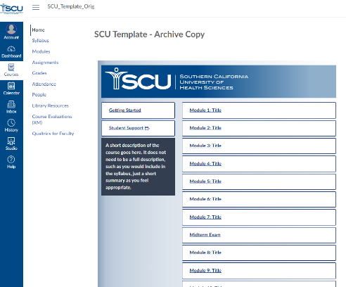
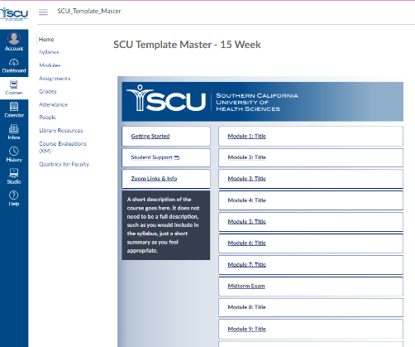
Template Walk-through
Original Template
Current Template

Slide 15
Key Points for Implementation
Support from Leadership
Coordination with Program Directors
Faculty Outreach
  Presentations for Faculty buy-in
  QM Online Training for faculty
Template customization for each program

Slide 16


Uplift Project Statistics
Completed 266 course conversions in 1 year
  Some programs had faculty do conversion, some had “concierge” conversions by Online Ed team
  Direct concierge uplift – 95
  One-on-one consultations - 35
  Faculty trained in QM – 175

Slide 17
Faculty Comments
I love that it is consistent from course to course, and it looks really clean.
Did not have to worry about how things are set up! There are many options available when putting together the courses and it is easy to set things up how I like
The course pages became easier to navigate. Students and faculty know where to find all the standard course materials within the canvas page.

Slide 18
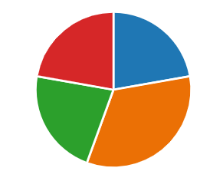
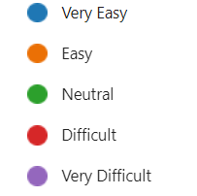
Faculty Comments
How would you rate your overall experience with the process of converting your course(s) to the new template?
  22% Very Easy
  33% Easy
  22% Neutral
  22% Difficult

Slide 19
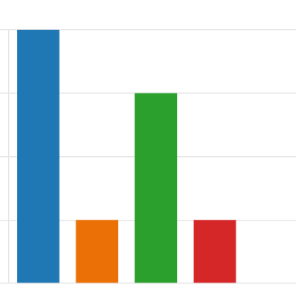
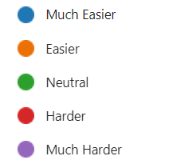
Faculty Comments
Do you believe the new template has made your course easier or harder for you to manage?
  45% Much Easier
  10% Easier
  35% Neutral
  10% Harder

Slide 20
Student Comments
Simple to use once you learn your way around the template.
There has been a reduction in students asking for Canvas clarification from the professors, which is great for both parties.
There are still settings that were not uniform, and some time was wasted correcting the issue. 2-3 this term
Generally works very well and I do appreciate the uniformity. However, I don't know if the modules rather than weeks is necessarily better or worse

Slide 21
Lessons Learned
Program adjustments to Template
  Program image branding
  Homepage links
  Enforced consistency within program
Challenges and roadblocks
  Faculty confusion
  Faculty resistance
  Low monitoring from PDs
Solutions
  Manual check, report to PDs, U leadership
  University Leadership support
  One-on-One consultations, workshops
  Pre-term Training Drop-in Sessions
  Mandatory QM group trainings

Slide 22
Advice for Others
Sell Template & QM to Admin first
Sell to faculty
  Something to help them teach better
Have early adopters pitch to colleagues
Multi-pronged support strategy

Slide 23
Questions?
SelomAssignon@scuhs.edu
ScottSTandifer@scuhs.edu
?

