Slide 1

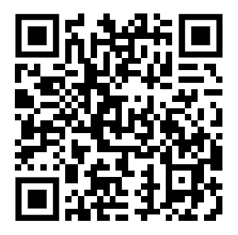
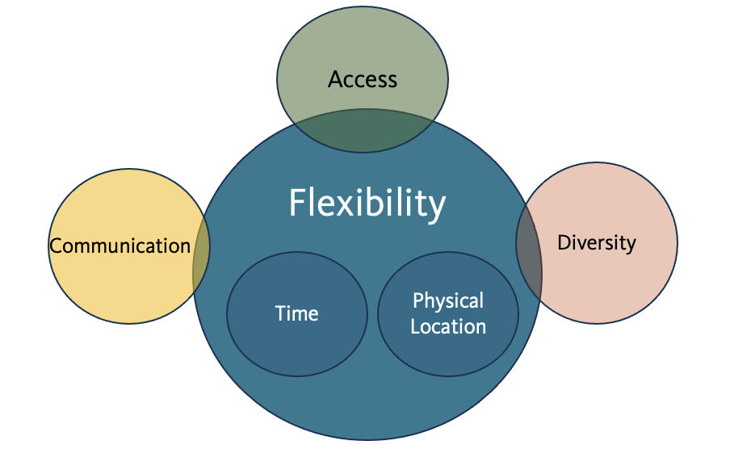
What can online learning do for students that face-to-face learning cannot?
Nadia Jaramillo, Ph.D. & Naomi R. Aguiar, Ph.D.
Ecampus Research Unit
Research Context
This research was part of a larger study with 105 instructors who
had different levels of online teaching experience. Instructors
completed structured interviews focused on experiences of and
motivations for teaching online. Scan QR code to learn more.
Study Rationale
Research Questions
Codebook Excerpts & Exemplars
Variation by Experience
Parent Codes | Sub Codes | Examples
Flexibility | Physical Location | Physical circumstances in which students can attend courses
 | Time | Choices regarding when students can attend classes, complete assignments, & engage with learning activities
“It gives them the flexibility to fit the class into their schedule. Gives them the option to do it from home, rather than traveling great distance to get to the classroom, which saves them time when they're probably crunched for time already.”
1-2 years
Rather than an “alternative” pathway, online education may offer students benefits that exceed F2F environments
“They can work, if they're midnight workers they can work at midnight. If they're morning workers they can work in the morning. It's the freedom of time. It really is that. And I mean like within a day, not necessarily calendar, but within a day, it's like you can kind of work whenever you feel like it or whenever you have time…I think that's the number one benefit is just that freedom of time .”
3-9 years
“They don't have fixed hours. They can log in at whatever time of day they want to do and do the instruction, whatever. You also have the ability of people who are not place-bounded in Corvallis to go ahead and participate in classes”
10+ years
“I mean certainly the flexibility…you don't have to go and physically sit in a classroom for 4 hours or however many hours a week.”
1-2 years
What are the perceived benefits of online learning over F2F learning?
How do perceptions of these benefits differ based on years of teaching experience?
Parent Codes | Examples
Diversity | A range of circumstances (e.g., “parenting”, “working full time”) &/or individual differences (e.g., “shy”, “introverted”, “student athlete”)
Access | Opportunities to explore or obtain an educational experience that they not have otherwise (e.g., meeting people from other countries)
Emergent Themes in Flexibility
Methodology
N = 73 instructors
60-minute interviews (N = 105 total interviews)
Coding
Grounded Theory, Post-Positivist approach
Holistic & In-Vivo Coding (Saldaña, 2021)
Precoding, codebook development & coding, preliminary analysis
Graduate Students | 1 – 2 Years Experience | 3 – 9 Years Experience | 10+ Years Experience
n = 10 | n = 18 | n = 44 | n = 11
“How does online learning provide specific benefits to students that traditional classrooms do not?
Flexibility, Diversity & Access
“It creates an opportunity for those students to have access to the same learning that face-to-face students do without needing to uproot their life, move somewhere they can't move, or show up at times that they are unable to show up, but instead to come, be able to have the same access while working within their own constraints.”
3-9 years
References & Acknowledgements
Saldaña, J. (2021). The coding manual for qualitative researchers. sage.
Thank you to the faculty & graduate students who participated.

