Slide 1
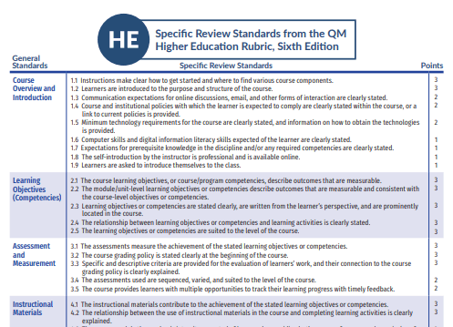
Beyond the Rubric
Social-Emotional Support Strategies for
At-Risk Online Learners
Join at slido.com
#1418064
Heather Burke, MA
Associate Professor, Hondros College of Nursing
Co-Chair Professional Development, QM Ohio

Slide 2


Join at slido.com
#1418064
ⓘ Start presenting to display the joining instructions on this slide.

Slide 3

Agenda
At-Risk Learners
SEL Basics
Case Study
Discussion
Best Practices
Join at slido.com
#1418064

Slide 4

At-Risk Definition
“At-risk” is a term grounded in K-12 literature, meaning: “poorly equipped to perform up to academic standards (Quinnan, 1997, as cited in Horton, 2015).
Source: Horton, 2015

Slide 5

What are the characteristics of an at-risk learner?
ⓘ Start presenting to display the poll results on this slide.

Slide 6
At-Risk Characteristics
“At-risk” is a term grounded in K-12 literature, meaning: “poorly equipped to perform up to academic standards (Quinnan, 1997, as cited in Horton, 2015).
Background Characteristics
Age Academic history Socioeconomic status Domestic violence Language barriers | First-generation Minority Incarceration Housing insecurity
Individual Characteristics
Unrealistic goals Self-confidence Motivation Unidentified disabilities Underprepared Self-discipline | Health issues Substance abuse Communication Behavioral problems Technology challenges Poor academic fit
Environmental Factors
Transportation Study environment Support services Course offerings Conflicting social norms/values Negative social network | Negative peer pressure Workforce issues Lack of mentoring
Source: Horton, 2015; Peth, 2008

Slide 7

Do you use any form of social emotional learning in your course(s)?
ⓘ Start presenting to display the poll results on this slide.

Slide 8
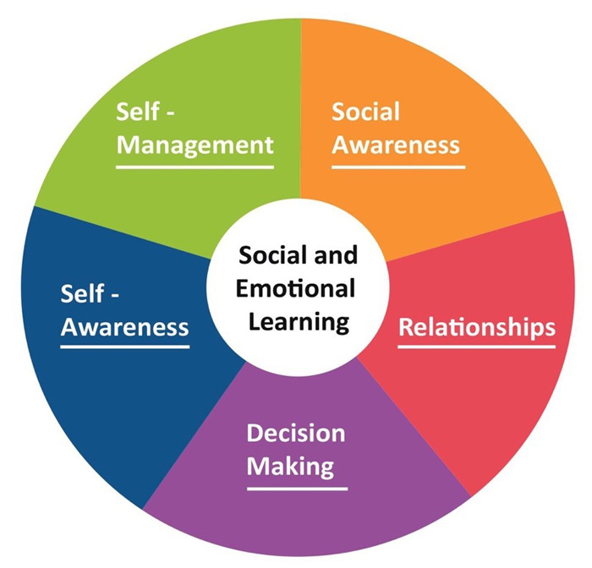
Social Emotional Learning (SEL)
What does this look like?
  safe, supportive learning environment
  belief in students’ success and promote a sense of ownership
  high, clear standards
  student self-evaluation and self-refection
  cooperative learning
  varied content for different learning styles
  strategies to address barriers to asking for help
  growth mindset oriented language
  frequent questions to continually engage students in what they are learning
  meaningful learner-instructor interactions

Slide 9
SEL in Higher Ed
Q: Is SEL common in higher education?
A: No. There is a focus on ”programs that address mental health, financial concerns, homesickness, adjustment to the academic demands of college, changes in career goals, campus culture and climate and more” (Cole, 2017, as cited in Reinert, 2019, p. 114).
Q: Why is this a problem?
A: These approaches are “focused on symptoms, rather than root causes” (Reinert, 2019, p. 115).

Slide 10


Slide 11
HCN & ENG 205 BASICS
Enrollment: 2,700
Demographics
72% Full-Time
28% Part-Time
93% Female
7% Male
37% White
44% African-American/Black
19% Unknown/Other
79% >25 years old
78% Ohio
Distance Learning
Campuses
Detroit, MI
Toledo, OH
Cleveland, OH
Akron, OH
Dayton, OH
Columbus, OH
Cincinnati, OH
Indianapolis, IN
20% enrolled in at least one online course
LMS: D2L Brightspace
Asynchronous
40% retention for first-time students
College Composition II
QM Certified Course
Time Period: 4/4/2022 – 3/17/2023 (4 quarters/10 weeks each)
Pre-Intervention: 191 students
Post-Intervention: 171 students
Current: 3,032

Slide 12
Do you use any form of formal or informal student progress/at-risk tracking?
ⓘ Start presenting to display the poll results on this slide.

Slide 13
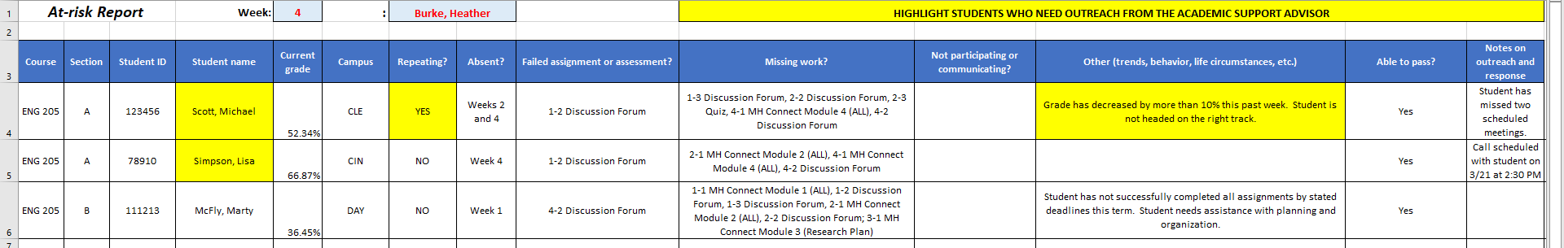
At-Risk Reporting
  At-Risk Standard Definition:
      Students who have a course grade of <70%
Online Students
Weekly Calls
Weekly Reporting

Slide 14
Pre-SEL Outcomes
28 Students (14.7%)
17 Passed (61%)
3 Failed (27%)
7 “W” After Week 5 (45%)
1 “W” Prior to Week 2 (9%)
11 Did Not Complete/Pass (39%)
At-Risk Student
Outcomes
At-Risk Student Trends
Week 1 Failed Assignment
15 (54%)
Missed 1 Week 3 (11%)
Week 1 Missed Assignment 18 (64%)
Missed >1 Week 8 (29%)
Failed Any Assignment 18 (64%)
Missed Any Assignment 23 (82%)
28 Students
(14.7%)

Slide 15


At-Risk Indicators
Week 1 assignment performance
  82% (23/28) of ALL at-risk students missed and/or failed a week 1 assignment
  73% (8/11) of students who either missed and/or failed a week 1 assignment did not pass/complete the course
Week 4 (pre-midterm) attendance
  73% (8/11) of unsuccessful students were absent during Week 4
    0% of W and F students were absent during week 1

Slide 16

SEL Strategies
Establish small groups
Establish a supportive learning environment
Normalize feeling overwhelmed
Establish clear standards
Focus on self-evaluations (“You gave me a C.” vs “I earned a C.”)
Connect content to students’ expectations and experiences
Develop positive instructor-student relationships
Address barriers
Identify obstacles/challenges
Identify learning preferences
Engage in goal setting
Collaborate with support services
Conduct emotional coaching
Request feedback
Continuously apply strategies from weeks 1-5
Demonstrate awareness of shifts in students’ demeanor
Weeks 6-10
Weeks 4-5
Weeks 2-3
Week 1
Preterm

Slide 17

Pre- and Post-SEL Outcomes
Period: 4/4/2022 – 9/16/2022
Pre-SEL: Assignments
64% (7/11) of W and F failed ≥1 week 1 assignment
64% (7/11) of W and F missed ≥1 week 1 assignment
54% (15/28) of all at-risk failed ≥1 week 1 assignment
64% (18/28) of all at-risk ≥1 week 1 assignment
Post-SEL: Assignments
33% (1/3) of W failed ≥1 week 1 assignment
56% (15/27) of all at-risk failed ≥1 week 1 assignment
0% (0/3) of W missed ≥1 week 1 assignment
59% (16/27) of all at-risk missed ≥1 week 1 assignment
Period: 10/3/2022 – 3/17/2023
28/191 Students (14.7%)
17 Passed (61%)
11 Did Not Pass (39%)
27 Students (15.8%)
24 Passed (89%)
3 Did Not Pass (11%)

Slide 18
Pre- and Post-SEL Outcomes
Post-SEL: Attendance
33% (1/3) of W were absent during Week 4
19% (5/27) of all at-risk missed at least one week of class
73% (8/11) of W and F were absent during Week 4
39% (11/28) of all at-risk missed at least one week of class
Pre-SEL: Attendance
29% (8/28) of all at-risk were absent during Week 4
11% (3/27) of all at-risk were absent during Week 4
4% (1/28) of all at-risk were absent during Week 1
7% (2/28) of all at-risk were absent during Week 1 – 0% W

Slide 19

Continuing Trends
0/79 (0%) absent week 1
13/13 (100%) missed and/or failed a week 1 assignment
Total at-risk students
  Pre: 14.7% (spring ‘22 and summer ‘22)
  Post: 15.8% (fall ‘22 and winter ‘23)
  Pre and Post: 15.2% (55/362)
  Present: 16.4% (spring ‘23)
    Week 1: 13/79 (16.4%)
    Week 2: 8/79 (10%)
    Week 3: 5/79 (6%)

Slide 20
Best Practices
Basics for Student Success
3) Normalize emotions
4) Ensure that course content meets needs (socially, emotionally, academically, and professionally)
5) Monitor at-risk students’ progress
2) Address barriers and offer strategies
1) Establish clear standards
6) Be PRESENT

Slide 21

How do you identify at-risk students?
How do you monitor and assist at-risk students?
Do you use any social emotional learning strategies in your online courses?
Have you have any successes and/or challenges with at-risk students and/or social emotional learning in your courses?

Slide 22
References
Dougan, R. (n.d.). Social emotional learning (SEL) guidebook: Ideas for incorporating SEL activities into your
classroom. Diablo Valley College. https://www.dvc.edu/faculty-staff/pdfs/SEL-Guidebook.pdf
Horton, J. (2015). Identifying at-risk factors that affect college student success.
International Journal of Process Education, 7(1), 83-101. https://www.ijpe.online/2015/risk.pdf
Panayiotou, M., Humphrey, N., & Wigelsworth, M. (2019, January). An empirical basis for
linking social and emotional learning to academic performance. Contemporary Educational
Psychology, 56, 193-204. https://doi.org/10.1016/j.cedpsych.2019.01.009
Peth, S.F. (2008). At-risk in the virtual classroom: A handbook for student success. ePublications at Regis
University. https://epublications.regis.edu
Reinert, P. (2019). Social-emotional learning: A model for higher education. Journal of Research in
Innovative Teaching and Learning, 12(2). doi: 10.1108/JRIT-02-2019-0039

