Slide 1
Breaking it Down to Build it Better: Deconstruction for Quality Implementation
Dr. Bridget Brooks
April 10, 2025

Slide 2

Session Outcomes
By the end, learners will be able to:
Identify tools and strategies to break
down, rebuild, and implement best practices.
Determine the components of a high-
quality, student-centered learning environment.
Evaluate quality assurance principles including alignment.
Determine actionable insights on how to refine courses for both immediate impact and long-term success.

Slide 3
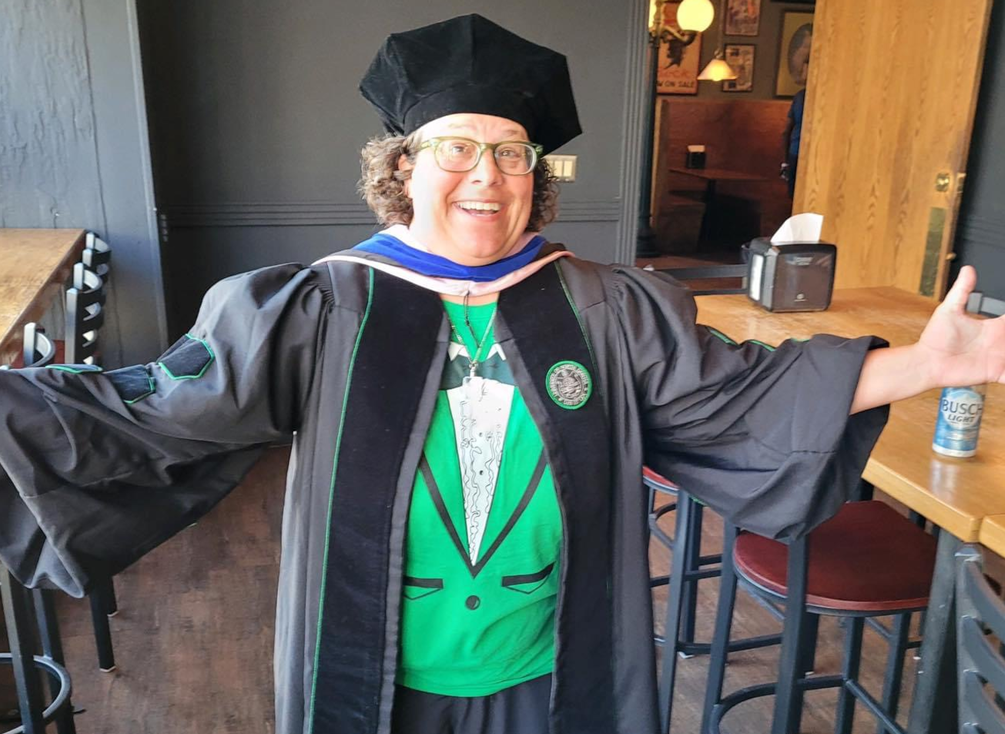
Introduction
Bridget Brooks
Instructional Designer, University of North Dakota
Curriculum Coordinator II, University of South Carolina
Online Instructor Since 2010
Quality Matters-2020-March to May
Teaching Online Certificate

Slide 4

Top Priorities
Transition to Blackboard Ultra
Quality Course Design
Accessibility Training and Support
Notes:
More in depth info on each item in the following slides. Things to point out to audience:
All of the NDUS institutions are getting hit with a lot of significant changes. UND's Teaching Transformation and Development Academy has determined these 3 items are our top priorities at the moment. It is easy to see that each individual item is important on their own, but we have found that these priorities are interconnected: quality courses drive engagement and learning; accessibility ensures inclusivity and meets legislative requirements; and transitioning to Blackboard Ultra provides the tools necessary to enhance both. Implementing them together will create a more effective and equitable learning environment.

Slide 5

Break it Down!
“Demo Day”
Let faculty know that we are going to start from the beginning
Pack up and move to a new home, only
bring what you need!
          Moving to Ultra makes this a bit easier

Slide 6
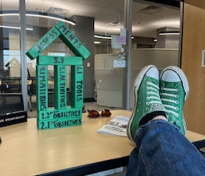
Outcomes! Outcomes! Outcomes!
A strong foundation
Start from the very beginning
          Importance of that strong
          foundation of courses
          and module outcomes
          Asynchronous course that
          includes an entire module on who, what,
          when, where, why and how of outcomes.

Slide 7
Activities and Assessments
Be sure to differentiate
Did our outcomes change, do we need to reassess?
Activities are where they practice new knowledge
          Assessments high stakes, learners prove what they know
          Were they able to achieve the outcomes? Did they have adequate practice? Give opportunities to self-reflect Learners don’t want busywork, and you don’t want to grade it!

Slide 8
Instructional Materials
Don’t use just for the sake of using them!
Make sure they align with the outcomes, check and double-check for misalignment
Use a variety of relevant options!
                Videos, textbooks, images
                Accessibility and usability are priorities
          Do the materials in the course help or hinder learners from achieving the outcomes? PDFs

Slide 9
Instructional Tools
Don’t use just for the sake of using them!
Make sure they align with the outcomes, check and double-check for misalignment
Use a variety of relevant options!
                LMS & the included tools, self-check activities,
                Accessibility, usability & privacy are priorities
          Do the tools in the course help or hinder learners from achieving the outcomes?

Slide 10
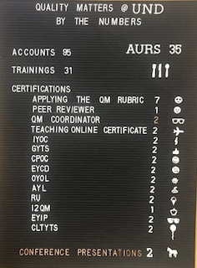
Impact
Make it immediate, but don’t stop there!
It doesn’t have to be all at once
    Think about a single drop of water
                Over time, what can water droplets do?
                Accessibility, usability & privacy are priorities
          What steps do you use to enhance long term impact?

Slide 11

Course Review Process
Worksheet
    Course Reviews have been updated utilizing QM
    Back and forth conversations
No Course Alignment Map required (OH NO)
  Course Alignment Verification Mark
  Replicates the QM Review Process on campus
    All Instructional Designers have completed
    Applying the QM Rubric

Slide 12

Verification Mark
    2.1 The course learning objectives describe measurable outcomes.
    2.2 The module/unit-learning objectives describe outcomes that are measurable and consistent with the course-level objectives.
    3.1 The assessments measure the achievement of the stated learning objectives.
    4.1 The instructional materials contribute to the
    achievement of the stated learning objectives.
    5.1 The learning activities help learners achieve the stated objectives.
    6.1 The tools used in the course support the learning objectives.
Notes:
Read the slide

Slide 13
Alignment
Learning Activities
Measurable
Course & Module Outcomes
Assessments
Tools & Materials
Notes:
Take a few moments to look at this image. Think about what is on

Slide 14
Alignment
Tools & Materials
Measurable Course
& Module Outcomes
Assessments
Activities
Notes:
Take a few moments to look at this image. Think about what is on

