Slide 1

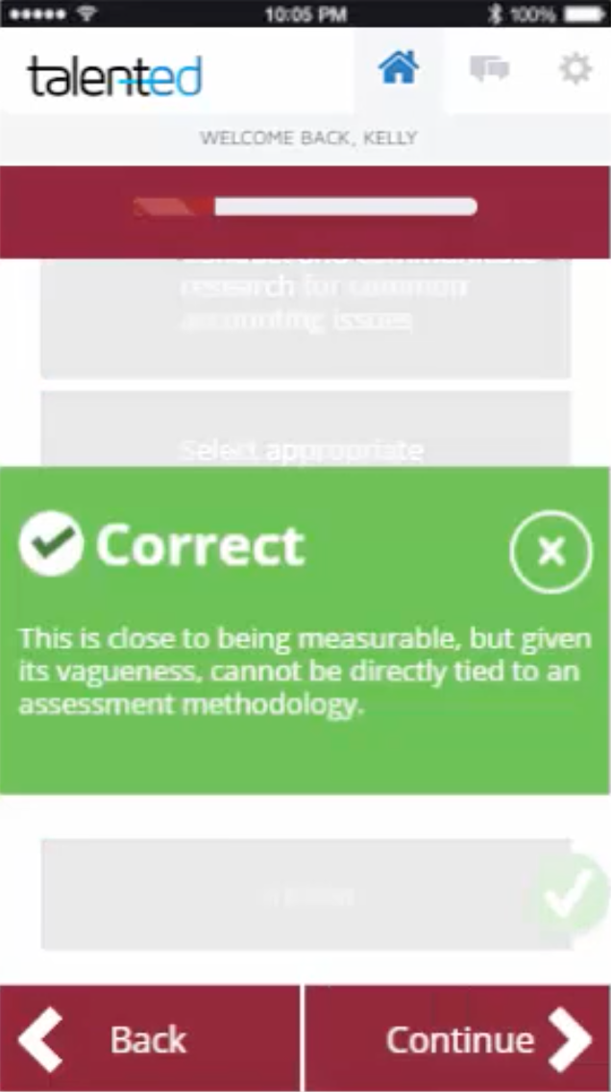


You be the
Reviewer
NCCU’s Gamified Approach to Re-Applying the Quality Matters Rubric
Racheal Brooks, Ph.D.
Coordinator
Office of e-Learning
Gail Hollowell, Ph.D.
Associate Professor
Biological & Biomedical Sciences

Slide 2

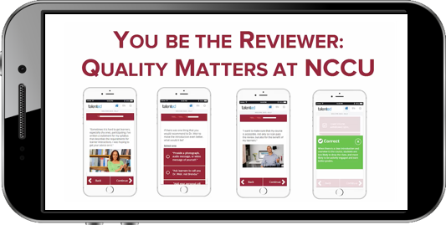
Session Objectives
Identify the factors that lead to NCCU’s development of the Applying the Quality Matters Rubric (APPQMR) mobile professional development application.
Discuss the phases involved in the creation of the mobile application.
Explore the impact of the mobile application on faculty approaches to online course design.
Discuss the modifications made to e-learning professional development based on lessons learned from performance analytics and focus group data.
NCCU Office of e-Learning | A Title III Activity

Slide 3

Quality Matters Rubric
Overview
Course Overview
and
Introduction
Learning Activities and
Learner Interaction
Course Technology
Learner Support
Accessibility and Usability
Learning Objectives (Competencies)
Assessment and Measurement
Instructional Materials
https://qmprogram.org
NCCU Office of e-Learning | A Title III Activity

Slide 4
Applying the Quality Matters Rubric (APPQMR) Workshop
Face-to-face
  One-day (7.5 hours)
Online
  2 weeks
Prerequisite for all QM roles and strongly encouraged for all members
Workshop Components:
  Introduction to Quality Matters
  Detailed review of 8 General Standards
  Application of QM Rubric through collaborative activities
  Utilization of Rubric Standards via “mini-review” of sample course
  Discussion of Reviewer tools and QM resources
NCCU Office of e-Learning | A Title III Activity

Slide 5
APPQMR Feedback
More in depth discussion of nuances of applying those Standards.
More time on the next opportunity.
Hands on activities.
Too long
Need more real examples for each
Standard to get better understanding.
Staying focused on applying the QM design to our course and programs, asking questions about our individual courses
Reduce the time.
The workshop was rather lengthy and should be condensed.
NCCU Office of e-Learning | A Title III Activity

Slide 6

Our App Development Process
PHASE 3: DEVELOPER TESTS (2017)
PHASE 1: RESEARCH & REQUEST PERMISSIONS (2016)
PHASE 4: BETA IMPLEMENTATION (2017)
PHASE 2: APP DEVELOPMENT (2016)
PHASE 5: DATA COLLECTION, ANALYSIS, DISSEMINATION OF INITIAL RESULTS (2017-2018)
PHASE 8: DATA COLLECTION, ANALYSIS, DISSEMINATION VIA PRESENTATIONS & MANUSCRIPTS (2019)
PHASE 6: DATA-DRIVEN CHANGE IMPLEMENTATION, LICENSING & QM EXECUTIVE ADMIN TESTS (2018)
PHASE 9: UPDATE APP & UNC SYSTEM AVAILABILITY (2019)
PHASE 7: RUBRIC UPDATE & COHORT 2 IMPLEMENTATION (2018-2019)
PHASE 10: QM COMMUNITY AVAILABILITY (2020)
NCCU Office of e-Learning | A Title III Activity

Slide 7


You be the Reviewer
Quality Matters at NCCU
20 Challenges delivered over 6 weeks
3 – 5 Minutes a day
iPhone, iPad, Android, and web compatible
Prior completion of APPQMR workshop
NCCU Office of e-Learning | A Title III Activity

Slide 8
Our Participants
Seven faculty from:
  Allied Professions
  Biological and Biomedical Sciences
  Environmental, Earth and Geospatial Sciences
  Human Sciences
  Language and Literature
  Nursing
  Social Work
Competed during a six-week period beginning October 9, 2017
Eligibility:
  Prior completion of APPQMR
  Access to iPhone, iPad, Android, or web browser
NCCU Office of e-Learning | A Title III Activity

Slide 9
Faculty Perspectives
Benefits of using gamification to reinforce Rubric standards
  Opportunity for professional development
  Personal satisfaction
  Application of skills to improve student engagement and learning outcomes
  Enhances reputation of program, university, and faculty members
NCCU Office of e-Learning | A Title III Activity

Slide 10
Faculty Perspectives
Benefits of using gamification to reinforce Rubric standards
  Supports meeting accreditation standards by aligning courses and meeting standards
    Accreditation Commission for Education in Nursing (ACEN) standards
    National Council of State Boards of Nursing (NCSBN)
  Impact of gamification on faculty stress/anxiety
  Provides opportunities for peer collaboration and competition
NCCU Office of e-Learning | A Title III Activity

Slide 11
Gamification as Professional Development
Learning Environment
Mobile learning increased faculty access to professional development beyond set schedules and locations.
Active Learning
Participants actively engaged in learning challenges by providing APPQMR-informed course design advice to hypothetical colleagues.
Learning Experience
“Chunked” content encouraged faculty to consistently engage with challenges.
Behavioral Changes
Faculty indicated making changes to their course shells.
They also indicated feeling empowered to assist colleagues.
Immediate Feedback
Faculty received immediate feedback for submitted responses and had access to in-app messaging for prompt technical assistance.
NCCU Office of e-Learning | A Title III Activity

Slide 12
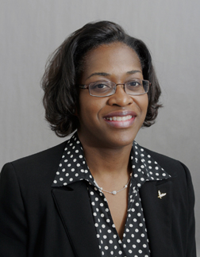
Gail Hollowell, PhD
NCCU Course Instruction
BIOL 1101 | General Biology I
BIOL 1201 | General Biology II
BIOL 1202 | Principles of Biology: Molecules and Cells
BIOL 1300 | Molecules and Cell Function
BIOL 2030 | Genomics Research Initiative
BIOL 2200 | Molecular Biology of Cells
BIOL 4350 | Cancer Biology
BIOL 4400 | Introduction to Research
BIOL 4610 | Tropical Pathogens & Infectious Diseases
BIOL 5800 | Research in Biology
Associate Professor
Biological & Biomedical Sciences
NCCU Office of e-Learning | A Title III Activity

Slide 13
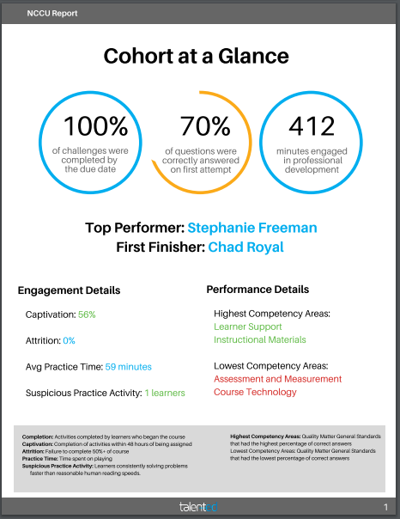
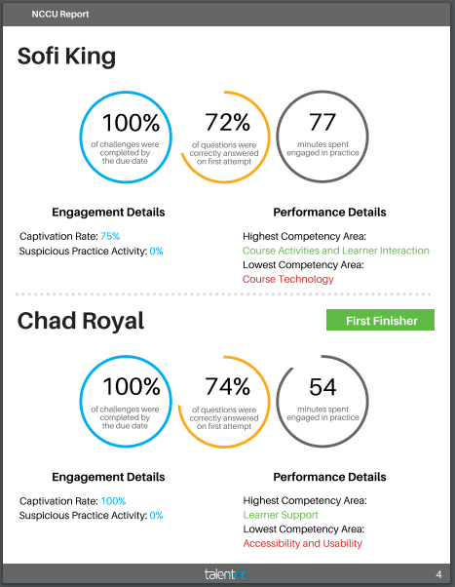
Performance Analytics
Professor 1
Professor 5
Professor 2
Professor 2
NCCU Office of e-Learning | A Title III Activity

Slide 14
Applying What We Learned
Lesson Learned | Future Application
70% Overall accuracy | Increase faculty exposure to QM Rubric Standards via e-learning PD Include mobile app participation as requirement following APPQMR
Potential Competency Area for Improvement: Assessment and Measurement | Reinforce key elements including: aligning assessments with learning objectives; developing effective assessment instruments; providing multiple opportunities to track progress
Potential Competency Area for Improvement: Course Technology | Encourage exploration of course tools that promote active learning and alignment of course technology with learning objectives and competencies
NCCU Office of e-Learning | A Title III Activity

Slide 15

NCCU Office of e-Learning | A Title III Activity

Slide 16
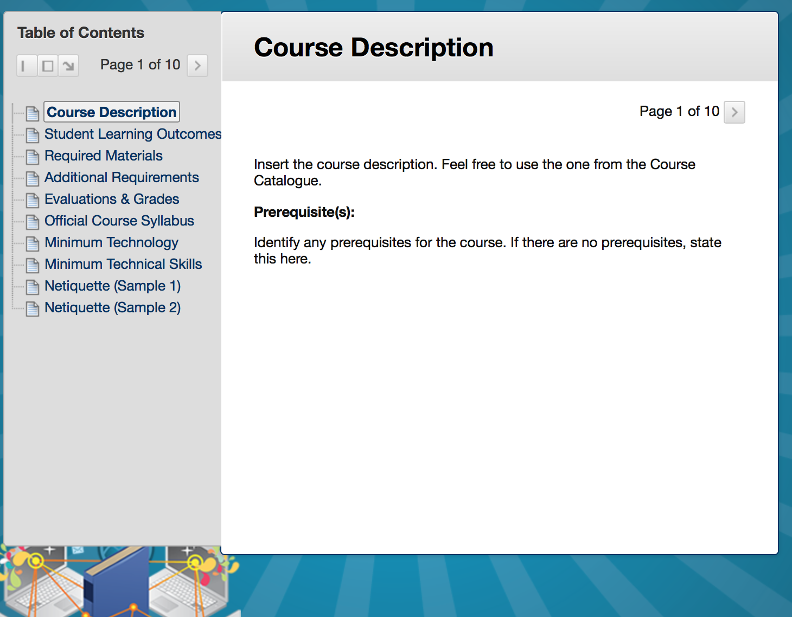
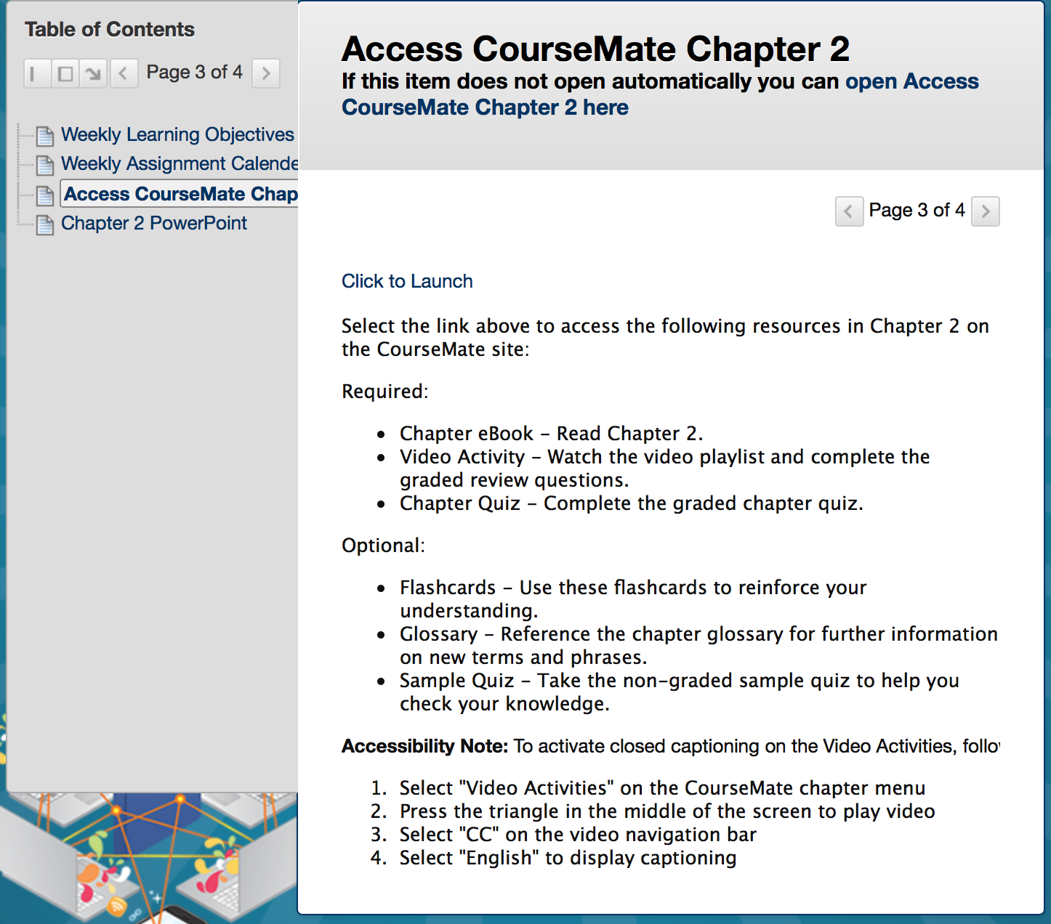
Best Practice Blackboard Shell
NCCU Office of e-Learning | A Title III Activity

Slide 17


NCCU Quality Course Design Cohorts:
e-Learning Mentoring Program
NCCU Office of e-Learning
Cohort 3
Cohort 1
Cohort 3
Cohort 1
Cohort 3
Cohort 1
Cohort 2
Cohort 2
Cohort 2
Mentoring Program
Spring Year 1
Mentoring Program
Fall Year 2
Mentoring Program
Fall Year 1
NCCU Office of e-Learning | A Title III Activity

Slide 18

Applying What We Learned
Quality Course Design Cohort III
Hospitality and Tourism Administration
HADM 1000 Introduction to Hospitality Management
HADM 3700 Leadership Colloquium in Hospitality and Tourism
HADM 3800 Human Resources Management
Allied Professions/Communication Disorders
EDSH 5721 Motor Speech Disorders
Public Administration/Executive MBA
PADG 5620 Organizational Theory and Behavior
NCCU Office of e-Learning | A Title III Activity

Slide 19
Moving Forward
Updated application to reflect 6th Edition Rubric changes
Quality Course Design Cohort IV
Allied Professions – Counselor Education
Allied Professions – Speech Disorders
Curriculum and Instruction – School Administration
Nursing
STEM Faculty – Innovation Initiative Grant
Biological & Biomedical Sciences
Chemistry
Environmental, Earth, and Geospatial Sciences
Mathematics
Pharmaceutical Sciences
School of Library and Information Sciences
NCCU Office of e-Learning | A Title III Activity

Slide 20




Thank You to
Our Sponsors

Slide 21
Questions

Slide 22
For additional information, contact:
Dr. Racheal Brooks
Coordinator, Office of e-Learning rmbrooks@nccu.edu
(919) 530-6677
Dr. Gail Hollowell
Associate Professor, Biological & Biomedical Sciences ghollowell@nccu.edu
(919) 530-6403

Slide 23
You be the
Reviewer
NCCU’s Gamified Approach to Re-Applying the Quality Matters Rubric
Racheal Brooks, Ph.D.
Coordinator
Office of e-Learning
Gail Hollowell, Ph.D.
Associate Professor
Biological & Biomedical Sciences

