Slide 1
Building a Network of
Peer Reviewers
Jake Bolen (bolenj@mctc.edu)
Director of Distance Education, Mountwest Community & Technical College
Carol Howerton (carol.howerton@southernwv.edu)
Associate Vice President for Academic Affairs, Southern Community & Technical College
Dr. Sherri Ritter (sherri.ritter@bridgevalley.edu)
Director of Digital Learning, Bridge Valley Community & Technical College

Slide 2

NSF Acknowledgement
This presentation is funded in part by the National Science Foundation under Grant No. 1204952.
Any opinions, findings, recommendations expressed in this material are those of the author(s) and do not necessarily reflect the views of the National Science Foundation.

Slide 3
Description
This session will discuss the collaborative efforts of three community colleges in southern WV to provide a Shared Peer Reviewer Network. Using the statewide subscriber managed review process, the network of reviewers will provide a cost effective model to deliver quality online courses to rural WV at no additional cost. A discussion of the concept at the state level and the implementation plans from the three institutional perspectives will be given. Providing the appropriate tools, involving faculty, and collaboration are the key components of this project and will be examined.

Slide 4
Learning Objectives
Summarize a cost effective online reviewer network model.
Identify the components of a successful shared peer reviewer network.
Discuss the implementation process associated with the shared peer reviewer network.

Slide 5
History
2012 Dr. Roxann A. Humbert introduced Quality Matters to WV
Dr. Humbert was the Statewide Director of Higher Education e-Learning for the Higher Education Policy Commission/WVNET
West Virginia Technical Assistance Broadband Grant Program (American Recovery & Reinvestment Act)
2012 Started training Peer Reviewers
2013 – 38 Peer Reviewers, Five Master Reviewers
2015 – 163 Peer Reviewers, 18 Master Reviewers

Slide 6
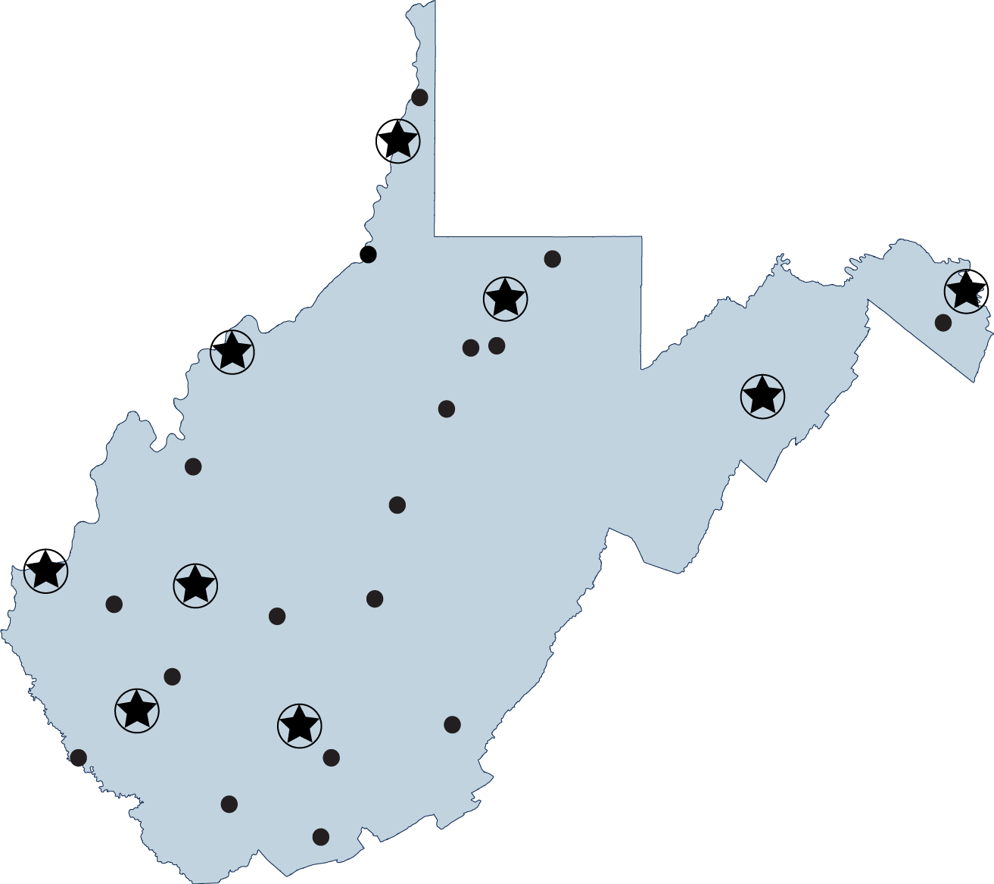
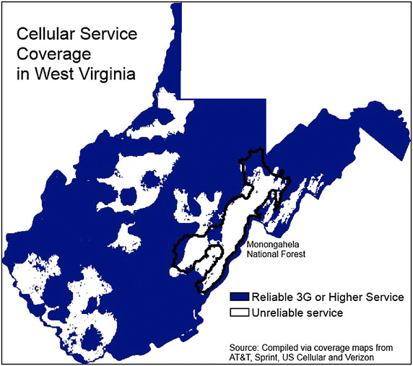
Geography
9 Community Colleges
27 Campuses
Reliable High Speed Coverage
Appalachian Mountains
Cellular Coverage

Slide 7
Summarize a Cost Effective Online Reviewer Network Model
Statewide Initiative lead by Dr. Roxann A. Humbert
Talks at state level involving all institutions
Applying the QM Rubric Training for Faculty and Staff
Improve Your Online Course Training for Faculty and Staff
Peer Review Training for Faculty
Institutional Review of Courses
QM Review of Courses using the Bartering System

Slide 8
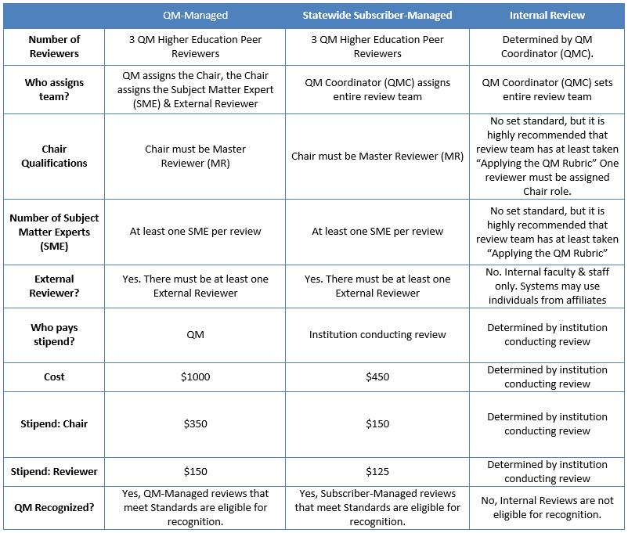
ADDITIONAL SAVINGS
If the institutions provides
The master and
One peer reviewer
The cost would be $175.
If the institution provides
Two peer reviewers and
The Statewide Managed Subscriber provides the master who is also the subject matter expert
The cost would be $200.00.
Network
Model

Slide 9
BridgeValley
Community & Technical College

Slide 10
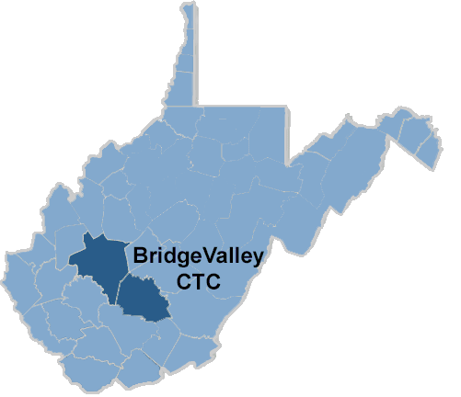
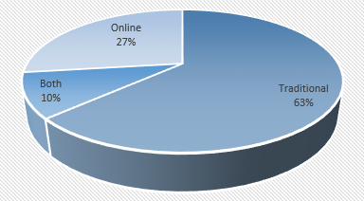
BridgeValley
Community & Technical College
Dr. Sherri E. Ritter
  Director of Digital Learning and Quality Matters Coordinator
BridgeValley
  South Charleston, WV
  Montgomery, WV
Student Population – 2,503
  46% full-time and 54% part time
  27% enrolled in only online classes
  10% enrolled in some online classes
  63% not enrolled in online classes
Faculty 103 full-time and 97 part-time

Slide 11
Timeline of QM At BVCTC
2012
Dr. Humbert Introduced QM
2013
First state training took place at KVCTC
2014
Improve Your Online Course Classes Offered
2015
Peer Reviewer Courses starting to get pushed
2016/17
Peer Review Courses

Slide 12
Institutional Implementation Stages
Stage 1
Introduce Concept to Administration & Begin Planning
QM training for Faculty & Staff
Stage 2
QM Template for Blackboard
Goals Tool in Blackboard
Stage 3
Build New Courses to QM Standards
Identify and Rank Reviews for Older Courses
Train Faculty to be Reviewers
Perform Reviews
Identify Faculty Leaders

Slide 13
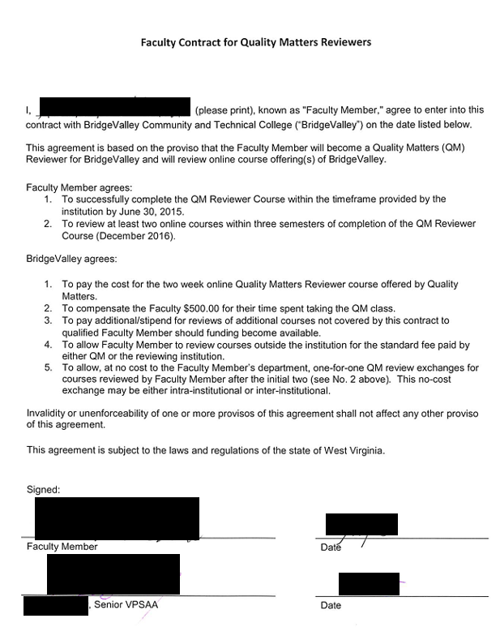
Training Reviewers
The institution agreed to…
  Pay for faculty to undergo the Peer Reviewer training
  during the summer break
  Faculty received a small stipend ($500) to do the training
  The institution provide an exchange credit (1 for 1 basis)
  for all QM reviews after the initial 2 reviews
The faculty agreed to…
  Successfully complete the training
  Review at least 2 classes within 3 semesters
  of the training.

Slide 14
Current BV QM Stats
Faculty
  Applying the QM Rubric (APPQMR) – 88
  Improving Your Online Course (IYOC) – 9
  Peer Reviewer Course (PRC) – 12
  Master Reviewer Certification (MRC) – 1
Courses
  9 Institutional Reviews Completed
  22 Currently Under Review

Slide 15
Mountwest
Community & Technical College

Slide 16
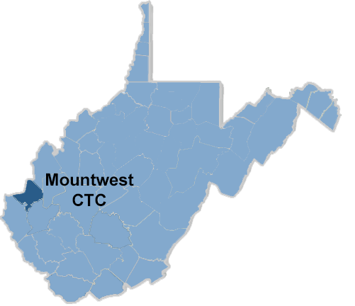
Mountwest
Community & Technical College
Jake Bolen
  Director of Distance Education
Mountwest Community & Technical College
  Huntington, WV
Student Population – 2,084
  57% full-time and 43% part time
  15% enrolled in only online classes
  40% enrolled in some online classes
  60% not enrolled in online classes
Faculty 65 full-time and 80 part-time

Slide 17
Current MCTC QM Stats
Full-Time Faculty
  Applying the QM Rubric (APPQMR) – 92.59% Online Faculty
  Applying the QM Rubric (APPQMR) - 81.48% All Faculty
  Improving Your Online Course (IYOC) – 44% All Faculty
  Peer Reviewer Course (PRC) – 8% All Faculty
  Master Reviewer Certification (MRC) – 1
Courses
  1 Institutional Reviews Completed
  1 Currently Under Review

Slide 18
Timeline of QM At MCTC
2015-2016
Peer Reviewer Courses starting to get pushed after Statewide meeting
2017
Started Reviewing Courses
2014/2015/
2016
Improve Your Online Course Classes Offered
2015
Hired Director of Distance Education
2014
APPQMR First Offered

Slide 19
Institutional Implementation Stages
Stage 1
Introduce Concept to Administration & Begin Planning
Continuation and education on QM training for Faculty & Staff
Stage 2
Identify and educate program specific instructors for courses to be reviewed
Stage 3
Build New Courses to QM Standards
Train Faculty to be Reviewers
Work with Online Oversight Committee members
Work with Grant Coordinator to determine review process
Stage 4
Identify highest use and low completion ratio courses for review
Create timeline to review courses on a rotation
Start reviewing courses

Slide 20
Training Reviewers
The institution agreed to…
  Pay for faculty to undergo the Peer Reviewer training
  Faculty receive a small stipend ($500) after reviews are completed
  Pay additional stipend for additional reviews not covered by the original contract
  Allow faculty to review courses outside the institution
  The institution provide an exchange credit (1 for 1 basis)
  for all QM reviews after the initial 2 reviews
The faculty agreed to…
  Successfully complete the training
  Review at least 2 classes within 3 semesters
  of the training.

Slide 21
Southern West Virginia
Community & Technical College

Slide 22
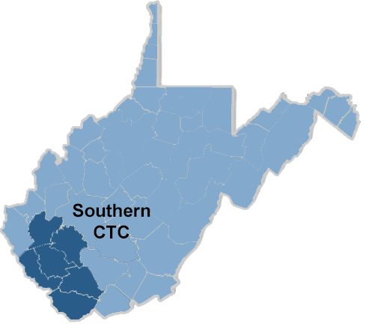
Southern WV
Community & Technical College
Carol Howerton
  Associate Vice President for Academic Affairs (2/20/2017)
    Project Director – National Science Foundation Grant (2013-2017)
    Interim Director Distance Education (2014, 2016)
Southern West Virginia Community and Technical College
  Coalfields of Southern WV –
    Boone, Lincoln, Logan, McDowell, Mingo, and Wyoming
    recession status 5/17 in ARC
  Student Population – 1,771
  71% full time and 29% part time
  37.1 % of schedule is online and 2.22 % of schedule is hybrid
  65.6 % of schedule uses online in some form
Faculty 66 full-time and 39 part-time

Slide 23
Current Southern QM Stats
Faculty
  Applying the QM Rubric (APPQMR) – 29 faculty (41%), 6 staff
  Southern Rubric and Course Development – 100% Online Faculty (75)
  Improving Your Online Course (IYOC) - 7
  Peer Reviewer Course (PRC) – 2
  Master Reviewer Certification (MRC) – 1 in progress
Courses
  60 online courses
  8 Quality Matters Approved with 3 more in progress
  7 Institutional Reviews Completed
  18 Currently Under Review
  All courses – required to have QM Template

Slide 24
Timeline of QM At Southern
2011
QM Conference
2012
Faculty and Staff Training on APPQMR and SCP-3000
Initial QM Template - EKU
2013
National Science Foundation Grant –Training Centers
2017
Reorganization – AVP, DE Committee for Peer Reviews
2014-2015
Course Reviews in process
All Courses with QM Template
First course in WV with full QM Approval

Slide 25
Institutional Implementation Stages
Stage 1
Introduce Concept to Administration & Begin Planning
Initial education on QM training for Faculty & Staff
Stage 2
Stage 3
Official QM Reviews
Train Faculty to be Reviewers
Policy SCP-3000 Distance Education
QM Template Required
National Science Foundation Grant – Training Faculty
Build New Courses to QM Standards

Slide 26
Training Reviewers -
National Science Foundation grant extension
  Add Peer Reviewer Process
Identifying faculty to participate
Contract with Mountwest and BridgeValley to mentor
  The institution agreed to… (still under development)
    Pay for faculty to undergo the Peer Reviewer training
    Faculty receive a small stipend ($500) to do training and two reviews
  The faculty agreed to… (still under development)
    Successfully complete the training
    Review at least 2 classes

Slide 27
