Slide 1

Building the Foundation: Championing QM Practices Across Curriculum, Product, and Instruction
Carly Fuller, VP Product Development & Innovation
Notes:
Our session today is designed to be part showcase, part conversation. I’ll share how our curriculum, product, and instructional teams work together to embed QM into daily practice, and I’m eager to hear how others are doing this too.

Slide 2



Do not edit How to change the design
Join at slido.com #1121868
The Slido app must be installed on every computer you’re presenting from

Slide 3
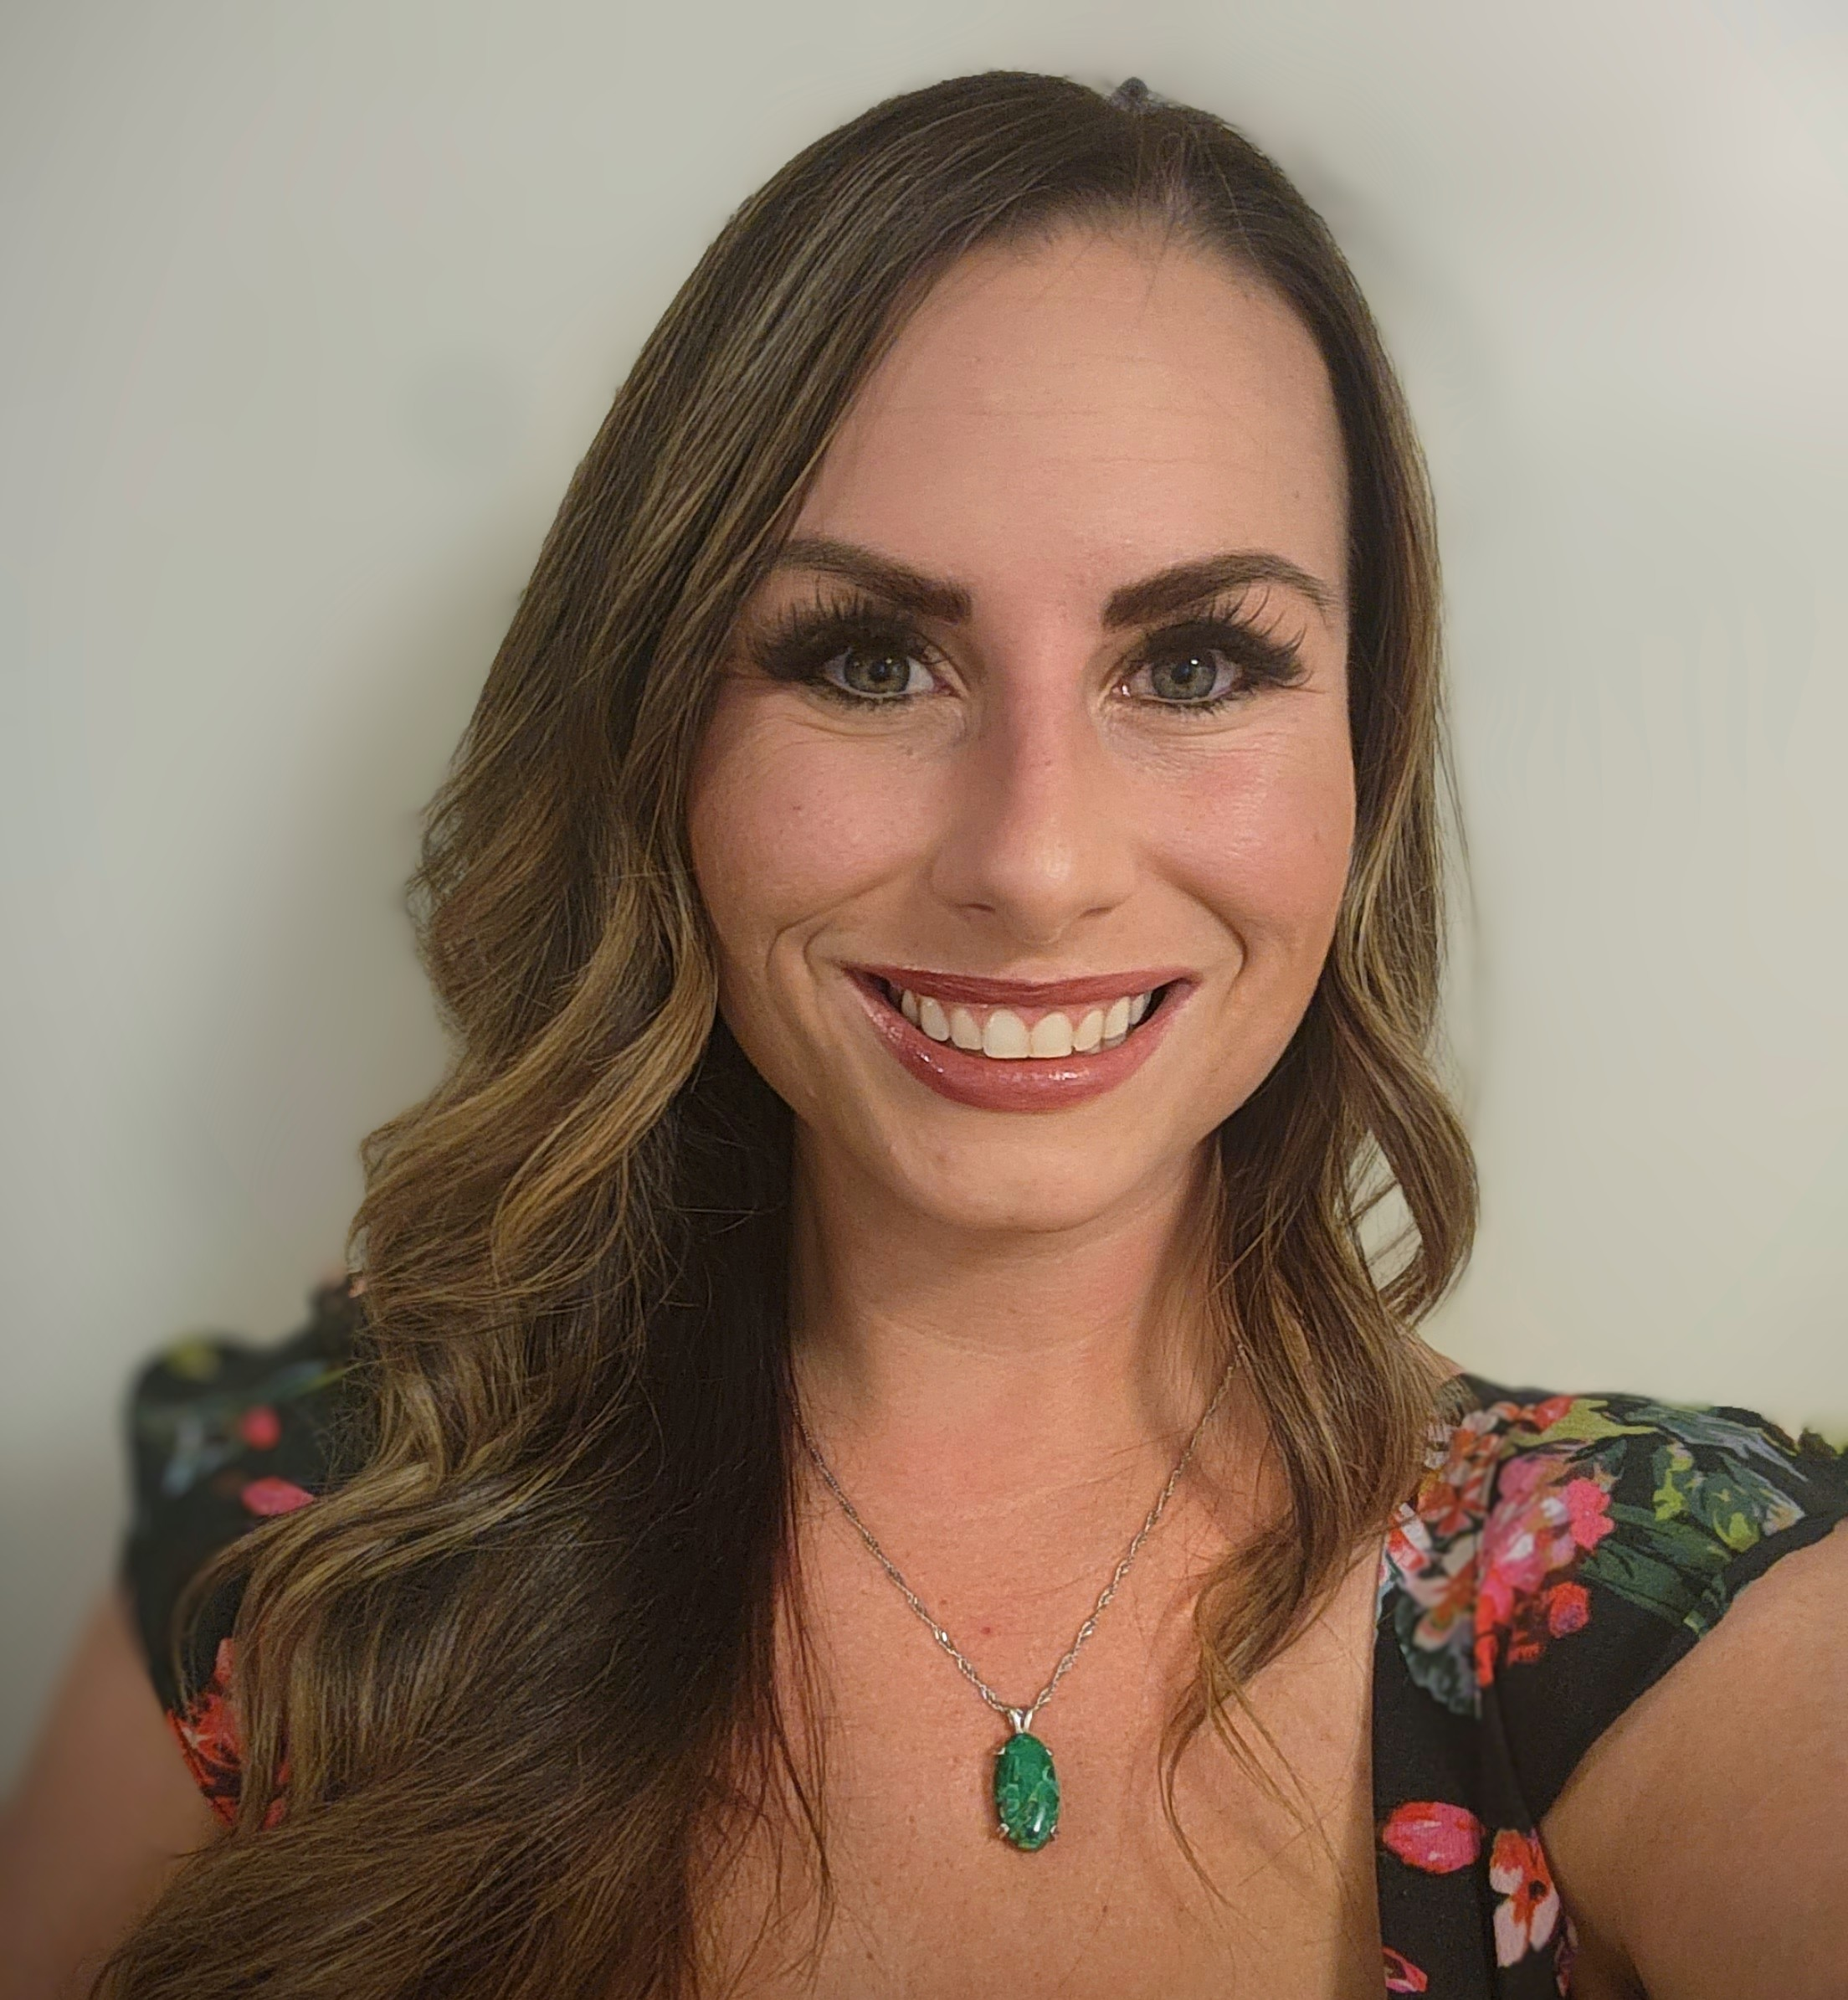
Carly Fuller
K-12 Master Reviewer
1EdTech - TrustEd Apps Certified Leader
15 years experience as a teacher, product leader, and digital learning customer success advocate
Pittsburgh, PA
Cat mom to David and Samson

Slide 4
Session goals
Share a scalable model for embedding QM across teams.
Showcase our eCourse Style Guide.
Exchange practices and lessons learned.
Notes:
This session is a “Conversation that Matters,” so expect to share and brainstorm near the end.

Slide 5
Learning Objectives
Identify strategies to align design processes with QM & NSQ standards.
Describe how internal style guides promote consistency.
Discuss sustaining a shared culture of improvement.
Notes:
You’ll see examples of each in practice.

Slide 6

Do not edit How to change the design
How does your organization define QUALITY in digital learning?
The Slido app must be installed on every computer you’re presenting from

Slide 7

Building the Foundation
Curriculum development strategies pre-pandemic
Immense growth produced opportunity to rethink our eCourse curriculum design and development practices
Quality Matters K-12 Rubric provided a philosophy for instructional design and a framework for connecting curriculum, instruction, and product
2008 – 2014: Classic eCourse Development
2020 – 2021: QM Adoption
2022 – 2023: Integration
2024 – Present: Maturity
2014 – 2019: Classic+ eCourse Development
Notes:
Harris Digital Learning, formerly EdisonLearning, created our original eCourse catalog between 2008 and 2015. This catalog primarily focused on having a multiple of desperate learning objects tied to learning objectives or standards. Assets would be in varied modalities and levels of rigor, but were meant to stand alone. This modularity was great for ease of course customization; however, it did not always produce a cohesive or consistent course.
EdisonLearning was sold to a single owner in 2014 and the organization went through a complete restructure. With that came a reduction of our product teams, including those who worked on curriculum development. With a smaller team, we focused on course modifications and course customizations which allowed the existing courses to be sold in more states. This included some new lesson development to meet changing academic standards or state requirements. We also made some updates to include interactivities to drive student engagement, as well as updates to improve the accessibility of the courses and reduce dependency on external resources. We were chugging along, meeting the requirements for our customers, but courses were becoming increasingly “Frankenstein-ed” as modifications increased.
Then COVID happened. We saw immense growth as a result. New customers and an influx of money meant that we could reinvest in the product. At that time, our Chief Learning Officer had experience with Quality Matters. Our largest customer CAOLA was also investigating using the QM certification process as a means of consistency with their vendors. This was just the push that was needed to rethink our eCourse instructional design. In 2020, we began work on a Proof of Concept where the course was planned through Backwards Design, and developed with the QM K-12 Rubric at the forefront. We released our first two courses with this design in 2021. I went through Quality Matters training and became a certified reviewer. We also submitted our first 4 courses to QM for certification and passed. Now a firm believer in QM, we updated our eCourse Style Guide with QM-standards and best practices, as well as templates and guidance to make our curriculum development process more efficient and consistent. In 2022 we looked to expand our QM PD within the staff and gain additional certified reviewers. We started to connect QM standards applied in curriculum with NSQ standards for instruction, ensuring consistency between the Curriculum and Instruction teams. I gained certification as a K-12 Master Reviewer. Changed our syllabus template and added resources to our knowledge base like the VPAT and Academic Integrity. Now with QM fully integrated into Harris Digital Learning culture, we were able to further embed QM practice in our work. We started to think beyond just curriculum and instruction, but also; what platform enhancements were needed to better align with QM standards. Changing the space in Course Player, adding Cyber Essentials and Course Intro Announcements to the quick nav bar, etc.

Slide 8
People & Professional Development
Building internal champions ensures sustainability.
5 Certified QM Reviewers
1 Certfied QM Master Reviewer
3 Certified Courses
112 hours of PD in 2024–25
100% of design staff trained on QM
Notes:
“Our greatest asset in sustaining quality has been our people.”
“We now have five certified QM Reviewers, with more on the way, and thirteen QM-certified courses.”
“In the past year alone, our team completed over 100 hours of QM-aligned professional development — from the new rubric update course to Universal Design for Learning.”
“Most importantly, 100% of our instructional design staff are trained in QM standards — so even new hires enter with a shared foundation.”
“Having in-house reviewers transforms quality from something done to us to something we own.”

Slide 9
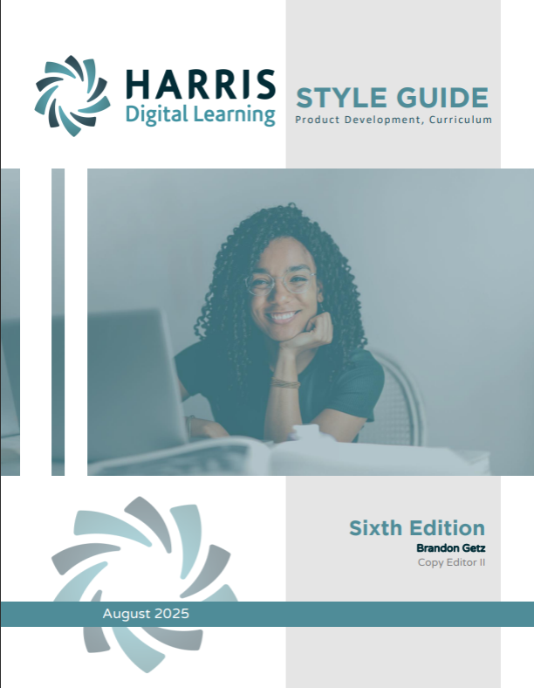
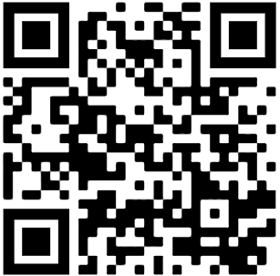
Ecourse style guide
Writing lesson objectives (pg. 3)
Images (pg. 40)
Alt-text (pg. 43)
Assessments (pg. 65)
Subject-specific guidelines (pg. 76)
Diversity and inclusion (pg. 99)
Notes:
Link to style guide here – include some examples and which QM standard they address. Also created timelines and checklists for preparing an eCourse for submission and a boilerplate course worksheet that we regularly update based on review feedback.

Slide 10
Process & Implementation
100% templates aligned to QM K–12 Rubric
3-Phase review cycle (Design → Peer Review → Certification)
Annual QM audit (4–6 courses/year)
Regular QM improvement coordination.
Notes:
“Next, let’s talk process — how we built QM into our development cycle.”
“Every new course template we use is aligned to the QM K–12 Rubric.”
“Our internal process follows three broad phases: Design, Peer Review, and Certification — even if not every course goes through external review.”
“We complete internal audits each year for about four to six courses and hold regular improvement coordination between Curriculum, ID, and Product teams.”
“This framework isn’t rigid — it’s cyclical, like a quality spiral that builds over time.”

Slide 11

Consider this:
What checkpoints do you have in place to ensure course quality and consistency?
Notes:
Take a moment to think about what checkpoints you have in place to ensure course quality and consistency. Then turn to an elbow partner and share. We’ll take a couple examples from the audience before we move on.

Slide 12
Course Design & Output
180 lessons × 9 assets = 1,620 reviewed elements per course
60+ courses built/revised since 2021
Accessibility compliance improved from ~40% → 99% (WCAG 2.2)
Notes:
“Here’s where the scale of our work really shows.”
“Each high school course includes roughly 180 lessons with 9 assets per lesson — that’s over 1,600 items per course reviewed for design consistency and accessibility.”
“Since 2021, we’ve built or revised over 60 courses using QM-aligned templates.”
“Accessibility compliance improved from about 40% to 99% with WCAG 2.2 — thanks to consistent tagging, headings, color contrast, and alt text standards.”
“This data helped our teams see quality as measurable and meaningful.”

Slide 13
Impact & Continuous Improvement
Fewer content-related support tickets in V2 courses
Increased stakeholder confidence
Improved accessibility and readability standards.
Notes:
“Beyond data, the impact shows up in everyday work.”
“We’re seeing fewer content-related tickets in our newer V2 courses — a direct reflection of better design documentation.”
“Teachers report stronger confidence in their course materials, and students are engaging more consistently.”
“Perhaps most importantly, our teams have adopted a shared language around quality — it’s not just a compliance step; it’s a mindset.”

Slide 14
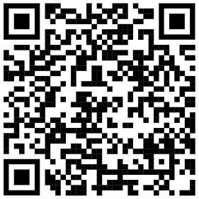
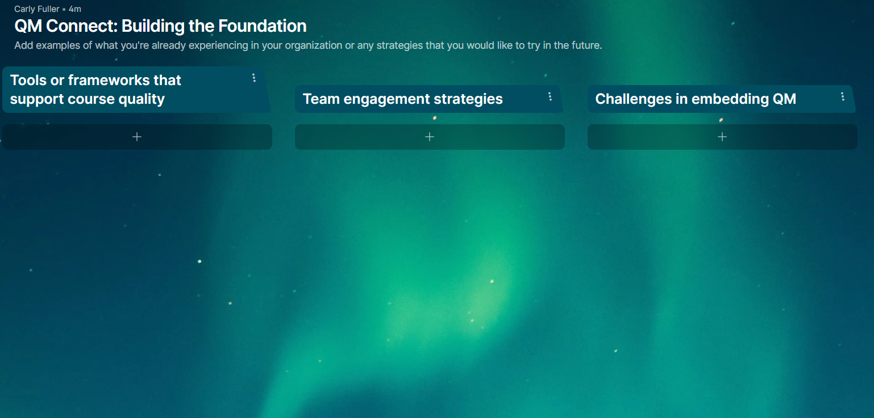
Conversation That Matters
https://padlet.com/carlyefuller/QMConnect2025
Notes:
“Now it’s your turn — this is where the real value of these sessions comes in.”
“I’d love for you to open our shared Padlet using the QR code on the screen.”
“You’ll see three columns: Tools or frameworks, Team engagement strategies, and Challenges or opportunities.”
“Take two or three minutes to add your ideas — what works in your organization, or what you wish existed.”

Slide 15

Key Takeaways & Resources
Quality starts with shared systems.
Style guides and checklists make standards actionable.
Collaboration sustains improvement.
Notes:
Need to pretty this up

Slide 16

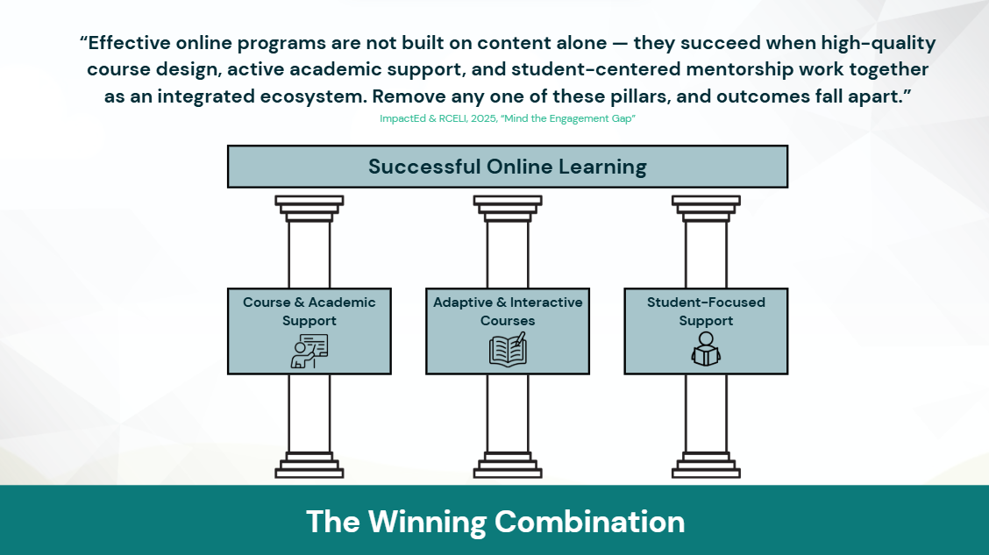
Learning that works.
Antithesis to teaching to the test and click-through culture
Adaptive courses and platform designed to support executive functioning skills
Provider of core and elective courses for middle school and high school
Varying course types and a la carte service options to match any program’s needs
Certified instructional and advisement services to extend school capacity
Notes:
Add notes from sales deck

Slide 17
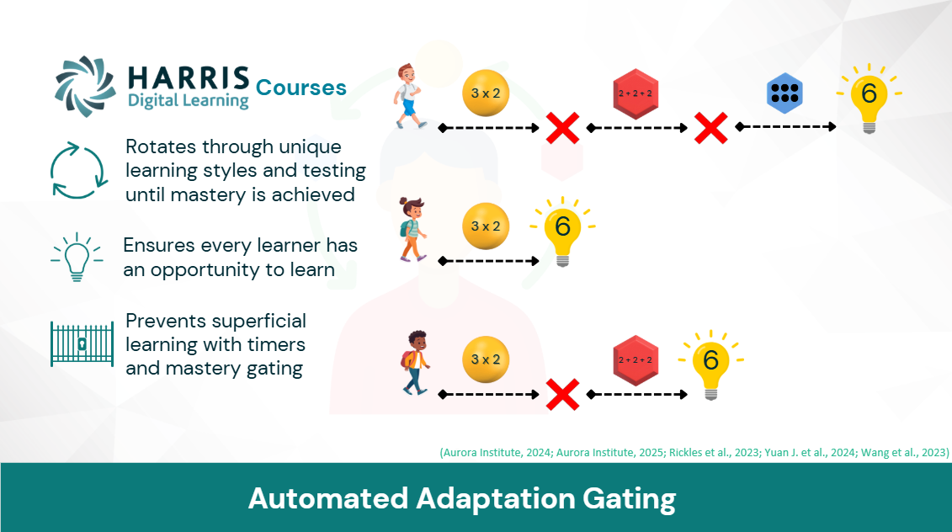
Notes:
Add notes from sales deck

Slide 18
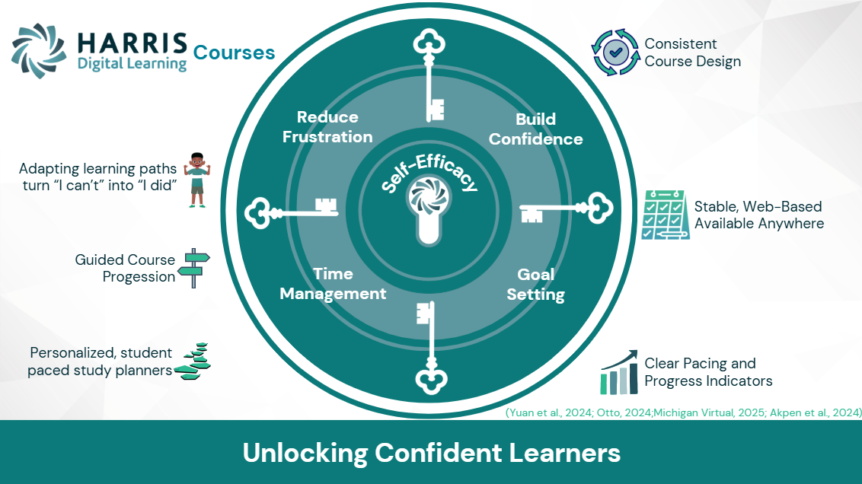
Notes:
Add notes from sales deck

Slide 19
Closing & QUESTIONS
Start small—standardize one process, train one team, document one guide.
Build the next generation of quality-driven digital learning together.
Notes:
Add QR code to HDL website

