Slide 1

Professional Development Matters: Enhancing Quality Assurance Across a Multi-College Institution
QM Connect Conference
Dr. Erik Richter, CCCS
Amanda Hardman, CCCS

Slide 2

Session Outcomes
Relate a multi-college institution's quality assurance plan to Quality Matters goals and processes.
Explain challenges facing a multi-college institution in adopting common quality assurance guidelines and practices.
Identify strategies and resources that can flexibly meet the QA needs of stakeholders.

Slide 3
Colorado Online Consortium Goals
Rationale | Goals
Meet student needs | Ensure equity of access & success Improve ease of use for students
Compliance with accreditation criteria | College oversight, improve efficiency, leverage existing state online investments
Growing student demand for online learning | Increase capacity, grow enrollment Offer more fully online programs Increase workforce & noncredit options Attract new markets
Economic ability to serve current & future students | Reduce internal competition, become more competitive externally Increase revenue, improve use of resources at a lower cost to students
Support existing CCCS efforts | Expand opportunities via technology

Slide 4
CCCS Quality Assurance Components
Quality standards
Professional development
College autonomy for implementation
Centralized support and multi-college collaboration

Slide 5

Initial Milestones for Systemwide Quality Assurance
Systemwide access to QM (Spring 2022)
Quality Matters Plus (QM+) and Healthy Course Checklist (Spring 2022)
Flexible professional development (Fall 2022)

Slide 6
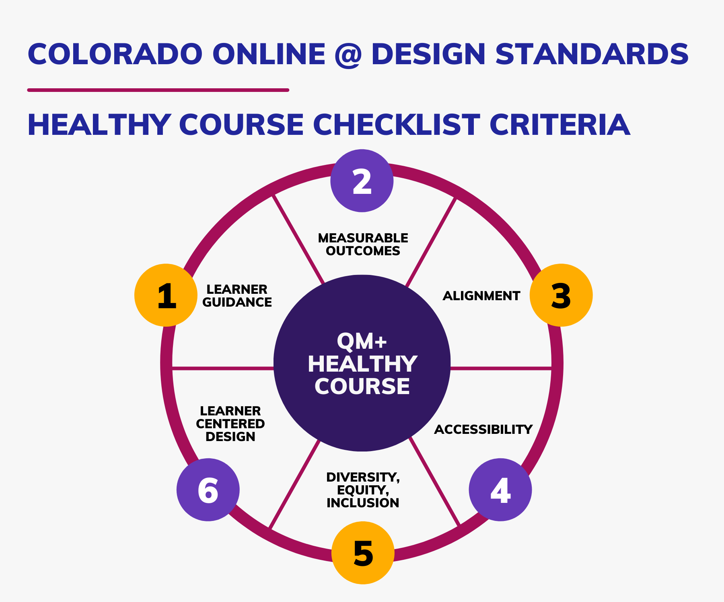
Healthy Course Checklist Criteria

Slide 7
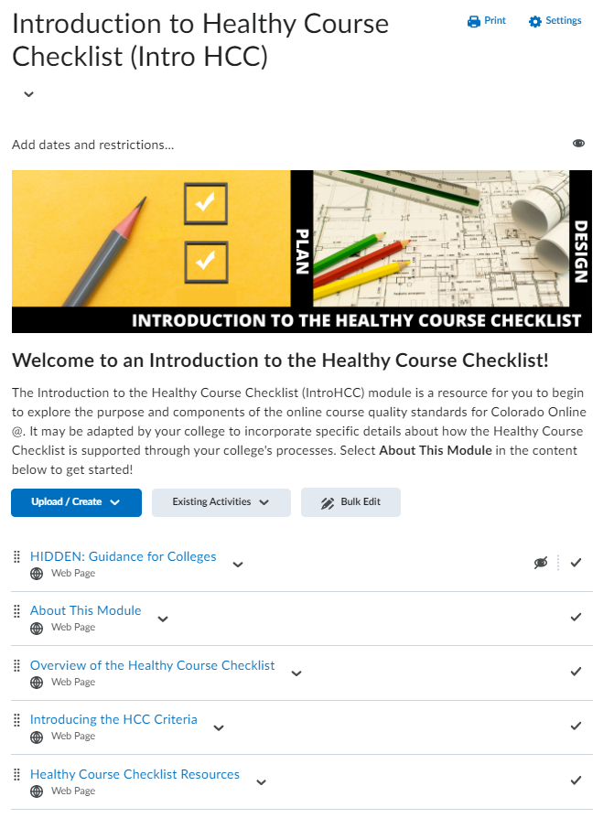
Milestone 1 Professional Development
  Provided module to 13 system colleges
  Created centralized access to module
  Integrated module into subsequent processes and professional development

Slide 8
Challenges of Multi-College Buy-In
Faculty Perspectives
Administrator Perspectives
Academic freedom
Design vs. delivery (or, quality design vs. teaching evaluation)
College autonomy and individual college priorities
Inequitable access to resources

Slide 9
CCCS Quality Assurance Implementation Plan
Colorado Online Consortium and Rural Consortium of Colorado
QMC collaboration

Slide 10
CCCS QA Implementation Plan Key Elements
Equitable access to QM and system-provided professional development
Equitable access to QM reviews through a subscriber-managed review process
Equitable access to learning design resources through Learning Design Community of Practice

Slide 11
Milestones to Maintain Momentum (1)
Development of Readiness Report review tools (Spring 2023)
Learning Design Community of Practice (Summer 2023)

Slide 12
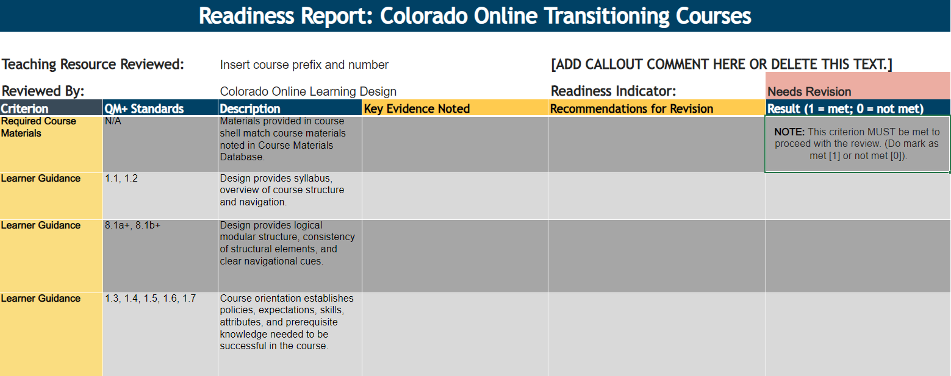
Readiness Report

Slide 13
Challenges to CCCS QA Implementation Plan
Consortial Transition Timeline
Allocation of Consortial Resources
Balancing the desire for a longer-range QA plan with more immediate needs of the transition
Change management
Enrollments
Shifting priorities

Slide 14
Milestones to Maintain Momentum (2)
Expanded access to flexible professional development through Learning Design Community of Practice (Fall 2023)
What's next? Cultivate QA review community

Slide 15
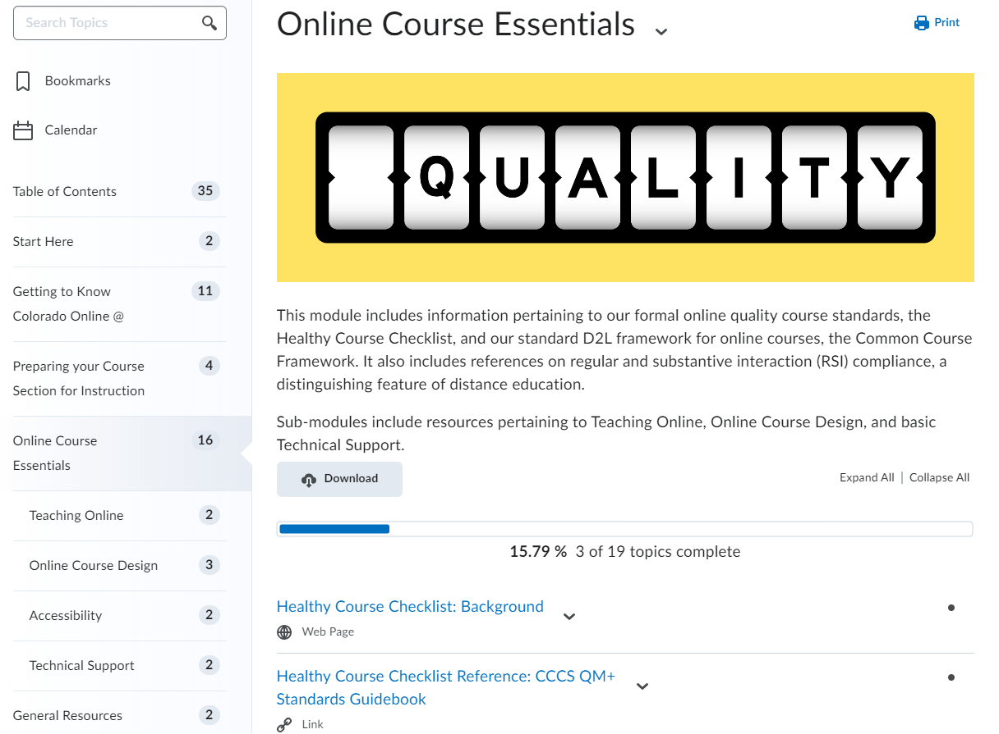
Milestone 3 Professional Development

Slide 16
Self-Enrollment into Collaborative PD
  Colorado Online Professional Development Faculty Resources
  Building Your Online Course from the Ground Up

Slide 17
How are you pursuing your milestones?
Do you have a clear pathway with identified milestones or do you have moving targets?
How do you account for change and challenge in your QA plan?
How do you create flexibility to maintain momentum toward QA goals?
How do you promote innovative collaboration between faculty and administrative stakeholders for the sake of learner needs?

Slide 18

Thank You!

