Slide 1

Ensuring Healthy Courses with QM "Plus": Supporting Equitable Online Course Design
QM Connect Conference
Tina Parscal, CCCS
Amanda Hardman, CCCS

Slide 2

Session Outcomes
Articulate the need for QM "plus" online course design standards to support equitable learner-centered learning experiences.
Demonstrate tools and resources to positively impact institutional culture around diversity, equity, and inclusion.

Slide 3
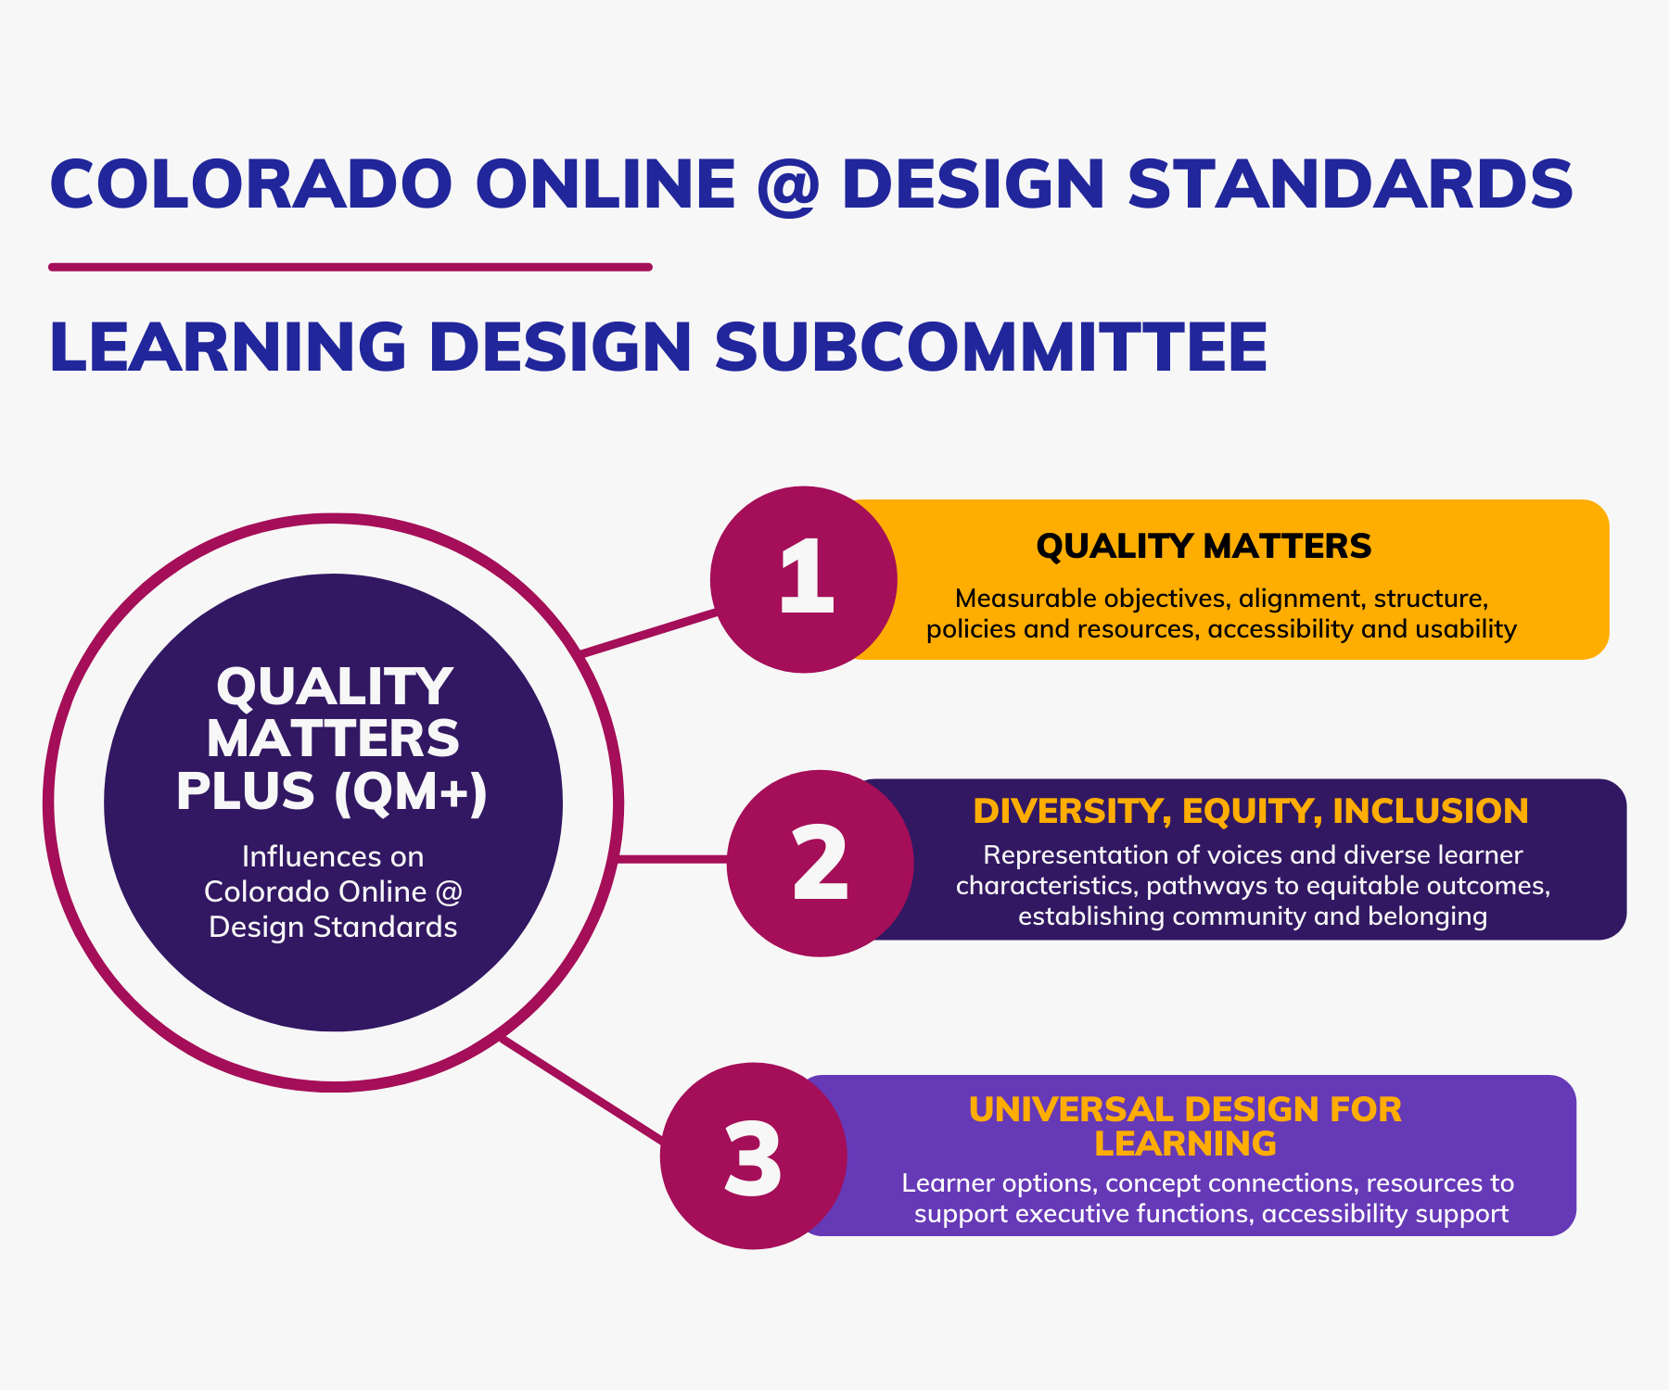
Influences on QM+

Slide 4
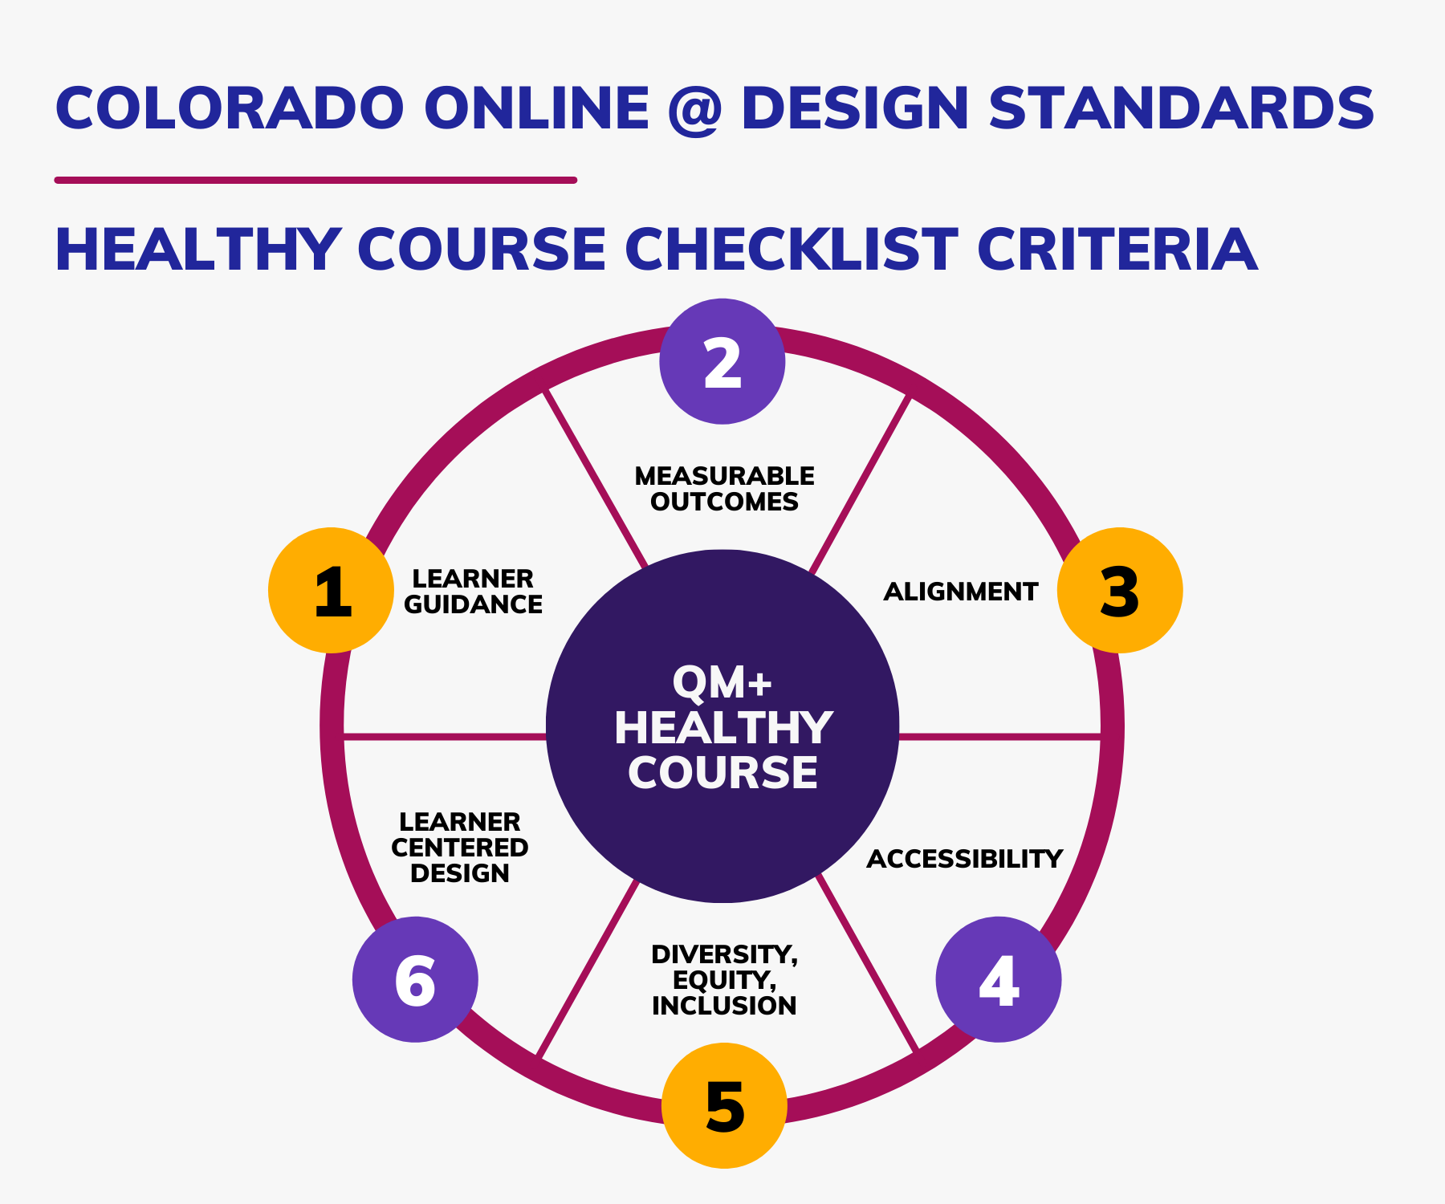
Healthy Course Checklist Criteria

Slide 5
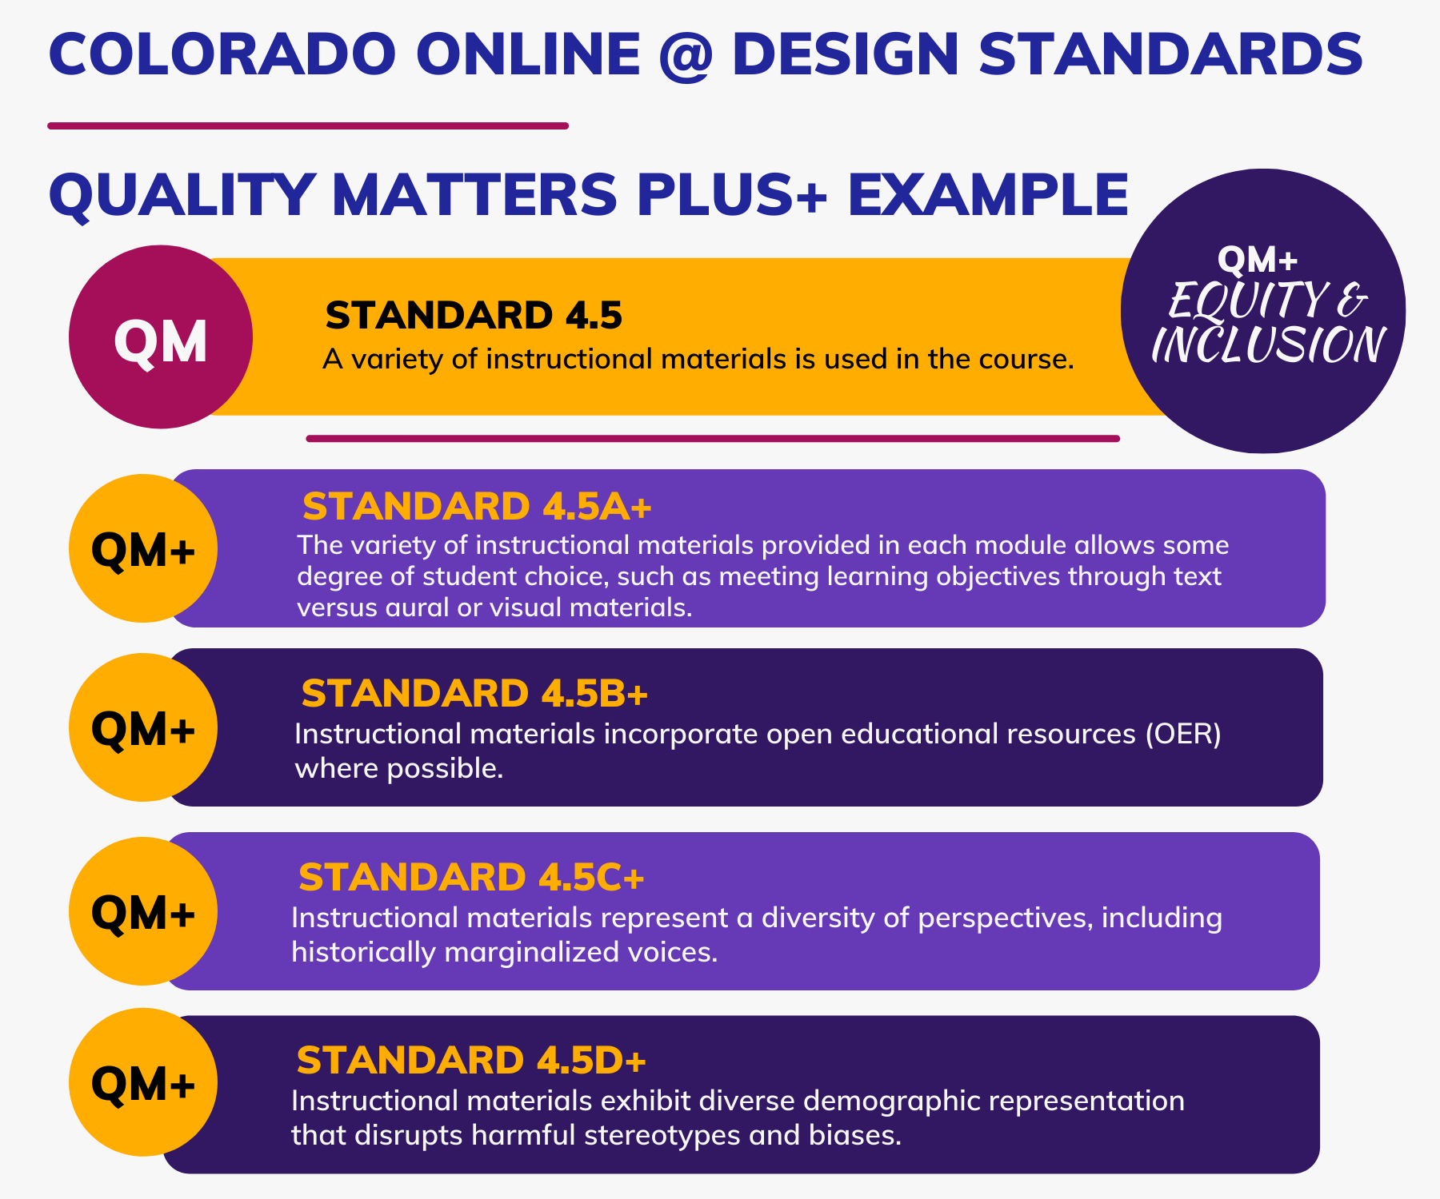
QM+ Example 4.5

Slide 6
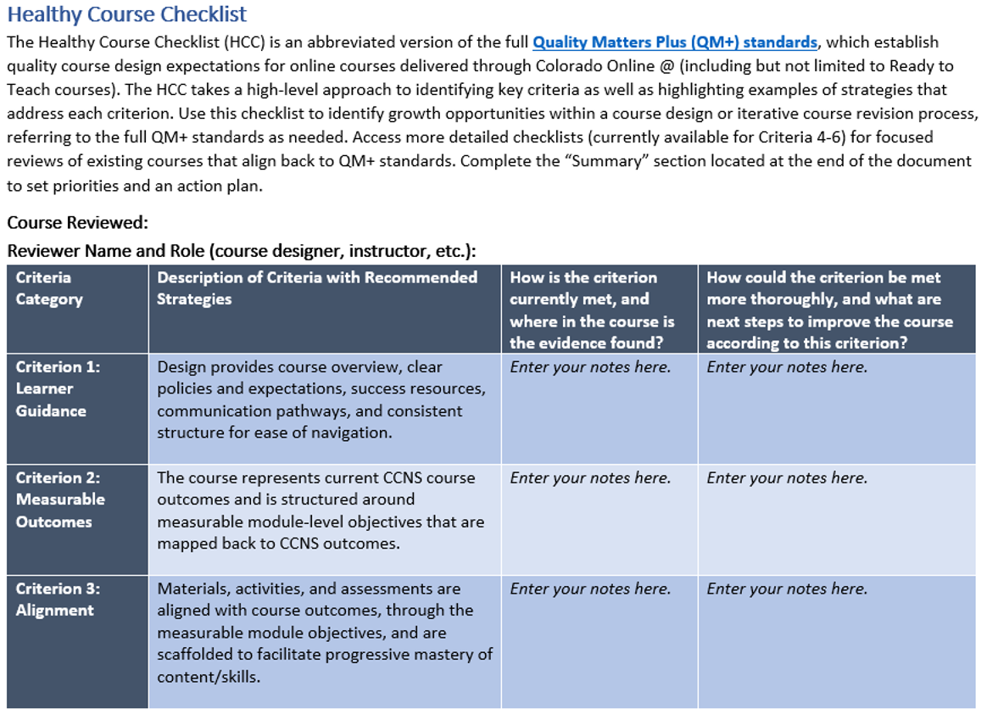
Healthy Course Checklist Screenshot1

Slide 7
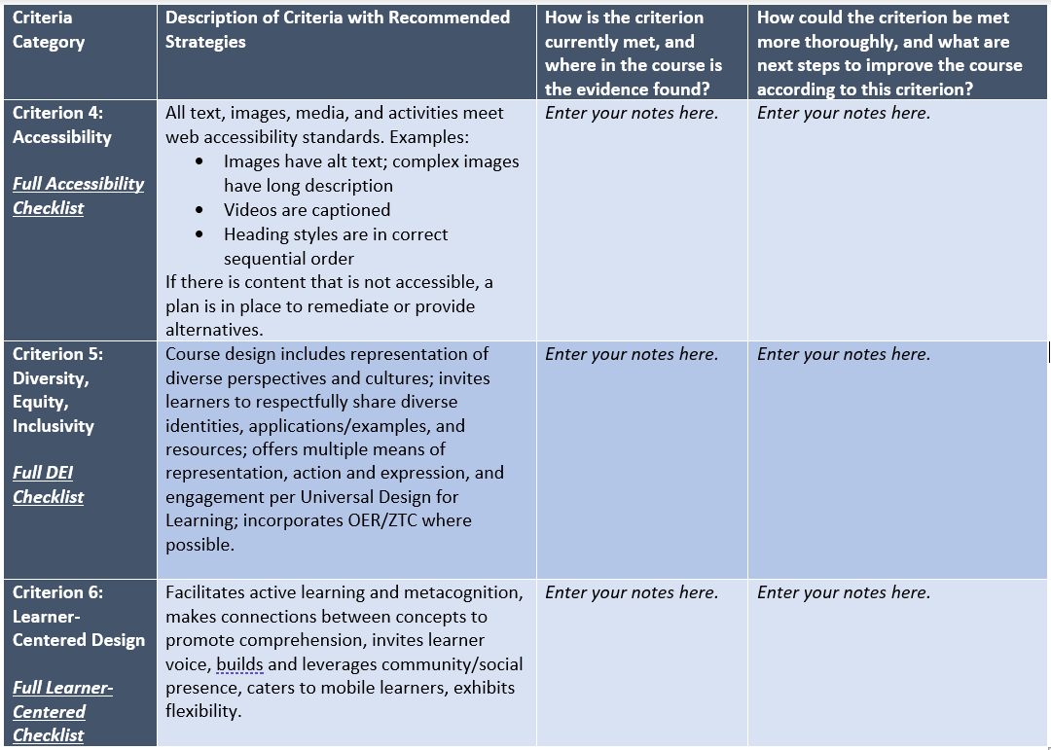
Healthy Course Checklist Screenshot2

Slide 8
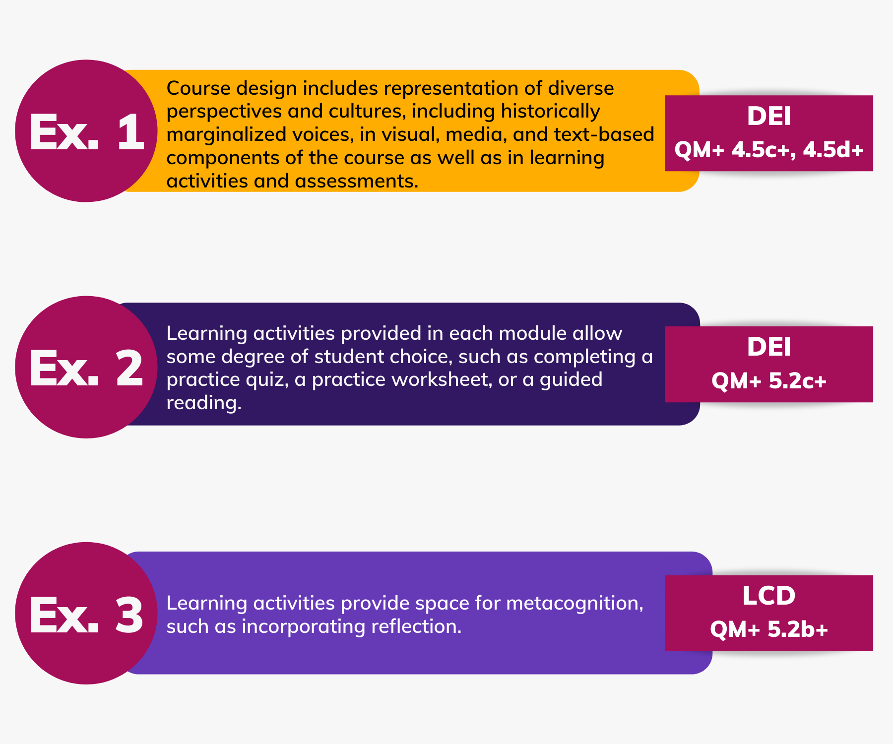
Standard Example 1

Slide 9
Standard Example 2

Slide 10
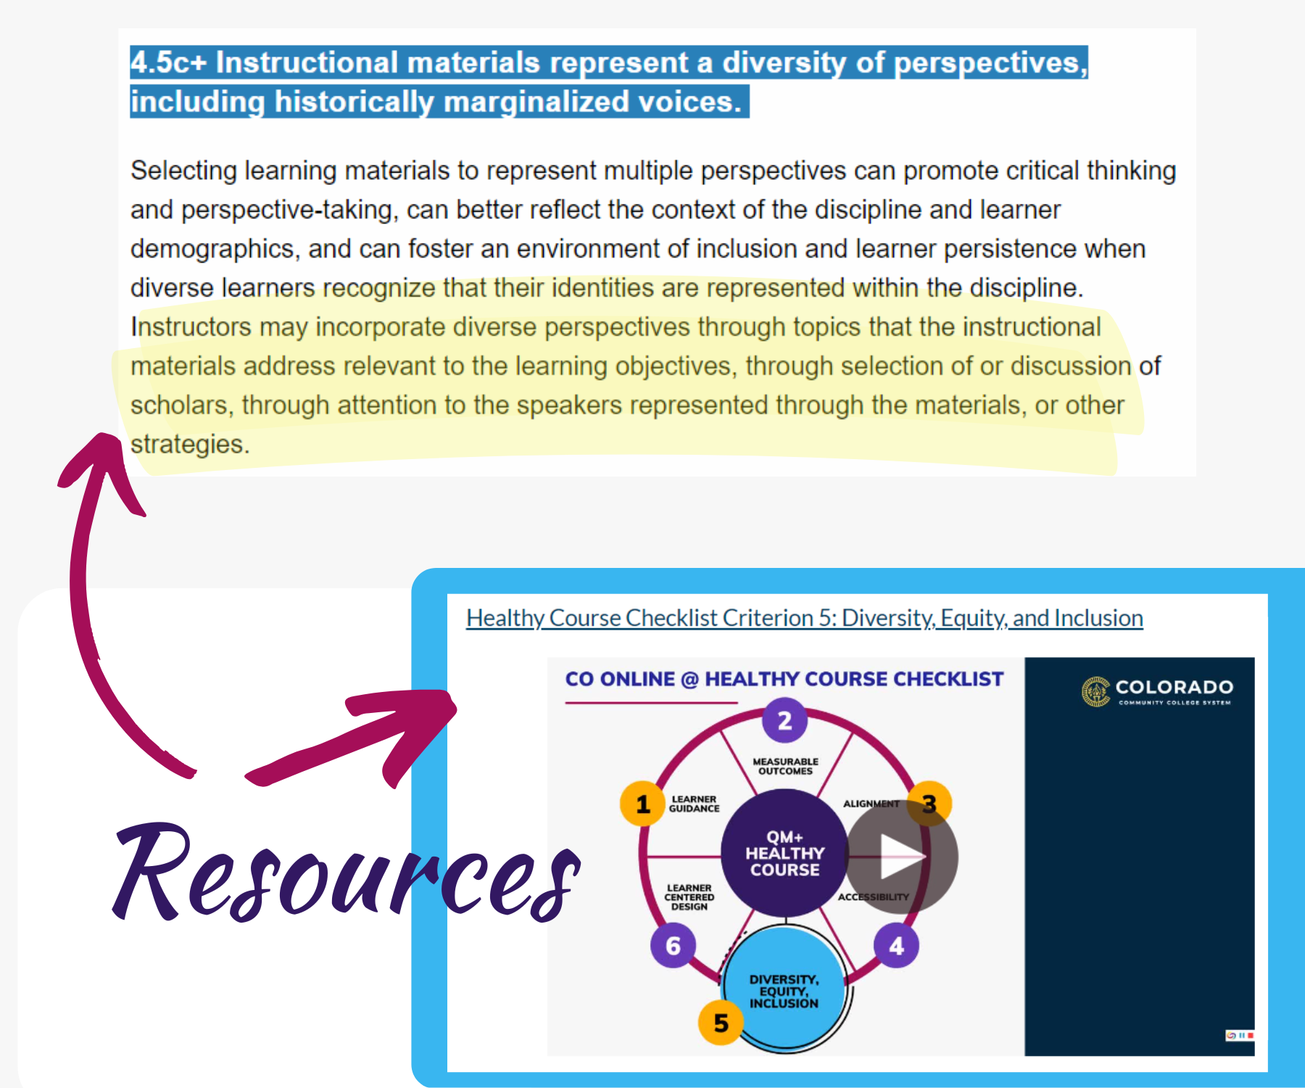
DEI Resources

Slide 11
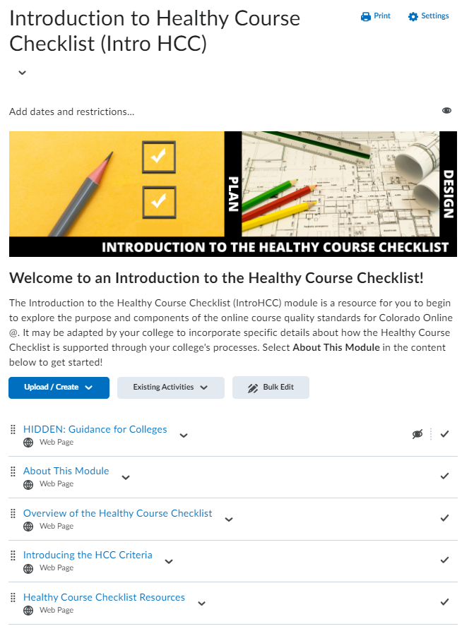
PD Resources1

Slide 12
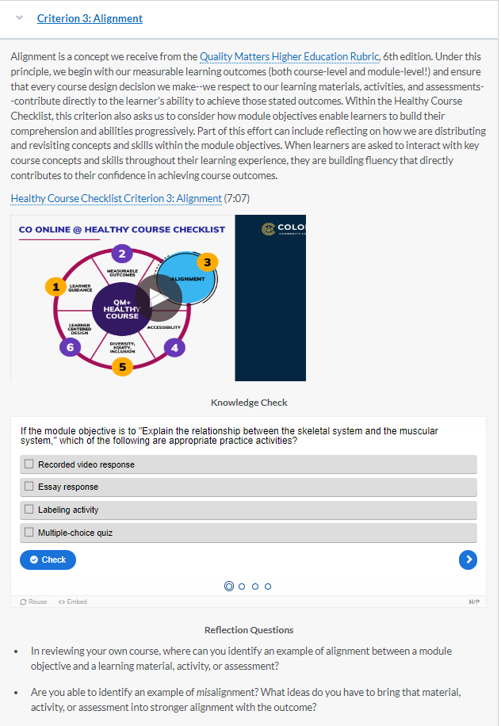
PD Resources2
QM+ training and support:
  Introduction to Healthy Course Checklist (Intro HCC)
  Applying the Healthy Course Checklist (APPHCC)
  QM+ Peer Mentor Training
  Healthy Course Checklist internal reviews
Partnered with QM training and resources:
  APPQMR
  Subscriber-managed reviews

Slide 13
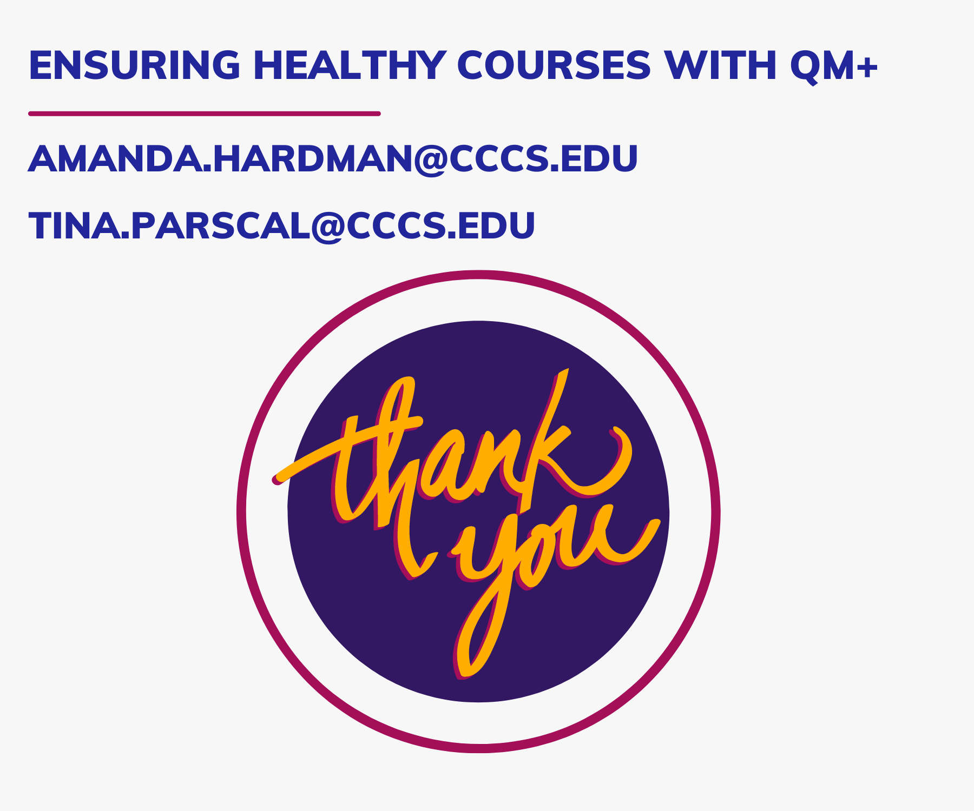
Thank You!
Notes:
Please contact us with any questions or thoughts: Amanda.Hardman@cccs.edu or Tina.Parscal@cccs.edu.

