Slide 1

Ensuring Healthy Courses with QM "Plus": Supporting Equitable Online Course Design
QM Quality in Action Conference
Tina Parscal, CCCS
Amanda Hardman, CCCS

Slide 2

Session Outcomes
Articulate the need for QM "plus" online course design standards to support equitable learner-centered learning experiences.
Demonstrate tools and resources to positively impact institutional culture around diversity, equity, and inclusion.

Slide 3
Colorado Online @ Consortium Goals
Rationale | Goals
Meet student needs | Ensure equity of access & success Improve ease of use for students
Compliance with accreditation criteria | College oversight, improve efficiency, leverage existing state online investments
Growing student demand for online learning | Increase capacity, grow enrollment Offer more fully online programs Increase workforce & noncredit options Attract new markets
Economic ability to serve current & future students | Reduce internal competition, become more competitive externally Increase revenue, improve use of resources at a lower cost to students
Support existing CCCS efforts | Expand opportunities via technology

Slide 4
Project Structure
Steering Committee
Collaborative and cross-functional
Subcommittees co-chaired by college and system reps
Project Team
Functional Groups & Consultants
Online Faculty & Instructor Advisory Committee
Academic Affairs
Technology
Learning Design
Learning Resources
Student Support Services
Course Scheduling
Curriculum and Instruction
Online Programs
Online Non-Credit Offerings
Faculty and student Support
LMS configuration and integrations
Business processes
Technology build for schedule and registration
Common navigation and course design elements
Common course quality standards
Collaborative development process and ready-to-teach courses
Training/ support for faculty and students
Library
OER
Course materials: Books, supplies, lab kits, publisher content
Student registration interface and business processes
Transcripting
Advising
Other student support services

Slide 5
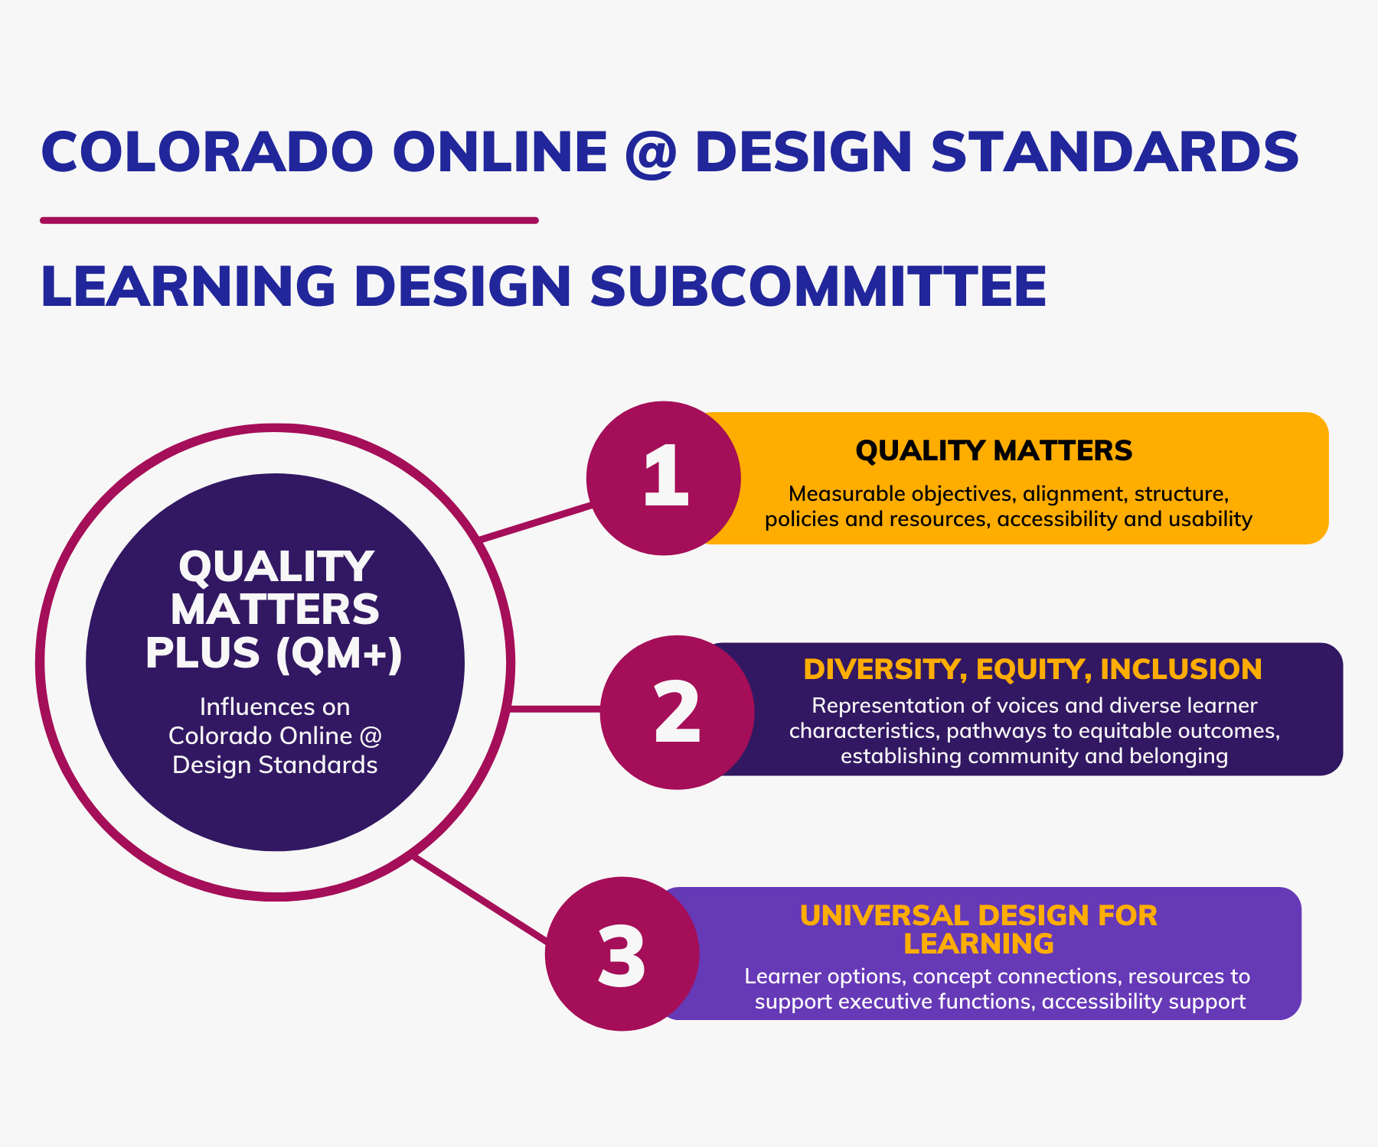
Influences on QM+

Slide 6
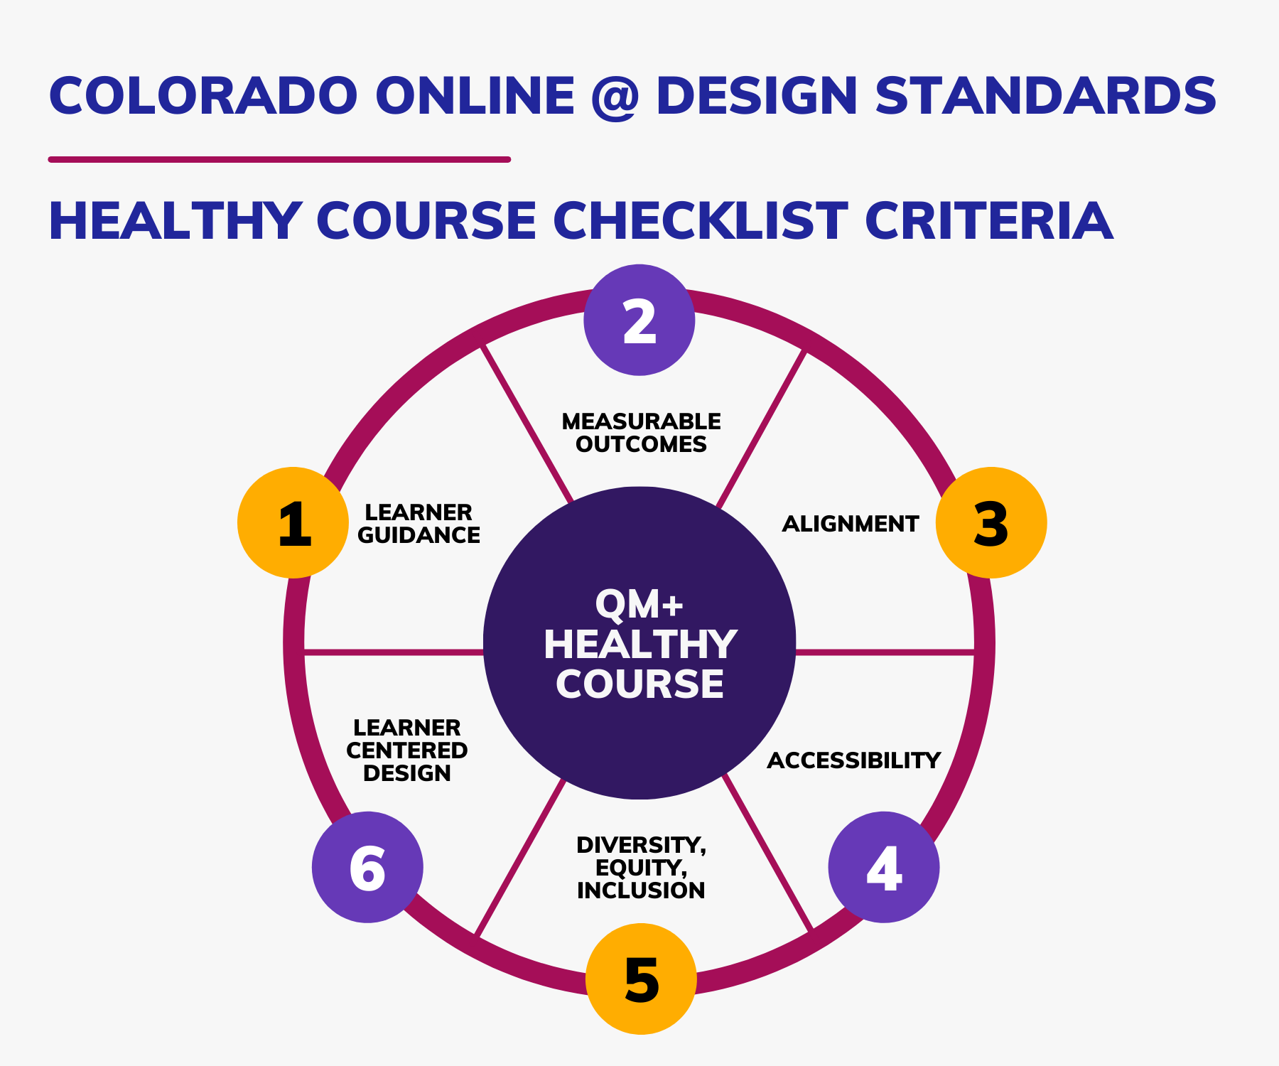
Healthy Course Checklist Criteria

Slide 7
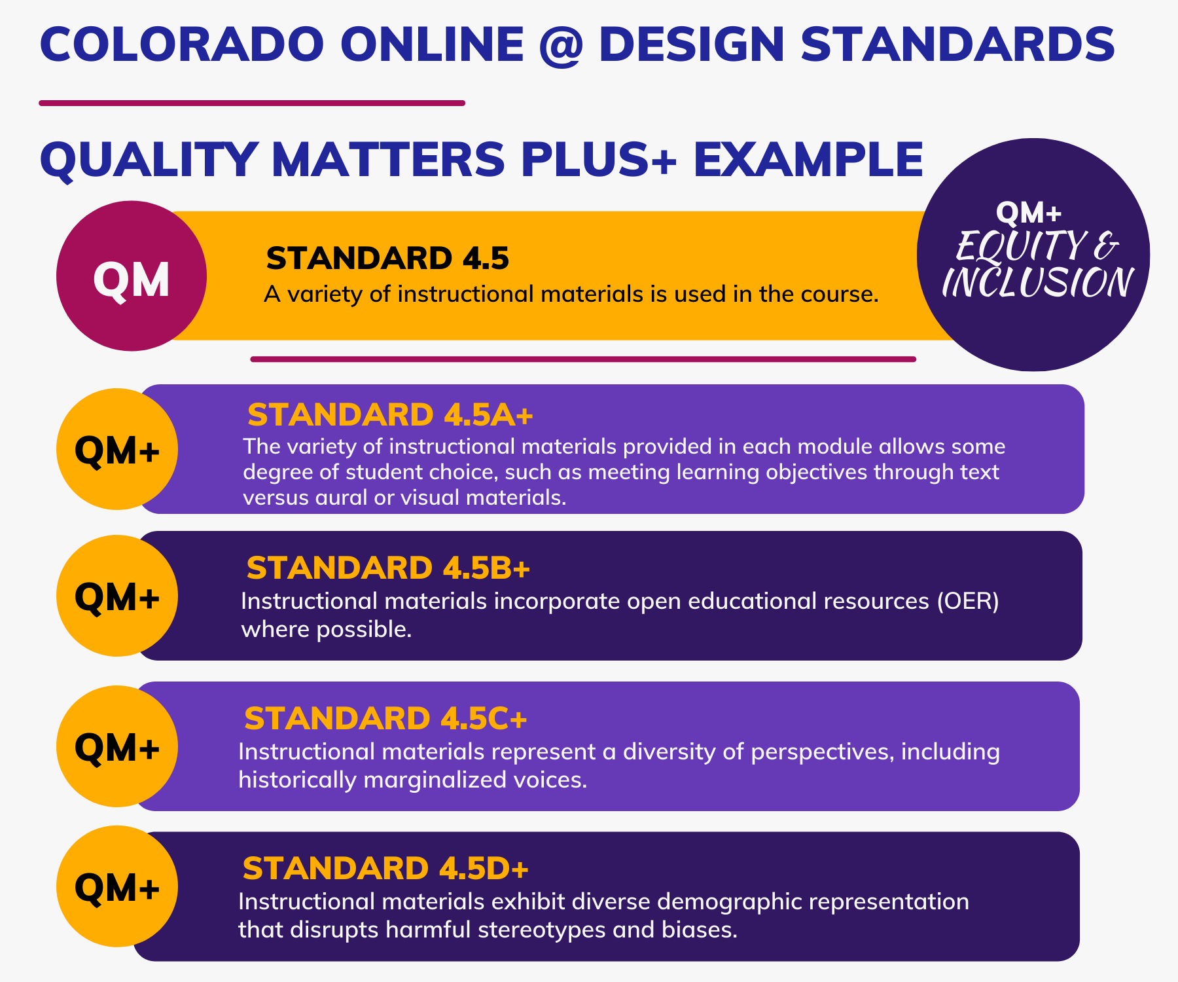
QM+ Example 4.5

Slide 8
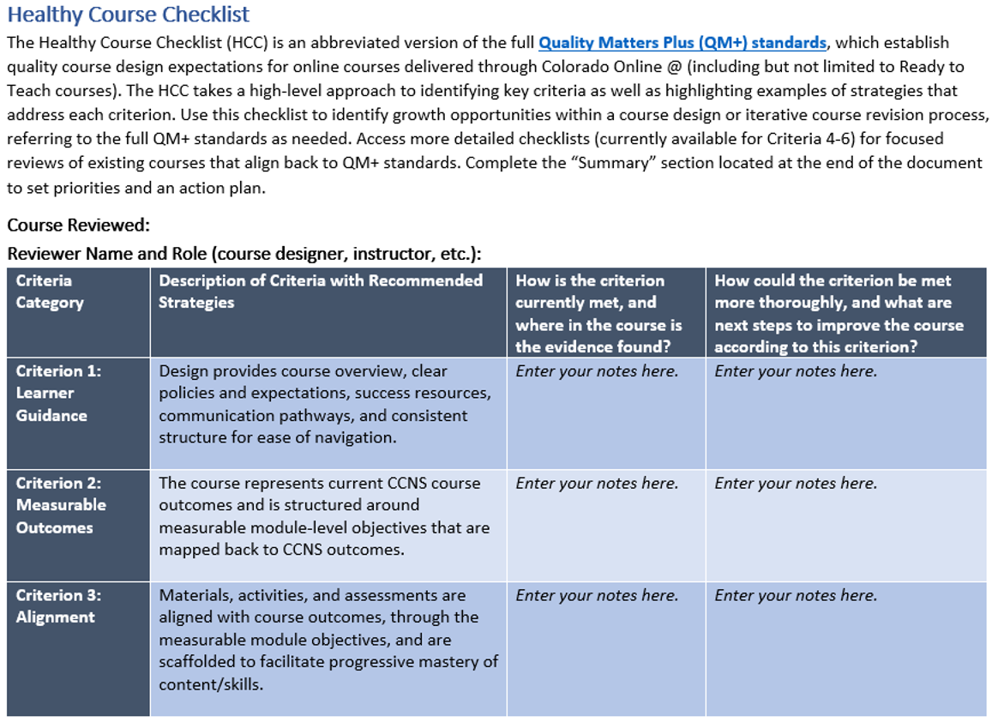
Healthy Course Checklist Screenshot1

Slide 9
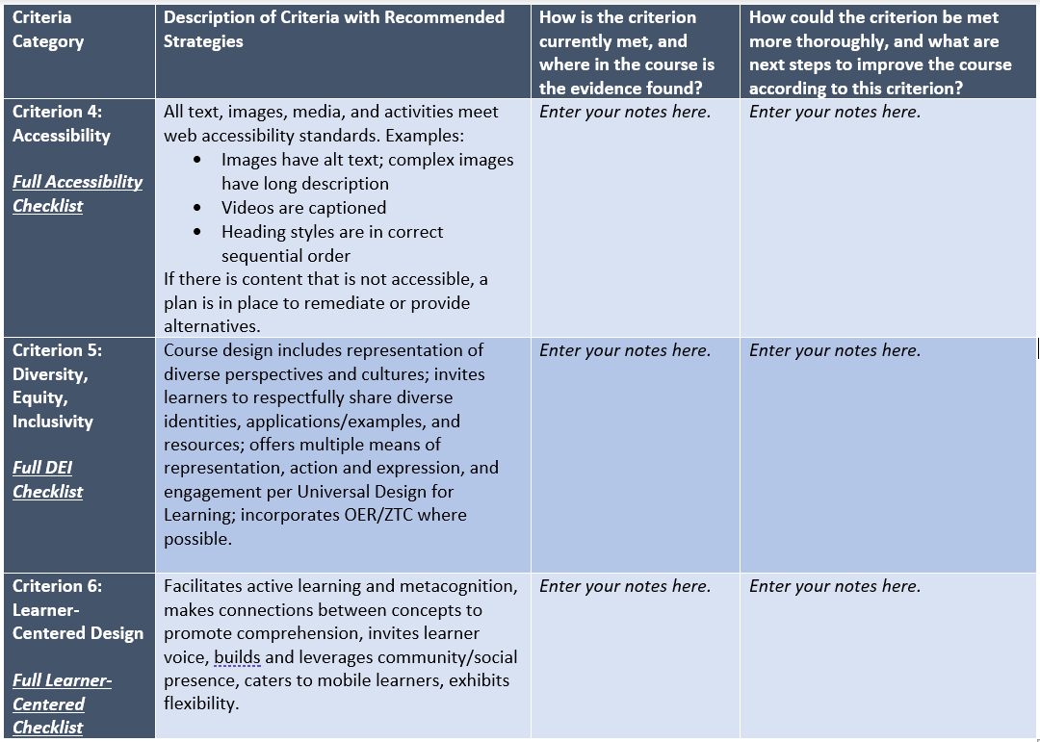
Healthy Course Checklist Screenshot2

Slide 10
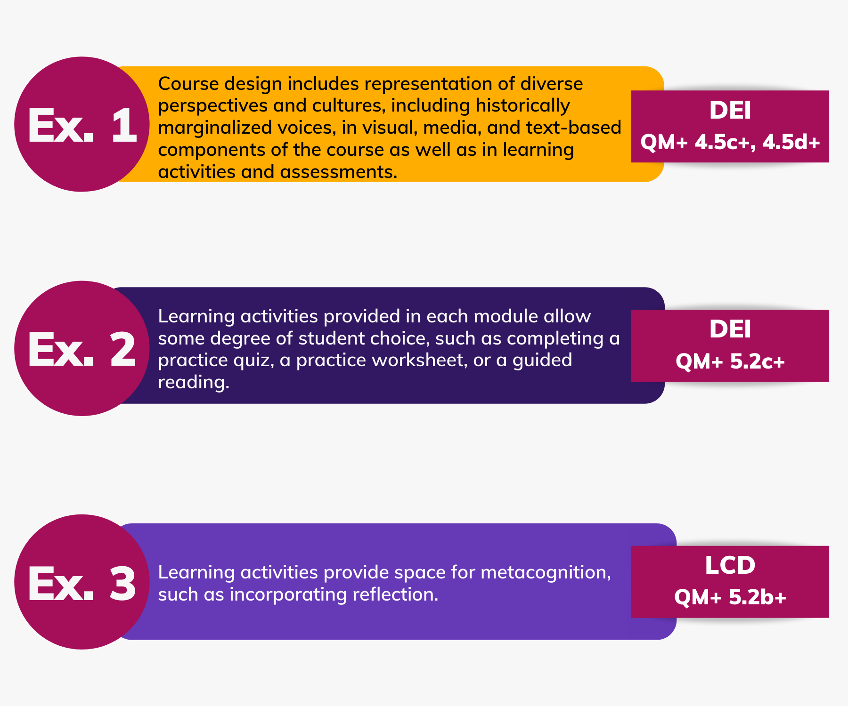
Standard Example 1

Slide 11
Standard Example 2

Slide 12
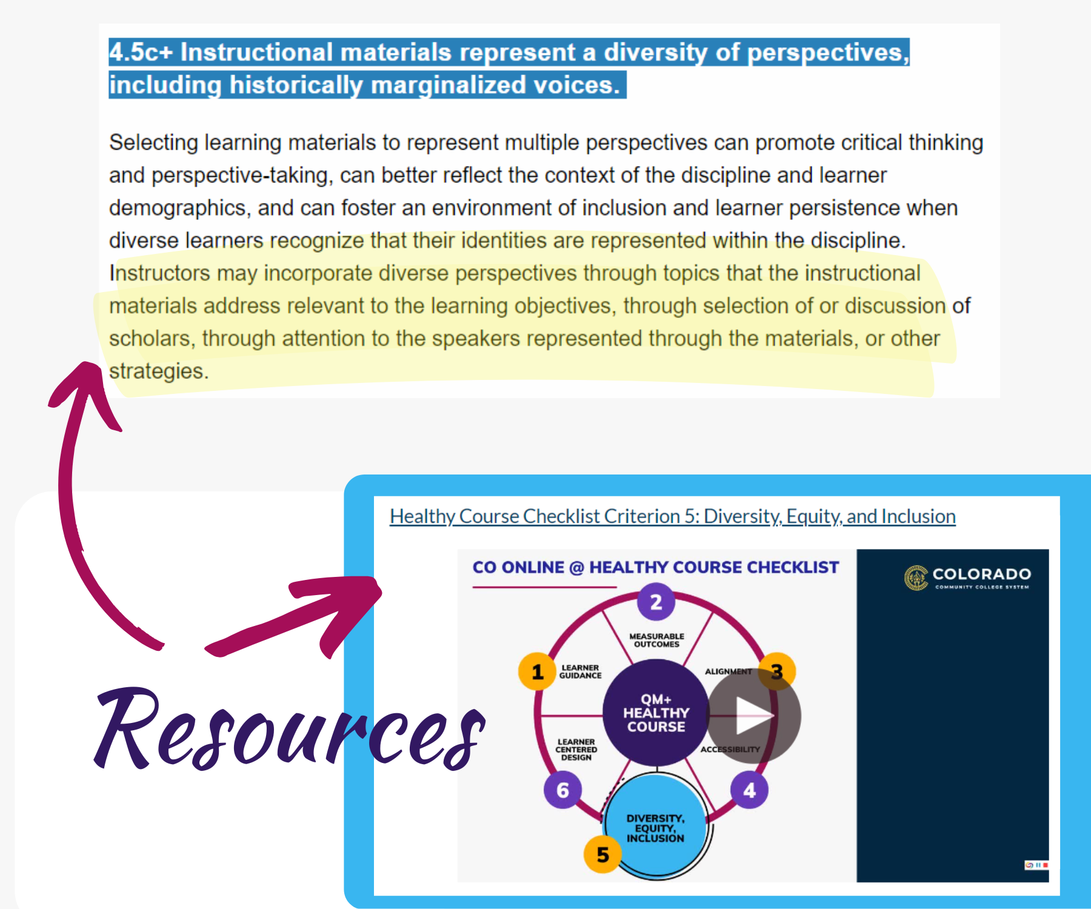
DEI Resources

Slide 13
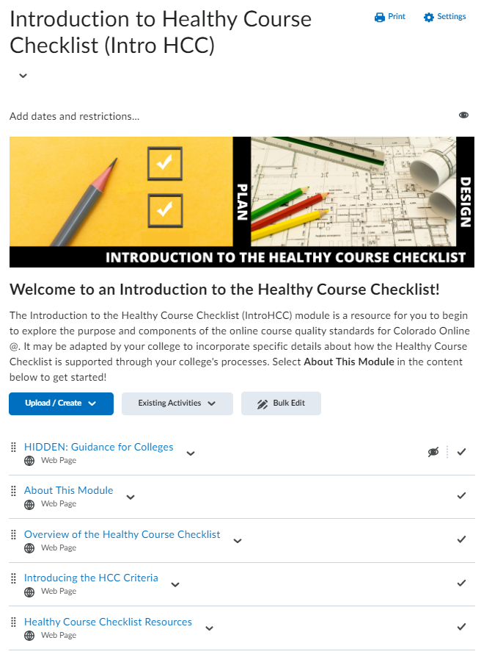
PD Resources1

Slide 14
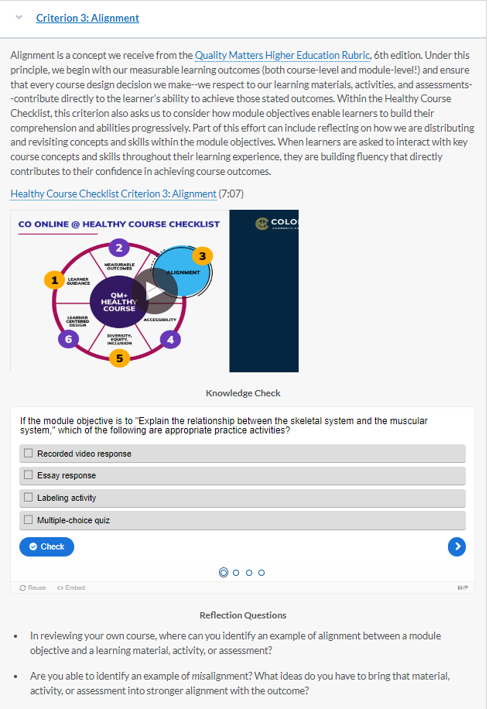
PD Resources2
Text
Video
Knowledge Check
Reflection Prompts

Slide 15
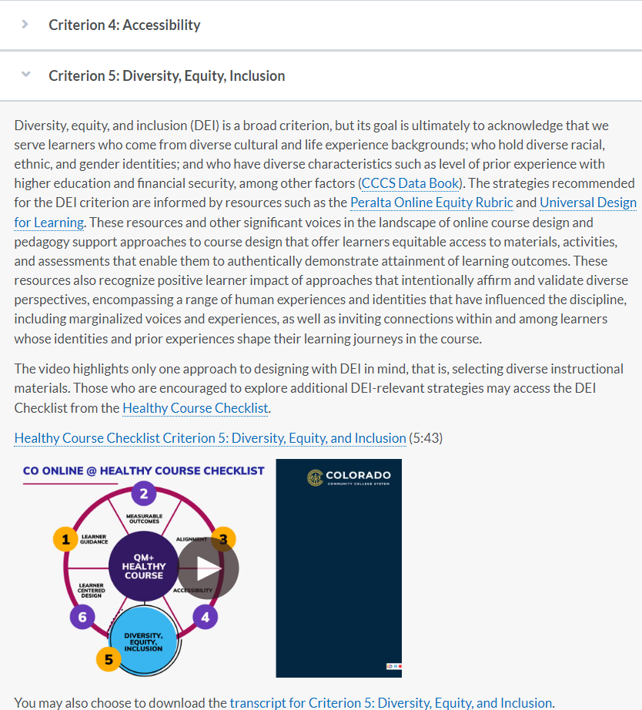
PD Resources3
CCCS training and support
Partner with QM training and resources

Slide 16
Successes and Challenges Moving Forward
Change is an iterative process
Trust is earned and refreshed on an ongoing basis
Current considerations:
  How can we balance the desire for a longer-range QA plan with more immediate needs of the Colorado Online transition?
  How do we promote stronger buy-in from faculty stakeholders that address concerns about QA (role of centralized unit vs. college, role of QA vs. teaching evaluation, etc.)?

Slide 17
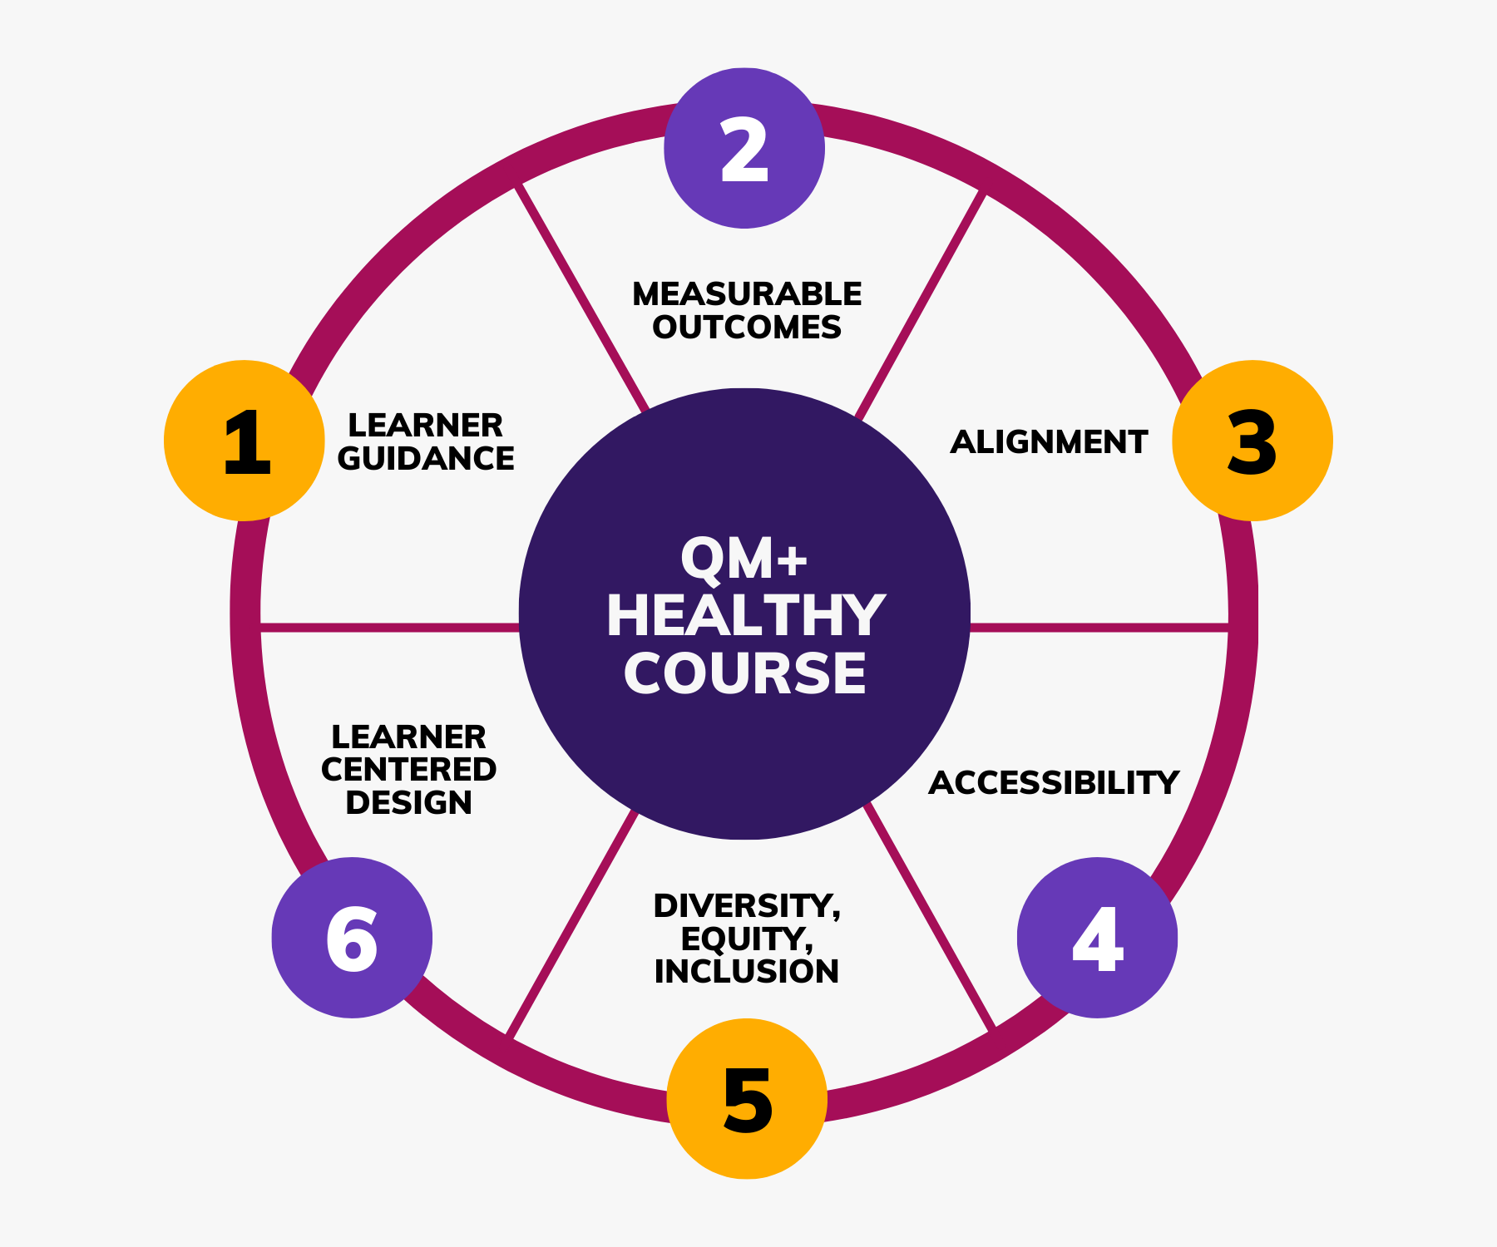
Questions?

Slide 18
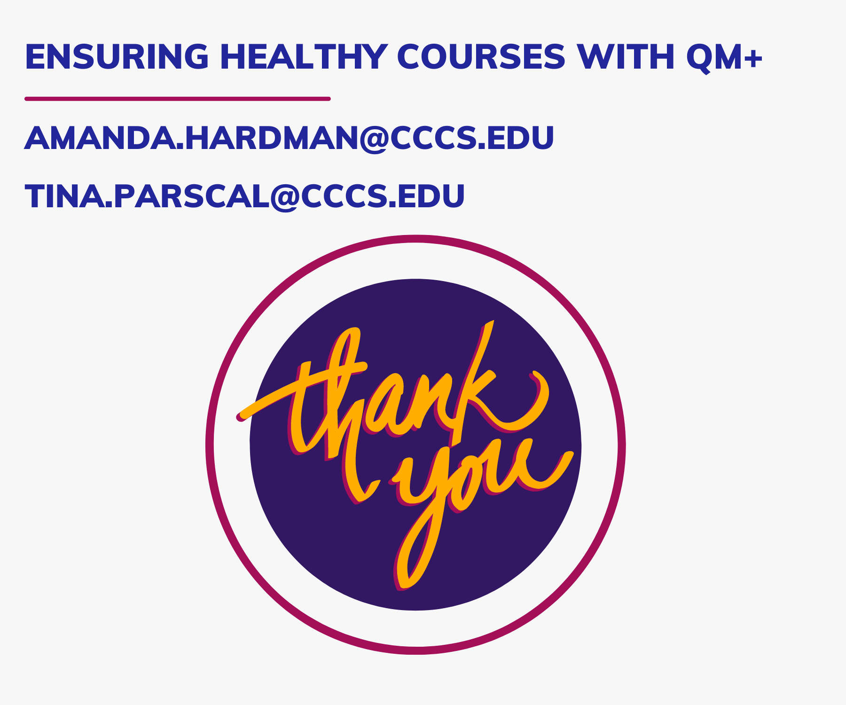
Thank You!

