Slide 1


Slide 2



CHLOE 3 Co-Directors
Ron Legon, CHLOE Co-Director
Executive Director Emeritus, Quality Matters
rlegon@qualitymatters.org
Eric Fredericksen, Contributing Editor
Associate Vice President for Online Learning and Associate Professor, University of Rochester
Eric.fredericksen@rochester.edu
Mughees Khan
Eduventures Senior Quantitative Analyst
MKhan@eduventures.com
CHLOE 3 SPONSORS
Platinum Sponsor
Sponsors

Slide 3
Agenda
Online Enrollment & the CHLOE Sample
Course/Program Structure and Student Engagement
Leadership and Governance
Contrasting Online Learning Models
New Topics in the CHLOE 4 Survey
Q & A

Slide 4
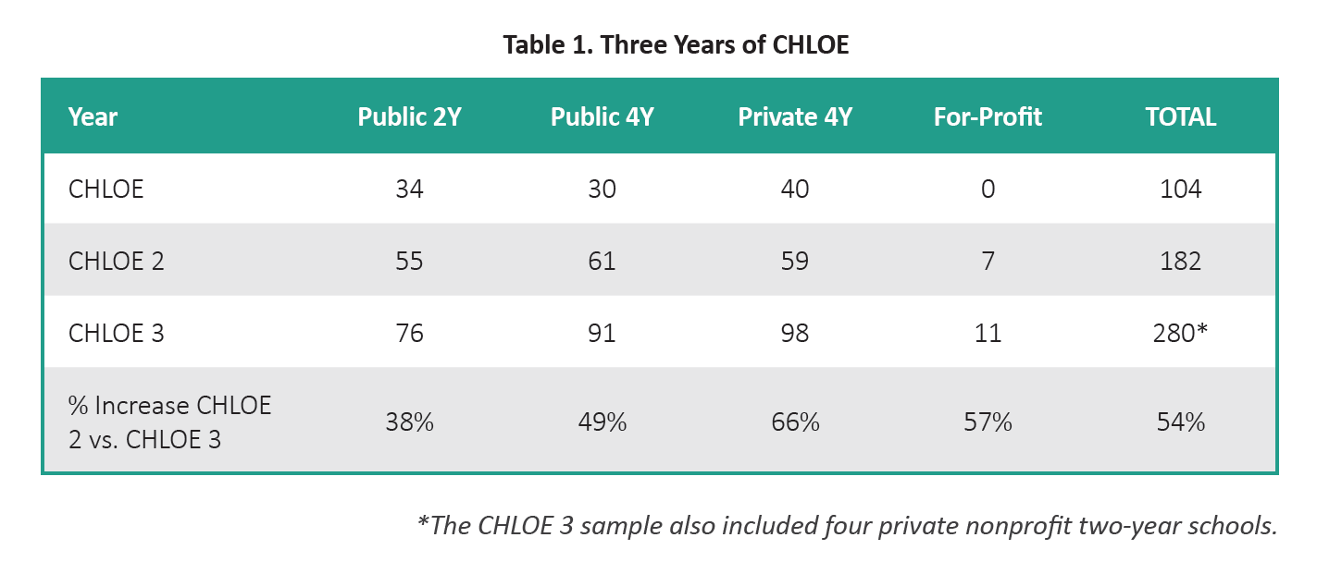
The CHLOE Sample Is Growing…

Slide 5
CHLOE 4 Survey Data Collection
Web-based survey administered in Qualtrics
Some Pros of Collection Method
  Allows for complex survey questions (pick and rank questions, sliding scales)
  Allows for survey respondents to save progress and return at a later point
  Can customize which questions are displayed to respondents
  Some Challenges
  Response rate and sampling
  Interpreting non-responses

Slide 6
Agenda
Online Enrollment & the CHLOE Sample
Course/Program Structure and Student Engagement
Leadership and Governance
Contrasting Online Learning Models
New Topics in the CHLOE 4 Survey
Q & A

Slide 7
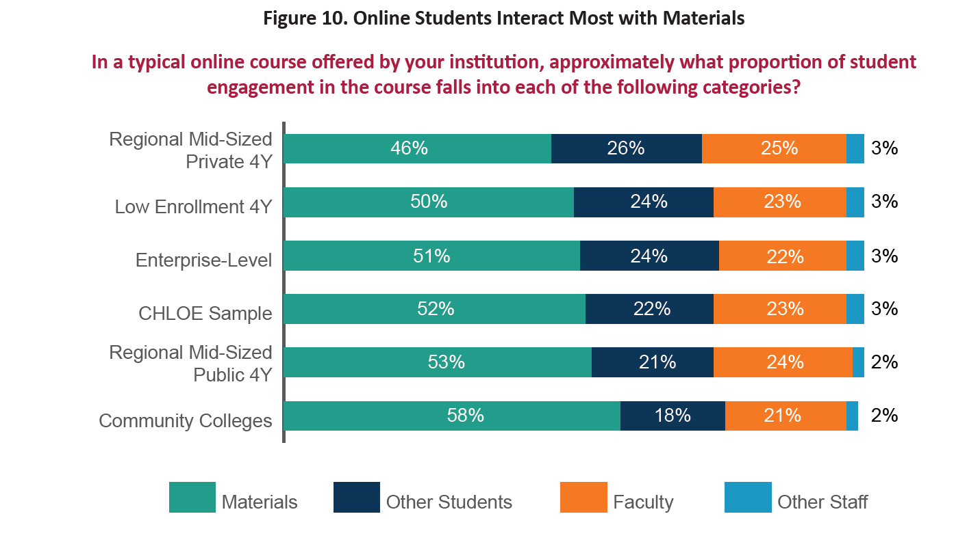
The typical online student experience

Slide 8
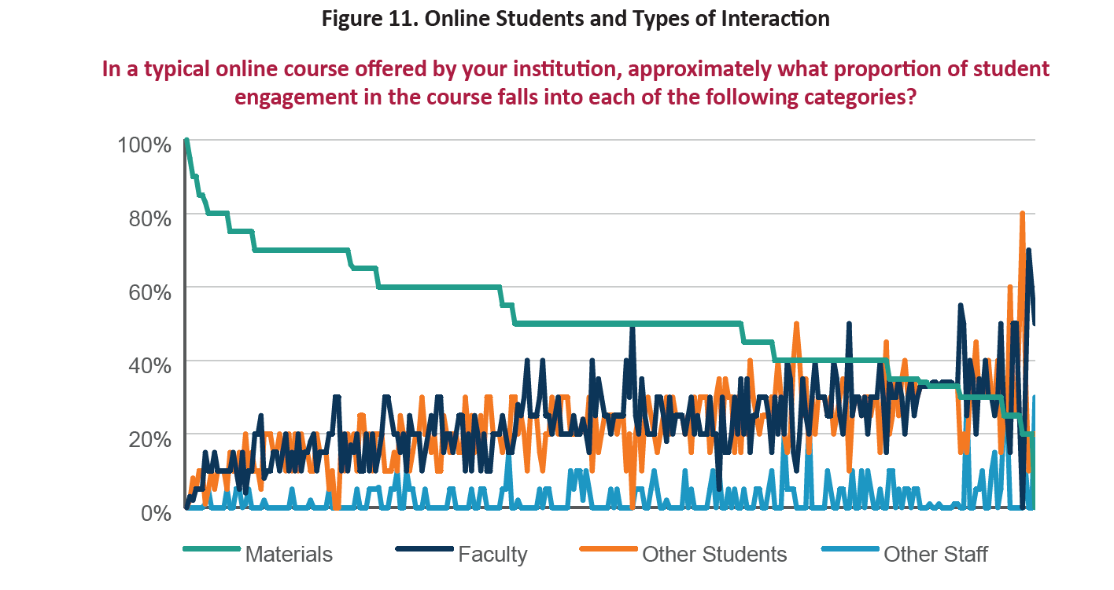
Online student experience possibilities…

Slide 9

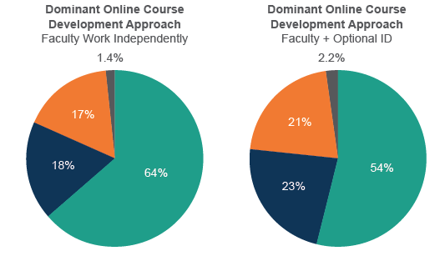
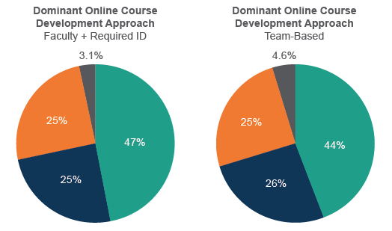

Slide 10
Agenda
Online Enrollment & the CHLOE Sample
Course/Program Structure and Student Engagement
Leadership and Governance
Contrasting Online Learning Models
New Topics in the CHLOE 4 Survey
Q & A

Slide 11
How do you and your institution define the scope of online learning for your (COO) position?
Universities (2016-2017)
Community Colleges (2017-2018)

Slide 12
Has your institution used your online learning efforts as a catalyst for organizational changes?
Universities (2016-2017)
Community Colleges (2017-2018)

Slide 13
Chief Online Officer (COO) Reporting Lines

Slide 14
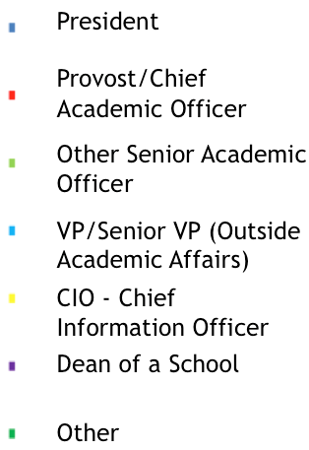
Whom do you report to?
Universities (2016-2017)
Community Colleges (2017-2018)

Slide 15
In what year was the current Chief Online Officer appointed?

Slide 16
Was the current Chief Online Officer recruited from the outside the institution or promoted from within ?

Slide 17
Chief Online Officer Roles
More than 90% lead or share responsibility for the following online issues: Lead Responsibility
      Online Faculty Training 66%
      Instructional Design for Online Courses 65%
      Coordination with Academic Units 61%
      Online Policy Development 58%
      Online Quality Assurance 56%
      Online Course Development 51%
      Strategic Planning 43%

Slide 18
More Chief Online Officer Roles
External Representation 48% lead
Budgeting Online Functions 46%
LMS Support/Administration 46%
Regulatory Compliance 46%
Contracting with External Providers 41%
Orientation of Online Students 40%
Selection of LMS and Online Tools 39%
Data Gathering and Reporting 34%
Online Support Services 31%
Online Program Development 29%
Online Technical Support 27%
Accessibility 22%
More than 75% also lead or share responsibility for the these online issues:

Slide 19
Dedicated Online Committees & Councils

Slide 20
Roles of Online Committees/Councils
Advisory rather than determinative in most cases
4 most commonly cited issues they address:
  Setting online policies (22% determinative)
  Strategic planning for online learning (12%)
  Coordination across programs and schools (7%)
  Technology acquisition (5%)
Relationship of committees/councils with Chief Online Officers
  The COO chairs or co-chairs 60% of the time
  The COO serves as a member in a third of the remaining cases
  Several COOs report to their committee

Slide 21
Control of Online Programs & Support Services

Slide 22
Agenda
Online Enrollment & the CHLOE Sample
Course/Program Structure and Student Engagement
Leadership and Governance
Contrasting Online Learning Models
New Topics in the CHLOE 4 Survey
Q & A

Slide 23
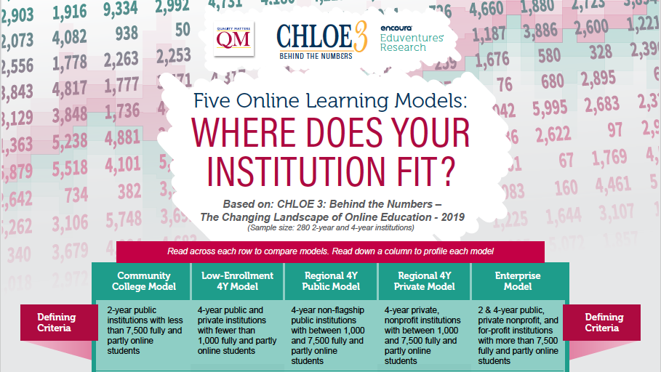

Slide 24
What is Greatest Source of Online Competition by Model?
Local Regional National
Community Colleges | 4Y Low Enrollment | Regional 4Y Public | Regional 4Y Private | Enterprise 2Y and 4Y

Slide 25
Who Has the Highest Proportion of Fully Online Students?
Partly Online Fully Online
Community Colleges | 4Y Low Enrollment | Regional 4Y Public | Regional 4Y Private | Enterprise 2Y and 4Y
Notes:
Despite emphasis on building fully online programs (except in community colleges), only regional private institutions report having more fully online students than those opting for a mix of online and on-ground courses

Slide 26
Who Has the Highest Proportion of Online Grad Students?
Undergraduate Graduate
Community Colleges | 4Y Low Enrollment | Regional 4Y Public | Regional 4Y Private | Enterprise 2Y and 4Y
Notes:
Only regional privates enroll more online graduate students than undergraduates

Slide 27
How Are Online Students Performing vs. On-Ground?
Online Better Online Same Online Worse
Community Colleges | 4Y Low Enrollment | Regional 4Y Public | Regional 4Y Private | Enterprise 2Y and 4Y

Slide 28
Who Requires Instructional Design Support for Faculty?
Community Colleges | 4Y Low Enrollment | Regional 4Y Public | Regional 4Y Private | Enterprise 2Y and 4Y

Slide 29
More Emphasis on Online Courses or Full Online Programs?
Full Programs Both Equally Courses Wide Variation
Community Colleges | 4Y Low Enrollment | Regional 4Y Public | Regional 4Y Private | Enterprise 2Y and 4Y

Slide 30
Who Is Investing in Alternative/Micro-Credentials?
Major Investment Some Investment Experimenting Some Interest No Interest
Community Colleges | 4Y Low Enrollment | Regional 4Y Public | Regional 4Y Private | Enterprise 2Y and 4Y

Slide 31
Agenda
Online Enrollment & the CHLOE Sample
Course/Program Structure and Student Engagement
Leadership and Governance
Contrasting Online Learning Models
New Topics in the CHLOE 4 Survey
Q & A

Slide 32
New and Expanded Topics in the CHLOE 4 Survey
Pros and cons of centralized vs. distributed support functions
Five year goals for the COO and for Online Learning at their institution
Relationship between the COO and other senior administrators
Preparing faculty to teach online
Academic honesty, proctoring and student authentication practices
Accessibility compliance
Updated findings on the use of online program managers (OPMs)
Updated findings on revenue generation and distribution processes
Contact bburch@qualitymatters to participate

Slide 33
Agenda
Online Enrollment & the CHLOE Sample
Course/Program Structure and Student Engagement
Leadership and Governance
Contrasting Online Learning Models
New Topics in the CHLOE 4 Survey
Q & A

Slide 34
Thank you!
Chief online officers wishing to participate in the CHLOE 4 Survey who have not taken part in the previous CHLOE surveys should contact:
Barbra Burch
Manager of Research and Development
Quality Matters
bburch@qualitymatters.org

