Slide 1

Calming the Waves,
Navigating a Sea of Reluctance
Presented by:
Elizabeth Rodriguez
Director, eLearning & Instructional Innovation Center
Laredo Community College

Slide 2
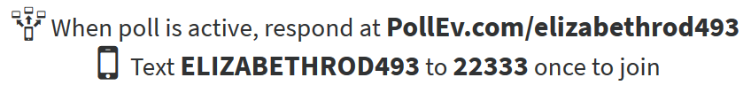
www.polleverywhere.com
In one word, describe the way your
faculty feel when initially learning about
Quality Matters.

Slide 3
QM Implementation Process
Fall 2014 - joined TXQM Consortium and began training staff on QM Process
Quality Matters Advisory Committee (QMAC) established
Timeline approved by administration and distributed to faculty
APPQMR Trainings (Face-to-face and Online)

Slide 4
QM Consultation Process
Increases awareness and encourages faculty to begin applying the QM Rubric
Consists of one-on-one meetings with faculty to evaluate course design
Sets a hands-on, caring tone for the hard work of applying the QM Rubric

Slide 5
QM Faculty Recognition
Upon completion of the Applying the QM Rubric Workshop, faculty receive a Certificate of Accomplishment
When official certification is awarded, congratulatory emails go out to faculty and administration are copied

Slide 6
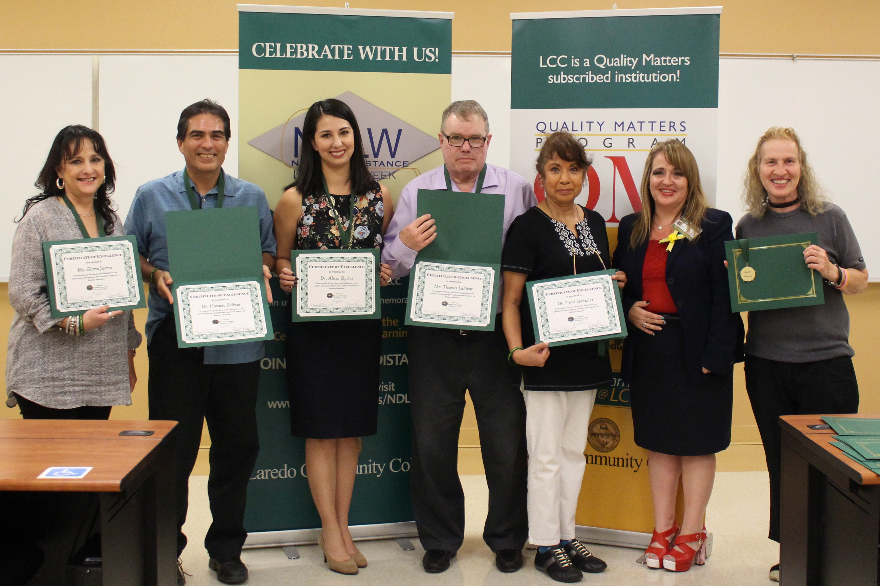
QM Faculty Recognition
National Distance Learning Week award ceremony (certificates of excellence and medals)
QM Seal applied to certified courses

Slide 7
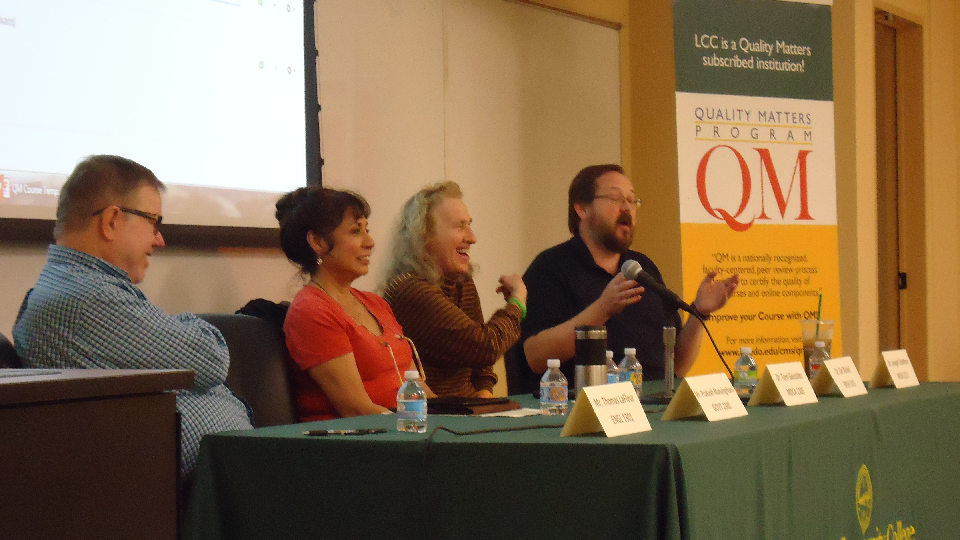
QM Forum
Peer encouragement
Opportunity to hear colleagues’ experiences
Occasion to ask questions about the process

Slide 8
QM Template Request Form
http://www.laredo.edu/cms/QMcoursedesign/

Slide 9
QM Template Live Demo
QM Template: https://laredo.instructure.com/courses/1378180
QM Certified Course designed using QM Template: https://laredo.instructure.com/courses/1353370

Slide 10
Faculty feedback and perspective

Slide 11
How did you feel when you learned of the Quality Matters process at LCC?
My first reaction, I have to admit, was negative. I perceived it to be a way for others to micromanage how we teach our classes.
- Dr. Jose A. Ramirez (HIST 1301 & 1302)

Slide 12
How did you feel when you learned of the Quality Matters process at LCC?
I felt overwhelmed when I heard about the two-week Applying the QM Rubric Workshop. While it was a time-consuming process, in retrospect I felt good receiving the certificate of completion.
Working on my online course to get it certified was very stressful, because following the rubric booklet was complex and required more attention to detail.
- Dr. Cin Bickel (SPCH 1311 & 1315)

Slide 13
How did you feel when you learned of the Quality Matters process at LCC?
I felt that good things were going to happen for LCC online students. Quality Matters can make any online course much better in relatively a short period of time, especially when working with Ms. Elizabeth Rodriguez. She is an expert in the field!
- Dr. Mikolaj Gorecki (MUSI 1306)

Slide 14
How did you feel when you learned of the Quality Matters process at LCC?
At first I was overwhelmed with the information. However, as soon as I began to apply the process and elements into my online course design, I was able to see the purpose and importance of implementing Quality Matters. I see a major difference in my new courses.
- Humberto Cardenas (ENGL 1301 & 1302)

Slide 15
How do you feel now that your course is QM Certified?
After receiving official QM certification, I feel that having QM certification has raised the level of clarity and understanding of my online course content and will improve student success.
- Dr. Cin Bickel (SPCH 1311 & 1315)

Slide 16
How do you feel now that your course is QM Certified?
In retrospect, I see that QM is simply a way of guiding us in how we structure our courses for optimum efficiency and fairness, but that the content remains entirely ours to select and deliver however we choose.
- Dr. Jose A. Ramirez (HIST 1301 & 1302)

Slide 17
How do you feel now that your course is QM Certified?
Students enrolled in my QM Certified course have considerably fewer questions regarding the organization of my course content. The newly designed modules are very helpful and give students easier and faster access to important information.
- Dr. Mikolaj Gorecki (MUSI 1306)

Slide 18
How do you feel now that your course is QM Certified?
After all my hard work, I felt overwhelmed with joy. I am QM certified in both my composition courses and it motivated me to work on getting my third course certified as well. I want to make sure that I cover all elements of QM.
After going through this process, it has inspired me to become a Peer Reviewer and evaluate other courses in my field.
- Humberto Cardenas (ENGL 1301 & 1302)

Slide 19
Questions?
Comments?

Slide 20
Elizabeth Rodriguez
Director, eLearning & Instructional Innovation Center
Laredo Community College
elizabeth.rodriguez@laredo.edu
Thank You! 😊

