Slide 1
Change the GAME!
Using Adobe Connect and Rubrics to
Deliver Hybrid Quality in Your Online Course

Slide 2
Agenda
Who’s the Speaker?
Course Design
Key QM Standards
Results
Adobe Connect
Grading Rubrics
Discussion

Slide 3
Michael A. Brown Sr.
Air Force Retiree – 24 years in uniform
40-plus years of military and civilian PR experience
PhD in Public Administration and Urban Policy, International Business
Deputy Director, Public Affairs, for a military organization at Fort Eustis, Virginia
Adjunct Professor, Florida Institute of Technology and Florida International University
Author

Slide 4





http://www.igi-global.com/video/examining-changing-role-communication-digital/176486
http://www.igi-global.com/book/motivationally-intelligent-leadership/181457
http://www.igi-global.com/book/solutions-high-touch-communications-high/16794
http://www.igi-global.com/book/social-media-performance-evaluation-success/169445
https://www.amazon.com/Social-Media-4EVR-Identifying-Achieving/dp/1492858919

Slide 5
Course Design
Imitate or create a hybrid format to enhance learning
Chat sessions identify common problems to enhance success
Grading rubrics used to enhance coverage of requirements
  Grade yourself on the criteria the professor will use
Welcome video to enhance the ability to reach all students

Slide 6
Key QM Standards
General Standard 1 (GS1): Make the overall course design clear to the learner at the start of the course.
  Set a positive tone
  Let them know what to expect
  Guidance helps learners get off to a good start
STANDARD 1.1 (S1.1): Clear instructions on how to get started and where to find various course components.

Slide 7
Key QM Standards (continued)
General Standard 5 (GS5): Focus on learner interaction to promote active learning.
  Facilitate and support learner engagement
  Energize the learning process
  Promote learner persistence
  STANDARD 5.1 (S5.1): Activities promote achievement of the stated learning objectives or competencies
  STANDARD 5.2 (S5.2): Activities are opportunities for interaction that support active learning.

Slide 8
Key QM Standards (again)
General Standard 6 (GS6): Course technologies support learners' achievement of course objectives or competencies
STANDARD 6.1 (S6.1): Use of mandatory Adobe Connect sessions to emphasize the various course components facilitate rather than impede the learning process.
STANDARD 6.2 (S6.2): Course tools promote learner engagement and active learning.

Slide 9
Addressing QM Standards
Course design improvements suggested by QM Standards
  Instructor’s welcome video provides syllabus overview
  Use Blackboard to assess the students’ grasp of blogs and online interactivity
  Changed the grade to include answering other blogs
  Interactive discussions based on learning objectives added

Slide 10
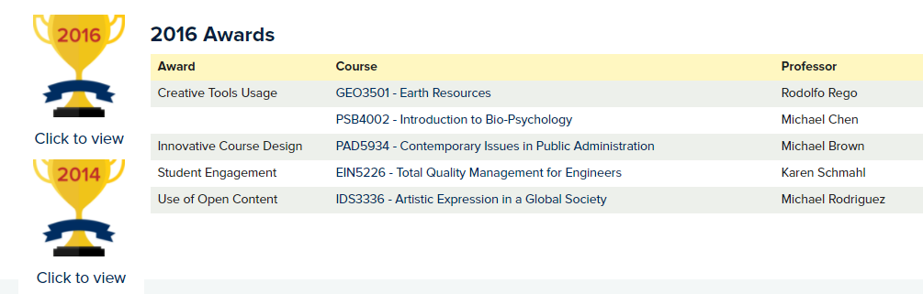



RESULT: Quality Matters Recognition
QM is a faculty-centered, peer review process that is designed to certify the quality of online and blended courses. QM is a leader in quality assurance for online education and has received national recognition for its peer-based approach and continuous improvement in online education and student learning. The Quality Matters Rubric is research supported and promotes best practice-based quality standards and procedures. QM subscribers include community and technical colleges, colleges and universities, K-12 schools and systems, and textbook publishers.
2016 – PAD 5934, Contemporary Issues in Public Administration
2015 – PAD3438, Communication Skills for Policy Management
2013 – PAD 5934, Strategies for Effective Public Communication

Slide 11
Adobe Connect Session
CLASS PARTICIPATION: What’s your experience?

Slide 12
Adobe Connect Session
GS1
GS6
S1.1
S6.1
Three or four mandatory sessions for credit in first week
Use chalkboard to demonstrate key issues
One-hour session; 30-40 minutes dedicated to student questions
Students have been complimentary about the sessions
Sessions are recorded so people can view them at will
S6.2

Slide 13
Grading Rubrics
CLASS PARTICIPATION: What’s your experience?

Slide 14
Grading Rubrics: Key to Success
GS5
S5.1
Grade issues are easy to discuss; the rubric is the key
How is the rubric created?
S5.2

Slide 15
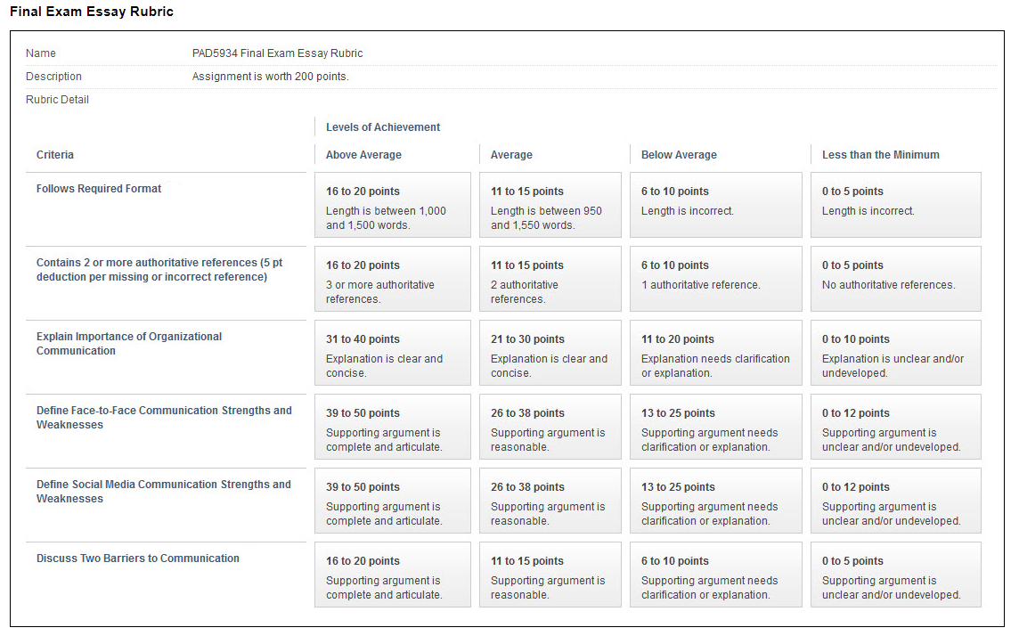
Improved Communication

Slide 16
Keys to Success
GS1
GS5
GS6
Ensure students understand grading rubrics
Interactive coverage of syllabus
“Meet” students before there’s a need to discuss issues
Ensure courses are interactive

Slide 17
The task of the modern educator is not to cut down jungles, but to irrigate deserts.
C.S. Lewis, British Novelist
DISCUSSION

